Slide 1
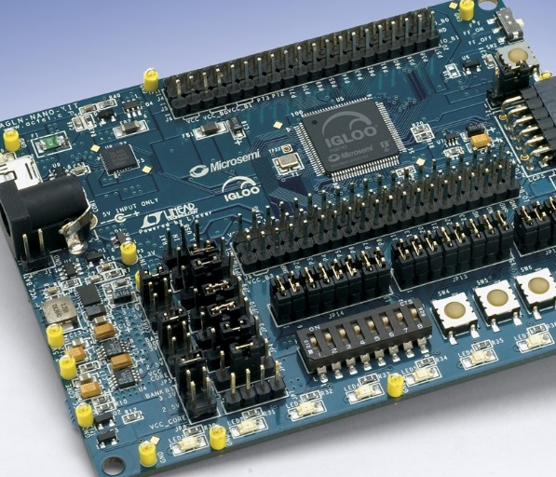

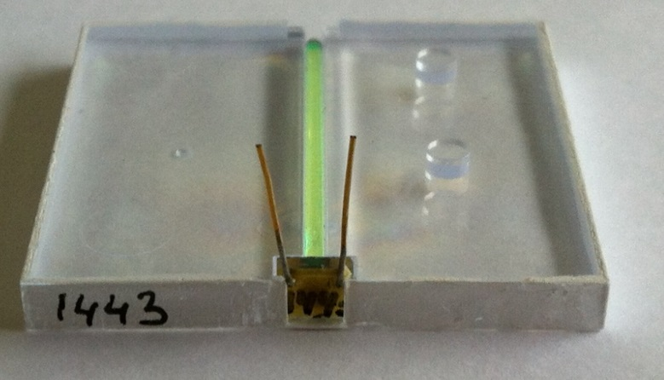
Bachelor Project
Explore properties and performance
of ultra low power FPGAs
For application on a future particle detector (CALICE AHCAL),
a reduction of power dissipation is required by orders of magnitude, with respect to industry standard Programmable Logic Devices.
Come in and participate in construction, programming, and measurements on cutting-edge devices
FPGA evaluation module
Keywords : digital circuit design
FPGA / VHDL / hardware description languages / HDL synthesis
ILC / CALICE / scintillator calorimeter
Experimentelle Teilchenphysik ETAP
V. Büscher, S. Tapprogge et al.
Further information: uli . schaefer @ uni-mainz.de
Detector for the Linear Collider
Scintillator Tile

