Slide 1
GOLD
Generic Opto Link Demonstrator

Slide 2
GOLD concept
Generic demonstrator for optical input / optical output data processors
Functional demonstrator for phase-0 topology processor
Technology demonstrator for technologies to be used throughout L1Calo upgrade
----->
ATCA form factor
Modular concept
  Mezzanines
  FMC connectors
Optical backplane connectors rather than front panel I/O
Opto/electrical conversion on input mezzanine
Electrical connectivity up to 10Gb/s in ATCA zone 2
Phase-0 topo-specific connectivity mainly via clock mezzanine

Slide 3
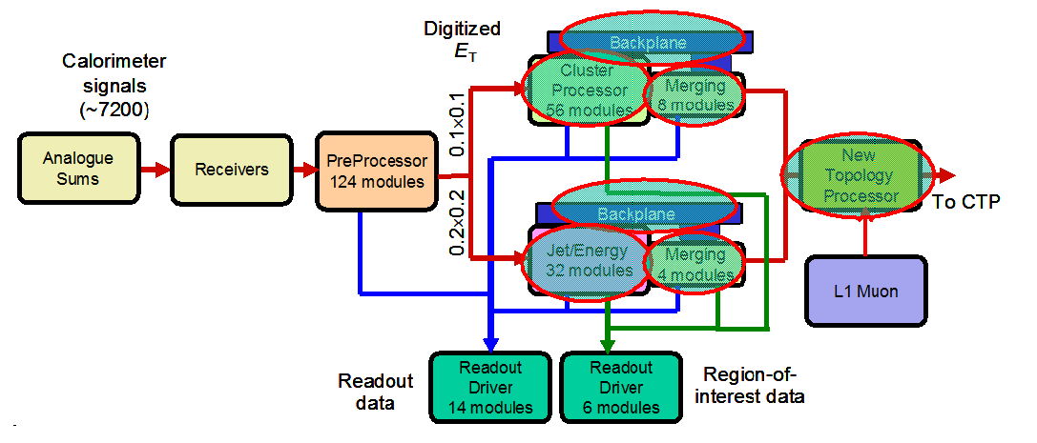
GOLD within TP context...
Increase backplane bandwidth from 40Mb/s to 160Mb/s (only modifying FPGA code)
Add a topological processor and increase real time data path bandwidth
GOLD
Replace the merger modules
Include Muon processing capability on topological processor
Backward compatible to current scheme (for staged installation)

Slide 4
GOLD floor plan
A-J FPGAs
front panel connectors
A
C
Z3
Z3: opto connectors
Mezzanines
V
E
W
B
D
V – Y : FMC connectors
Z2
F
X
Y
G
Z2: electrical connectors
H
J
Z1

Slide 5
GOLD use cases (from requirements doc.)
Demonstrator for AdvancedTCA module concept
  Module form factor
  Power supply concept
  IPMB monitoring and control
  Module control via serial protocol
  Backplane transmission at 10Gb/s
  Rear transition module concept
Demonstrator for Virtex-6 technologies
Demonstrator for optical backplane connection
Test bench for topological algorithms
Test bench for future LHC clock distribution schemes
Optical data sink for L1Calo modules
Optical data source for purpose of self-test and stand-alone link tests
Electrical data source/sink for tests with various electronics modules (limited bandwidth only)

Slide 6
Some details
Main board, ATCA sized, 22 PCB layers
FPGAs
Main power distribution network (central and POL regulators)
Connectors, including e/o converters for RTDP output and non-RTDP connectivity
FPGA configurator circuitry
Some local crystal clocks (for DAQ/ROI, Ethernet, configurator)
Input mezzanine module
Moderate PCB cost (12 layers, moderate real estate)
Sockets, secondary power distribution, some CPLD-based control, 10Gb/s fanout
Use daughter PCB routing rather than X-bar switches to adapt to GOLD use cases
Allow for migration to higher density o/e converter modules, should they appear on the market.

Slide 7
Some more details…
Clock mezzanine module
Recover and condition incoming (LHC bunch) clocks
Generate local crystal clock
Some limited multiplexing and fan-out
RTDP clocks 40.08MHz and multiples only
Allow for some real estate for general control circuitry (that’s not yet defined at this stage)
Allow for flexible use of scarce low-latency off-board differential electrical connectivity
USB/JTAG mezzanine
Initial scheme to provide minimum communication before FPGAs are configured
Use for Xilinx/Impact and Chipscope access during initial module tests

Slide 8
GOLD acting as a topo demonstrator
Initial board setup with LX240 devices only:
Two-stage processing in four input processors and a main processor
Real-time input into GOLD main board: 96 links (24 per input processor), 6.4Gb/s line rate
Input mezzanine real estate for 12*12-way receivers
Backplane optical connectivity 5 sockets * 12/24/… fibres
Electrical real-time output, up to 12 LVDS pairs via clock mezzanine, to front panel
LHC bunch clock and L1A via clock mezzanine module carrying either a TTCdec or GBT circuitry (two distinct module versions)
One SFP module each for DAQ and ROI data. Input section of the SFPs available for purpose of optically distributed clock signal
Module control via serialised VME⁻⁻ , or via Ethernet (Phy on clock mezzanine)
Environmental monitoring via I2C (IPMB)
FPGA configuration via SystemACE

Slide 9
Signal integrity – 10Gb/s
No PCB simulation tools available right now
BLT module has been designed without simulation and happens to work up to 6.4 Gb/s electro/optical data transmission
Design 10Gb/s tracks with small numbers of vias, top to bottom layer only, to avoid stubs.
Keep in-pair skew on 10Gb/s links below 5ps
PCB manufacturer in charge of differential track impedance control (100R +/- 10%)
Impedance of via pairs unknown, expect some discontinuity there. Via drill diameter and distance dictated by PCB mechanics (aspect ratio etc.) and therefore not subject to impedance control

Slide 10
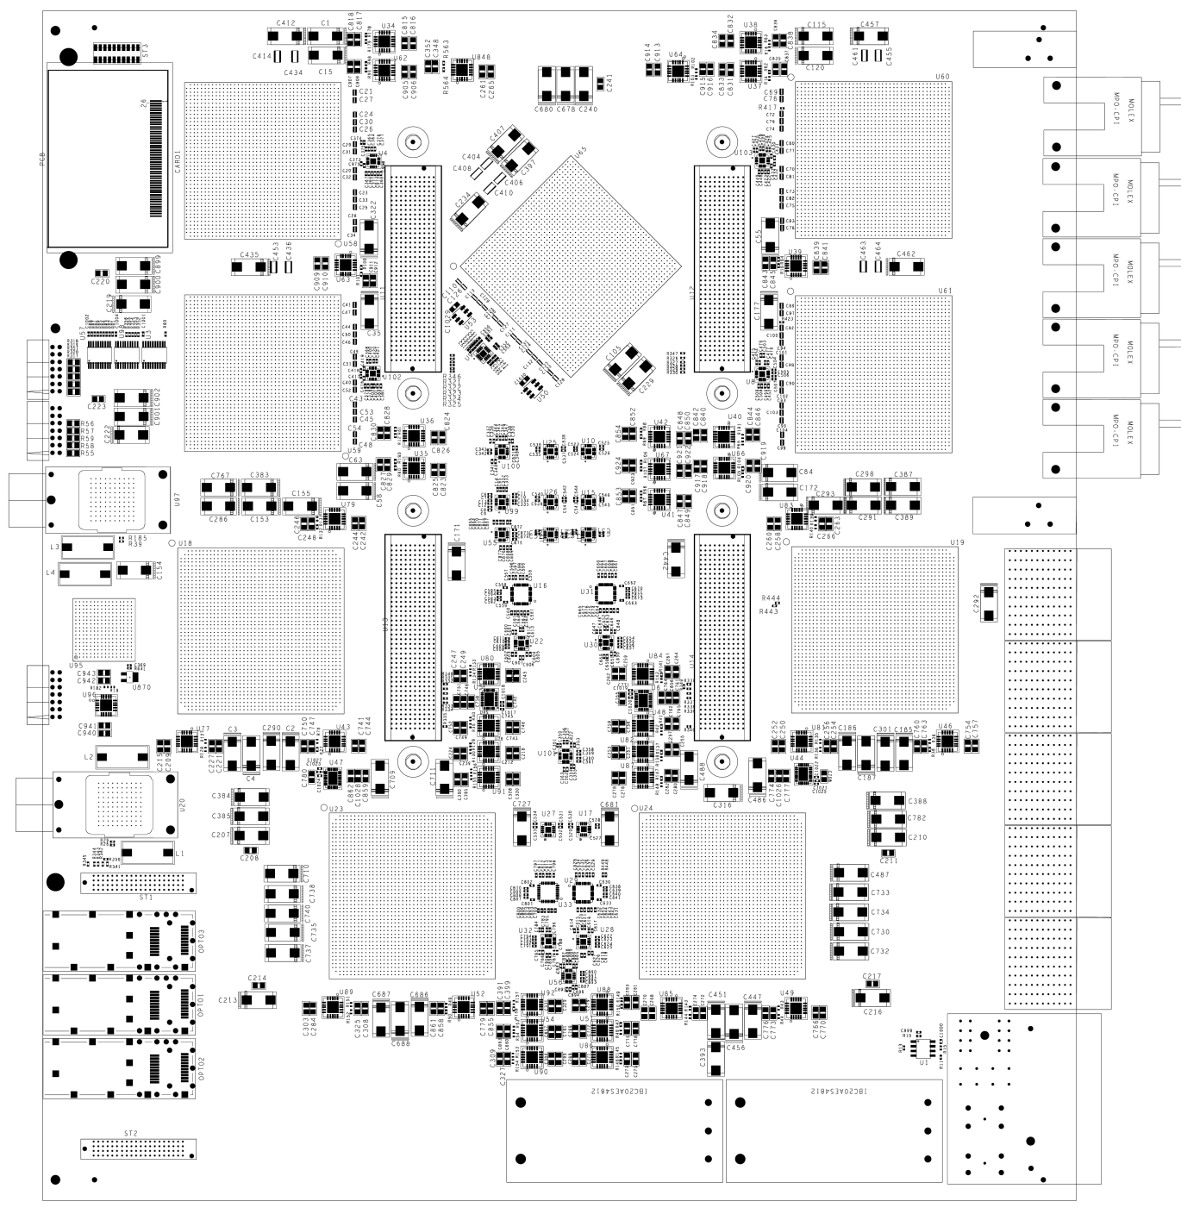
GOLD floor plan
Z3
5 * XC6VLX
(Processor L, main processor M) up to 36 links each
Two pairs of XC6VHX (H) 72 links each
5+ 12-channel optos on daughter
Clock generation
144 multigigabit input links in zone 2 (equiv. 22300 bit / BC)
L
L
M
Opto
L
L
H
H
Z2
890Gb/s
total
H
H
Z1

Slide 11
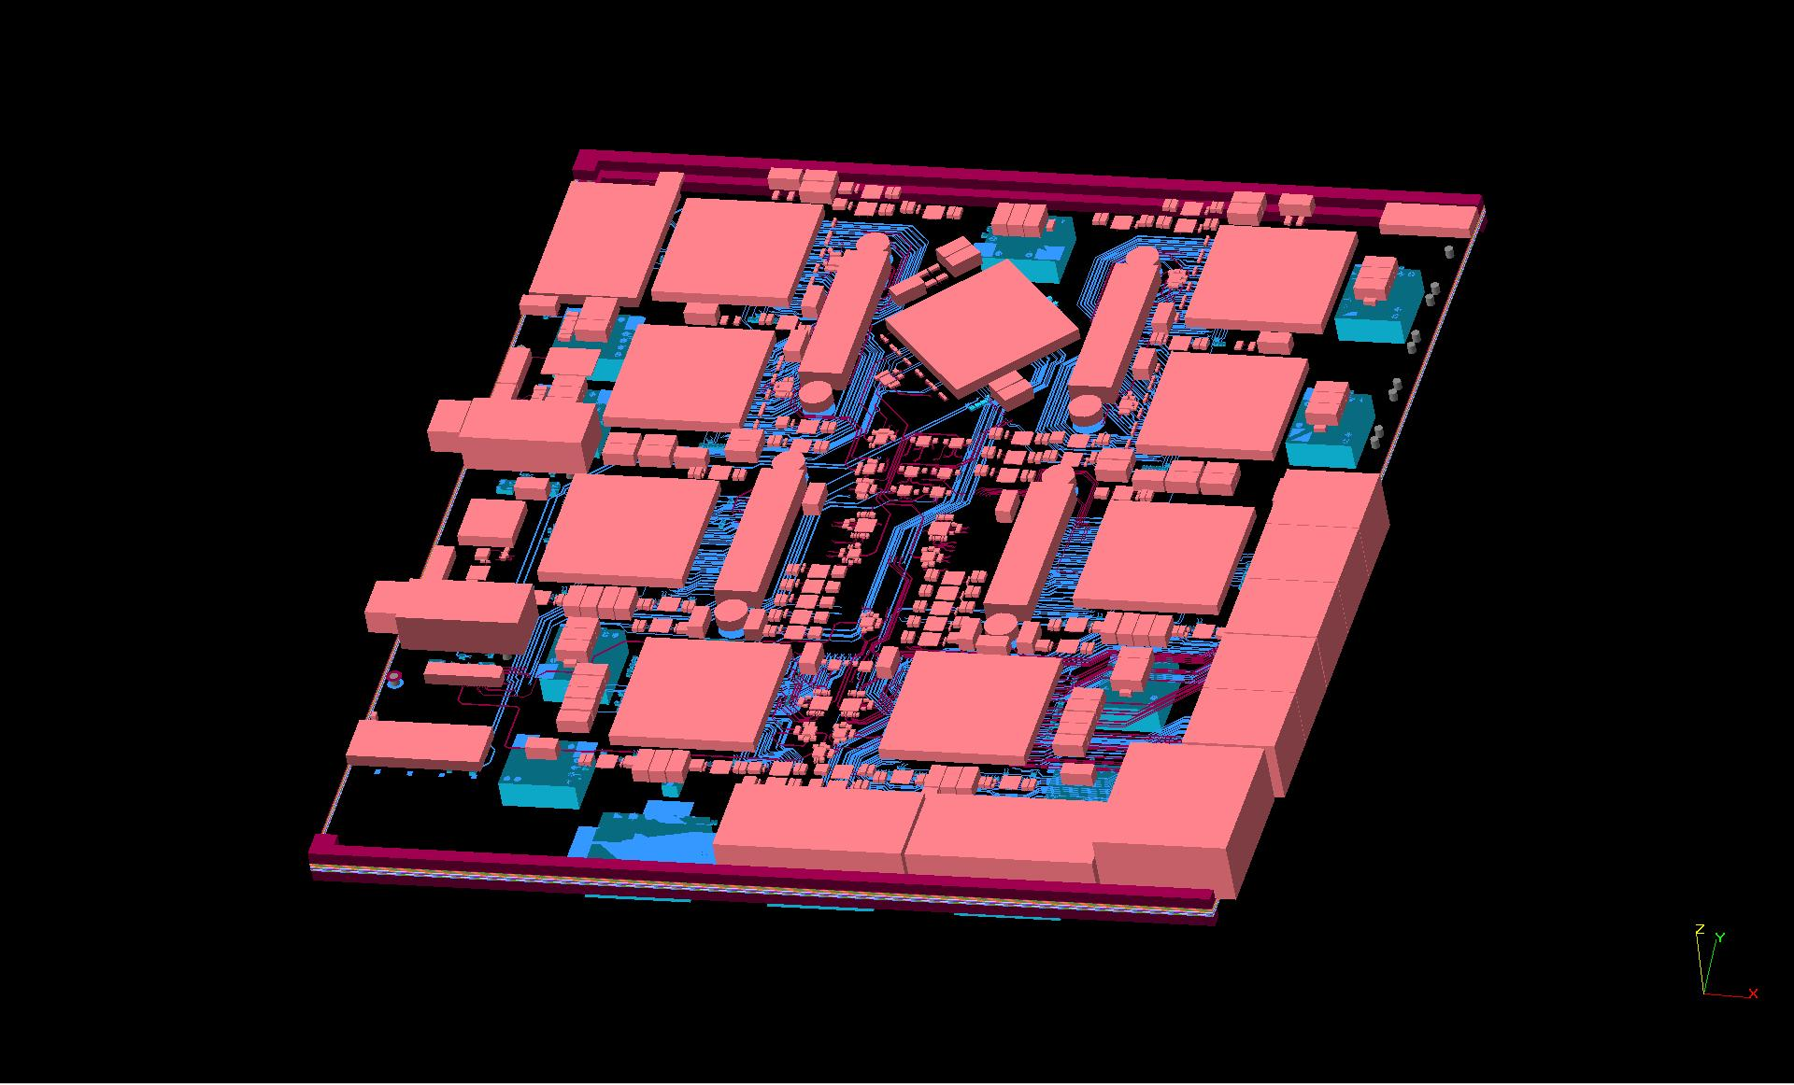
Densely packed, thick module

Slide 12
Some GOLD history
Module originally planned for 5 - 9 devices 6VLX550T, with opto backplane connection only, SNAP12 based
Converted to a mixed scheme 6VLXT / 6VHXT (6.5/10Gbps)
Added electrical backplane connectivity in ATCA Zone 2
Learned about power consumption of Virtex 6
→ re-design of on-module power distribution
Ran into problems with differential auto routing / automated pin swaps
Decided to hand route it all !
Over months increased GOLD PCB layer count from 16 to 22 to fit all tracks
Converted o/e transceivers from SNAP12 to Avago style footprint
Modified power distribution for MGT supplies again due to new assessment (XPower) of probable dissipation

Slide 13
Deliverables
Minimum of two GOLD PCBs
Initial module assembled with small number of FPGAs only (two?)
Incremental assembly
  If incremental assembly turns out to be difficult, but GOLD proves operational so far, assemble 2nd copy with larger number of devices
Currently total of 5 LXT devices waiting on the shelves, any further quantities would need to be purchased.
Planning for several iterations of clock mezzanine and input mezzanine modules. Quantities tbd.
Current input mezzanine is meant to be a standalone test adapter with four 12-channel receivers and two 12-channel transmitters
Some initial board service firmware and software will be available soon
Algorithmic firmware under way

Slide 14
Plans
Some final cleanup on the design (couple of weeks)
PCB production (28 days, ie. ~6 weeks !)
Assembly (?)
On-going development of
  Service firmware
  Algorithmic firmware
  Online software (non-GUI, non-HDMC)

Slide 15
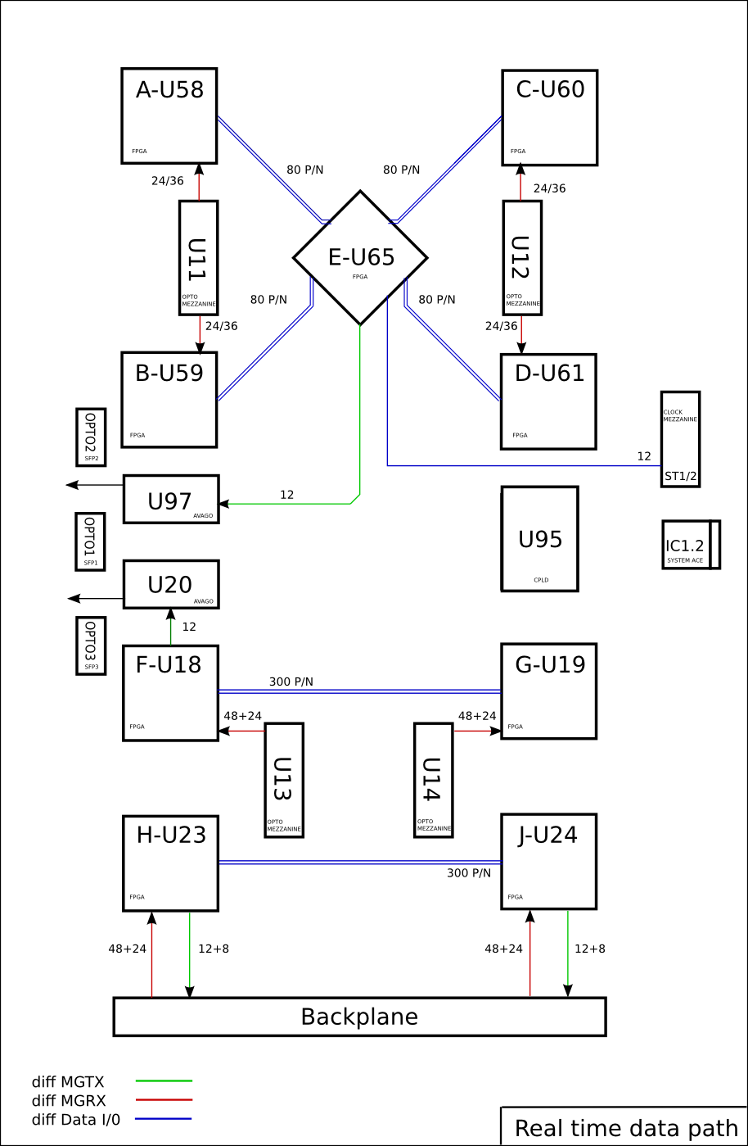
backup

Slide 16
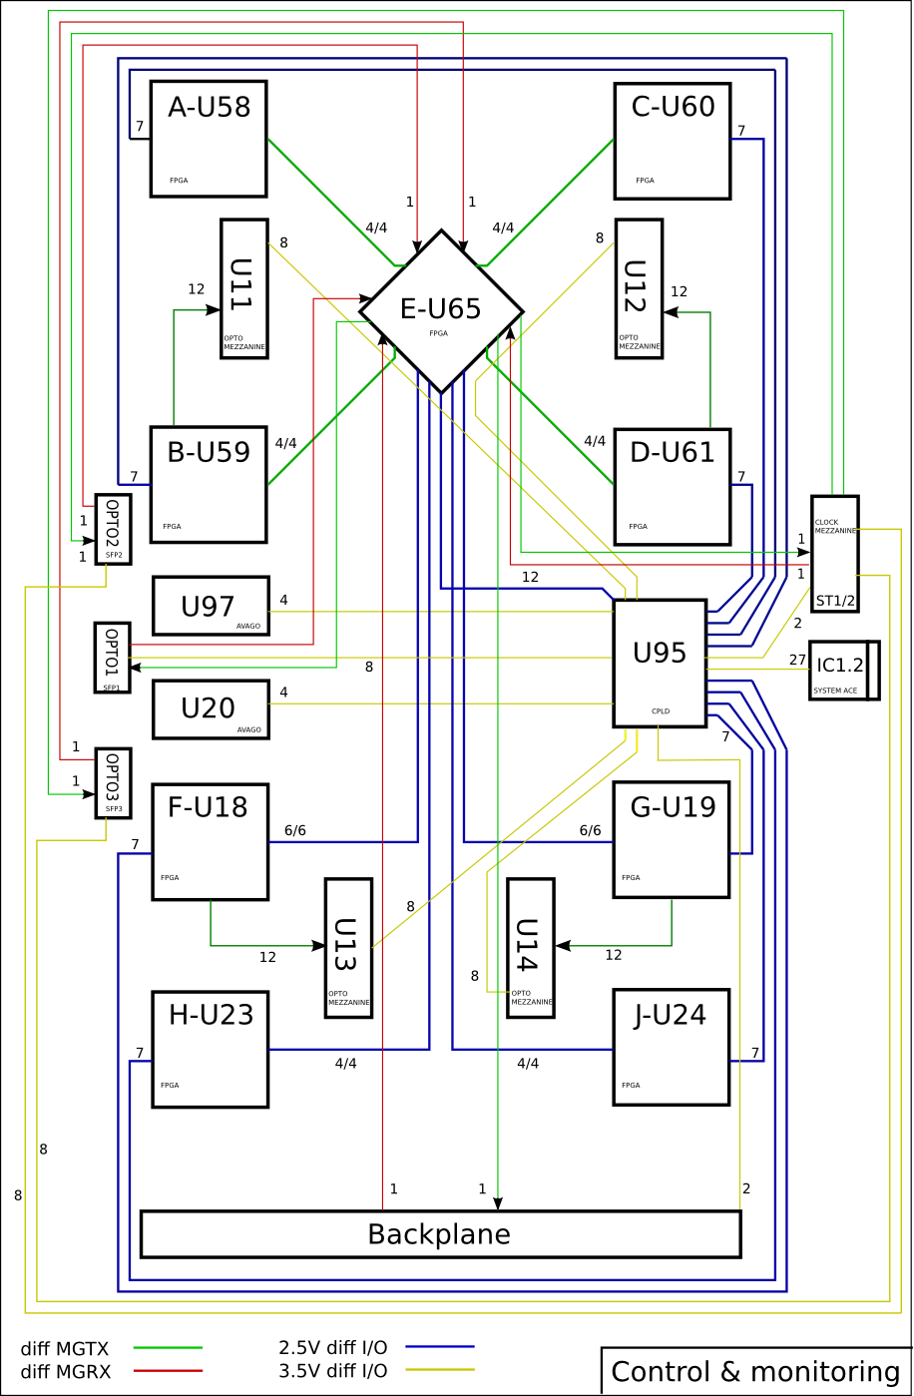

Slide 17
