Slide 1
From DPS & legacy system
RTM
module
jFEX
module
Optical
plant
RTM
jFEX
To L1Topo
Hub module
Hub module
ROD
TTC
switch

Slide 2
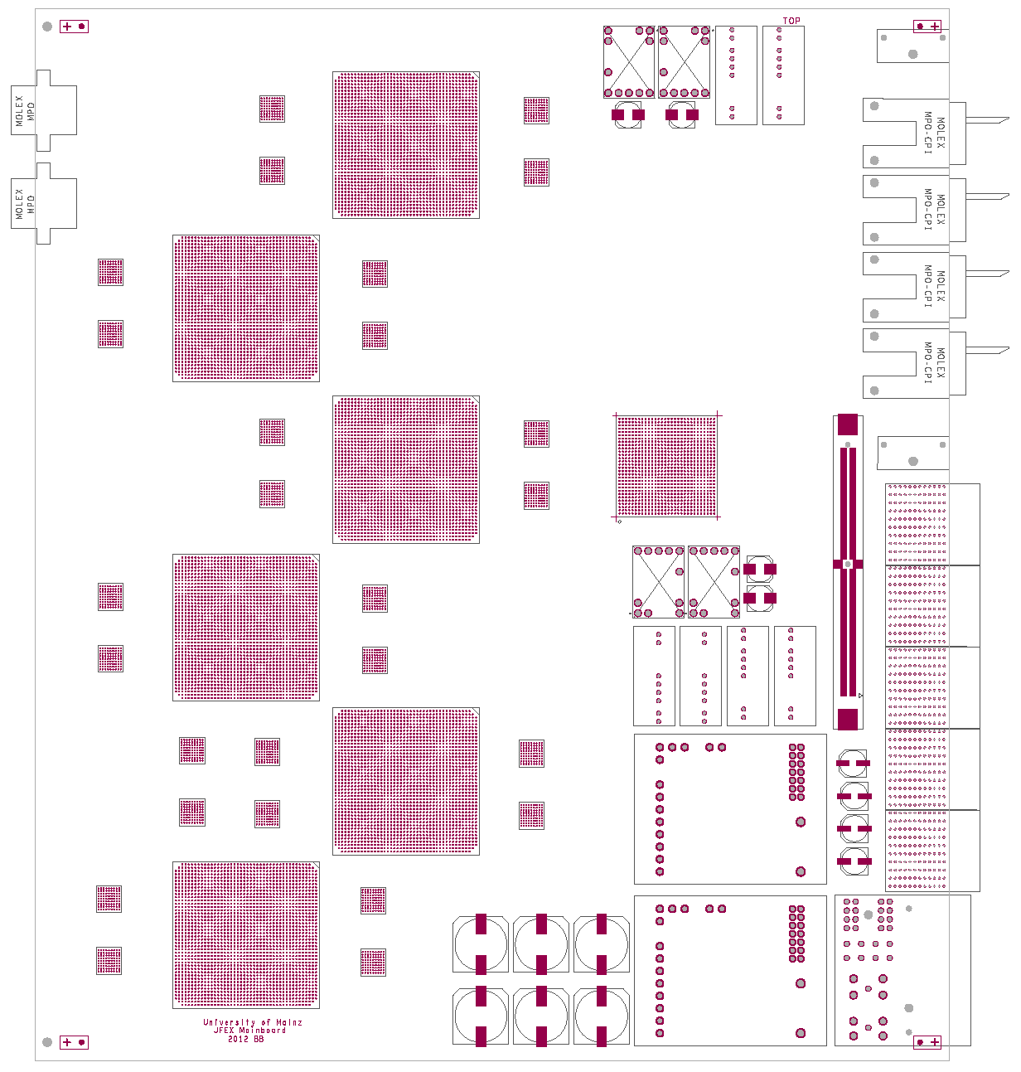
Fibres out
Processor FPGA
Fibres in
µPOD
Z3
algorithms
control
IPBus
Front panel
IPMC
Backplane
merge
out
Z2
power
Z1

