Slide 1
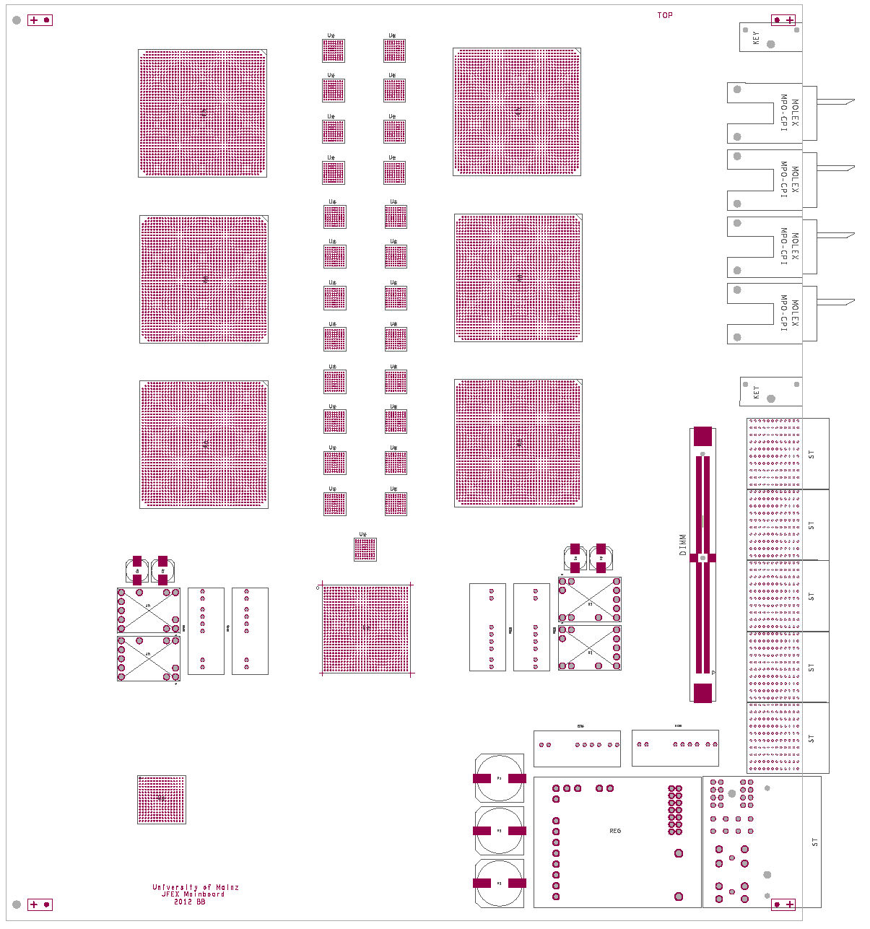
The jFEX system
Mainz
Mainz …
From DPS & legacy system
RTM module
jFEX module
Opt.
plant
RTM
jFEX
To L1Topo
tau: Oregon
MSU
Hub module
Hub module
ROD
TTC
Common / UK
switch
TTC : Argonne
Hub : MSU
Common: software data base DAQ…
Switch : Stockholm
Common IPbus
Common IPMC
ROD : Cambridge

Slide 2
effort

