Slide 1
L1Topo review www.staff.uni-mainz.de/uschaefe/browsable/L1Calo/Topo
Uli

Slide 2
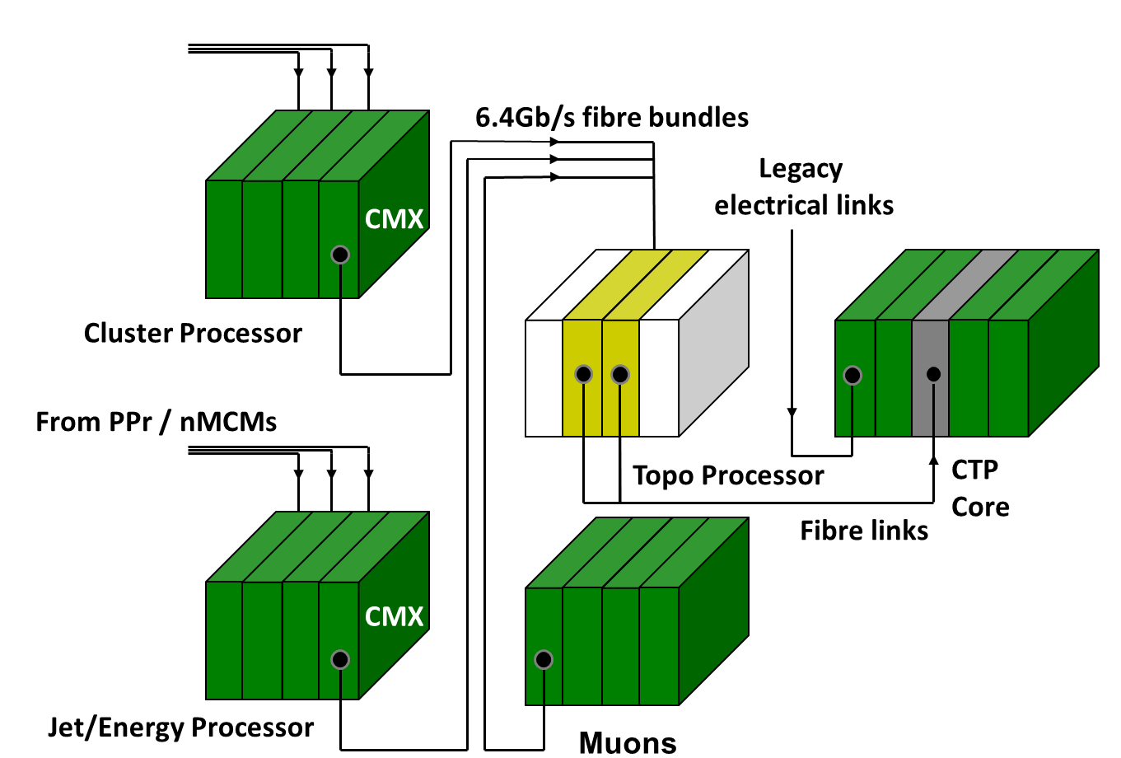
Intro – LVL-1 2013/14
payload up to
160 * 10Gb/s
200GB/s
(half that pre phase1)
payload up to
24 * 5Gb/s
15GB/s

Slide 3
Intro
Allow for any conceivable topological algorithm:
Route a maximum fibre count / data volume into individual module / processor
Bandwidth estimate :
(cf. www.staff.uni-mainz.de/uschaefe/browsable/L1Calo/Topo/L1Topo_Algorithms_0_2.pdf)
  Electrons, tau, jets, MET : 553 Gb/s (pre phase 1 , all available data)
  Muons 267 Gb/s (phase 1)
  Total aggregate bandwidth 820 Gb/s
  Achievable @ 6.4Gb/s line rate
Bandwidth available for phase 1 with FEXes
  twice that @ 13Gb/s line rate
  supported by FPGAs
  Roadmap for pluggable opto components unknown
Scalable in terms of bandwidth and processing power
  FPGA type
  Module count
Consider some electrical, low latency real-time path

Slide 4
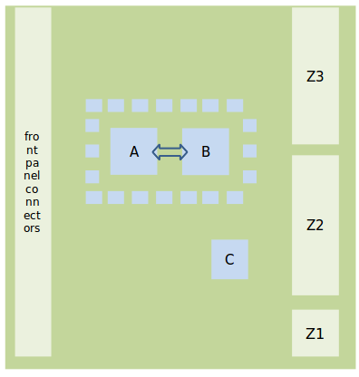
Floor plan, critical components…
Design goal : Keep compact, with short traces and no on-board signal duplication
→ require:
2 processor FPGAs
A, B: XC7V485T
→ XC7V690T
High-density mid-
board o/e converters
(miniPOD)
High density fibre plant
Controller XC7K325T (C)
Form factor : advancedTCA
From CMX
To CTP

Slide 5
numerology
Real-time input links: maximum bandwidth available on market: 160 *13Gb/s links per two FPGAs
All links supplied from fibres, with 48-way connectors that fits 4 connectors
Processor-to-processor bandwidth maximised (230 Gb/s)
Real-time output optical 24 * 6.4 Gb/s +
Electrical real-time path: 44 diff pairs total (1 bank per FPGA)
Minimum 1 DAQ and ROI link each. Optional 12 fibres miniPod (?)
Link count on prototype to be decided now: 112 v. 180

Slide 6
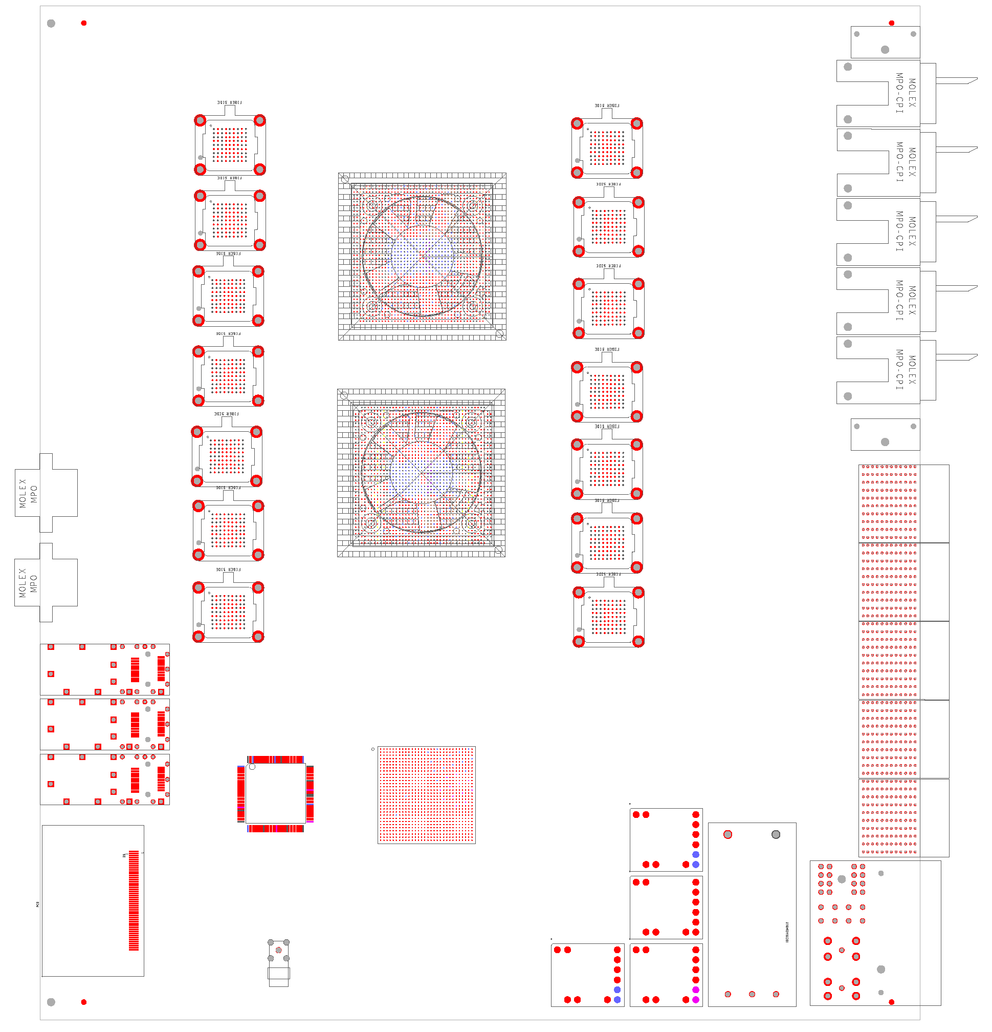
Floor plan, so far…

Slide 7
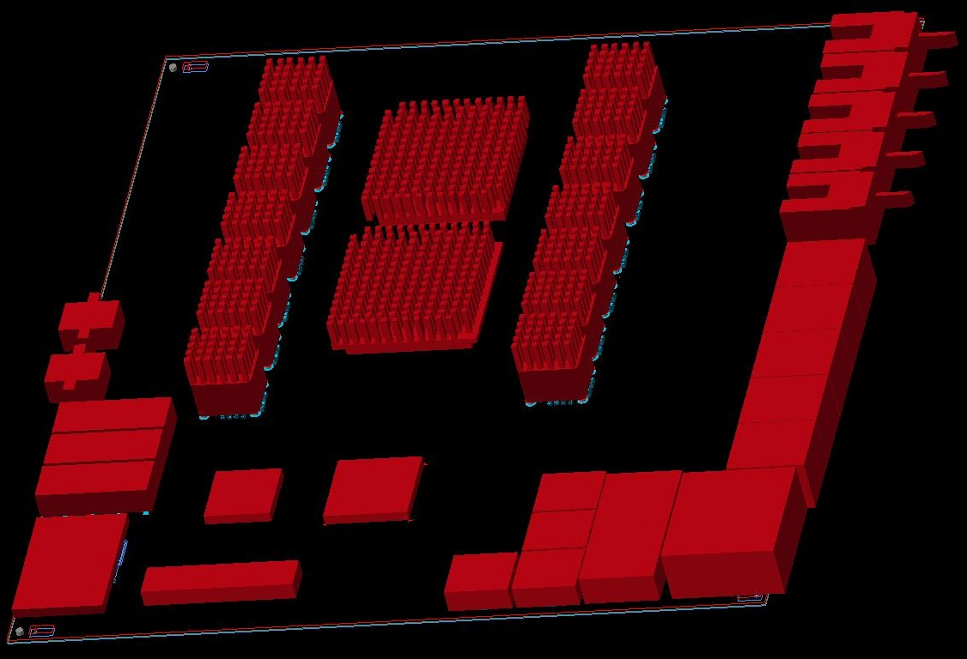
… and in 3-d

Slide 8
PCB status and components
Detailed design under way
FPGAs (production silicon) available end 2012 / early 2013
Initial module(s) using engineering samples
Opto transceivers to be ordered *now*
Samples of fibre assemblies (48-way) to be ordered *now*
Lead times seem reasonable
Opto modules : single manufacturer, NDA on docs
Choice of device types
  Round ribbon vs. bare (flat) fibre ribbon
  No heat sink vs. heat sink
Fibre assemblies : probably several manufacturers, documents on the web
Choice of # fibres per POD connector 48
  Choice of Round ribbon vs. bare (flat) fibre ribbon
Need to make sure fibre assemblies actually fit the modules
MPO/MTP connector - define gender : male connector on processor side

Slide 9
(not so) randomly picked comments
Assignment of fibre links, if prototype device is smaller than production
smaller number of PODs, all fully populated
Use 690T-ES devices rather than 485T production silicon
  Initial prototype is 485T ES anyway
  Engineering silicon performance not guaranteed
  Lead time expected similar
  Can afford only one such 160-channel prototype module (or 2 485T based). All other money is CORE
RTDP line rate
Make sure all links are able to operate at 6.4 and 10 Gb/s. 13 Gb/s optional. Depends on maximum miniPOD rate.
Line rate gap for 485T. 9.6Gb/s impossible !
Electrical real-time I/O
Define required bandwidth: sum of chip-to-chip and module-to- module I/O is a constant ! So far 44 external lanes envisaged.
ROI/DAQ bandwidth
Decide now what’s required
Ready to add miniPOD (12 channels)
All V7 compatible rates acceptable

Slide 10
comments
Configuration schemes
Use multiple schemes: legacy ACE, one or several alternatives
Flash write cycle (20 minutes), device density, configuration speed
Module control – decision to be taken now
Initially VME extender
Later whatever L1/L1Calo favour
MGT/separate crystal to allow for any format/rate
# channels ?
Front panel optical/electrical and/or backplane ?
Open for processor based Ethernet. On Mezzanine.
Zynq ?
ATCA/IPMC etc.
Need to start looking into documentation available now.
Put h/w on mezzanine and hope that someone in the community can provide scheme/software
Not required initially for operation on the bench.
Module count/ duplication
No backplane links
no far end PMA loopback
Need to stop here…

