Slide 1
jFEX / baseline
S. Rave, U. Schäfer
For L1Calo Mainz

Slide 2
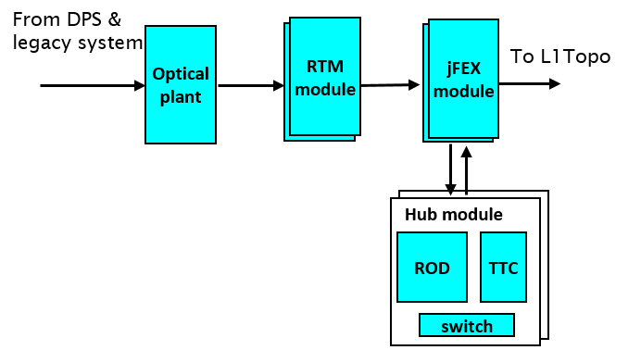
jFEX system : overview
Jet finding and energy sum calculation
Sliding window algorithms
Single AdvancedTCA shelf
DPS feeding jFEX system via optical plant
Readout, TTC, control via
common hub modules
Eight jFEX modules
Each covering phi octant
9.8 eta x 0.8 phi (Barrel, Endcap, FCAL)
Environment in phi
Opto fibre input via rear-transition modules
Readout, TTC, control via backplane
Optical output to L1Topo
Input data
6.4Gb/s baseline ( see high-speed option ! )
8 trigger towers per fibre (4x2)

Slide 3
Jets: Sliding Window Algorithms
Increase dynamic range wrt. Phase 0 scheme
Improve granularity by factor of four, to 0.1×0.1 (η×φ)
Allow for flexibility in jet definition
(non-square, Gaussian filter, …)
Increase environment
  Baseline 0.9 × 0.9
  optional 1.7 x 1.7
  Pre-clustering in jFEX, large jets at L1Topo
Fat tau algorithm resides in same modules
Towers ROIs environment
Phase 0 Phase 1

Slide 4
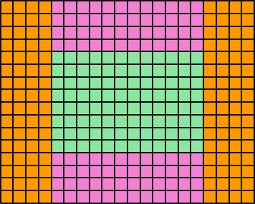
Data replication
Sliding window algorithms requiring large scale replication of data
Forward duplication only (fan-out)
No replication of any source into more than two sinks
Eta-strip / phi octant organisation:
Fan-out in phi handled at source only (DPS)
  Transmit “core” and “environment” data
  Duplicate all data using additional Multi-Gigabit Transceivers (100% duplication)
  Maximizing signal integrity
  Minimizing latency
Fan-out in eta handled at
destination only
  Baseline “far end PMA loopback”
  Low latency FPGA-to-FPGA re-transmission
ϕ
η

Slide 5
jFEX module
Processor modules
Eta strip × phi octant : per module ~9.8 × 0.8
Granularity 0.1 x 0.1 except FCAL
(up to) 72 × 8 bins × 2 × 2 (upstream duplication, e/h)
(up to) 288 incoming fibres @ 6.4Gb/s baseline
22(24) × 12-way “MicroPOD” high density receivers
Four 72-way fibre connectors (“MPO/MTP”)
Processor FPGAs
Core of up to 1.2×0.8 (η×ϕ), plus environment 0.8×0.8
20 × 16 bins → 80 high speed links
6 large FPGAs per module
XC7VX690T / XC7VX1140T (overlap region)

Slide 6
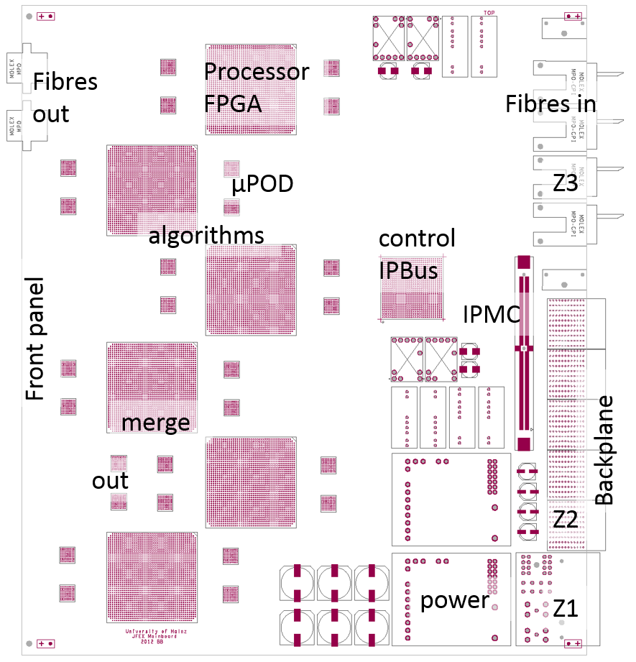
Floorplan & Details
Input data from back
Data duplication to neighbour FPGAs
Feature identification
Results to merger stage (low latency)
Fibre output to L1Topo on front panel
Module control via IPMC and Ethernet (“IPBus”)
Readout and timing/control via backplane
  Hub / ROD modules
Maximum space for real-time circuitry !

Slide 7
Baseline vs. options
jFEX (just like eFEX) design dominated by management of very high input data volume and duplication at system and FPGA level.
Massive duplication affects signal integrity
Decision in favour of a baseline data rate of 6.4 Gb/s
However, recent link test results very promising
Continue test programme on higher transmission rates
Higher transmission rate option strongly favoured !!!
Build modules capable of double rate
4η × 4ϕ trigger towers per fibre seems good choice
jFEX module will be able to handle one quadrant in phi
Full eta, 1.7 environment in phi
Partitioning at FPGA level will require some additional work
1.7 x 1.7 jet size will be possible
Remark (triggered by yesterday’s discussion)
Pileup corrections possible with jFEX and L1Topo
jFEX calculates both jets and energy sums (slice along phi)
Perform pile-up corrections on L1Topo

