Slide 1
From L1Calo to S-L1Calo
algorithms – architecture - technologies

Slide 2
L1Calo S-L1Calo phase1 phase2
phase1:
  do not modify PPr – JEM – CPM
  replace CMMs by something new
  add a global calorimeter trigger processor close to the CTP
phase2: assume
  different type of off-detector links
  different granularity
  replace L1Calo
  integrate CTP and global calorimeter trigger ???

Slide 3
what we need...
... some hardware to receive trigger information from the calorimeters and run trigger algorithms with improved background suppression and rate capability. However:
upstream interfaces not yet defined
detailed algorithms not yet known
Nevertheless, we need to start work on a concept now :
adequate physics performance
scalable
reliable (signal integrity)
advanced (but not exotic) technologies
simple scheme
small number of different module types
commonly used COTS
industry standard protocols and form factors
affordable, but not cheap

Slide 4
what we got: current L1Calo - algorithms and architecture
feature extraction: calculate global variables and identify localized objects by sliding window algorithm :
jets, e/gamma, tau
feature reduction : Count objects passing energy thresholds
feature correlation not included on L1Calo
Implementation:
5 stages (in terms of data reception / processing / re-transmission):
  JEM/CPM : fan-out and sliding windows/threshold/count
  2-stage merging (CMM)
  final stage of feature correlation offloaded to CTP (incl. muons)
electrical data transmission: serial and parallel
fan-out via
  upstream link replication 38%(JEP), 25%(CP) in phi direction
  backplane re-transmission : 75%, in eta direction

Slide 5
S-L1Calo - algorithms and architecture
future system conceptionally very similar:
feature extraction: calculate global variables and identify localized objects by sliding window algorithm
  jets
  e/gamma
  tau
feature reduction : drop objects of least significance ?
feature correlation
Implementation might also be similar to L1calo, but could be more compact, in smaller number of stages:
jet/cluster module (JCM) covering feature extraction (jets, e/γ, τ) and possibly some feature reduction
GCT → CTP
Optical data transmission only
o/e
processor
e/o

Slide 6
data transmission and fan-out scheme
go optical
keep fan-out simple and avoid latency penalty:
  upstream optical link replication
    excellent signal integrity
    additional optical components required
    cost effective for low replication factors only
    → it pays to go for highest density / highest link speed
  downstream electrical link replication
    signal integrity depends on backplane and connectors
    additional de-serializers
    very cost effective
    (multi – Gb/s links
    cheap)
  avoid re-transmission
  on the backplane
  (serdes latency)
source
e/o
o/e
sink
e/o
source
e/o
source
e/o
o/e
sink
e/o

Slide 7
technologies
The need for high bandwidth data transmission, in particular for network processor applications, has brought us new and improved standards on paper and on silicon.
link speeds on existent high volume products scaling up (SAS2.0/SATA3.0 @ 6 Gb/s electrical)
network processor protocols (Interlaken / SPAUI / SPI-S) build on scalable high speed link definitions OIF-CEI-6G, -11G, -25G
FPGA on-chip links currently support up to 48 CEI-6G lanes (ie. aggregate bandwidth of 36 Gigabyte/s per FPGA)
parallel opto links (SNAP12/MSA) are available up to 10Gb/s per lane
low power (~1W) mid-board mount SNAP12 devices (fibre pig-tail) move O/E converters away from board edge so as to improve density, routability and signal integrity
AdvancedTCA allows to route 10Gb/s lanes on a backplane

Slide 8
... and how about phase1 ???
while the sliding window processor will stay as is ...
try to extract largest possible volume of features from the processors via merger interface
think about moderate feature reduction at crate level
consider one-stage feature correlation integrating global calorimeter trigger and CTP
for everything else just follow the same lines:
choice of components, opto transmission, link replication, data rate / board density considerations...

Slide 9
phase 1 – the algorithms ???
due to moderate feature reduction (or no reduction at all) full topological information will be available at the CTP*
we should define what topologies we want to explore
  features within the same solid angle
  back-to-back topology
  ????? → please have ideas and simulate them !
please remember that all information we want to correlate needs to end up on the same processor chip
→ some further level of link replication and fibre patching might be required to get the data where needed
^{*)} for CTP read : central trigger processor or global calorimeter trigger processor (in case we do not want to re-do the CTP). A re-designed CTP might be preferred, so as to better correlate with muons.

Slide 10
Motivation: Pileup @SLHC: ~400 interactions per BX (50 ns bunchspacing and 10³⁵s⁻¹cm⁻²)
degradation of algorithm performance
compensation by more granular data (Phase 2) „granularity vs. environment“ size
and/or refined algorithms (Phase 1 & 2)
Possible selection criteria on L1 by using RoI information on CTP level:
exclusive trigger combinations beyond multiplicity combination:
distinct separation between em and jets at different thresholds
Azimuthal “back-to-back” criteria
e.g. Selection of Higgs production
Forward-Backward correlation in rapidity gap in η
e.g. VBF processes
definition of isolated muons by using calorimeter energy
tagging of b-jets by soft muons
calculation of mass/transversal mass of object pairs
or even more objects
Etmiss correction by using pT of muons,
identification of jets directing to cracks or Etmiss
Relatively straightforward
Level of
difficulty
complex

Slide 11
R&D road map
get some further input on suitable algorithms
let’s try and follow industry standard electrical and optical component development
  decide on development platform soon: ATCA/μTCA ?
  phase 1 : 6Gb/s technology is here today and can be used out of the box
  phase 2 : expect further increase in density and data rates. Make use of it.
be warned : attractive technologies are attractive to big buyers even more. Component availability is a problem already now. Lead time for SNAP12 devices (irrespective of data rate) is currently 20-30 weeks !

Slide 12
example : re-do current system
assume unchanged pre-processing (including BCmux), but optical links from the PPr to the digital processors
total cluster and jet input data volume is roughly
4 [crates] * (14+2) [slots] * 64 channels = 4096 channels ↔ 1640 Gb/s ↔ 288 fibres @ 5.6Gb/s
→ total data volume will fit on 8 modules with just three SNAP12 devices each.
though the links would easily fit on a single FPGA per module, the design is likely to be logic capacity bound. Use several FPGAs per board, with high capacity and few links
each module could process full phi range and 8 eta bins. Overlap would be 6 eta bins → downstream link duplication only.
we can easily end up with a two-stage system of JCMs sending data directly to a single module Global Calorimeter Processor that can be integrated with the CTP which connects up muons

Slide 13
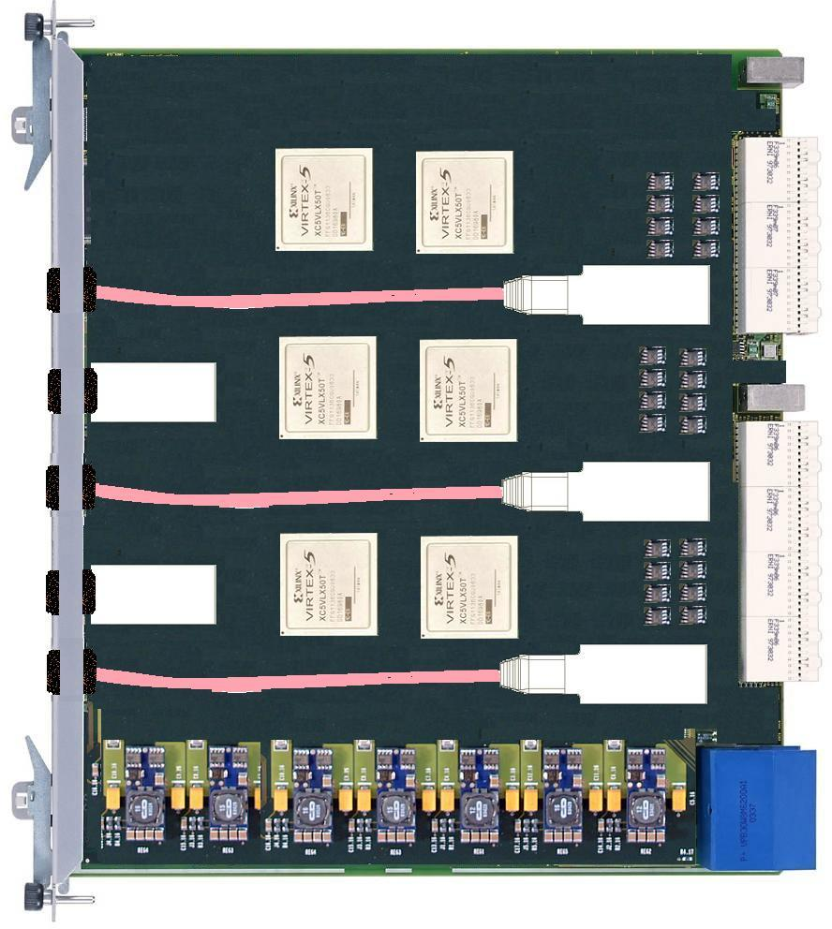
The implementation...
Advanced TCA
XC5VFX100T – FF1136
SNAP12 : ICT75GVX1361
CML or PECL fanout

