Slide 1
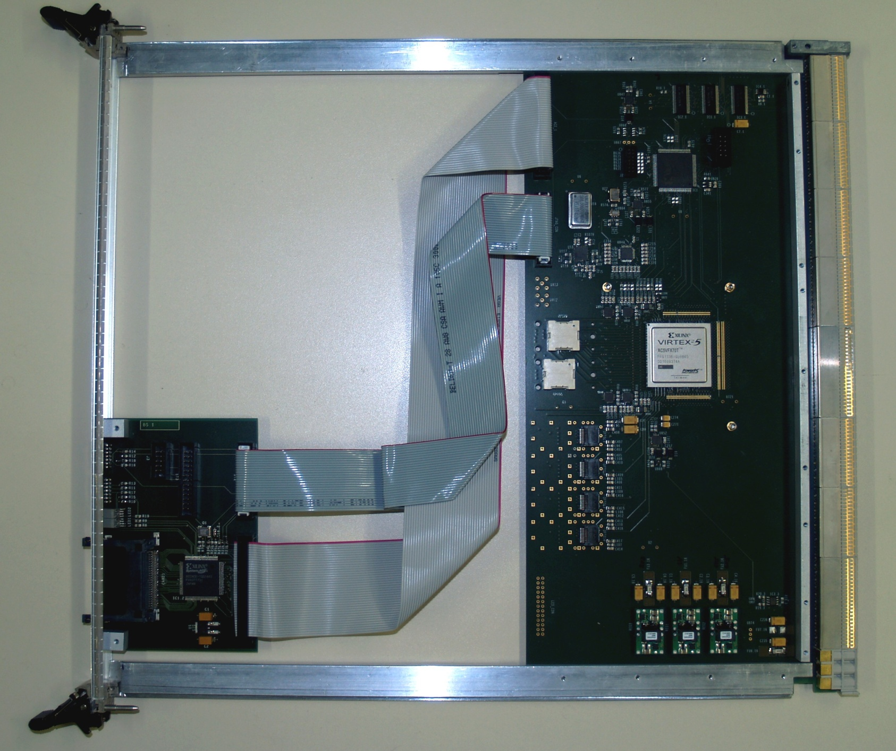
BLT – status – plans
BLT – backplane and link tester
Recent backplane test results
Test plans – week June 15

Slide 2
Backplane test results
BLT module assembled end of March
Minimum set of firmware for backplane tests only
Discovered impedance mismatch and - discontinuities on JEM11 signals : due to layout error
Data taken for all JEM positions, for both merger positions
Forwarded clock
23 data bits : serialised 16-bit counters (mark/space ratio up to 1/16)
Parity bit
Results, as documented previously:
550ps error free data eye at 240 Mb/s, source terminated
2.2ns data eye at 320Mb/s, sink terminated

Slide 3
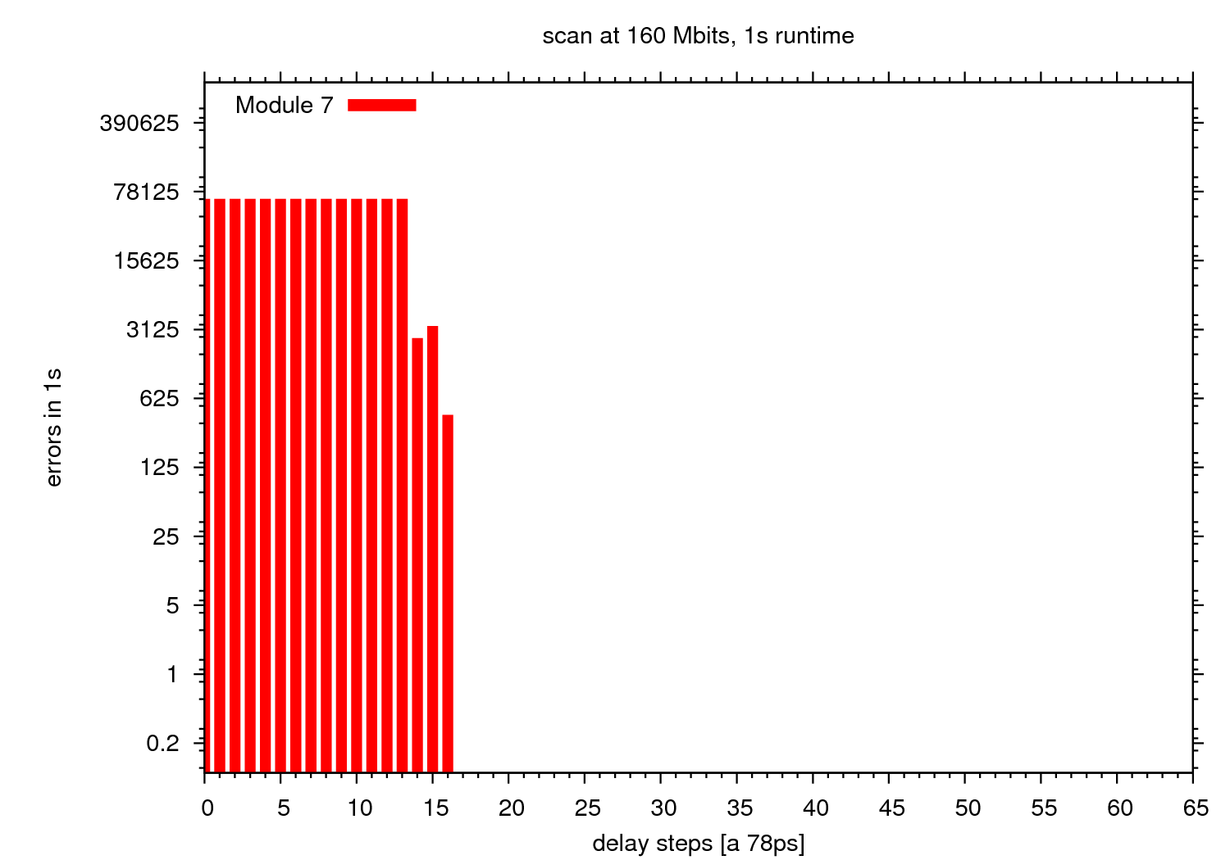
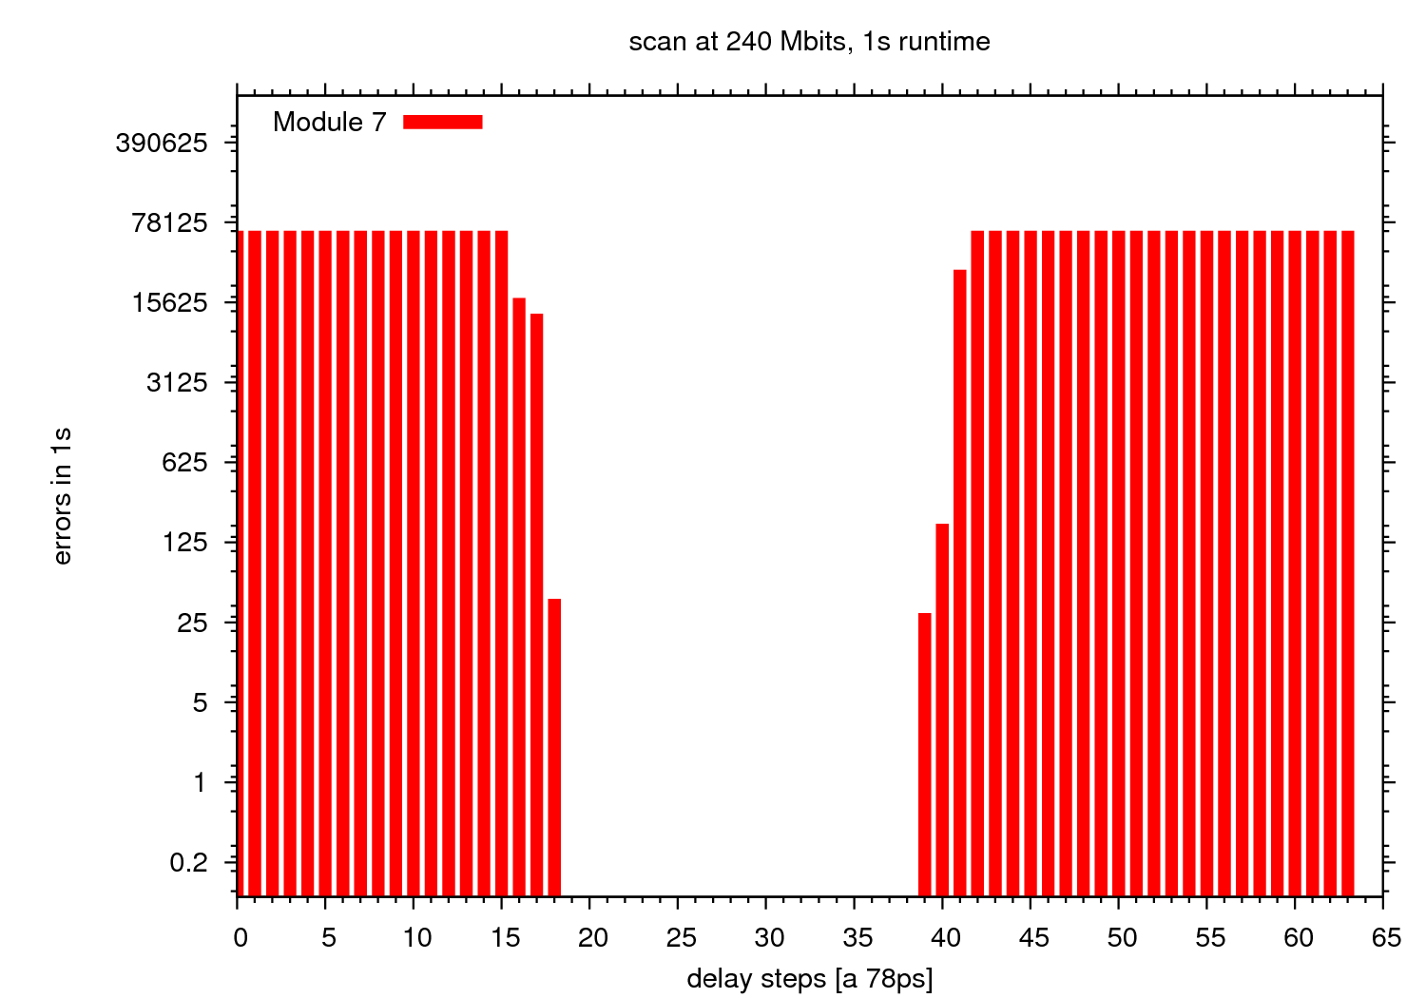
Recent backplane tests
Improved transmission scheme:
Clock line terminated at sink (SSTL2 signalling, DCI)
Data lines terminated at source only (power dissipation)
Eye > 3.7ns @ 160Mb/s (limited by phase shift range 5ns)
Eye ~ 1.5 ns @ 240Mb/s
160Mb/s
240Mb/s

Slide 4
Plans: test week at CERN June 15
– Uli, Christian² –
Test rig:
Backplane tests with maximum possible number of JEMs and CPMs
JEM firmware tests – modified VME interface in jet processor – requires readout to check for correct readout timing
Have another go at in-situ flash card re-write, if possible
Test rig / USA15:
Timing calibration
Run improved software:
Firmware version check
Improved error handling (recent CLKdes2 failure)
TDAQ panel
...

Slide 5
BLT – further plans
BLT has shown to sample all 400 merger lines at elevated rate
BLT has generous logic capacity (XC5VFX70T)
BLT provides 16 multi-Gigabit links – not yet operated
SNAP12 / MPO (currently up to 3.x Gb/s)
4*SFP up to 6.5 Gb/s
Links might be capable of current G-Link / ROD protocol
We should be able to use the BLT as a demonstrator (even prototype ?) for phase 1
Would be ideally suited to interface a global merger to current L1Calo, up to 6.5 Gb/s optical
Any plans for global merger demonstrator ?
NB Mainz has resources available for h/w design, but currently insufficient effort on f/w & s/w

