Slide 1
Mainz L1Calo upgrade activities
news – BLT hardware/firmware status

Slide 2
News from MZ
People working on L1Calo upgrade:
  Bruno Bauß (hardware design)
  Marius Groll (project management, physics)
  Uli Schäfer
  Christian Schröder (firmware, software)
  Stefan Tapprogge
  Kim Temming (firmware, software)
Test lab being set up for work on high speed links
  Sampling scope w. 30 GHz TDR probes
  High speed clock recovery unit (12.5Gb/s)
  ATCA /μTCA crates (soon)
  High bandwidth real-time scope (soon)
  Improvements on PCB / assembly facilities planned

Slide 3
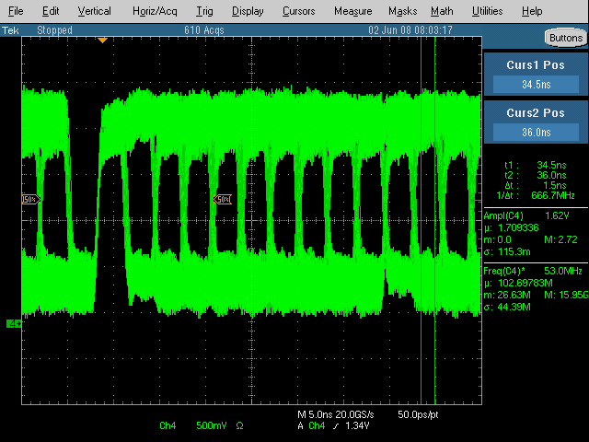
backplane merger line transmission tests
Scope shot of a sink terminated 320Mb/s CMOS signal having travelled the full length of the backplane looks promising
→ Build a module capable of bit error rate tests on all 400 merger lines arriving in a CMM slot

Slide 4
BLT – backplane / link tester
Backplane / link tester module design under way
  Fits in CMM slot
  Connects all 400 merger lines into one FPGA (XC5VFX70T)
  Parallel termination to half rail voltage possible (soldering option) for data rates up to 320 Mb/s
  TTC clock recovery and cleanup, based on successfully operated jitter cleaner module
  VME –– controlled
  1*SNAP12 transmitter (6.25 Gb/s * 12)
  1*SNAP12 receiver

Slide 5
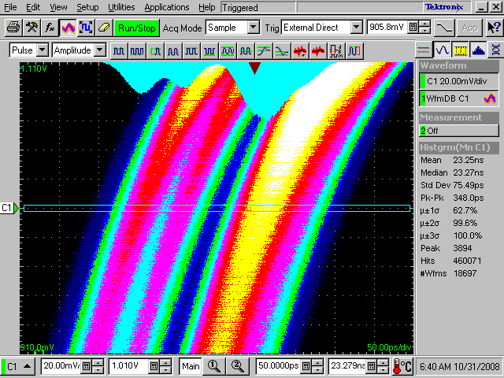
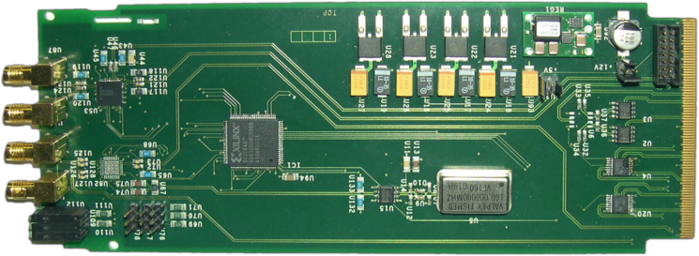
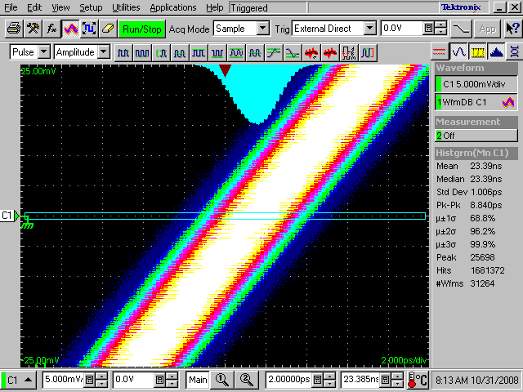
BLT block diagram – clock conditioning
clock scheme based on forwarded clocks
plus centrally distributed LHC / TTC clock
➔ jitter reduction required
➔ Tested already on stand-alone board
Peak-to-Peak jitter ~350 ps
➔ Sufficient to run 6.5 Gbps
Peak-to-Peak jitter ~8 ps
RMS jitter ~700 fs

Slide 6
BLT hardware status
Schematic capture finished by mid December, see http://www.staff.uni-mainz.de/baussh/Backplanetester
Layout under way (12 layer PCB)
  High speed links, clocks, merger lines hand routed (30% done)
  VME and controls will be auto routed
No PCB manufacturer / assembly company chosen yet.
Will take some time to get feedback on PCB production and assembly related issues
Assembled boards available end February (unless we throw a lot more money at the project)
High speed link tests might have to wait since our previous supplier for high-speed opto links pulled out of SNAP12 business.

Slide 7
BLT firmware status
Some JEM code might be re-used (VME interface)
Jitter cleaner control firmware available (Christian)
Kim started work on bit error rate firmware

