Slide 1
JEM configurator progress
FPGAs are RAM-based programmable logic devices
Need to be loaded with a ‘configuration’ after power-up, so as to define their functionality
Typically loaded from external flash memory: from CompactFlash disk via ‘SystemACE’ chip
Howto:
Generate configuration file image (‘IMPACT’)
Write to CF card with standard USB flash adapter
Insert card into module

Slide 2
JEM block diagram
CF card
System
ACE
clock mirror
DES
Input
--
10 X
9 W
Sum
V
M
E
Configuration:
6 FPGAs
SystemACE chip
CF card
VME interface built from programmable logic (CPLD = non-volatile device)
----------------------
SystemAce physically connected to VME
→ Should be possible to flash the cards while in the module
U
TTCdec
To SMM
3 x 40 bit @ 40 Mb/s
DES
Input
8 H
7 G
6 F
40
DAQ/Timing/VME
DAQ
T
G
Opto
60
G
Opto
DES
Jet
ROI
Input
5 E
4 D
3 C
S
60
CAN
DES
Input
2 B
1 A
0 V
To JMM
R
60 bit @ 80Mb/s
each 165 pins FIO
88 pair

Slide 3
In-situ flash update via VME
Connect SystemACE to VMEbus via CPLD (firmware)
Have crate CPU write the flash image from file through SystemACE chip onto CF disk
Create empty disk image file
Loop-mount on any Linux computer
Copy configuration files into image
Umount and transfer to target system
Have custom software write image to CompactFlash disk
Status by Summer 2008:
Flash writer works in Mainz
Fails at CERN (USA15) for unknown reason → give up
March / April, 2009: Richard Staley (B’ham) discovers and explores an issue with the L1Calo VME subsystem: VME mount module (VMM) generates data strobes not compliant with VME specs

Slide 4
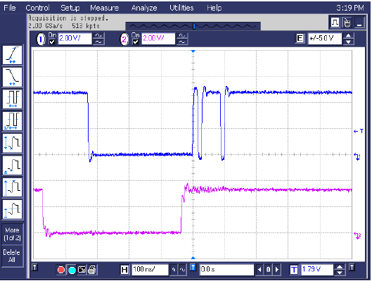
VME issue
Date strobe exhibits glitches
For write operations these glitches trigger read operations after a valid write access on B’ham modules
No problems seen so far on JEMs, except...
DS0*
WRITE*

Slide 5
Refurbish flash write firmware
Keep flasher software nearly unchanged
Re-work firmware such that read access is protected from glitches
Start read operations only if data strobe asserted for a minimum of 50ns
Finish internal read operations after a predefined delay, do not wait for data strobe being deasserted
Latch the data until VME cycle finished
Results:
Test rig Mainz : new firmware ok now, though 2008 version fails !
Test week June 15:
Flash card writer error-free on CERN test rig
Error-free in USA15, all 32 JEM modules could be updated after a somewhat lengthy CPLD update procedure (successful thanks to Andrea)

Slide 6
What next...
No more need to enter the pit for FPGA firmware updates
VME access tightened for flash card operations only, since no problems had been observed elsewhere
Keep an eye on reliability of VME operations and have further refurbishment in case instabilities are observed
Unfortunately, for any update of the VME CPLD we would again have to enter USA15 and reload each JEM individually. That would be a major intervention, if required during ATLAS running...

