Slide 1
Ethernet-driven control and data acquisition scheme for the Timepix-based TPC readout
C. Kahra, U. Schäfer, M.Zamrowski
Uni Mainz

Slide 2
TPC readout chain
TPC to be read out by one or several pixel sensors (256*256 pixels)
Timepix chip bonded on a FR4 carrier
Amplifier
Discriminator
TDC
TOT
Common stop
Serialiser (LVDS link)
Flat cable connection (ZIF) to adapter board
Trigger, test pulse, voltage monitor
Flat cable connection to Xilinx ML506 evaluation board
FPGA Virtex-5 (XC5VSX50-TFFG1136)
Deserialiser
Buffer
Ethernet / IP packet engine (UDP)

Slide 3
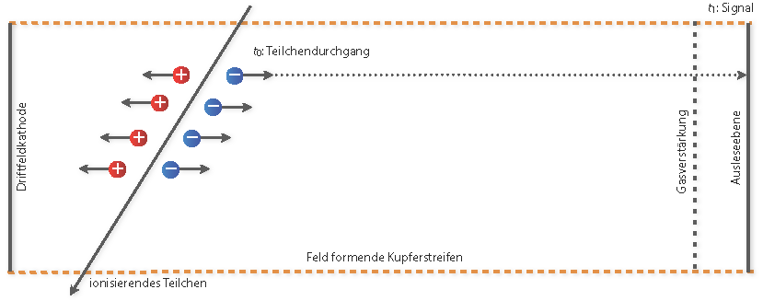
Detector and readout chain
cathode
TPC
GEM
Timepix chip
ML506
Adapter
Ethernet
Xilinx
Flat cable
Flat cable

