Slide 1
Ethernet-driven control and data acquisition scheme for the Timepix-based TPC readout
R. Degele, C. Kahra, U. Schäfer, M.Zamrowski
Univ. Mainz

Slide 2
TPC readout chain
TPC to be read out by one or several pixel sensors (256*256 pixels)
Timepix chip bonded on a FR4 carrier
Amplifier
Discriminator
TDC
TOT
Common stop
Serialiser (LVDS link)
Flat cable connection (ZIF) to adapter board
Trigger, test pulse, voltage monitor
Flat cable connection to Xilinx ML506 evaluation board
FPGA Virtex-5 (XC5VSX50-TFFG1136)
Deserialiser
Buffer
Ethernet / IP packet engine (UDP)

Slide 3
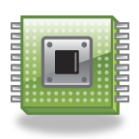
TPC readout chain
GEM
Timepix chip
TIMEPIX-
ADAPTER-
BOARD
cathode
ML506
ETHERNET
Ionizing particles

Slide 4
Adapter board
Power supply
3V
S/N
Connector to Xilinx ML506
7V
3V, 5V
ID -NUMBER
2V2
TIMEPIX-CONTROL
Connector to Timepix
TIMEPIX-DATA (LVDS)
ADC
4-Channel
24-Bit
DAC-OUT DIGITAL
DAC-OUT
CONTROL, CLK, ADDRESS
Voltage
Reference
2V5
TP_IN
5V
TEST_IN
Testpulse generator
control
Trigger
RJ45
(TLU)
TRIGGER, BUSY, RESET, DATA CLOCK

Slide 5
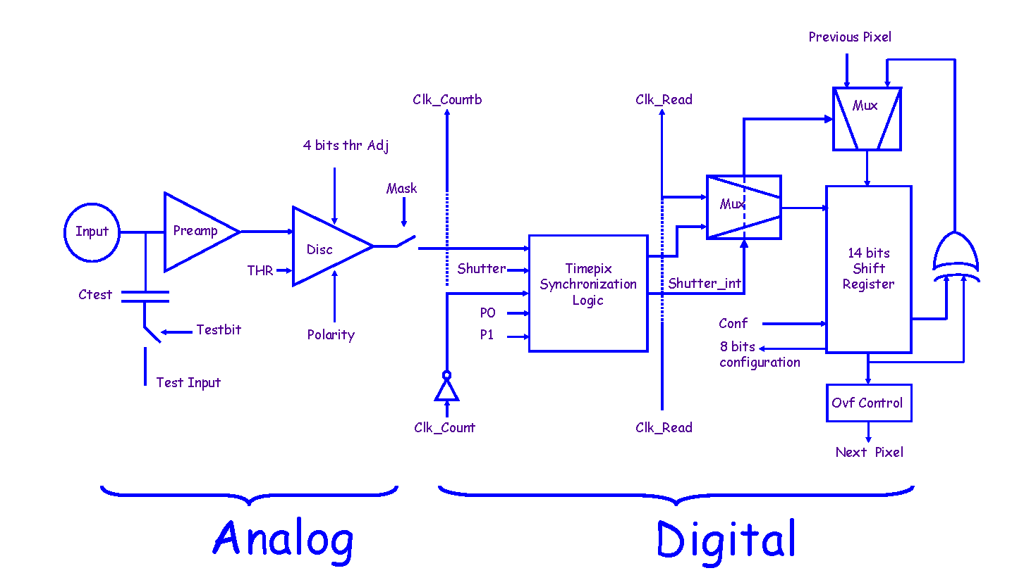
Timepix
20µm
10µm
55µm
Pixel cell

