Slide 1
Ethernet-driven control and data acquisition scheme for the Timepix-based TPC readout
R.Degele, C.Kahra, U.Schäfer, S.Tapprogge, D.Wicke, M.Zamrowski
Univ. Mainz

Slide 2
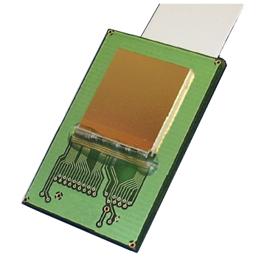
TPC readout chain
TPC to be read out by one or several pixel sensors (256*256 pixels)
Timepix chip bonded on a FR4 carrier
Amplifier
Discriminator
TDC
Time Over Threshold
Common stop
Serialiser (LVDS link)
Flat cable connection (ZIF) to adapter board
Trigger, test pulse, voltage monitor
Flat cable connection to Xilinx ML506 evaluation board
FPGA Virtex-5 (XC5VSX50-TFFG1136)
Deserialiser
Buffer
Ethernet / IP packet engine (UDP)
Ethernet link to computer

Slide 3
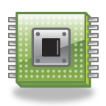
TPC readout chain
GEM
Timepix chip
TIMEPIX-
ADAPTER-
BOARD
cathode
ML506
ETHERNET
Ionizing particles

Slide 4
Lab test setup
Programmer
Flat cable
Xilinx ML506
Adapter
Ethernet to computer
Flat cable
Timepix

Slide 5
Timepix
256*256 channel matrix
55µm * 55µm pitch
Analogue input stage with per-pixel threshold adjust
Digital TDC w. 14-bit LFSR counters @ up to 100MHz
Several conversion modes incl. TOT and common stop
shutter input
No zero suppression
Serialisation of matrix data (~1Mbit) into LVDS output
Auxiliary controls:
Test pulse in
Diagnostics : analogue monitor for internal current sources (DAC_OUT)

Slide 6
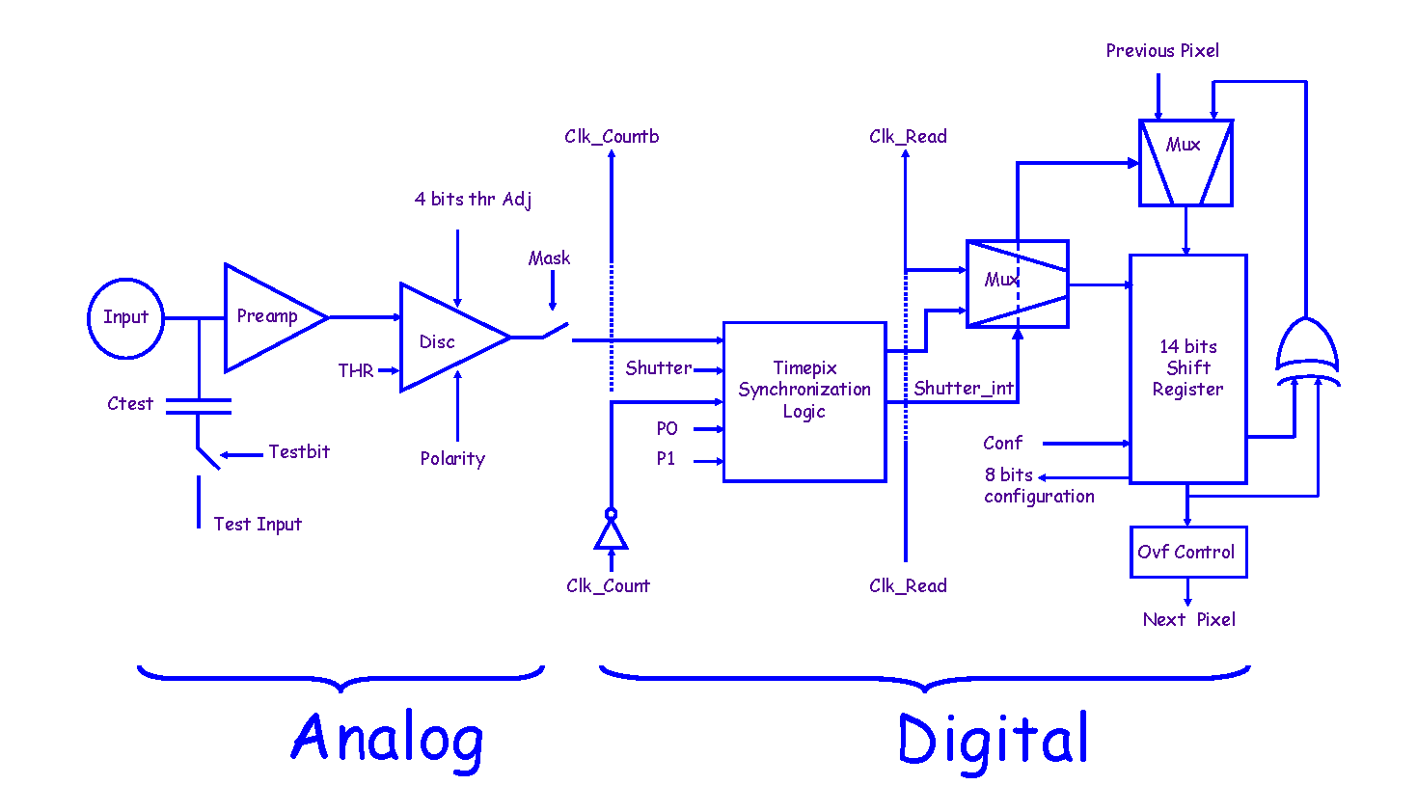
Timepix
20µm
10µm
55µm
Pixel cell

Slide 7
Timepix – a few particularities
There exists a global threshold setting (THL, 14-bit)
Pixels can be threshold-corrected individually by a 4-bit value.
Range of threshold correction is set globally (THS)
Above global settings and other current source settings can be read back as analogue voltages via DAC_OUT pin for diagnostic purposes
Counters are 14-bit Linear Feedback Shift Registers = Pseudo Random Number Generators
Require linearisation so as to recover the time/amplitude information
Require special consideration if zero suppression or thresholding are to be done
Serial communication done by a simple clock/data/enable interface, through shift register

Slide 8
Adapter board
Power supply
3V
S/N
Connector to Xilinx ML506
7V
3V, 5V
ID -NUMBER
2V2
TIMEPIX-CONTROL
Connector to Timepix
TIMEPIX-DATA (LVDS)
ADC
4-Channel
24-Bit
DAC-OUT DIGITAL
DAC-OUT
CONTROL, CLK, ADDRESS
Voltage
Reference
2V5
TP_IN
5V
TEST_IN
Testpulse generator
control
Trigger
RJ45
(TLU)
TRIGGER, BUSY, RESET, DATA CLOCK

Slide 9
Adapter board
To ML506
Trigger
To Timepix
Test pulse in
Power
To ML506

Slide 10
FPGA module : Xilinx ML506
Virtex-5 based : XC5VSX50-TFFG1136
On-chip Ethernet MAC
On-chip 3Gb/s serial links : run at 1Gb/s for Ethernet
On-board Gigabit Ethernet phy chip (1000BASE-T)
64 bit user I/O on 2.54mm headers
Nonvolatile configuration storage via SystemACE (CompactFlash card)
A lot of periphery, not currently used for Timepix readout

Slide 11
FPGA Firmware
VHDL description
Common clock for digitisation and data transfer, crystal based, frequency currently hard coded in VHDL
SerDes interface to the Timepix bit-serial port
Control and status registers, data stream pass-through
Network communication based on Xilinx-supplied Ethernet macro (TEMAC wrapper)
No embedded CPU
Minimalist network protocol stack
UDP only
No management protocols (ARP etc.)
Shutter operated under software control or in response to a trigger (TLU) with programmable delay and width
Timepix protocol not fully understood from documents → modelled on MUROS2 readout scheme

Slide 12
Firmware : Data transport to computer
Data transmission scheme to readout PC using UDP protocol:
<ethernet><IP><UDP><control><data>
standard Ethernet/IP/UDP headers
18-byte control field mapped to register file within the FPGA (control and status words)
Variable length data field carrying data to/from Timepix chip
Timepix matrix data not buffered on FPGA, data kept on Timepix while awaiting packet transmission
Data pulled by computer (handshake)

Slide 13
Control software
C++
Currently command line interface only, no GUI
Base functionality:
Reset Timepix
Set current sources (write FSR)
Enable test pulse
Set Timepix matrix
Read out matrix
Operate shutter
Complex operations
Start a run : initialise matrix and read it out upon reception of a trigger, linearise data, write to file
Pixel calibration

Slide 14
Pixel calibration
Intercalibrate all pixels so as to achieve a uniform noise level across the whole of the chip
Measure noise in TOT mode for a fixed period of time
Repeat the measurement for
All global threshold settings ( 0 to 16383) (THL)
All per-pixel threshold corrections (0 to 15)
A pre-set correction scale (THS, 0 to 255)
Calculate optimum per-pixel correction values
Software status:
Base functionality and run control done
Pixel calibration s/w development under way
To do: read back current source data (DAC_OUT)

Slide 15
Tests / Results
Timepix and readout wired up in the lab (Mainz)
Run with TPC in Bonn
Readout working at
Event rates up to 23 Hz @ 40MHz system clock ++
Scaling to 33 Hz @ 100MHz clock
Readout rate of bare Timepix would be (100Mbit/s) / 1Mbit = 100Hz
FPGA code pipelined, packet overhead is low
FPGA currently polled by PC, i.e. handshake for each packet transmitted
→ Bottleneck probably due to latency in Linux IP stack

Slide 16
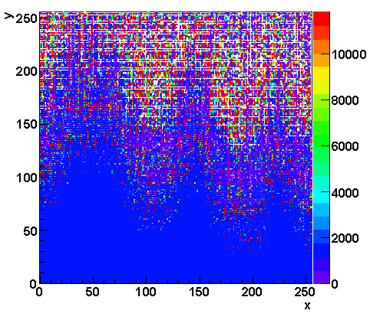
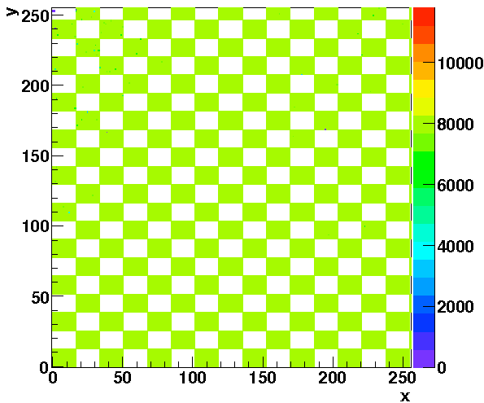
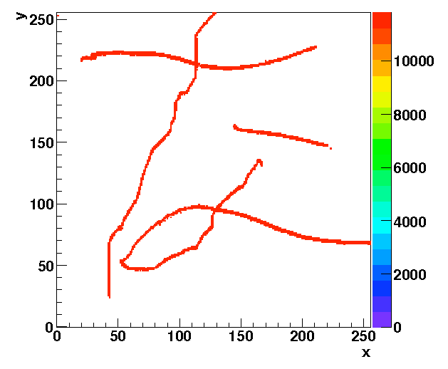
Results: Some basic sanity checks ...
Noise @ threshold THL=290, common stop mode
8000 test pulses, counter mode. 17*13 pixel clusters masked out
←
Timepix pixel matrix 256*256
Locally induced noise, “written” to Timepix sur-face with a pulser and an insulated wire →

Slide 17
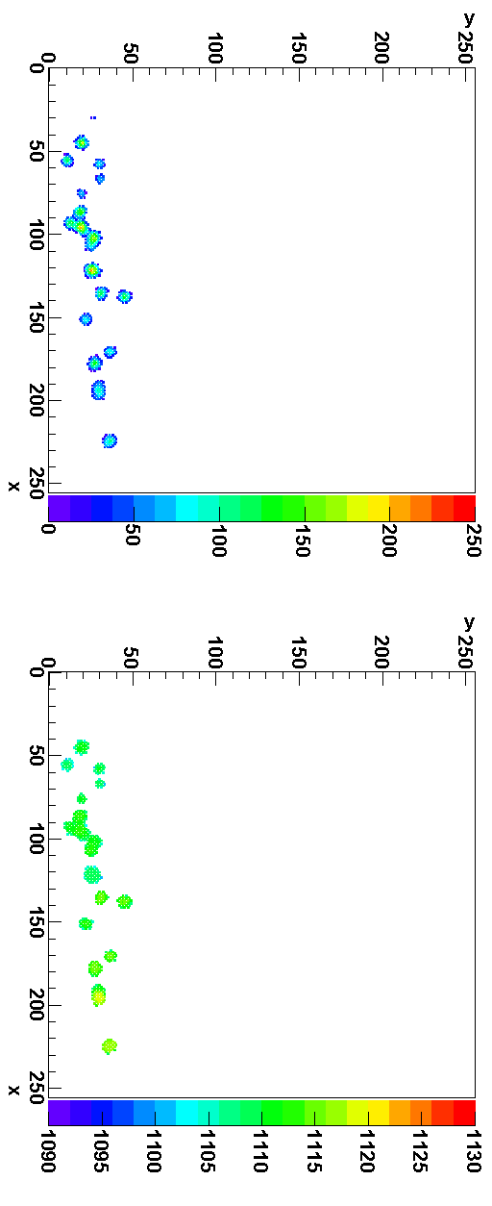
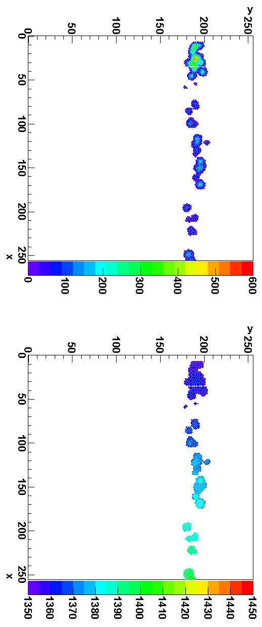
Results: muons in the TPC
Energy deposit → (TOT mode)
Muon tracks crossing the TPC ← at 8.9cm and 2.8cm → distance to readout plane.
Both deposited charge and drift time measured concurrently by operating every other pixel in TOT or common stop mode
X-Y-Zdrift view →
(common stop mode)

Slide 18
Summary / Outlook
A readout system for a TPC, with Timepix-based digitisation, has been implemented on a Xilinx ML506 development board (Virtex-5)
Data path off the FPGA into the computer via Gbit Ethernet and UDP protocol
Readout rate currently up to 33 events per second
System successfully operated in the electronics lab and on a TPC
Plans:
Re-target to Virtex-6
Increase event rate
Increase channel count
Consider zero-suppression on the FPGA
…

