Slide 1
Hardware status GOLD
Update 02 Feb. 2010

Slide 2
GOLD design changes
Availability of high performance components :
Xilinx XC6VHX380T will become available during lifetime of GOLD
This more than doubles xGb/s link bandwidth per FPGA / Module
(higher aggregate bandwidth than on single ended I/O)
New non-SNAP12 parallel opto transmitters and receivers (Avago)
exhibit better signal integrity
Modified pinout wrt SNAP12
pre-emphasis on receiver electrical interface
equalization on transmitter electrical interface
Seem to be cost effective
→ Modify GOLD design
Keep half the GOLD as shown in Heidelberg
Equip the other half with XC6VHXT rather than XC6VLXT
Wire the added xGB/s connectivity to ATCA backplane
Build additional opto module for Avago receivers

Slide 3
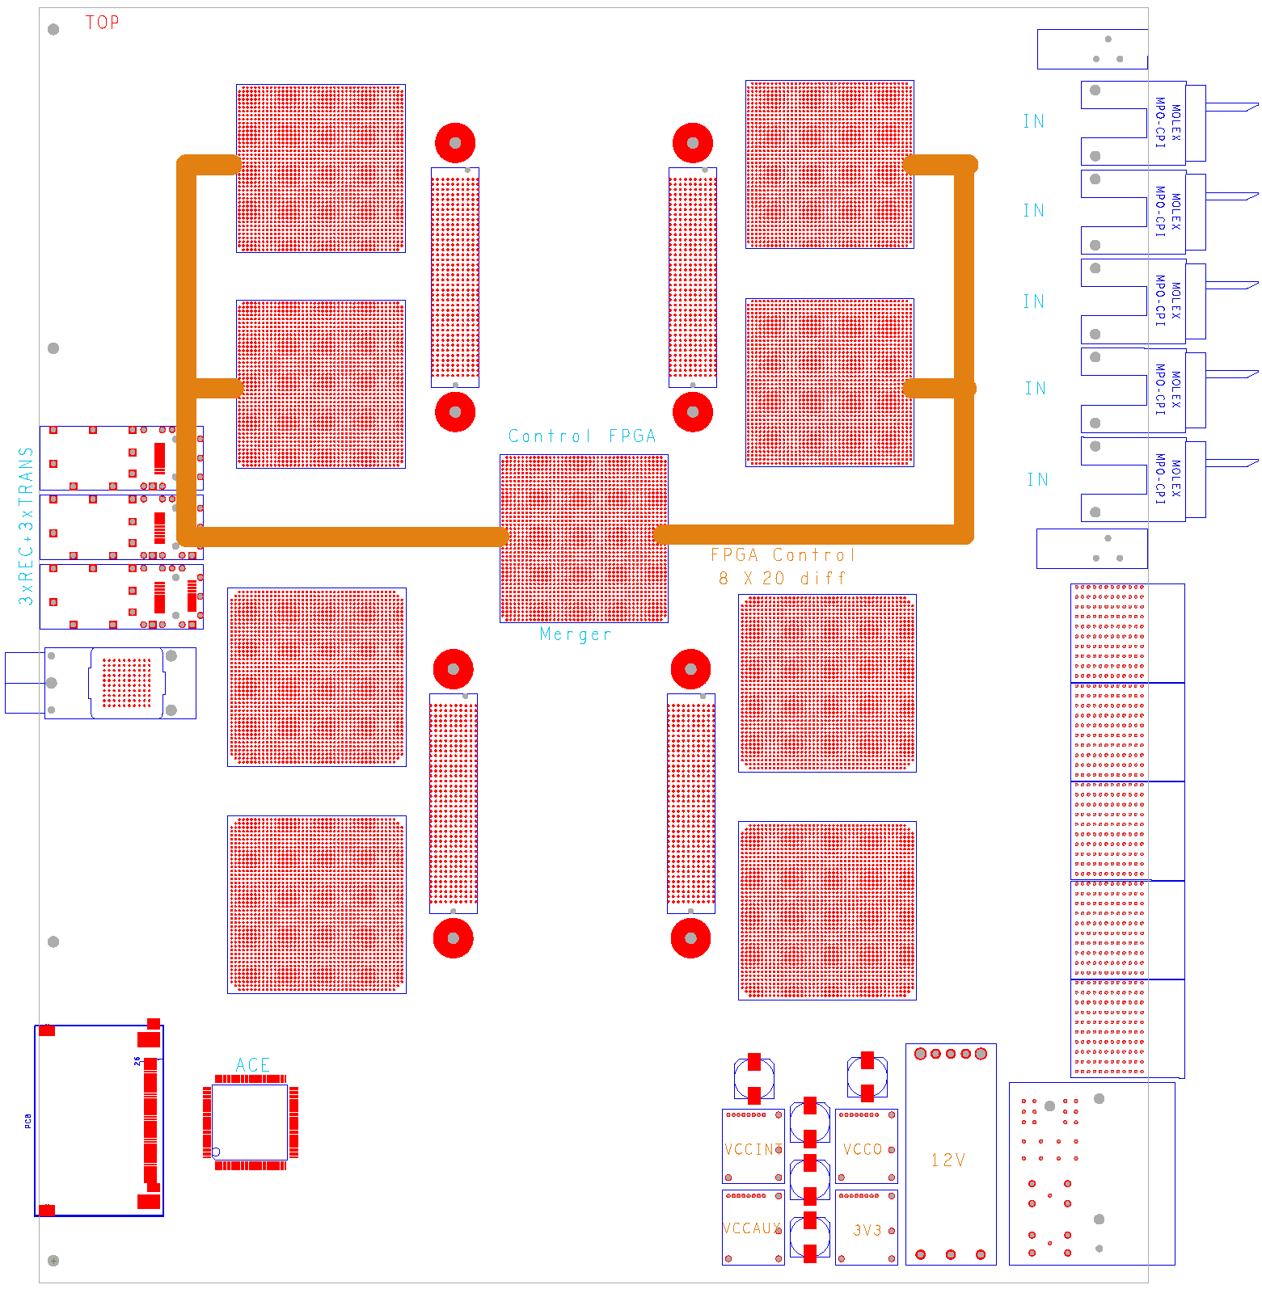
GOLD floor plan
Z3
V
Modification:
Discard bottom four XC6VLX and replace by XC6VHX (H)
ES silicon of 72-link devices expected to be available soon (48*6.5+24*11) Gb/s
Add multigigabit links in zone 2 (equiv. 22300 bit / BC)
standard Z2 connectors have been reported to support 10Gb/s
V
Opto
V
V
M
Z2
H
H
890Gb/s
total
H
H
Z1

Slide 4
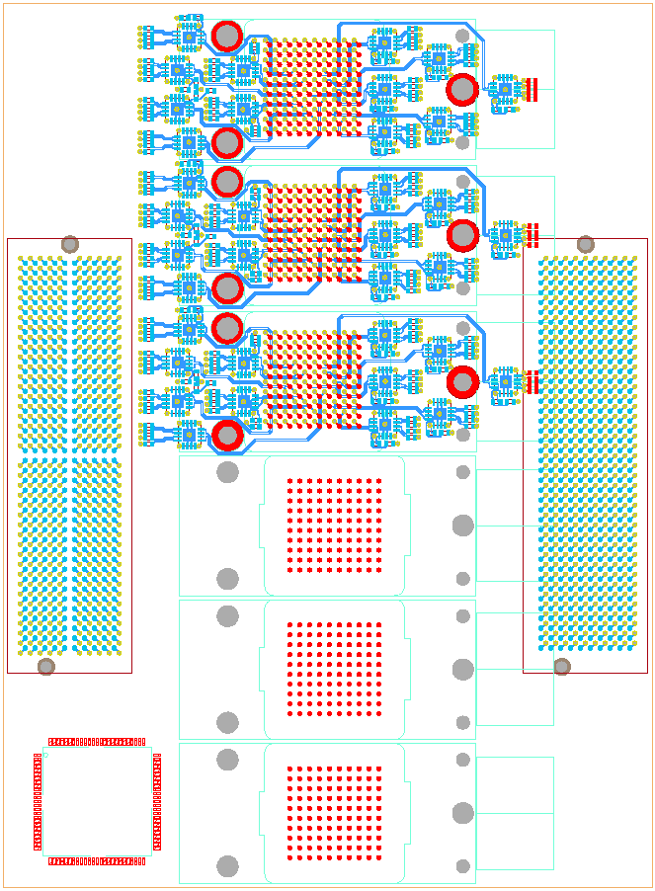
Test daughter
Build two versions: SNAP12 and AVAGO
Half size module
3* opto receive
36 * fanout (*2, CML)
2 FMC connectors
3 * opto transmit
control CPLD

