Slide 1
ATLAS L1 Calorimeter Trigger Upgrade - Uli Schäfer, MZ -
The ATLAS L1Calo collaboration
Argonne, Birmingham, Cambridge, Heidelberg, Mainz, MSU, QMUL, RAL, Stockholm

Slide 2
Outline
Current L1 Calorimeter Trigger
Phase 1
Pre-Processor upgrade
Digital processors / topological trigger
Towards Phase 2

Slide 3
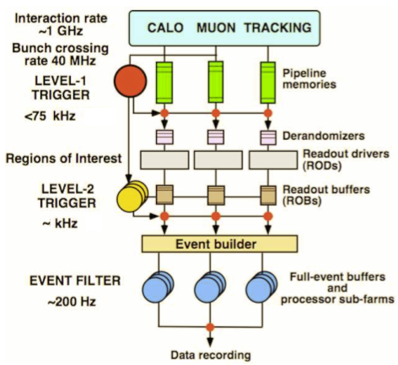
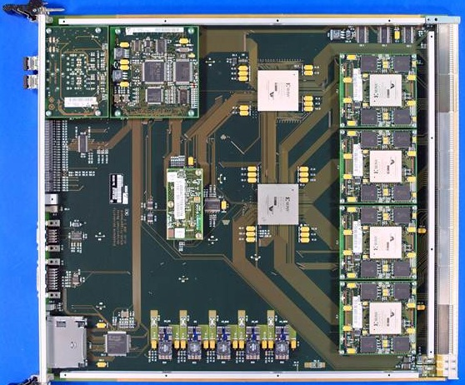
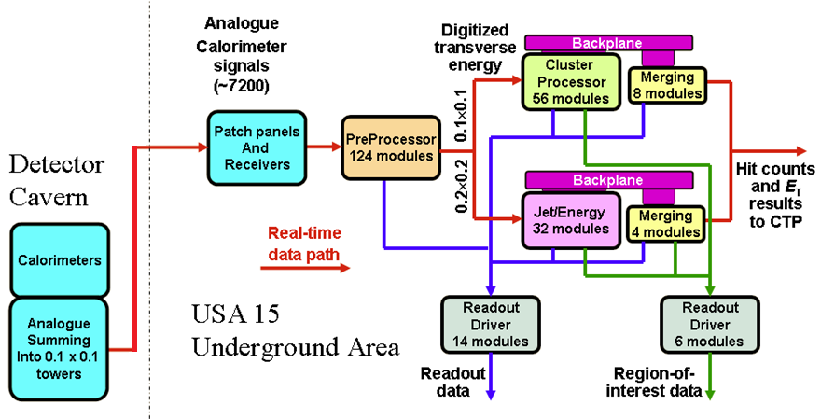
ATLAS Trigger / current L1Calo
L1
Jet/Energy module
µ
calo
CTP

Slide 4
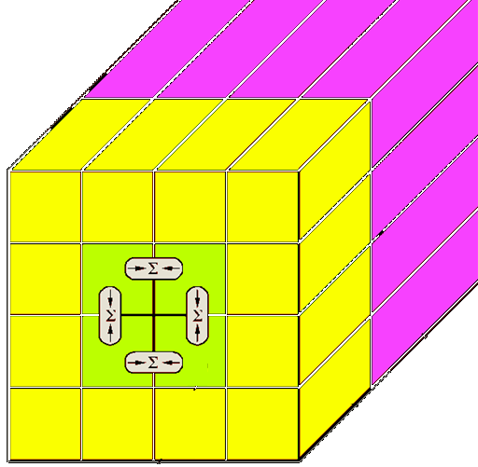
Current L1Calo
Analog signal chain on- and off-detector
Mixed-signal Pre-Processor with discrete analog and ASIC-based digital circuitry : digital filtering / gain control / bunch crossing identification
Digital processing:
Sliding windows algorithms for jet and em cluster detection on processor modules at granularity ≥ .1×.1 (η×φ)
Data consolidation by thresholding and counting objects
Data transmission on parallel backplane to mergers
Global results determined by summation trees on daisy-chained merger modules
Final results of electromagnetic and hadronic object count (at given thresholds), and total and missing transverse energy reported to Central Trigger Processor
Topological information (Regions of Interest – ROIs – basically energy sums per window) sent to 2nd level trigger only for all level-1 accepted events

Slide 5
L1Calo upgrade
Due to expected increase in pile-up of events at rising luminosities, the current algorithms will be degraded
Trying to improve L1Calo algorithms in two phases.
Phase-1:
Improve digital signal processing on Pre-Processor
Add topological processing with limited hardware modifications / additions
Phase-2: improve granularity of L1Calo algorithms in η, φ, and depth. Replacement of L1Calo.
NB :
I am presenting here a snapshot of current thinking only
The upgrade steps are related to, but not strictly dependent on the LHC machine upgrade steps
L1Calo will attempt to stage the installation of new hardware, i.e. there are likely to be sub-phases
Phase-1 upgrade is mainly internal to L1Calo, no strict need for modifications of external interfaces
Phase-2 is dependent on calorimeter readout electronics upgrade
Don‘t expect me to present a timeline…

Slide 6
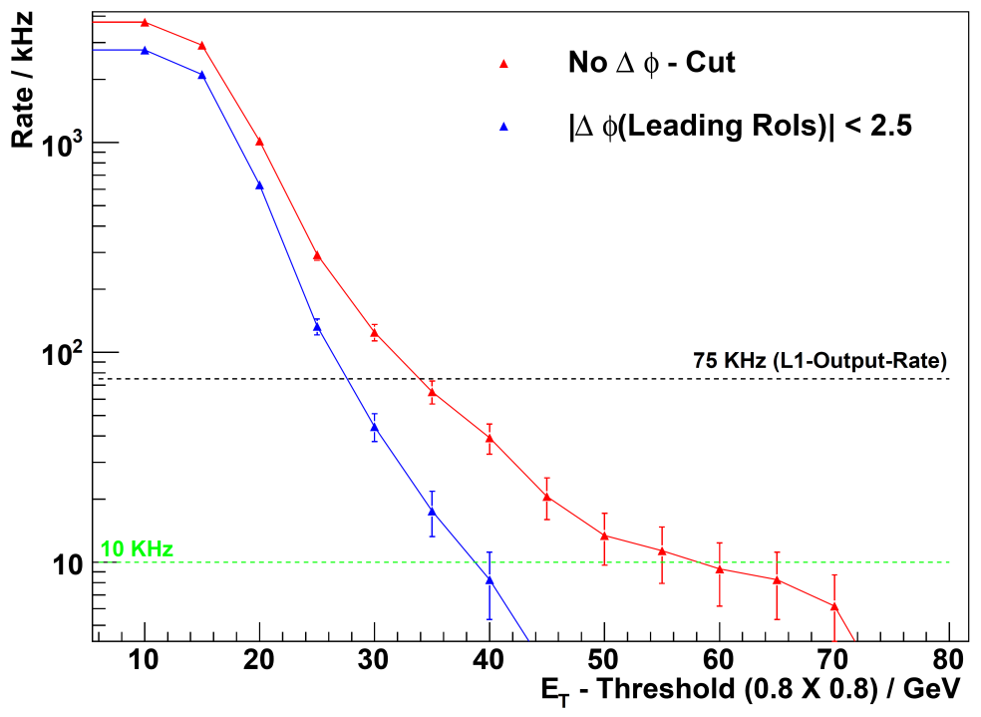
L1Calo upgrade simulation
Simulations of trigger algorithms at high luminosity / high pileup scenarios are being pursued within L1Calo community: Cambridge, Mainz, MSU, QMUL…
Initial results indicate need for considerable improvement on L1Calo algorithms
Just an example… SUSY trigger…
L1 trigger rates for 2-jet events at 10³⁴ cm⁻²s⁻¹
Require E_{tmiss} > 30 GeV
Threshold energy of 2nd leading jet
… and now cut on topology: Δφ(jet1,jet2)
→ Benefit from use of topological information

Slide 7
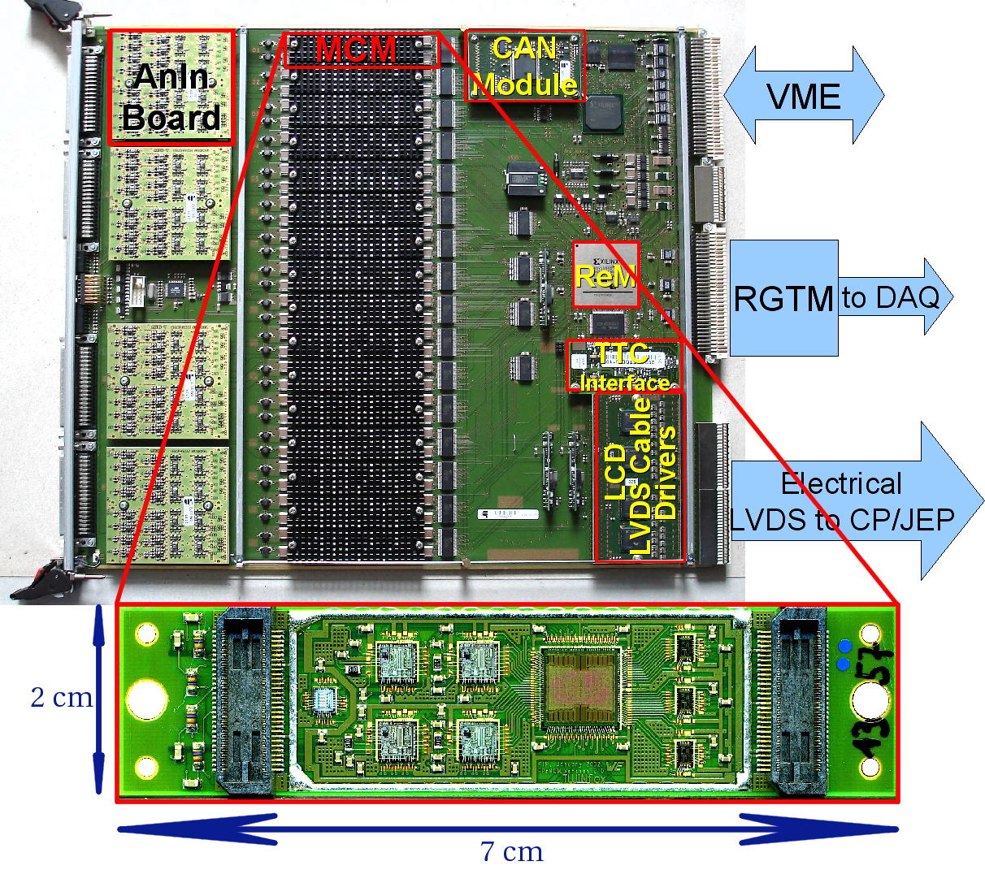
Upgrading the PreProcessor…

Slide 8
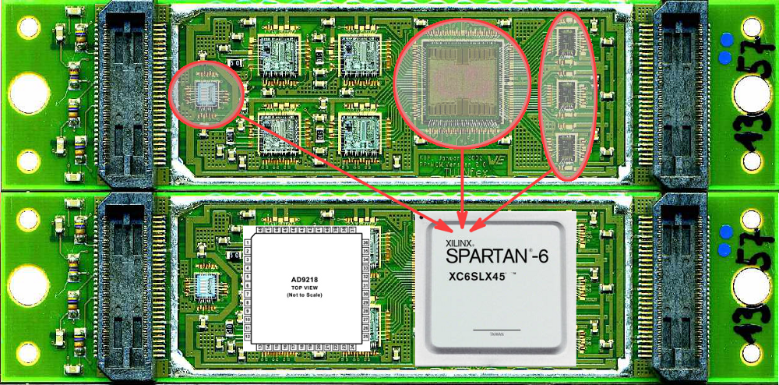
New MCM
We would like to develop a pin-, size- and latency-compatible substitute for the MCM based on today's components:
AD9218 -- dual FADC, 105MHz, 10bit
Xilinx Spartan-6 (SC6SLX45) FPGA in the CSG324 (15x15) package
Functionality of ASIC, PHOS4 and LVDS Serialisers inside FPGA
Modern reconfigurable device will allow us to adjust and to add new pre-processing algorithms (event-by-event pedestal subtraction, more sophisticated BCID algorithms, etc.) for higher luminosity expected after the LHC Upgrade

Slide 9
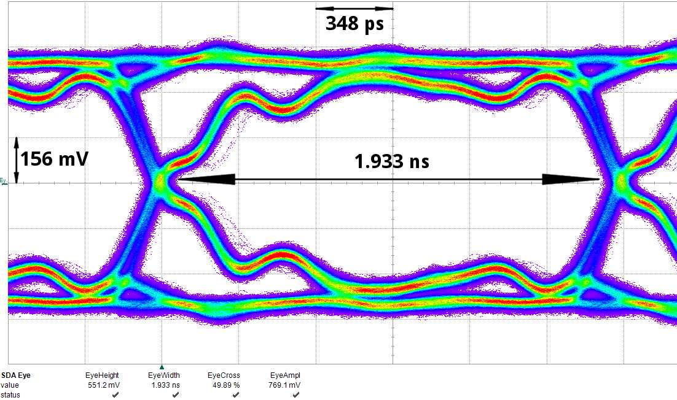
LVDS Serializers
480Mb/s serialisers for LVDS are implemented using Spartan-6 output serialiser blocks (OSERDES2). Eye-diagram shows a good signal quality:

Slide 10
PprASIC
PprASIC (including serializers) verilog code is adopted and synthesized for the Spartan-6 FGPA.
Estimated power consumption:
FPGA: ~200 mW
ADC: ~275 mW per channel at 105MHz; ~1W on module

Slide 11
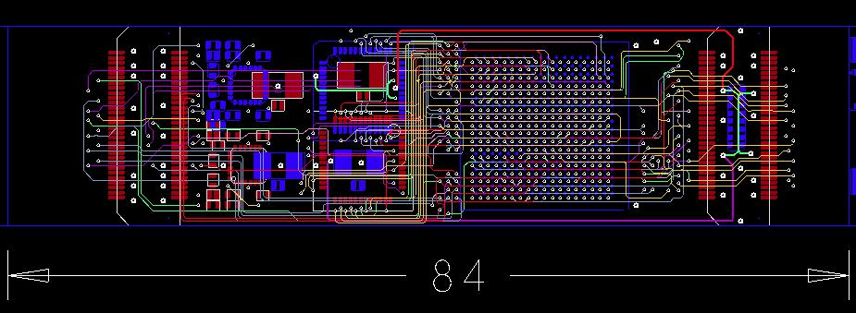
nMCM PCB Layout
10 layers design
Aim is to keep production technology as ''standard-and-simple'' as possible

Slide 12
and the digital processors : Topology
So far topology of identified objects not propagated through 1st level trigger real-time data path for bandwidth reason
Increase RTDP bandwidth and send (almost) full ROI information to a single processor stage where topology cuts are applied and double counting is suppressed by jet/electron/... matching :
Increase backplane bandwidth of existent processor modules 4-fold (40Mb/s→160Mb/s) with modification to FPGA code only
Replace the merger modules by “CMM++” modules
Single FPGA processor
16*25bit*160Mb/s (=64Gb/s) parallel input capability
Possibly up to ~400Gb/s optical I/O
Backward compatible to current merger modules so as to allow for staged installation scenario
Daisy-chain CMM++s electrically or optically similar to current scheme
Star-couple all CMM++s into topological processor for maximum performance

Slide 13
New merger module: CMM++
VME --
VME
CPLD
Legacy DAQ, ROI readout
(Glink)
SNAP12
Topological processor links:
12-fiber bundles,
6.4/10 Gbit/s/fiber
LVDS merger links
Virtex 6
HX565T
SNAP12
SNAP12
SNAP12
Backplane
data from
JEM/CPM
modules
(160 MHz)
Legacy
LVDS outputs
to CTP
SNAP12
SNAP12
9U × 40 cm

Slide 14
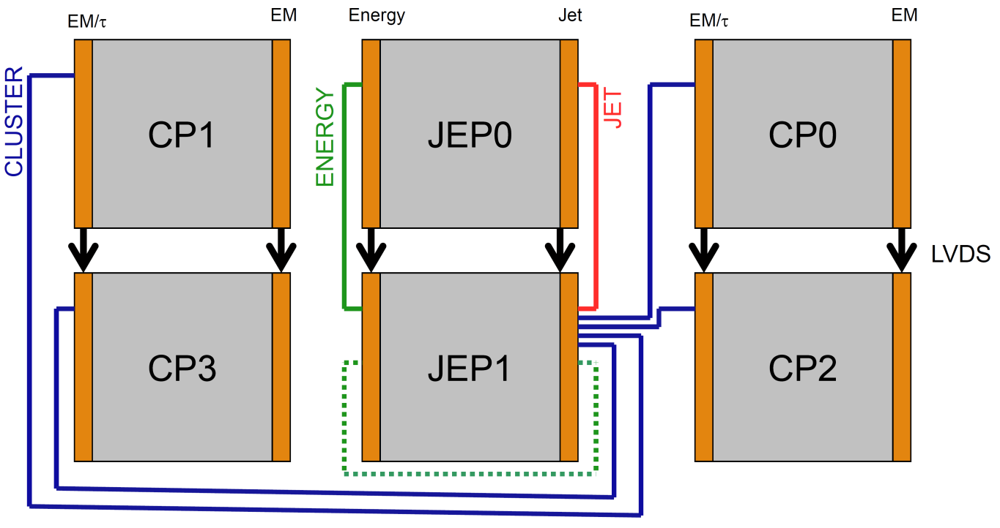
L1Calo Phase-1
Daisy chained
Combination of low-latency LVDS + high bandwidth opto links
CMM++
Full system w. topo processor
single crate

Slide 15
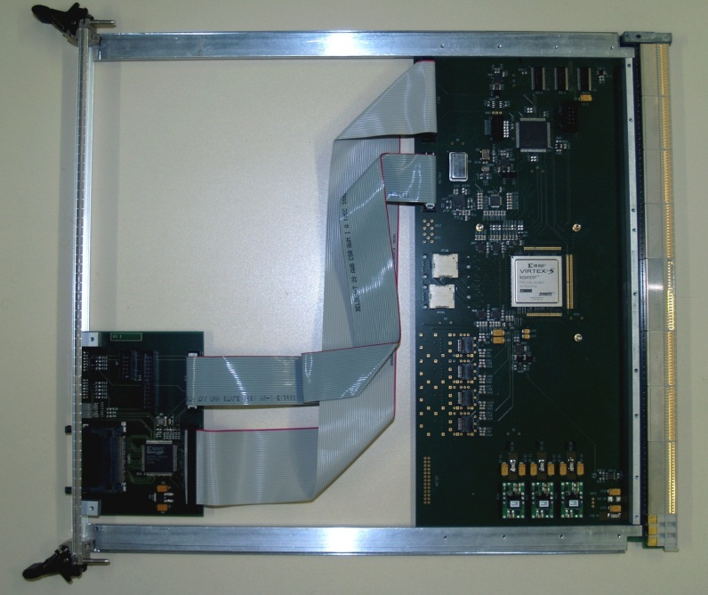
Demonstrators / Prototypes so far…
Work on CMM++ prototype has started recently. Currently at specifications stage. VHDL system modelling started at MSU.
“GOLD” demonstrator (not just) for a topological processor currently being developed in Mainz Latency → data replication schemes Density → processing power, connectivity
Mainz-built “BLT” backplane and link tester successfully verified 160Mb/s data reception on the processor backplane. Equipped with SNAP12 opto-link interface and LHC bunch clock jitter cleaning hardware required on CMM++

Slide 16
GOLD concept
RTM
«data concentrator» scheme: many in – few out
Advanced TCA form factor
Limited connectivity on front panel
Input links via optical connectors in zone 3
12-channel 10Gb/s opto modules on daughter card
Electrical connectivity up to 10Gb/s in zone 2
Power budget ~400W
front
Z3
back
Z2
ATCA

Slide 17
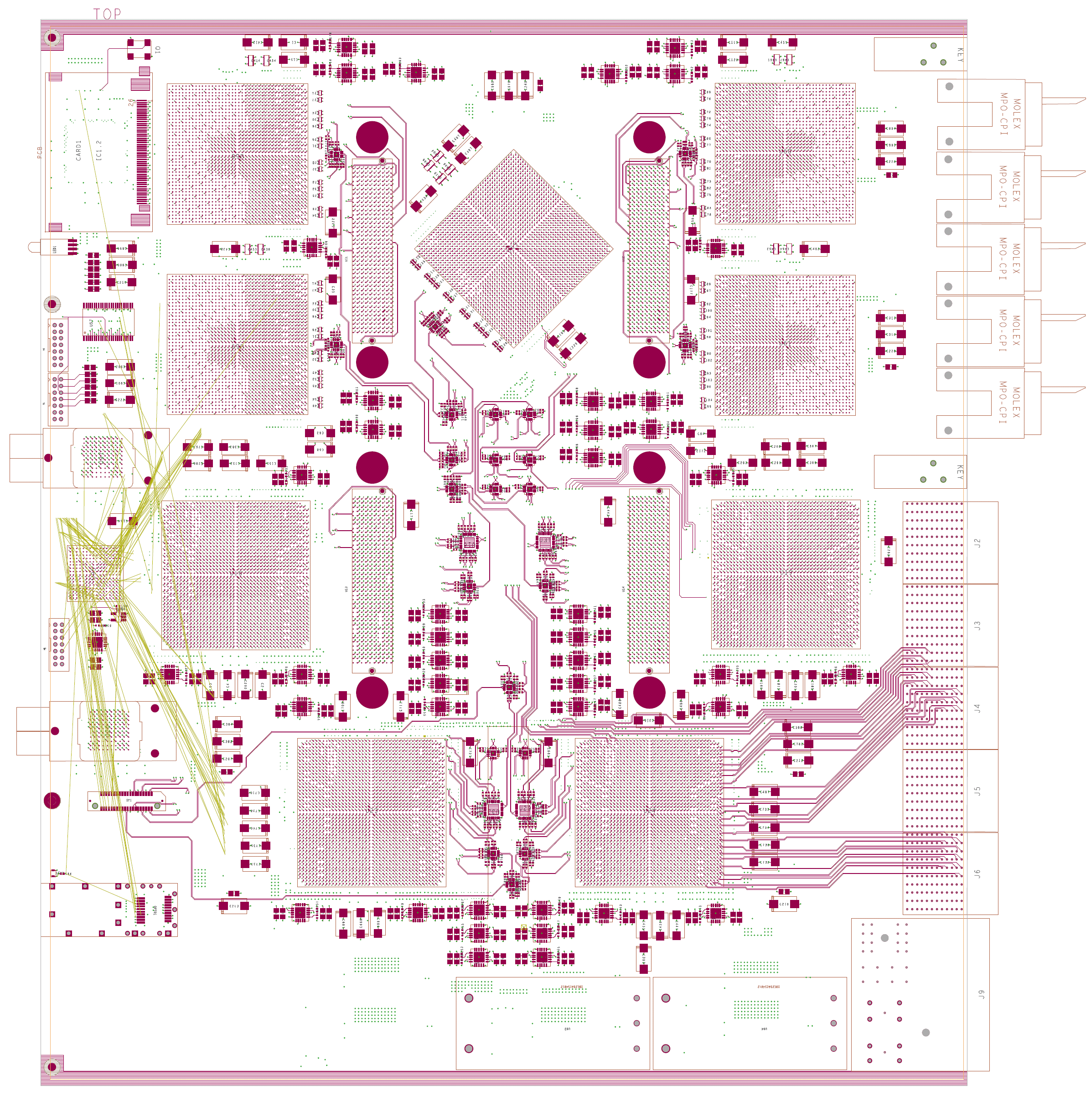
GOLD floor plan
Z3
5 * XC6VLX FPGAs (Processor L, merger M) up to 36 links each
Two pairs of XC6VHX FPGAs (H) 72 links
5+ 12-channel optos on daughter
Clock generation
144 multigigabit links in zone 2 (equiv. 22300 bit / BC)
L
L
M
Opto
L
L
H
H
Z2
890Gb/s
total
H
H
Z1

Slide 18
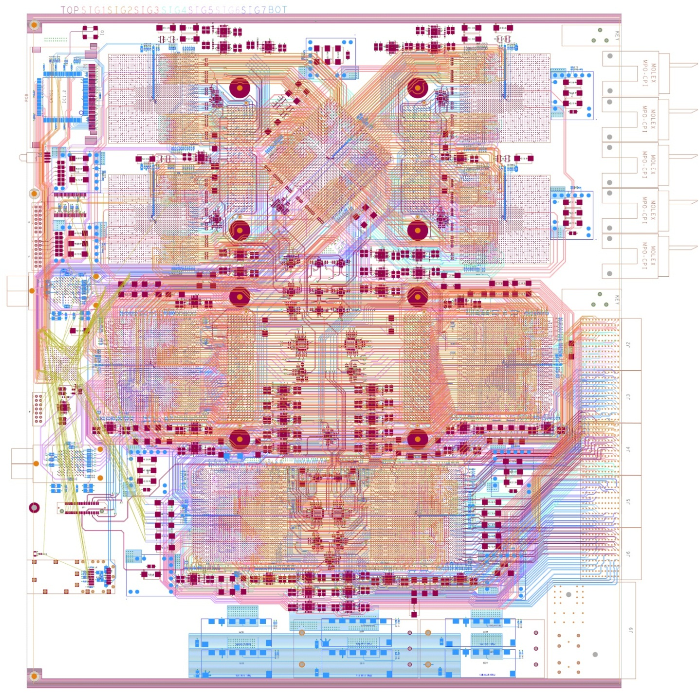
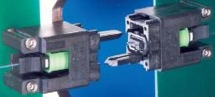
Optics & module status
up to 72 fibres per connector (MPO/MTP)
Module currently being hand-routed (~ 400 differential pairs per FPGA)
Daughter modules yet to be designed

Slide 19
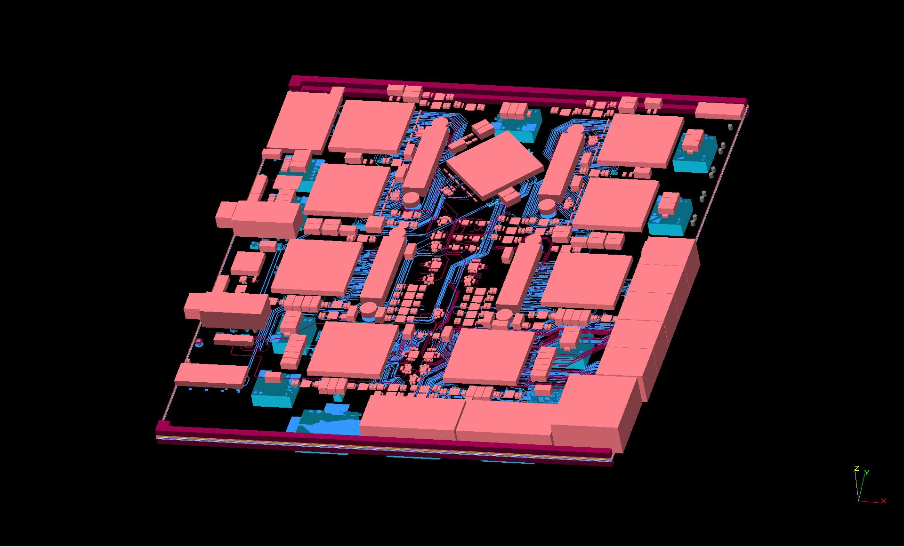
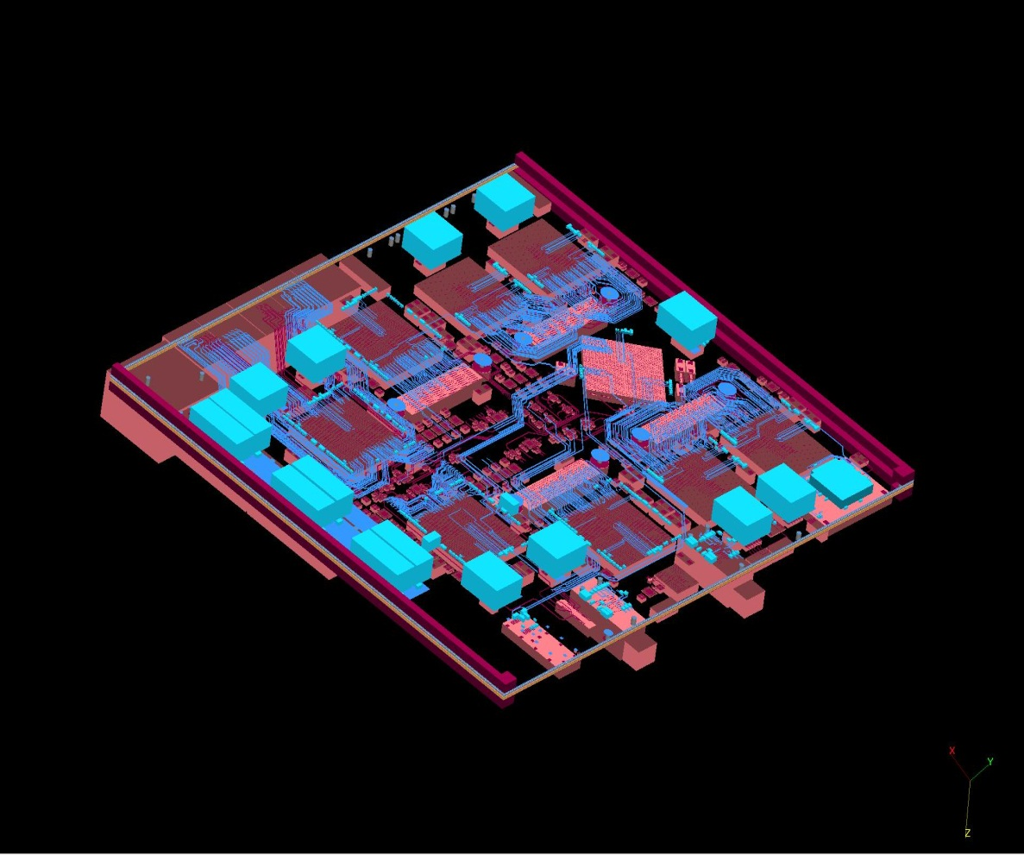
3-d model

Slide 20
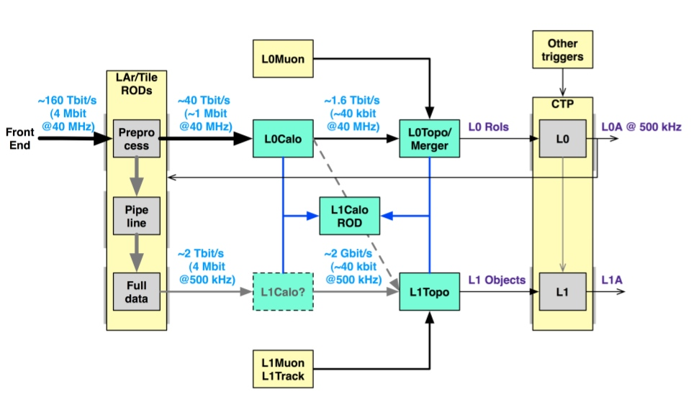
eventually … Phase 2 !
« Once the calorimeter readout is replaced … in 20xx … »
High granularity trigger data provided on optical links
New sliding windows processor with optical interfaces only
Synchronous low-latency L0 plus asynchronous L1

Slide 21
Summary
Need for substantial improvement of trigger algorithms indicated by initial simulation results
Timeline for trigger upgrade not strictly dependent on LHC upgrade phases
Work has started on conceptual designs and demonstrators for upgrade phases 1 and 2
Likely having to work on phase-1 and phase-2 hardware projects concurrently ☹
Benefit from similar requirements on phase 1 and 2 ☺

