Slide 1
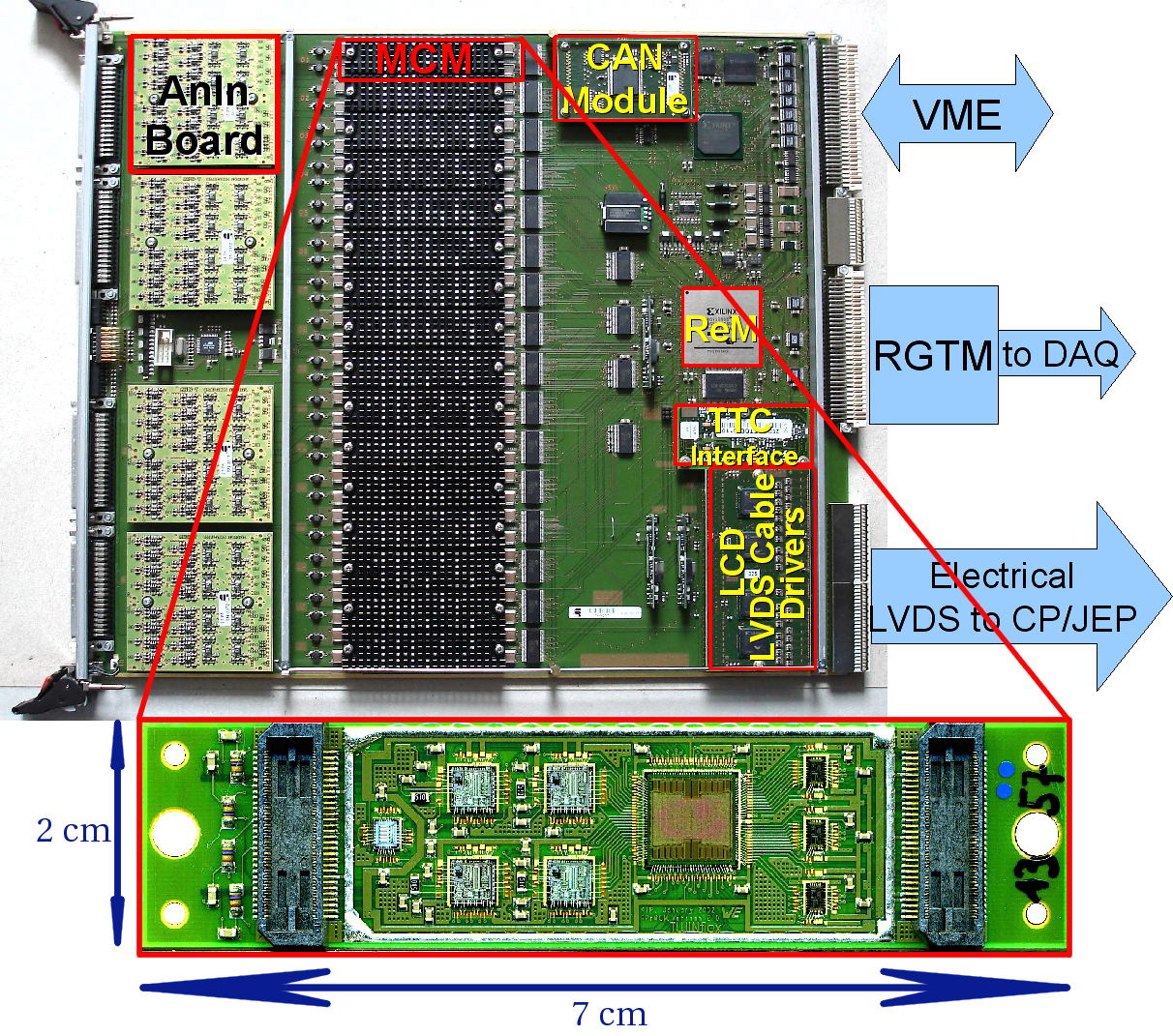
L1Calo PreProcessor Module

Slide 2
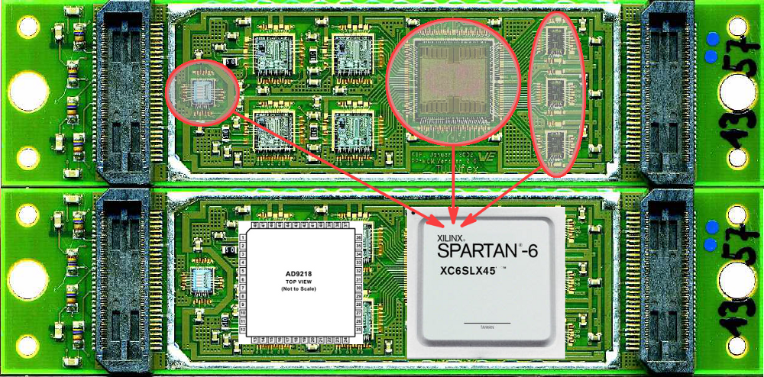
New MCM
We would like to develop a pin-, size- and latency-compatible substitute for the MCM based on today's components:
AD9218 -- dual 105\,MHz 10\,bit FADC
Xilinx Spartan-6 (SC6SLX45) FPGA in the CSG324 (15x15) package
Functionality of ASIC, PHOS4 and LVDS Serialisers inside FPGA
Modern reconfigurable device will allow us to adjust and to add new pre-processing algorithms (event-by-event pedestal subtraction, more sophisticated BCID algorithms, etc.) for higher luminosity expected after the LHC Upgrade

Slide 3
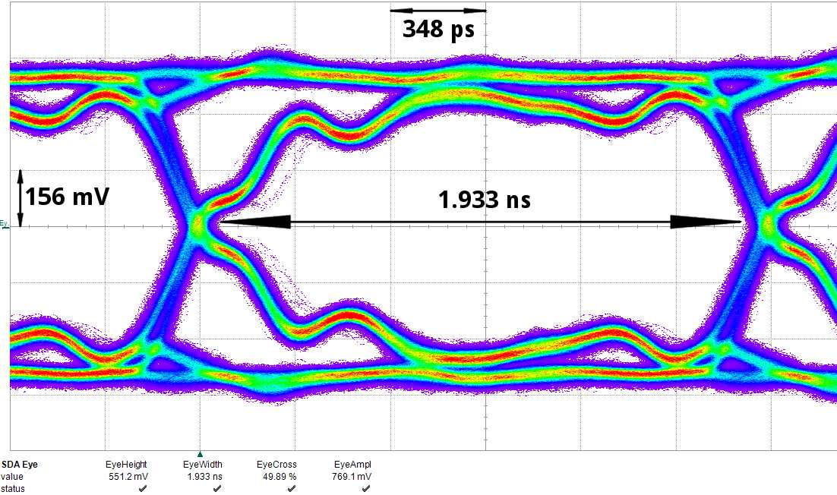
LVDS Serializers
480Mb/s serialisers for LVDS are implemented using Spartan-6 output serialiser blocks (OSERDES2). Eye-diagram shows a good signal quality:

Slide 4
PprASIC
PprASIC (including serializers) verilog code is adopted and synthesized for the Spartan-6 FGPA.
Estimated power consumption:
FPGA: ~200 mW
ADC: ~275 mW per channel at 105MHz; ~1W on module

Slide 5
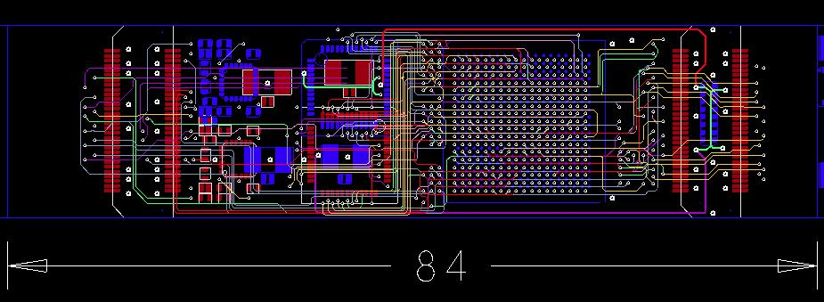
nMCM PCB Layout
10 layers design
Aim is to keep production technology as ''standard-and-simple'' as possible

