Slide 1
Hardware status GOLD
Generic Opto Link Demonstrator
Assess the use of optical backplane connectivity for use on L1Calo

Slide 2
GOLD – why ?
Any future L1calo module will require large fibre plant to cope with the required (input) connectivity
Connect optically via front panel (MPO connectors)
Cheapest, most conventional
Least convenient wrt system maintenance
Opto-electrical conversion on rear transition modules
Considerable power dissipation outside module cage
xGb/s electrical routing required from back to front module
Opto connectors from RTM to front module, mid board transceivers
Reduce xGb/s track length
Avoid impedance discontinuities RTM/connector/front module
High density interconnect
front
2
1
back
RTM
SNAP12
3
3

Slide 3
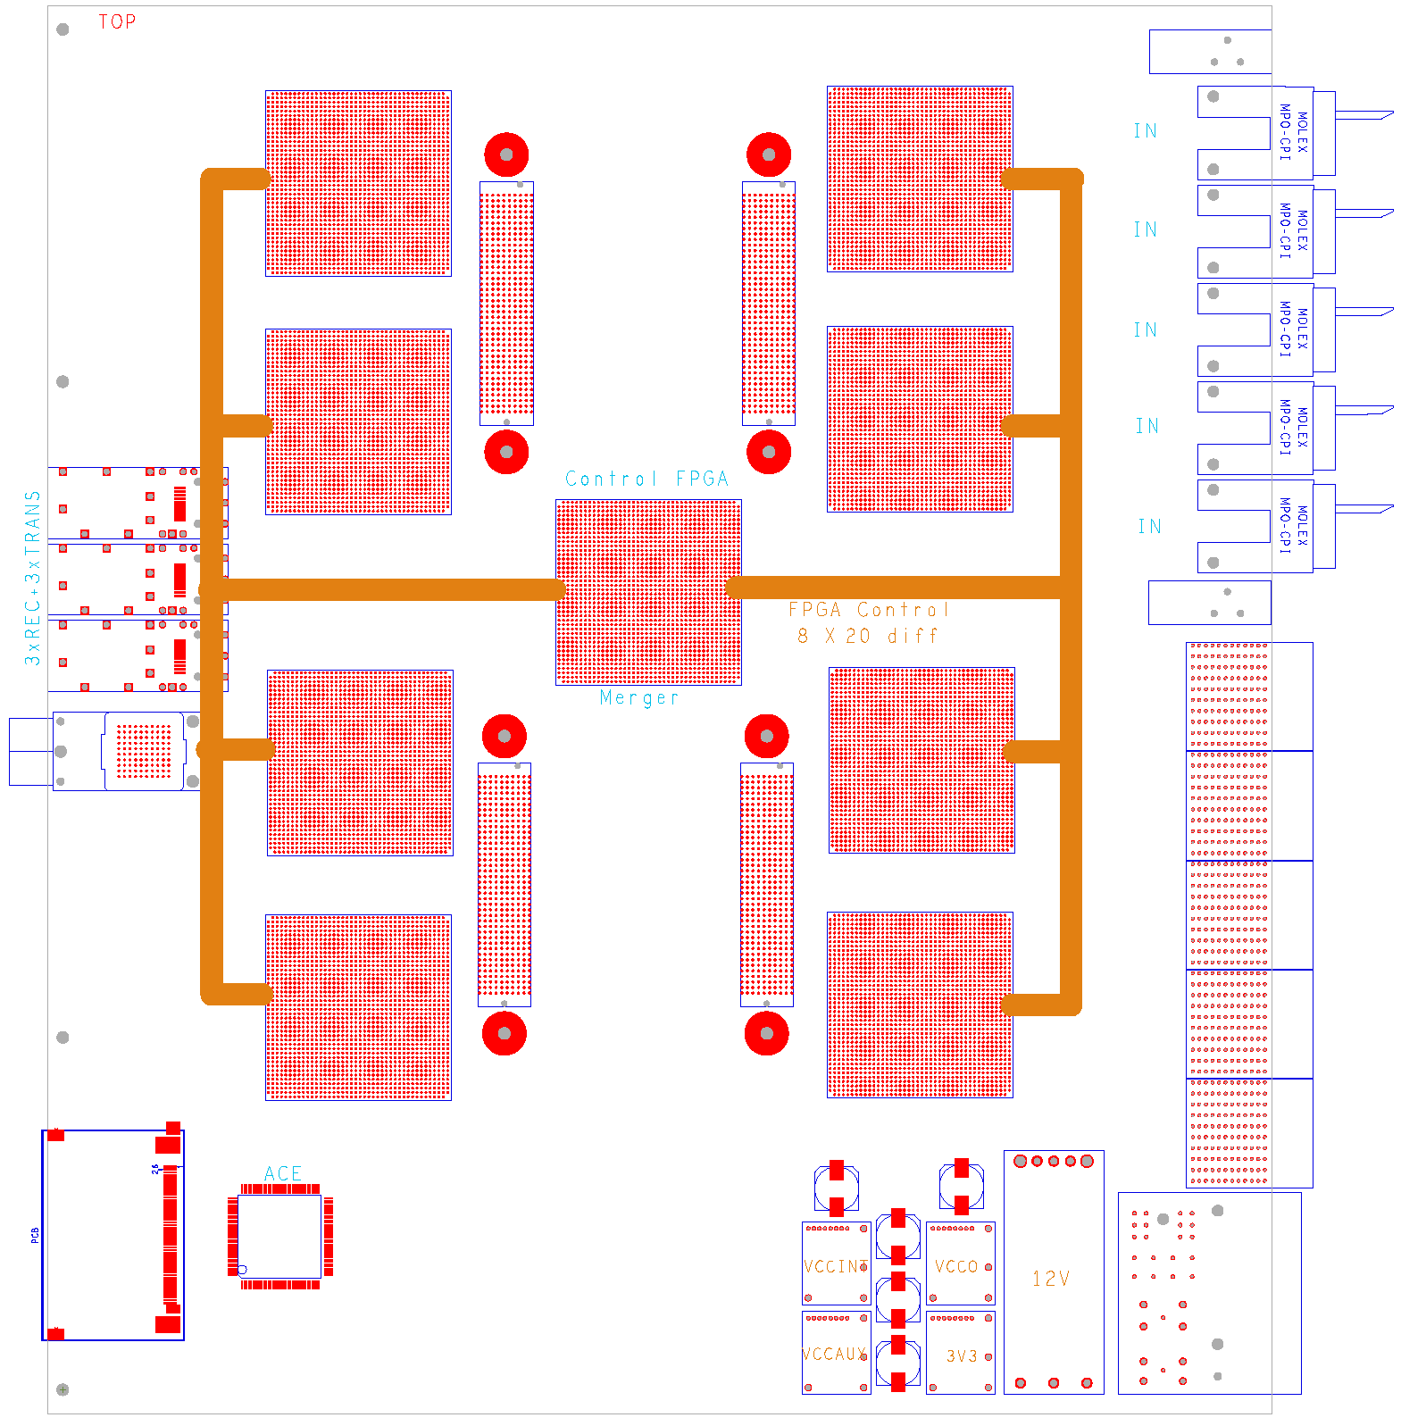
Gold floor plan
Z3
ATCA
daughter module w. 4*FMC connector
8 processors
SFP / SNAP12 out
Merger / control
SystemACE config
Opto
Z2
Z1

Slide 4
Gold floor plan
Z3
ATCA
daughter module w. 4*FMC connector
8 processors
SFP / SNAP12 out
Merger / control
Local routing
SystemACE config
Opto
Z2
Z1

Slide 5
Gold floor plan
Z3
ATCA
daughter module w. 4*FMC connector
8 processors
SFP / SNAP12 out
Merger / control
Local routing
SystemACE config
Opto
Z2
Z1

Slide 6
GOLD
Data concentrator scheme : many in, few out
ATCA form factor (8U x 280 mm)
Standard Zone1 connectivity (2*-48V supply scheme)
Currently no plans for use of Zone2 electrical connectivity
Zone3 (RTMs) 6.5Gb/s optical links
8 processors, 1 merger XC6VLX240T/550T-FFG1759 (24/36 * GTX link)
Optical inputs from backplane via bare fibre ribbons, 144 fibres
12 * SNAP12 optical receivers (baseline: standard pin-out, not Avago)
Electrical link fan-out (*2) with CML buffers (SY58011 or similar)
‘Realistic’ fanout scheme would require knowledge of algorithms → xGb/s routing on daughter module carrying SNAP12 + fanout chips
Allow for full size or half size modules
Set of daughters for both SNAP12 and Avago transceivers
4 GTX outputs per processor into merger FPGA
1*SNAP12 out from control/merger FPGA
Few SFP opto links for control purposes (incl. serialised VME)
Clock recovery, jitter cleaner and clock fanout as on BLT
Parallel connectivity (up to 1Gb/s) via differential lanes only
Run ~50 lanes from each processor into merger
Use remaining ~350 links on each processor to interlink neighbours
Configuration via SystemACE (CompactFlash)

Slide 7
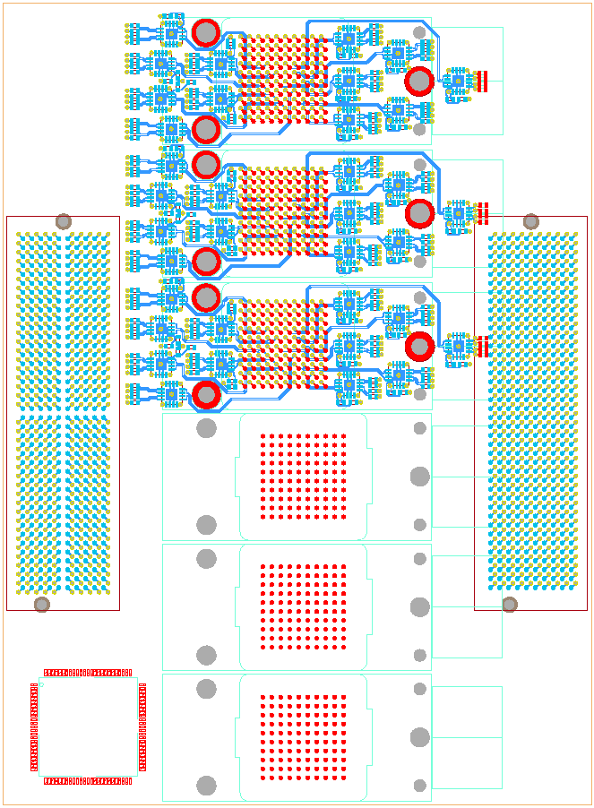
Test daughter
Half size module
3* SNAP12 receive
36 * fanout (*2, CML)
2 FMC connectors
3 * SNAP12 transmit
SNAP12 control CPLD

Slide 8
Optical backplane connectors
Available from a couple of manufacturers
Individual or 4-connector housings available
MT connectors for 12-36 fibres each, dependent on manufacturer (proprietary)
MT-to-MTP cable assemblies available from manufacturer only
expensive
MTP/MPO connectors for 12-72 fibres in single-connector housing
Takes more space than proprietary approach
12-fibre ribbon will yield insufficient connection density on ATCA RTM boards
24-fibre ribbons starting to become popular
Have a local supplier for custom made MTP 24-fibre ribbons and fanout cords (from January?)
Have ordered components : individual connectors, MTP compatible
Opto/PCB purely mechanical interface only, allow for change of concept later

Slide 9
GOLD status / outlook
Components have been identified, including optical backplane connectors
Floor planning under way
Schematic capture started
Design along the lines of Xilinx ML605 (V6 specific) and BLT
First module to go into production is test daughter for transmission tests
SNAP12
Data source 3 fibre ribbons
Data sink 3 fibre ribbons
Build module according to ATCA standard and with baseline backplane opto connector
Should provide input to L1Calo prototyping
Reconsider module size and optical interface upon transition from demonstrator to prototyping phase.

