Slide 1
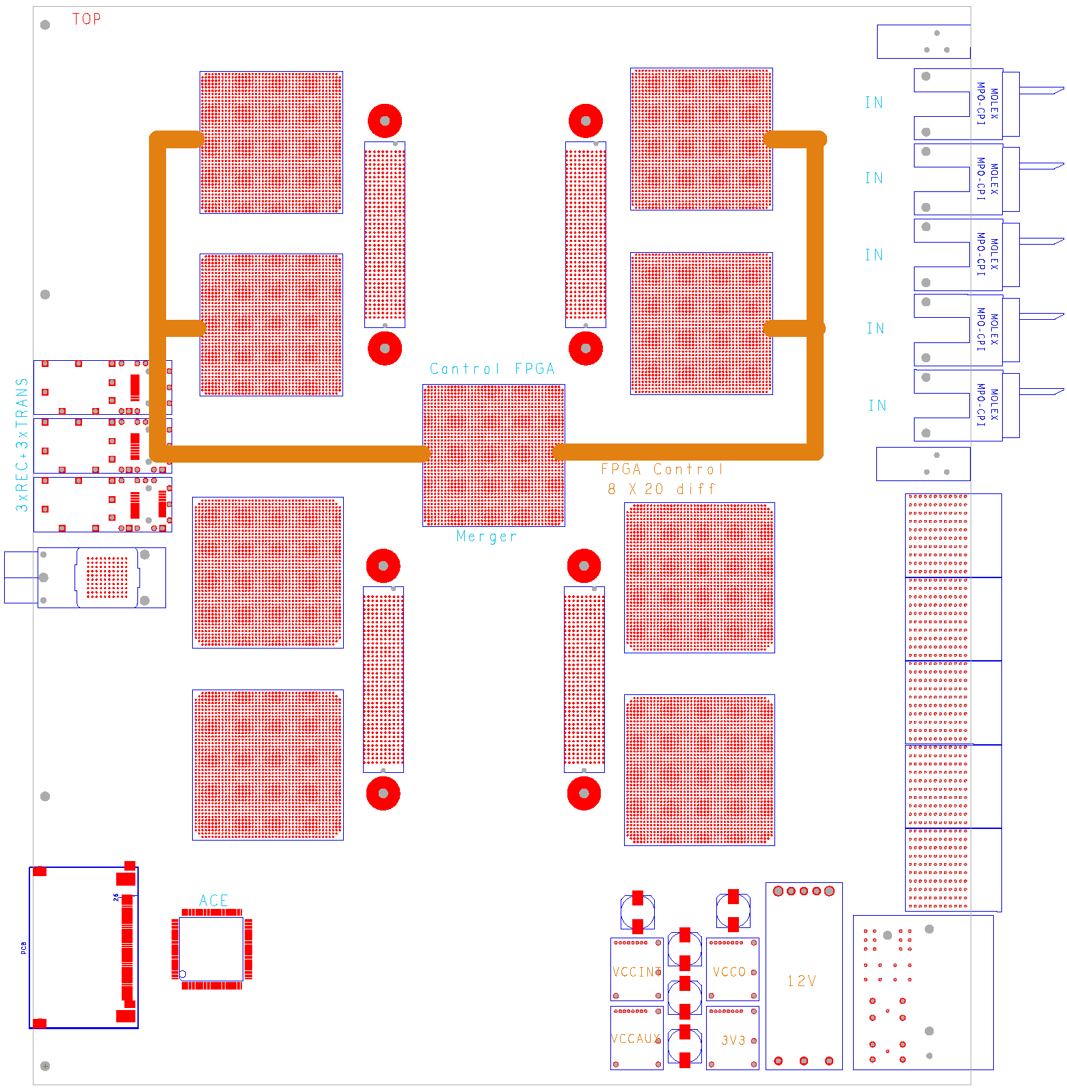
More GOLD...
Z3
V
Modification:
Discard bottom four XC6VLX and replace by XC6VHX (H)
ES silicon of 72-link devices expected to be available soon (48*6.5+24*11) Gb/s
Add multigigabit links in zone 2 (equiv. 22300 bit / BC)
standard Z2 connectors have been reported to support 10Gb/s
V
Opto
V
V
M
Z2
H
H
890Gb/s
total
H
H
Z1

