Slide 1
Hardware status GOLD
Update 03 Mar. 2010

Slide 2
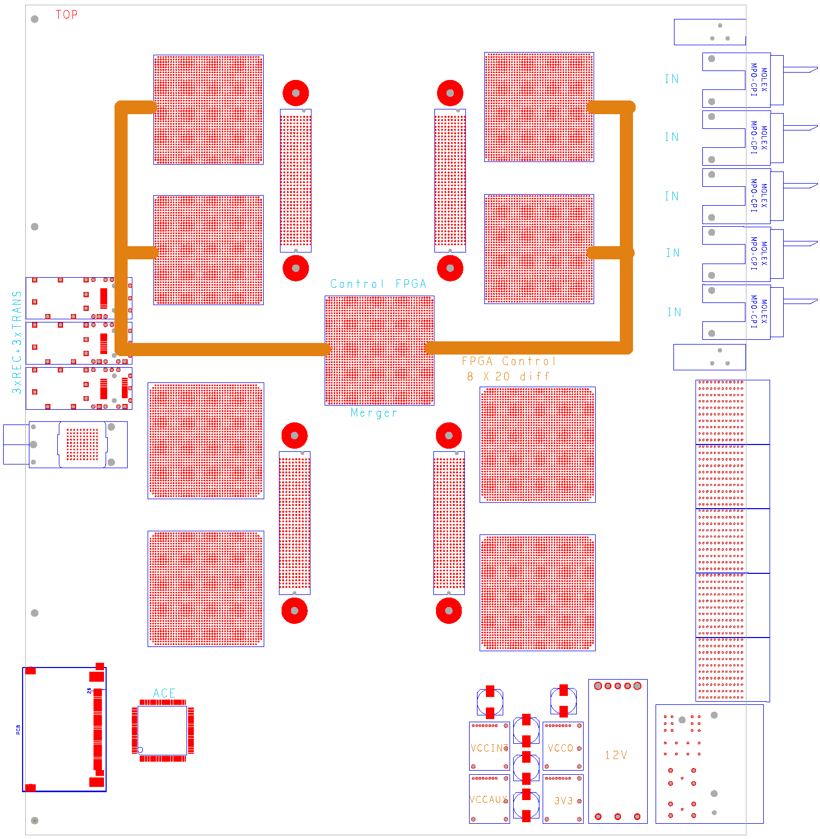
GOLD floor plan (approximate)
Z3
L
5 * XC6VLX (L,M)
4* XC6VHX (H)
144 multigigabit links in zone 2 (equiv. 22300 bit / BC)
L
Opto
L
L
M
Z2
H
H
890Gb/s
total
H
H
Z1

Slide 3
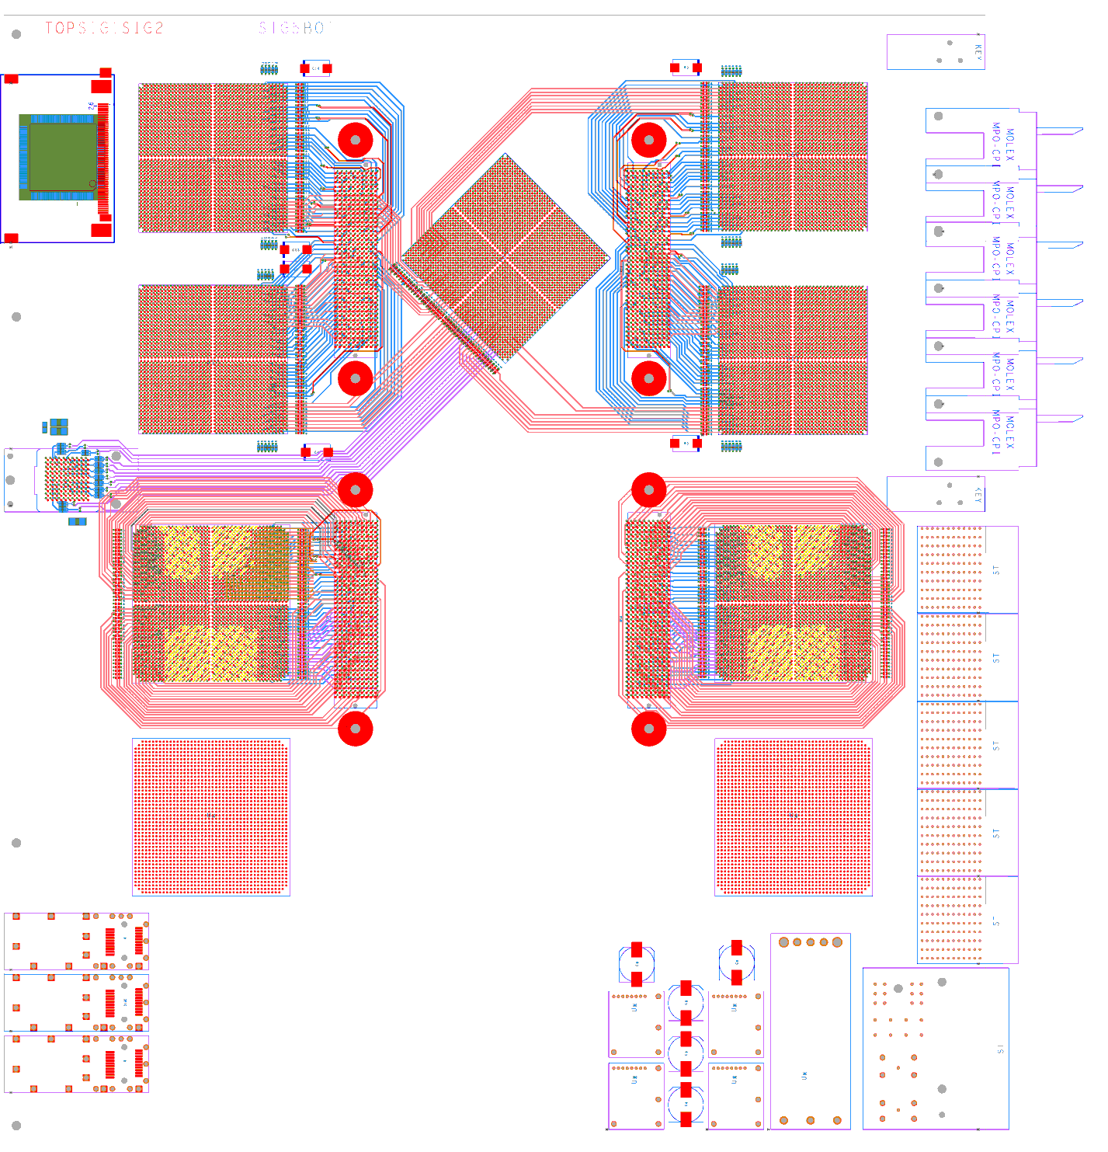
GOLD – current status
Schematics partially done
Routing as shown:
xGb/s links hand routed →
‘Low’ speed links (1Gb/s) to be auto routed

Slide 4
GOLD status
Schematics and layout under way
Components ordered. Lead time:
AVAGO (2*T, 2*R) : arrived
SNAP12 : mid April
Xilinx XCVLXT: 8-10 weeks
Production of Xilinx HXT devices delayed
Firmware activities:
Currently working on extension of VME bus from 9U processor crates, via BLT module, optically into GOLD

