Slide 1
Hardware status GOLD
Generic Opto Link Demonstrator

Slide 2
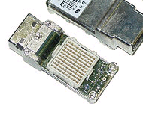
Pre-historic & GOLD
Backplane and link tester ”BLT” built and tested in 2009
9U*40cm, fitting CMM slot in JEP/CP crate
1 FPGA Virtex-5
400 s/e backplane links
Multi-Gigabit links (FPGA on-chip)
1 SFP electro/optical link – pluggable, bidirectional pair
1 pair of SNAP12 optical device – plug. 12 fibre unidirectional
Minor h/w issues
Successfully operated on 160+ Mb/s backplane signals
Successfully operated on Gigabit optical links (SFP)
To further explore optical links and new technologies → GOLD
AdvancedTCA (ATCA) form factor
Many Virtex-6
Higher link count
Higher link speed
Optical backplane connectors
o
e
SNAP12

Slide 3
GOLD concept
RTM
ATCA form factor
Limited connectivity on front panel
Input links via optical connectors in zone 3
12-channel optos on daughter modules
Electrical connectivity up to 10Gb/s in zone 2
front
Z3
Z2
ATCA

Slide 4
GOLD floor plan
Z3
5 * XC6VLX (Processor L, merger M) up to 36 links each
Two pairs of XC6VHX (H) 72 links each
5+ 12-channel optos on daughter
144 multigigabit links in zone 2 (equiv. 22300 bit / BC)
L
L
M
Opto
L
L
H
H
Z2
890Gb/s
total
H
H
Z1

Slide 5
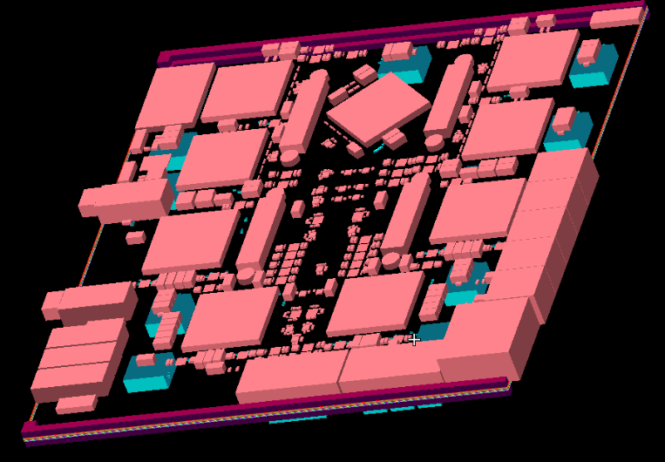
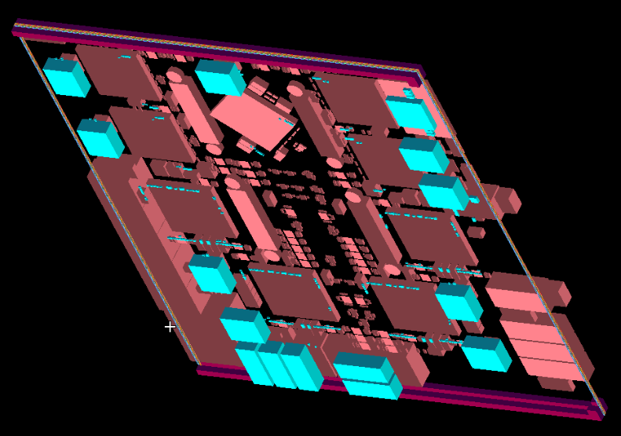
real GOLD

Slide 6
GOLD – forever ?
Module originally planned for ca. 8 x 6VLX550T with opto backplane connection only
Converted to a mixed scheme 6VLXT / 6VHXT (6.5/10Gbps)
Added electrical backplane connectivity in zone 2
Learned about power consumption of Virtex 6 → re-design of on-module power distribution
Currently designing for 480W per module (primary supply -48/12V converter)
Difficult to find power converters with small footprint, high current and a lead time below 40 weeks
Module densely packed, power converters on bottom
Thick module, more than 1 ATCA slot
Xilinx documentation for HXT devices far from complete
However, things are now starting to look better now...

Slide 7
GOLD status
Schematics and layout under way
Components ordered in February
Xilinx 6VLXT: arrived
Xilinx HXT ???
SNAP12 : ???
AVAGO 10Gb/s 12-channel optos (2*T, 2*R) : arrived
... While Bruno's heroic battle against missing documentation and unavailable components continues ....
... some firmware activities:
Currently working on extension of VME bus from 9U processor crates, via BLT module, optically into GOLD (see next presentation)

