Slide 1
Hardware status GOLD
Generic Opto Link Demonstrator

Slide 2
GOLD concept
RTM
ATCA form factor
Limited connectivity on front panel
Input links via optical connectors in zone 3
12-channel optos on daughter modules
Electrical connectivity up to 10Gb/s in zone 2
front
Z3
Z2
ATCA

Slide 3
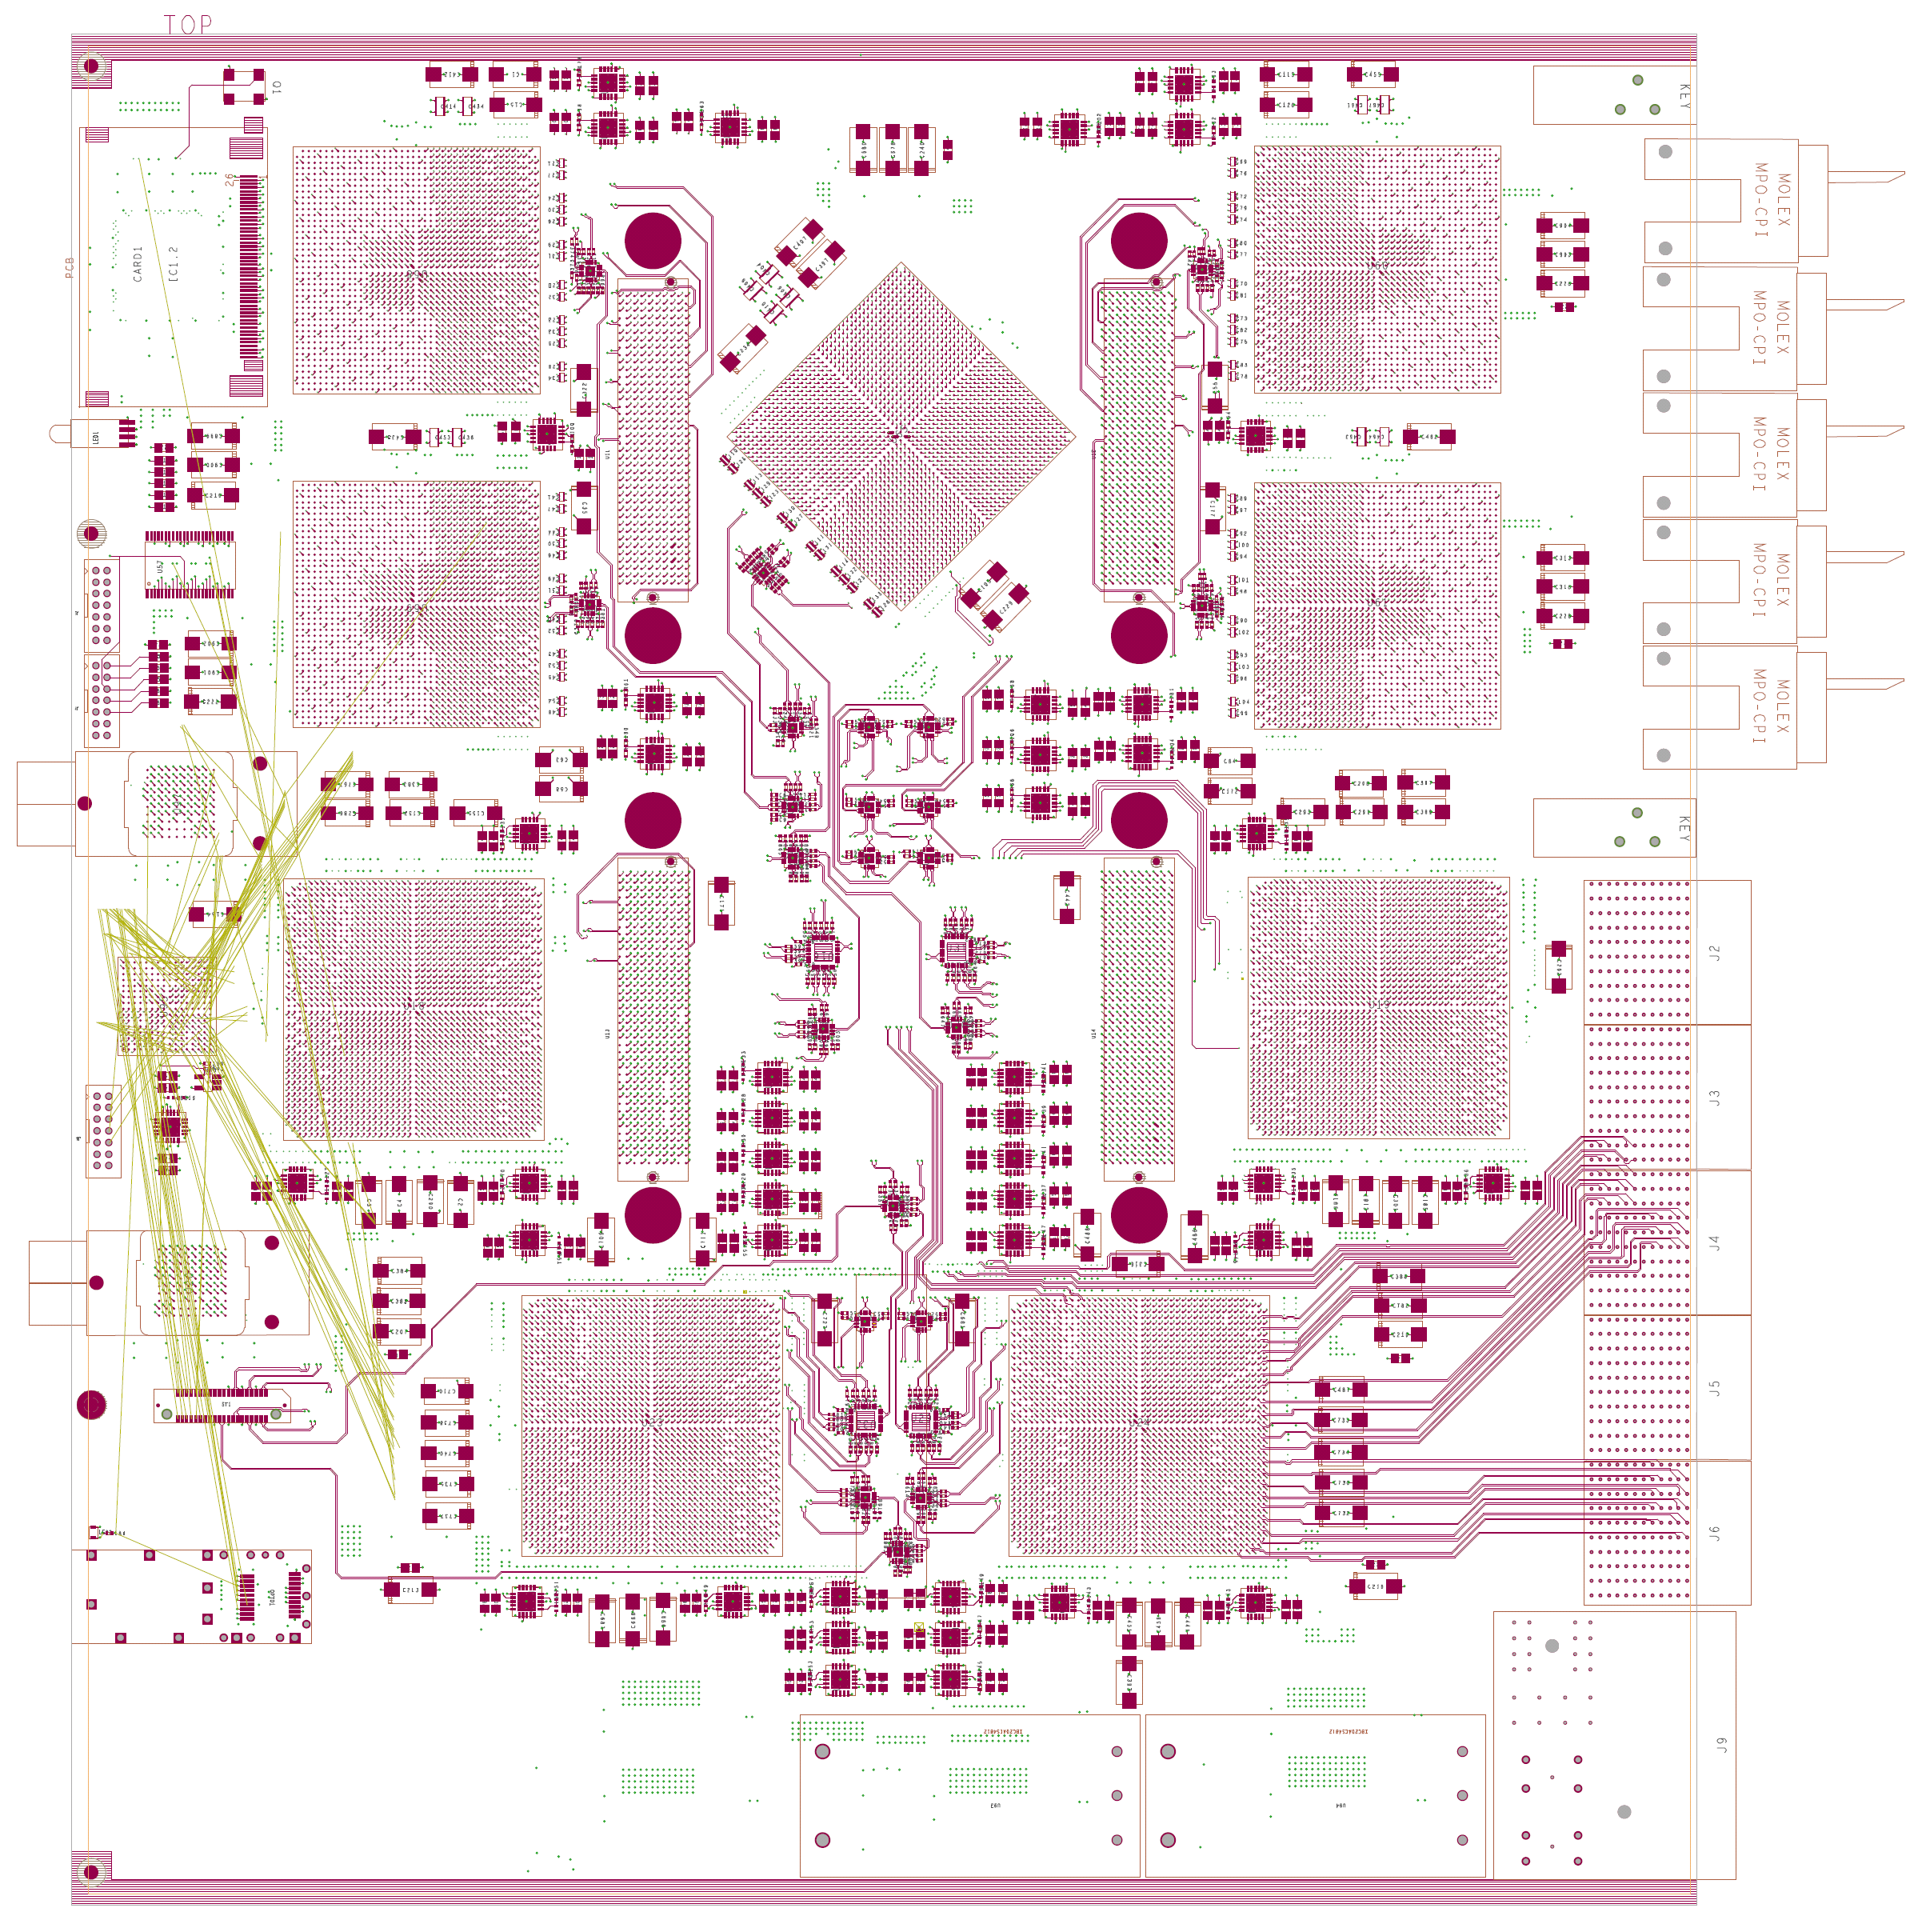
GOLD floor plan
Z3
5 * XC6VLX (Processor L, merger M) up to 36 links each
Two pairs of XC6VHX (H) 72 links each
5+ 12-channel optos on daughter
Clock generation
144 multigigabit links in zone 2 (equiv. 22300 bit / BC)
L
L
M
Opto
L
L
H
H
Z2
890Gb/s
total
H
H
Z1

Slide 4
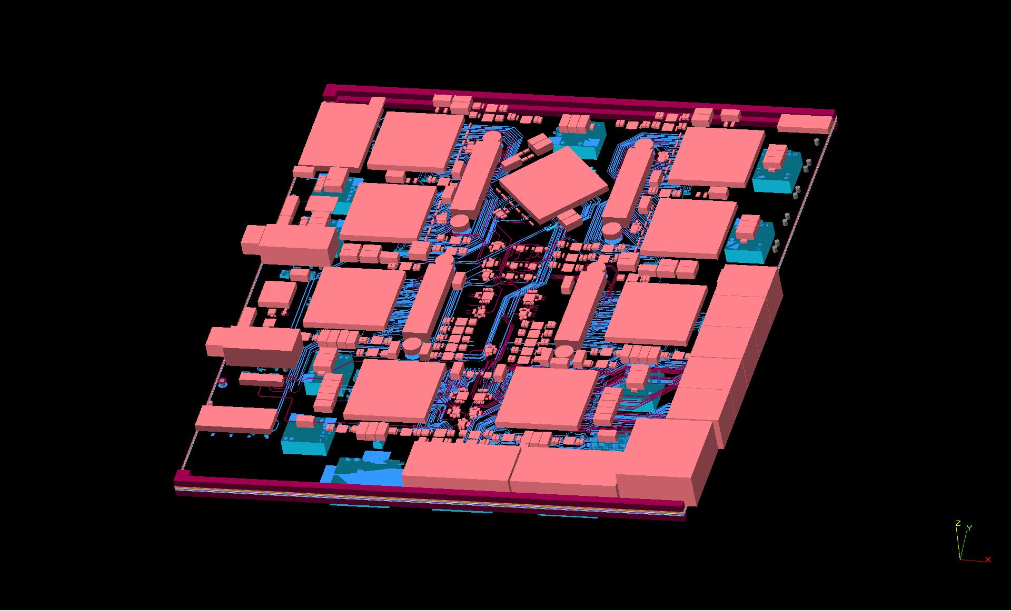
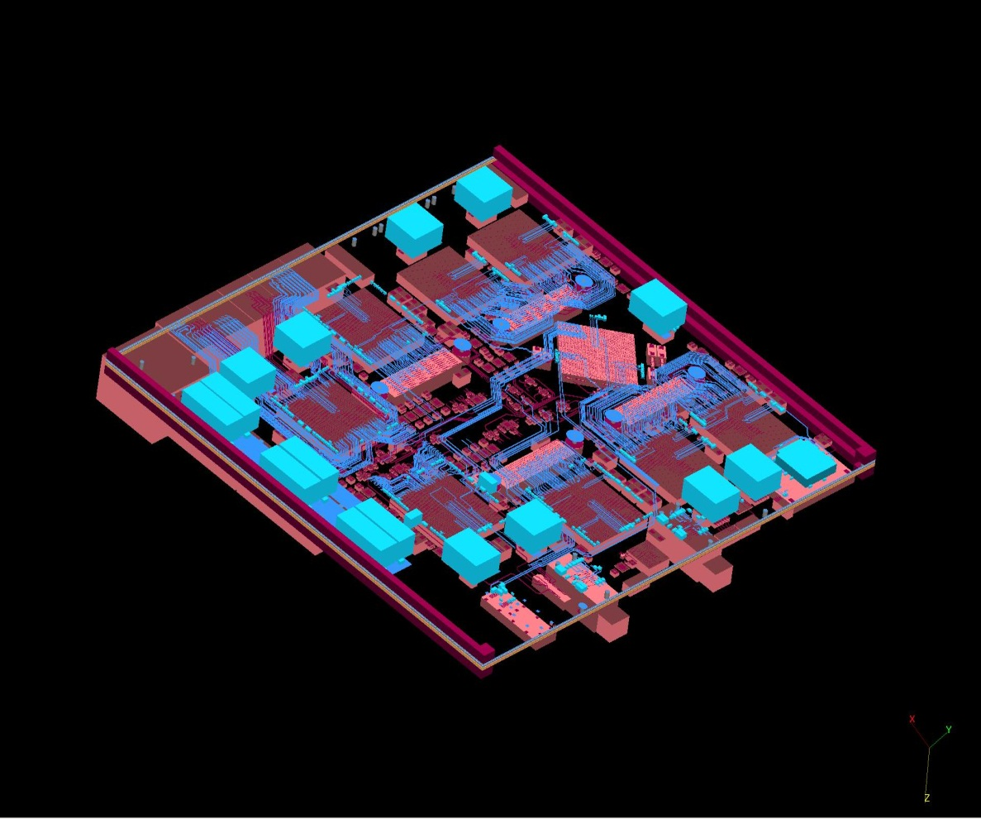
real GOLD

Slide 5
GOLD history
As reported last time already:
Module originally planned for ca. 8 x 6VLX550T with opto backplane connection only
Converted to a mixed scheme 6VLXT / 6VHXT (6.5/10Gbps)
Added electrical backplane connectivity in zone 2
Learned about power consumption of Virtex 6 → re-design of on-module power distribution
Currently designing for ~450W per module
Difficult to find power converters with small footprint, high current and a lead time below 40 weeks

Slide 6
Just a few issues with the tools…
Mainz (Bruno) used to Cadence design tools for 10 years. Designs have got more complex since.
Tools have apparently not kept pace:
It is not possible to turn differential pin pairs of a device single ended. Need to be defined during initial creation of device symbol – that strongly limits the capabilities of an FPGA to resolve routing issues at board level, if both differential and single ended lines are used in a design
Autorouting differential pairs is basically impossible since automatic pin swap is not supported on differential signals. With given signal layer count (9) autorouter stopped at 50% unrouted signals.
→ GOLD is being hand-routed now !

Slide 7
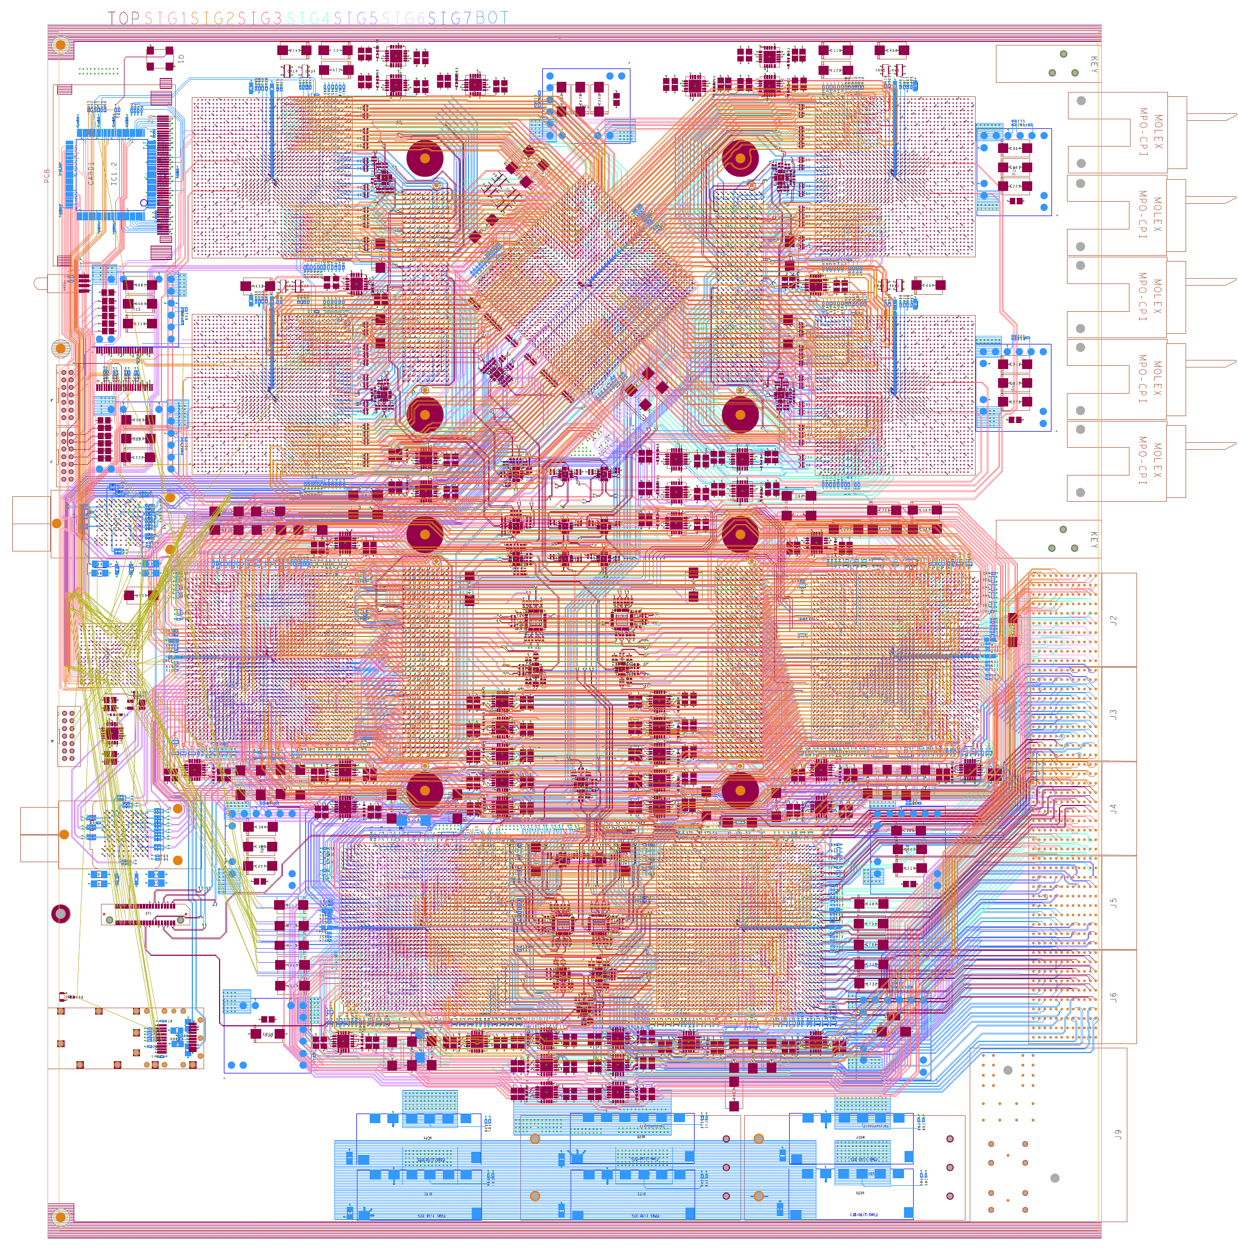
Routing

Slide 8
GOLD status
Schematics and layout well under way
Xilinx 6VLXT waiting on the shelf
Xilinx 6VHXT not yet available
2 daughter modules (opto link module and clock module) will have to be designed
Decided against SNAP12 devices due to lack of availability
AVAGO 10Gb/s 12-channel optos (2*T, 2*R) have been purchased
Some further GOLD related activities at MZ:
Reinhold working on 6U VME serialiser for GOLD module control via VME bus
Andi has been successfully fighting link latencies on a V5: reduction by ~1 bunch tick when giving up 8b/10b encoding and reducing payload

