Slide 1
Fast Detector Readout
T. Flick
University Wuppertal
3. Detector Workshop of the Helmholtz Alliance "Physics at the Terascale"
Heidelberg 2010

Slide 2
Overview
Detector readout constraints and strategies
Main concepts nowadays
Limits to tackle
Future ideas and possibilities
Summary

Slide 3
Readout Constraints
The current particle physics experiments record enormous quantities of data.
Accelerators serve very high event density (LHC aim: 40 MHz collision rate, O(20) events /bunch crossing, O(1000) tracks to be recorded)
The future development aims for even higher rates or beam intensity to provide more data within a shorter time at even higher energies. Fast tracking will become more and more important for trigger decisions.
BUT: Data which is not read out is lost and therefore useless
Therefore the readout system must be fast and reliable
To be used even in the innermost sub-detector of big detector system it also must be designed as low mass and low power devices and to be radiation hard
Since the readout channels are many the communications channels are very dense: Avoid cross talk

Slide 4
Concepts in Use
The standard readout system are today Optical links
  Array based or single channel
  Different wavelength and components possible
    850 nm -1510 nm
    single mode or multi mode transmission
Different bandwidths due to detector types
  Few ten Mb/s up to several Gb/s
Commercial / self made devices
  Radiation tolerance
  Power and material budget
FE-Electronics
TX
RX
RX
TX
Off.Det.
Readout
Electonics
Notes:
Optical link scheme
Some pics

Slide 5
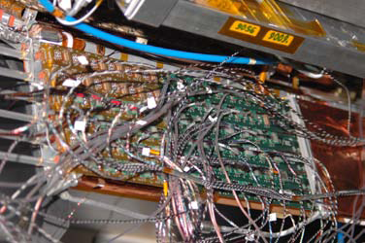
Limits to tackle
Maximal data rate
  Usable bandwidth
  Contingency for peak data rates
  Overhead for encoding schemes or error checking
Space limits
  Not much space in the innermost parts of detectors
  Redundancy
Technology limits
  Power consumption
  Radiation hardness
  Mass
Modularities
  Data transmission channels per readout device vs. serialisers and multiplexers
Typical space situation
inside the detector
Notes:
Pictures: SQP Optoboards

Slide 6
Next Readout Generations
Situation today:
  High bandwidth (Gb/s) links, very few radiation hard components
    Telecommunication around 60 Gb/s already
  Lower bandwidth O(100 Mb/s) is radiation tolerant
Next developments under test or design will reach a 5-10 Gb/s data transmission bandwidth (even in radiation hard designs)
Several R&D projects are under investigation spread all over the world
  GBT / versatile link (CERN + several groups worldwide)
  Modulated light signals (i.e. ideas at NIKHEF)
  Wireless readout (i.e. Upsalla University)

Slide 7
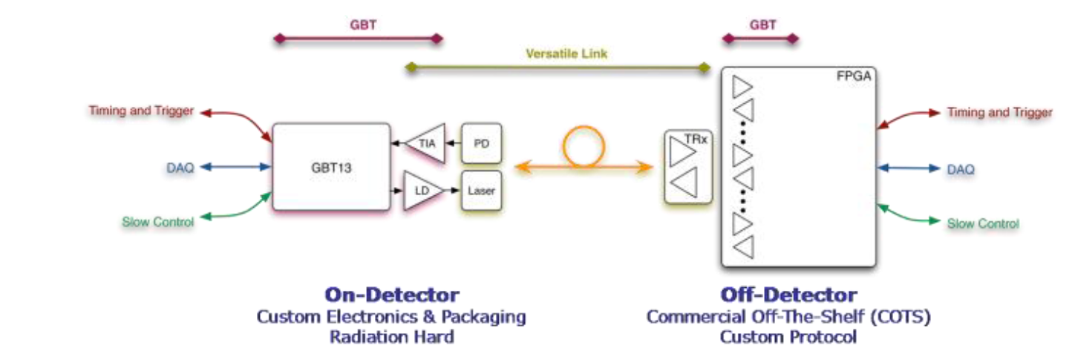
GBT / Versatile Link
Idea GBT: Provide at common receiver / driver for on- and off-detector usage for as many experiments as possible.
4.8 Gb/s electrical implementation for a TTC and data link
  3.2 Gb/s usable bandwidth for data
  Rest for error checking, encoding, …
Consists of trigger link, DAQ link and slow control link
Custom made chip set on detector side, FPGA based implementation off-detector
GBT is the electrical part of the link
Needs to be connected to a fast optical link

Slide 8
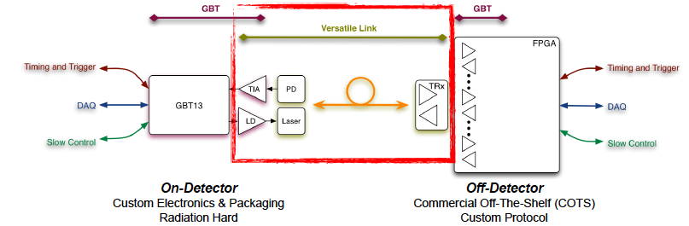
GBT / Versatile Link
Idea Versatile Link: Provide a fast and radiation hard optical for as many experiments as possible
Studies for radiation hardness for all components underway
  To qualify up to the inner tracker levels
850nm and 1310nm versions
Commercial opto components with custom drivers and packaging
Several architectures
under study:
Point to Point
Point to Multipoint

Slide 9

Modulated Light
For transmission over long distances with high bandwidth (~40 Gb/s) the lasers are not switched anymore.
Light signal is externally modulated (switched)
Switchers (pockets cells) must be fast, small, radiation hard.
First proposals are around to use it in physics detectors
  on-detector modulators are on top of the laser driver → more components as in the standard design.
  Low mass and power needs more study.
Encyclopedia of Laser Physics and Technolo
Notes:
Issues auflisten

Slide 10
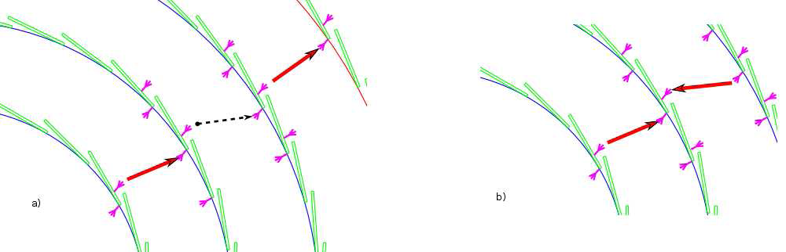
Wireless Detector Readout
Transmission using millimeter waves (invented for wireless computer and television needs, HDTV need 3Gb/s)
Free space communication, realized in 60 GHz band
  Enables small chips 2.5x2.75mm chips, ~150mW power consumption (90nm processes)
  Antennas must be oriented very precisely
Measured with 4Gb/s:
  BER of 10⁻¹¹
Possible to read out independent on detector geometry
Signals do not pass the silicon layers → Reflections
Interlayer „Cluster“-finding
Reflections and high
channel density are
the main challenges
under study
Studies using commercial
components have been#
started (i.e. Upsalla)

Slide 11
Readout Topic in
Helmholtz Alliance
Several Groups are dealing with readout issues in the Alliance
Several experiments / detectors
Many common questions and problems (also solutions?)
These activities can be supported by the Alliance. Forums to communicate are needed to exchange experiences and work together on common items.
Two topics has been started / initiated lately to get a closer communication between Alliance groups.
  Data transmission test bench (under development)
  Topical workshop Detector Readout Links (planned)
Notes:
Insgesamt ==> Ziel: Staerkung der Aktivitaeten in Dund Organisierung eines Meinungs/ErfahrungsaustauschDie beiden momentanen Planungen dann im Anschluss.Die Test Bench sollte 'dringender' beschrieben werden: 'Produktion'im naechsten halben Jahr (?? oder ist das komplett unrealistisch?)

Slide 12
Readout Link Test Bench
Pattern Generator
Seria-lizer
Optical or electrical transmitter
Data
Generator
Fast Scope
PC
BERT
De-Serializer
Receiver
Opt./electr.
Link
Reference
FPGA board
Complete Transmission Line

Slide 13
Test Bench Purpose
Aim of the setup is to provide a test bench in which each component of the transmission line can be tested.
  Very modular concept
  Data protocol, transmitters, receivers, electrical/optical links can be exchanged to DUT
  Tests in irradiation environments are supported
External devices (Pattern Generator, Scope) for testing of signal quality, jitters, screws, latencies, etc.
  Do not belong to the test bench, but are to be taken from VLDT
The setup is to be done using commercial devices and serves as comparison benchmark

Slide 14
Status
Since no positions have been financed for this the development work is going in parallel to the “normal” lab-work
HD (LHCb / U. Uwer): Working on a test card for irradiation (10k funding 2010)
  Board has most of the functions (FPGA firmware) on it, which are need for this setup: Data generations, transmission/receiving, comparison
  Test of different optical components
W (ATLAS / P. Mättig): FPGA firmware for data transmission and receiving (10k funding in 2011)
  Encoding / Decoding schemes
  Phase adjustments
  Duty cycle controls
  Optical components test
DESY (ATLAS / I. Gregor): Will be the central place for keeping the setup (10k funding in 2012)
  Development / Production work to come
No expensive devices will be bought (Pattern Generator / Scope) → to be used from from the Alliance pool (VLDT)
Hardware production should start in first half of 2011

Slide 15
1. Topical Workshop of the Helmholtz Alliance for Detector Readout Links
Will take place in Wuppertal
2 days in week of 14.-18. February 2011
Topics:
  Overview of institutes involved in detector readout links
  Transmission bandwidths, what is useful, what is possible
  Implications on detector performances
  Technology items:
    Radiation tolerance
    Power budgets
    Radiation length
  Techniques for data transmission
    Protocols
  Trigger (Fast Tracker, ROI, …)
Invitation and announcement will follow soon
Many groups have
Expressed their
interest / support

Slide 16
Summary
Fast detector readout systems are to be driven to the next generation to satisfy needs for higher luminosity machines, higher detector occupancies and fast trigger decisions
Several R&D projects are underway world wide
Two possibilities to strengthen the Alliance groups have been started
  Support by common infrastructure (test bench)
  Providing a forum for discussion and knowledge sharing

