Slide 1
L1Calo – towards phase II
Mainz upgraders :
B.Bauss, V.Büscher, R.Degele, A.Ebling, W.Ji, C.Meyer, S.Moritz,
U.Schäfer, C.Schröder, E.Simioni, S.Tapprogge
Current L1Calo
Some technicalities : Latency and data duplication
Strawman for phase 2
04.04.2011 14:31

Slide 2
Prologue: the L1Calo trigger rates…
Simulations suggest horrible increase of calorimeter trigger rates with rising luminosity for current trigger scheme. What can we actually do about that ?

Slide 3
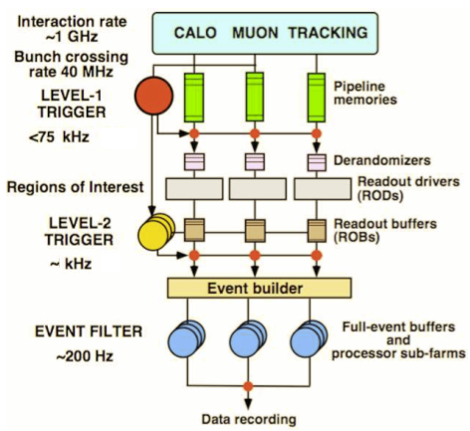
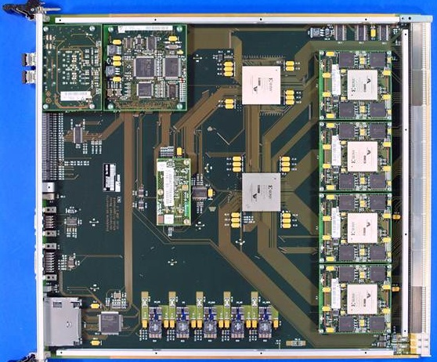
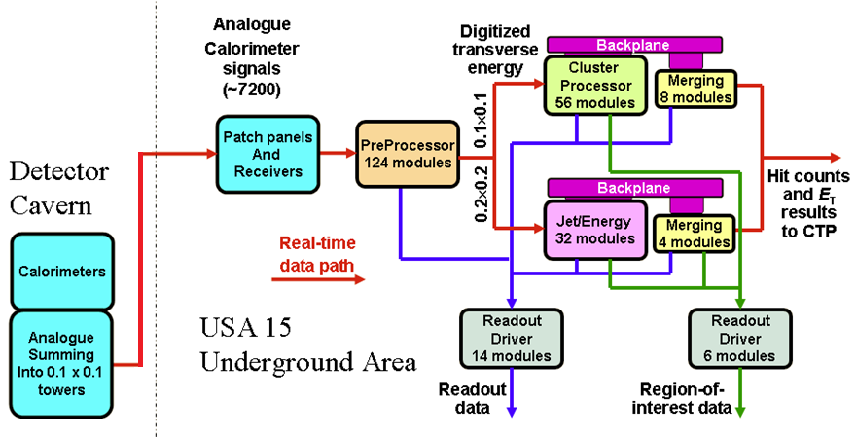
ATLAS Trigger / current L1Calo
L1
Jet/Energy module
µ
calo
CTP

Slide 4
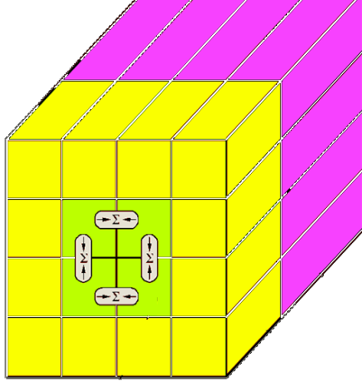
Current and future L1Calo
Analog signals transmitted off the detector (0.1×0.1) η,φ
Pre-Processor: ADCs, digital filters, baseline/gain/linearity, bunch crossing identification
Digital processors:
Sliding windows for jet and em cluster extraction, data consolidation by thresholding and counting objects
Global results determined by summation on daisy-chained merger modules (CMMs)
Final results of object count and total and missing E_{T} sent to Central Trigger Processor
Phase 0/1 (i.e. from 2013/14 !):
Improve pre-processing (new MCMs)
Increase digital processor backplane bandwidth to extract topology, replace mergers (CMM++)
Add topological processor stage, include muon data
Phase 2 : complete replacement of L1Calo
sliding window

Slide 5
Latency, data duplication, data paths …
Total latency currently limited to c. 2.5 μsec
Cables
Serialisation / de-serialisation on module/chip boundaries
Processing
Sliding windows algorithms require duplication of data across processor module and crate boundaries
All L1Calo real-time data transmitted electrically : analogue, 480 Mb/s serial, 40/80/160Mbps parallel
Data duplication by mixture of forward duplication (zero latency) and cross-module communication (1.x BX +)

Slide 6
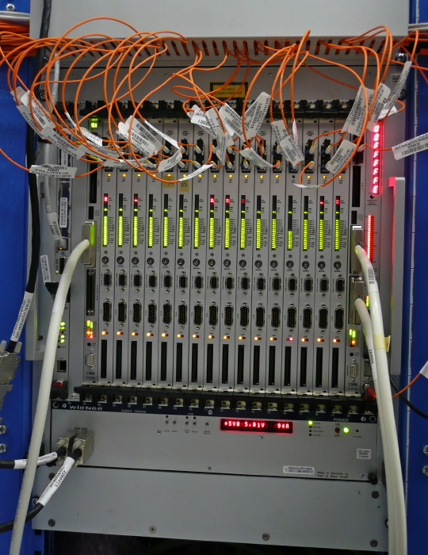
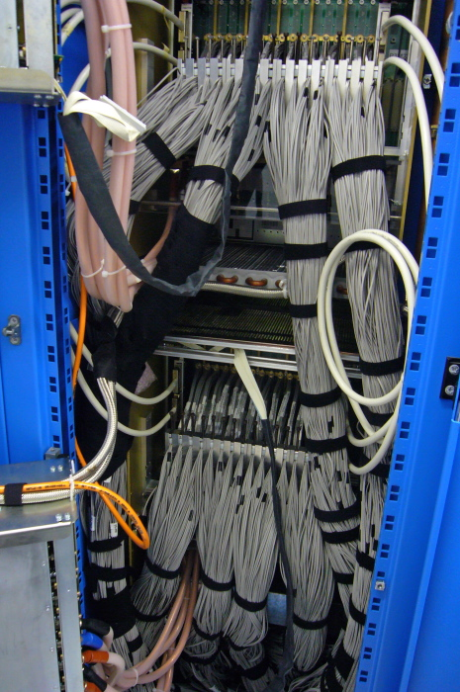
The horror lurks behind…
Jet/En. processor
Jet/Energy processor
Pre-processor

Slide 7
Upgrade : Go optical
Phase 0/1/2 upgrades will be based on optical interconnect
Latency issues will not disappear by miracle
Accept inherently higher latency per high speed link
Increase system density by use of FPGA-internal Multi-Gigabit Transceivers (MGTs)
Partition the system such that excessive de-serialization/re-serialization is avoided
Optimize the data replication scheme
Explore options for latency reduction on the FPGA

Slide 8
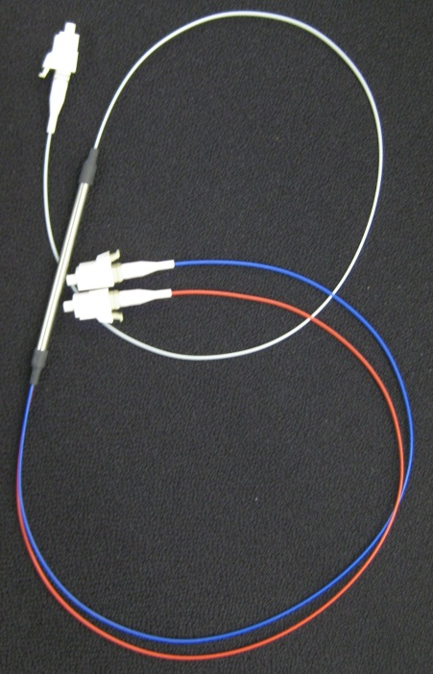
Data replication
source
Do not share any data between modules of same subsystem to avoid additional SerDes latency
sink
Forward data replication only:
Duplication at source
Mirror a link
Assemble a different stream optimised for the replication
Optical splitter (fibre coupler)

Slide 9
Phase 2
Latency impact on Phase 2 design…
3.2 μs latency insufficient for track trigger
Probably needs seeding
Current favoured solution is a two stage system L0 and L1
Level 0
low latency, synchronous (“real-time”) trigger system
input to L0Calo goes digital (LAr and Tile)
includes Topo processing + muons
send RoIs to region-based track trigger
L0 accept at ~500 kHz (?)
Level 1
includes calorimeter, muon and track trigger
might run asynchronously
higher latency (to be defined)
possibility of HLT-like algorithms

Slide 10
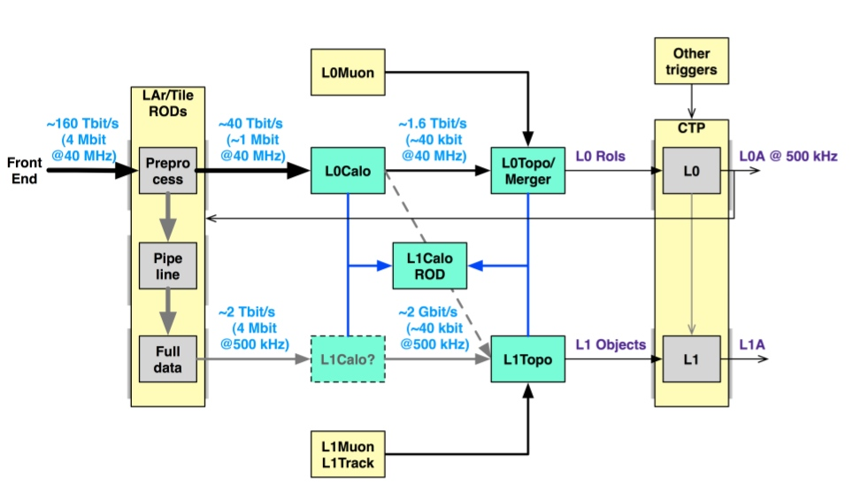
…some old slide on… Phase 2 !
« Once the calorimeter readout is replaced … in 20xx … »
High granularity trigger data provided on optical links
New sliding windows processor with optical interfaces only
Synchronous low-latency L0 plus asynchronous L1
Murrough Landon, 2010

Slide 11
…as of last week (R.Middleton)

Slide 12
Cont’d…

Slide 13
From 2013/4 ?

Slide 14
Some (almost) final words
https://indico.cern.ch/getFile.py/access?subContId=3&contribId=2&resId=1&materialId=slides&confId=133899
And some initial questions (in random order, more to come)
How do we get muons into topo processors? What data volume ? Timeline ?
Sector logic
MuCTPi
How to define the boundary between topo processors and CTPs ?
…
…
…

Slide 15
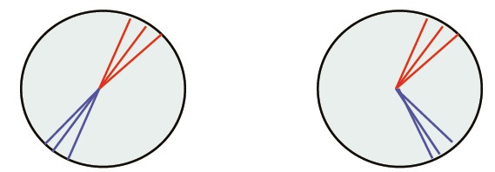
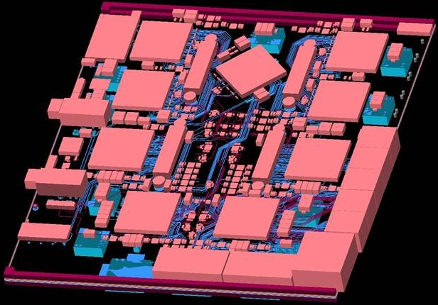
Some current upgrade activities in Mainz
Simulations of topological algorithms at high luminosities (10³⁴ cm⁻²s⁻¹)
Simulation and implementation of new algorithms in VHDL
Improvements on VHDL code for current processors
Design of demonstrator modules for phases 0/1 and 2 → Generic Opto Link Demonstrator
Topological processor (0/1/2)
Phase-2 Level-0 sliding windows processor
Latency optimization
Data replication schemes
FPGA on-chip MGT operation modes and fabric interfaces

