Slide 1
Phase-0 Topological Processor
Uli Schäfer
Johannes Gutenberg-Universität Mainz

Slide 2
Topological Processor
Simulations suggest a need for topological trigger criteria, so as to keep Level-1 trigger effective at high luminosities.
Example algorithms:
Angular correlations (jets, direction of missing energy)
Muon isolation
…
Hardware implementation
→ Need to feed a maximum of data into a
single point (module, FPGA)
Input from L1Calo and Muons
  ~ 1 Tb/s aggregate bandwidth
  Do not partition into multiple modules for reason of latency.
TOPO

Slide 3
Current L1Calo Scheme
PPr
CP
40Mb/s
CTP
analog
480Mb/s
JEP
real-time paths shown only
Mixed Signal Pre-Processor
FPGA based digital “sliding window” processors (e/m cluster, jet/energy)
Object count and global quantities via chained mergers CMM into CTP
Object positions to Level-2 and DAQ only

Slide 4
Phase 0 Scheme
TOPO
Muon
CP
6.4/10Gbps
PPr (nMCM)
CTP
analog
480Mb/s
JEP
real-time paths shown only
New CMX module with two interconnect options
  Chained (legacy and opto links)
  Star topology with all opto links into topological processor
Muon information included on topo processor

Slide 5
… Topology Processor
Input from L1Calo and Muons
  ~ 1 Tb/s aggregate bandwidth
  Fibre optical inputs @ 6.4/10 Gbps per fibre
Output to CTP
  electrical (LVDS)
  fibre optical ~ 1Gb/s +
Interfaces to TTC/GBT/…, Level-2, DAQ, control, DCS,…
Small number of modules (~1)
Probably dedicated crate, near CTP
Have started upgrade programme
2010 : 6.4Gb/s data source BLT in CP/JEP crates
to live in CMM slots → CMX
2011 : Topo processor demonstrator GOLD
→ 2013/14 topological processor commissioned in USA15

Slide 6
Phase-0 Topo Processor floor plan
front panel connectors
opto
Z3
Z3: opto connectors for real-time input
12-chan
M
Mezzanine connector
Z2
Z2: electrical connectors
A / B FPGAs XC7VX690T-FFG1927
A
B
Power supply and control
Z1
AdvancedTCA
322x280 mm

Slide 7
Bandwidth / Algorithms / Latency
Baseline two FPGAs per processor
80 Links/FPGA @ 10Gb/s →1.6Tb/s total →1.28Tb/s payload
Preliminary data formats for jet and cluster processors:
96*(14*8+32) bit @40 MHz => 553Gb/s
For muon data assume data volume comparable to current MUCTPI input: 16*13*32 bit @ 40MHZ =>267Gb/s
Plus ε (energy, ?)
Some level of data reduction on the CMX is being considered
One or two FPGAs per processor seem appropriate
Dependent on processing resources required for algorithms one might wish to duplicate processors
  Forward link duplication for latency minimisation
  Multiple processors on module
  Multiple modules in crate

Slide 8
Algorithms
Several algorithms have been suggested:
Jet dφ
Cluster dφ
Muon isolation
Muon MET
Jet/cluster overlap removal
Some have been simulated and shown to be effective
Algorithms require
Sorting of objects to size
Cuts in η,φ
Possibly cuts for absence of objects in given η,φ bin
→ Choose reference algorithm and put in hardware !

Slide 9
Reference Algorithm
Define bandwidth requirements
Determine consumption of logic resources
Determine latency
Baseline device for Phase-0 topo processor is Virtex-7
Target for reference algorithm implementation is Virtex-6
  Xilinx development board now
  - limitations in input channel count, link speed
  GOLD topo demonstrator in a couple of months time
Choose an algorithm that has been physics-simulated in MZ and shown effective: Jet dφ

Slide 10
Jet dφ
Based on preliminary phase-0 JEP backplane data format
32 JEMs × (4 jet candidates × 14 bits + 8 presence bits) → 82Gb/s input bandwidth
Select two largest candidates in a 6-deep sort tree
Feed position information into lookup-table to allow for cuts in η and φ
Report single result bit to CTP
First results on a XC6VLX240T:
8 % of available CLB LUT resources used
5 % of block memory resources used
Algorithm latency, down to the FPGA pin : 3 LHC bunch ticks
But : mind the gap !

Slide 11
Latency
Latency is actually dominated by the MGT links. Including that we
arrive at a total latency :
with buffered transmission scheme : 8 bunch ticks
with phase alignment : 7 bunch
Health warnings:
Latency figures are preliminary, working on reduction
Total latency comprises serialisation from 320Mb/s on CMX, de-serialisation to 40Mb/s on topology processor, and algorithm
Latencies have been calculated from data sheet, obtained from VHDL simulation, and been measured
Measured link latencies have been extrapolated from 3.2 Gb/s to 6.4Gb/s due to bit rate limitations on Xilinx development board
Different partitioning of the sort tree into CMX / topo processor will not affect algorithm latency
“phase alignment” low latency mode has been partially withdrawn / restricted by Xilinx for current devices (errata AR#39430)
Eventually we will want to target Virtex-7 and should therefore deal with Virtex-7 errata rather than Virtex-6 ones

Slide 12
“GOLD” demonstrator / medium term plans
(Full-function) demonstrator for phase-0 topology processor
→ https://indico.cern.ch/getFile.py/access?contribId=19&sessionId=7&resId=2&materialId=slides&confId=112739
ATCA format, modular, optical RTM connectivity @ 6.4 / 10Gbps
L1Calo internal review passed in May
PCB in production / assembly
From 08/’11 available for signal integrity and latency studies
Test bench for topology algorithms
Initial system tests with current L1Calo and CMX prototype
Review input connectivity requirements (including Muons)
Review processing power requirements (algorithm dependent)
Topology processor prototypes in 2011/12, baseline : Virtex-7
Commission production modules in 2013/14 shutdown
Connect up with CMX and CTP
Connect up with muons as soon as muon trigger signals become available
. . .

Slide 13
Backup

Slide 14
The demonstrator : GOLD
Functional demonstrator for phase-0 topology processor
Technology demonstrator for technologies to be used throughout L1Calo upgrade programme, studies on fibre optical connectivity schemes
----->
ATCA form factor
Modular concept
  Mezzanines
  FMC connectors
Optical backplane connectors rather than front panel I/O
Opto/electrical conversion on input mezzanine
Electrical connectivity up to 10Gb/s in ATCA zone 2
Phase-0 topo-specific connectivity
  Provide all interfaces

Slide 15
GOLD floor plan
A-J FPGAs
front panel connectors
A
C
Z3
Z3: opto connectors
Mezzanines
V
E
W
B
D
V – Y : FMC connectors
Z2
F
X
Y
G
Z2: electrical connectors
H
J
Z1
AdvancedTCA
322x280 mm

Slide 16
GOLD - some details
Main board, ATCA sized, 22 PCB layers
FPGAs (Virtex-6 LXT, HXT)
Connectors, sockets for e/o converters
FPGA configurator and local clocks (DAQ/ROI, Ethernet,…)
Main power distribution network (central and POL regulators)
Input mezzanine module, allow for choice of input devices and input signal routing
12 layers, moderate real estate
Sockets for o/e converters, 10Gb/s fanout
Clock mezzanine module
Recover and condition incoming (LHC bunch) clocks
Some limited clock multiplexing and fan-out
Provide additional space for auxiliary components and front panel connectivity

Slide 17
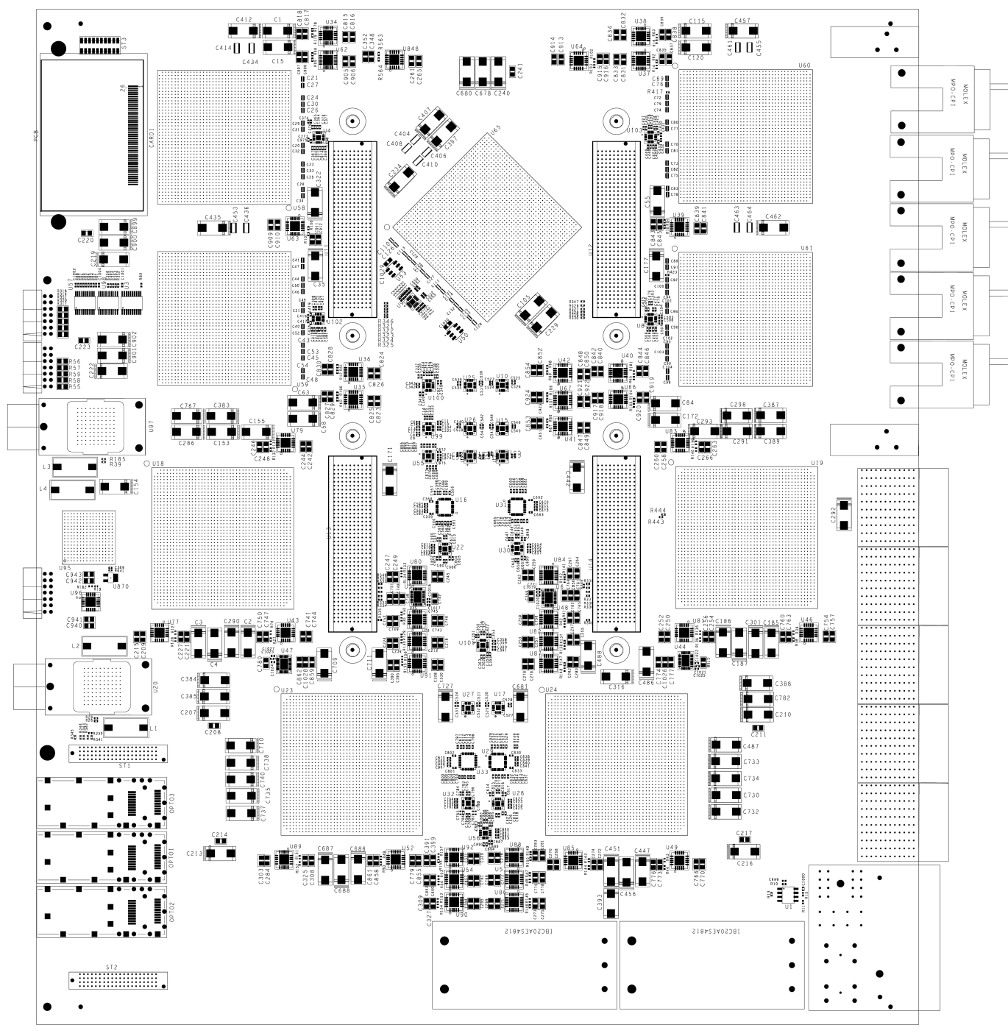
GOLD floor plan
Z3
5 * XC6VLX
(Processor L, main processor M) up to 36 links each
Two pairs of XC6VHX (H) 72 links each
5+ 12-channel optos on daughter
Clock generation
144 multigigabit input links in zone 2 (equiv. 22300 bit / BC)
L
L
M
Opto
L
L
H
H
Z2
890Gb/s
total
H
H
Z1

Slide 18
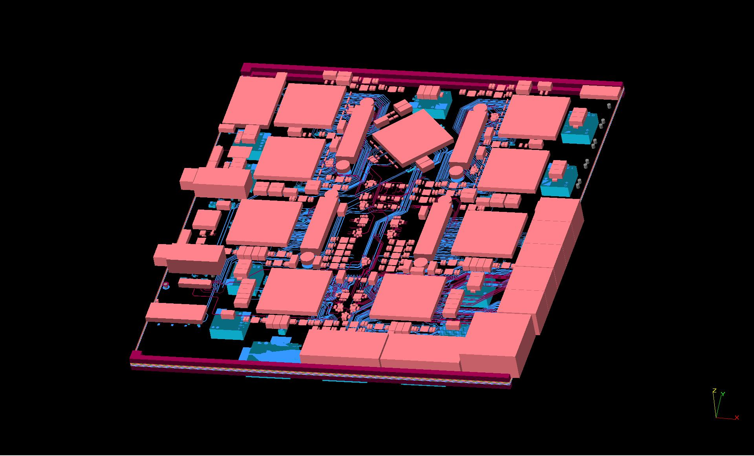
Densely packed, thick module

