Slide 1
Phase-0 topological processor
Uli Schäfer
Johannes Gutenberg-Universität Mainz

Slide 2
Scheme
Block diagram
Algorithms
Latency
Status : GOLD

Slide 3
Topology Processor
Simulations suggest a need for topological trigger criteria, so as to keep Level-1 trigger effective at high luminosities.
Example algorithms:
Angular correlations (jets, direction of missing energy)
Muon isolation
…
Hardware implementation
→ Need to feed a maximum of data into a single point (module, FPGA)
Input from L1Calo and Muons
~ 1 Tb/s aggregate bandwidth
Do not partition into multiple modules for reason of latency.
TOPO

Slide 4
Current L1Calo Scheme
PPr
CP
40Mb/s
CTP
analog
480Mb/s
JEP
real-time paths shown only
Mixed Signal Pre-Processor
FPGA based digital “sliding window” processors (e/m cluster, jet/energy)
Object count and global quantities via chained mergers CMM into CTP
Object positions to Level-2 and DAQ only

Slide 5
Phase 0/1 Scheme
TOPO
Muon
CP
6.4/10Gbps
PPr (nMCM)
CTP
analog
480Mb/s
JEP
real-time paths shown only
New CMX (CMM++) module with two interconnect options
Chained (legacy and opto links)
Star topology with all opto links into topology processor
Muon information included on topo processor

Slide 6
… Topology Processor
Input from L1Calo and Muons
~ 1 Tb/s aggregate bandwidth
Fibre optical inputs @ 6.4/10 Gbps per fibre
Output to CTP
electrical (LVDS)
fibre optical ~ 1Gb/s +
Interfaces to TTC/GBT/…, Level-2, DAQ, control, DCS,…
Small number of modules (~1)
Probably dedicated crate, near CTP
Have started development programme
2010 : 6.4Gb/s data source BLT in CP/JEP crates ✓ to live in CMM slots → CMX
2011 : Topo processor demonstrator GOLD !

Slide 7
Topo processor floor plan
front panel connectors
opto
Z3
Z3: opto connectors
M
Mezzanine connector
Z2
Z2: electrical connectors
A / B FPGAs XC7VX690T-FFG1927
A
B
Power supply and control
Z1
AdvancedTCA 322x280 mm

Slide 8
Bandwidth / Algorithms / Latency
80 Links/FPGA @ 10Gb/s →1.6Tb/s total →1.28Tb/s payload
Jet dφ : 32 JEMs × (4 candidates × 14 bits + 8 presence) → 82Gb/s

Slide 9
The demonstrator : GOLD
Functional demonstrator for phase-0 topology processor
Technology demonstrator for technologies to be used throughout L1Calo upgrade programme, studies on fibre optical connectivity schemes
----->
ATCA form factor
Modular concept
Mezzanines
FMC connectors
Optical backplane connectors rather than front panel I/O
Opto/electrical conversion on input mezzanine
Electrical connectivity up to 10Gb/s in ATCA zone 2
Phase-0 topo-specific connectivity
Provide all interfaces

Slide 10
GOLD floor plan
A-J FPGAs
front panel connectors
A
C
Z3
Z3: opto connectors
Mezzanines
V
E
W
B
D
V – Y : FMC connectors
Z2
F
X
Y
G
Z2: electrical connectors
H
J
Z1
AdvancedTCA 322x280 mm

Slide 11
GOLD - some details
Main board, ATCA sized, 22 PCB layers
FPGAs (Virtex-6 LXT, HXT)
Connectors, sockets for e/o converters
FPGA configurator and local clocks (DAQ/ROI, Ethernet,…)
Main power distribution network (central and POL regulators)
Input mezzanine module, allow for choice of input devices and input signal routing
12 layers, moderate real estate
Sockets for o/e converters, 10Gb/s fanout
Clock mezzanine module
Recover and condition incoming (LHC bunch) clocks
Some limited clock multiplexing and fan-out
Provide additional space for auxiliary components and front panel connectivity

Slide 12
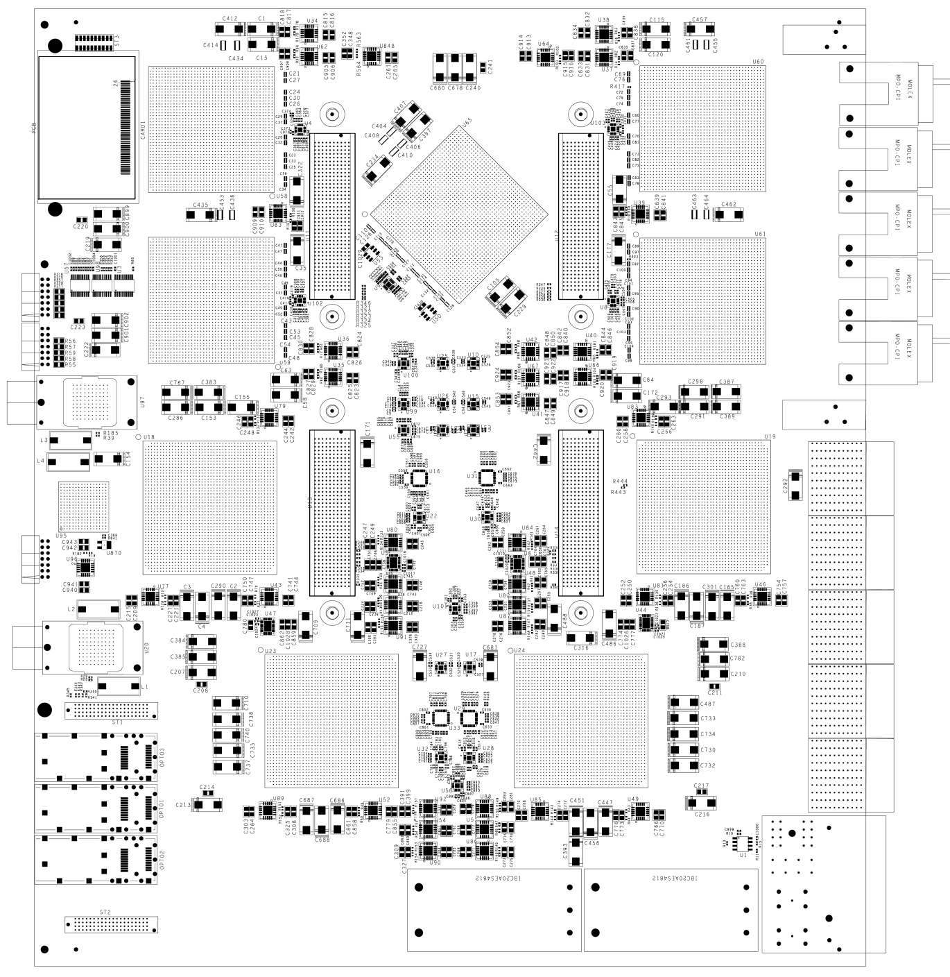
GOLD floor plan
Z3
5 * XC6VLX (Processor L, main processor M) up to 36 links each
Two pairs of XC6VHX (H) 72 links each
5+ 12-channel optos on daughter
Clock generation
144 multigigabit input links in zone 2 (equiv. 22300 bit / BC)
L
L
M
Opto
L
L
H
H
Z2
890Gb/s
total
H
H
Z1

Slide 13
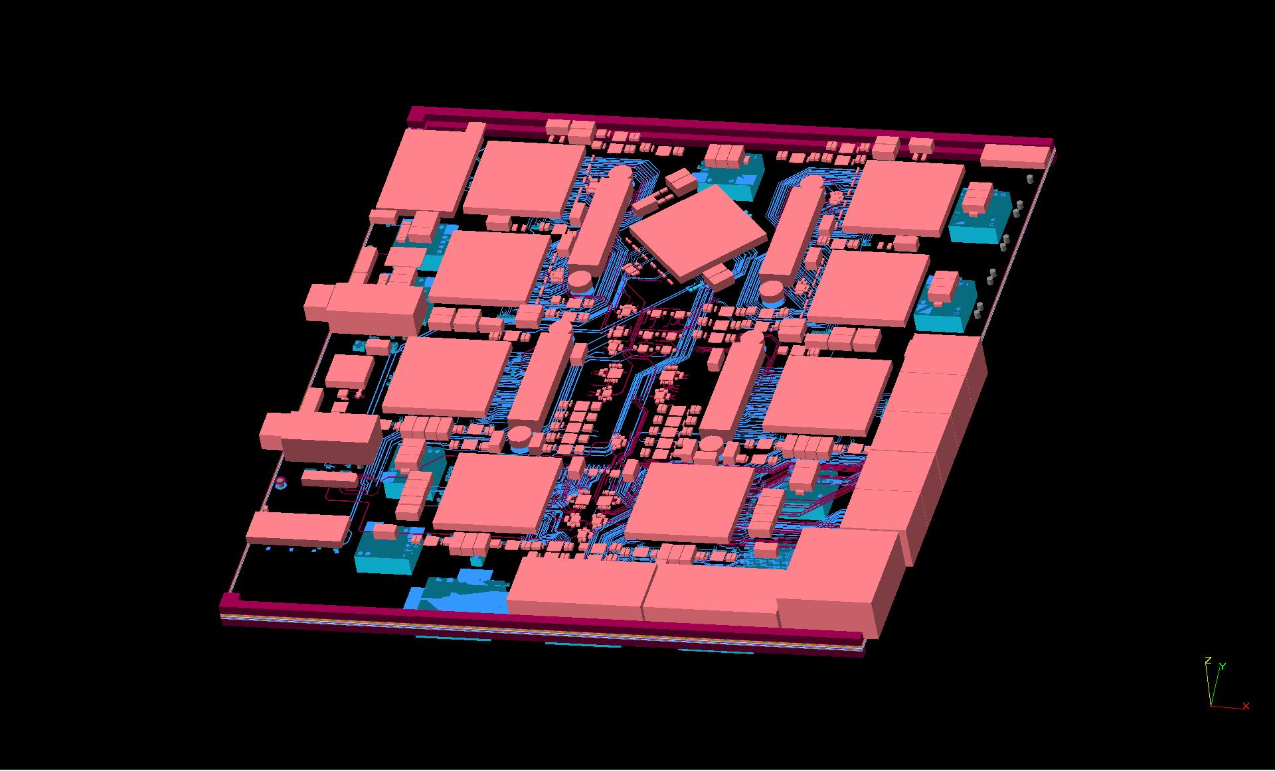
Densely packed, thick module

Slide 14
Production and test programme
L1Calo internal review ✓
Some cleanup & checks on the design (couple of weeks)
PCB production, assembly ~ 2 months
On-going development of service firmware, algorithmic firmware, online software
From July 2011 available for studies on
Signal integrity and data transmission bit error rates
Latency issues
Optical interconnect schemes and link replication
→ Use for
Test bench for topology algorithms
System level tests along with current L1Calo modules and CMX merger module prototypes

Slide 15
Plans for Phase 0 / 1
Start with detailed design work on topology processor prototypes in 2011, pending
Review availability and suitability of FPGA devices : Virtex 7 vs. Virtex 6 HXT
Finalise optical interconnect scheme
Review input connectivity requirements (including Muons)
Review processing power requirements (algorithm dependent)
Commission production modules in 2013/14 shutdown
Connect up with CMX and CTP
Connect up with muons as soon as muon input signals become available
For phase 1 no hardware modifications are currently planned, unless requirements change beyond the ones known by end 2011
However, open for further improvements in next following long shutdown:
→ will continue to explore upcoming technologies (opto links, FPGAs, …) and ready to leverage for possible phase1 project

