Slide 1
GOLD Status and Phase-1 Plans
Andi E. & Uli S.

Slide 2
Phase 0 – GOLD hardware status
All electronic components available
GOLD PCB still with manufacturer
Due July 29
Manufacturing problems with just one (very last) layer
Etching and plating currently not possible at required structure size (75μm)
Reason currently under investigation
Expect delays…
Waiting for further information
Slot to be negotiated with assembly company as soon as new estimate of PCB lead time known
Mezzanine modules (initial test versions) in production
12-channel receive/transmit opto module
Crystal clock module
Uncritical due to different manufacturer and structure sizes
Mezzanine modules to be assembled in-house

Slide 3
Phase 0 – GOLD f/w status
RTDP:
Whole Path implemented!
Latency approximation on Xilinx-Demoboard with half speed test done!
Full-speed-test: when GOLD available!
Trying out possibilities to minimize latency in algorithm and ser-/ deserialization: under work!
Algorithms: Δφ between two biggest Jets implemented & tested!
Control:
VME-- from BLT(in CMX-slot) to all FPGAs on GOLD done!
I²C: FPGA to 12-channel o/e conv. on mezzanine done!
Xilinx IBERT for Multi-Gigabit-Transceivers(MGT) done!
Optimize settings of 12-channel-e/o-conv. and MGTs to get best signals when GOLD available!

Slide 4
Phase 0 – GOLD status
Boundary Scan tool ready!
Software:
Only simple C code with VME--
‘GUI’ for I²C control of 12 channel o/e converter done!
TODO:
Playback & Spy (f/w & s/w), …
Signal measurement with our new oscilloscope on
test-input-mezzanine

Slide 5
Phase 1 – plans : JEP
JEP comprising 32 JEMs
JEM is modular system
Large and empty main board
Seven mezzanine modules
JEP conceived ~ Y2K
Detailed design and production in 2003/6
Expected to run until phase 2 (202x)
Maintenance issue
FPGA design tools / device support (ISE 10.1)
Spare modules and electronic components
Number of spare mainboards seems adequate right now
Mezzanine modules of some concern
Input modules had been rather difficult to procure in sufficient quantities due to production issues
Problems with cleaning / drying procedure after assembly
A few modules had died early
Situation seems stable currently
No experience with long term operation of home built modules yet
Think about replacement JEMs, built in recent technology
Consider different partitioning of functionality into modules

Slide 6
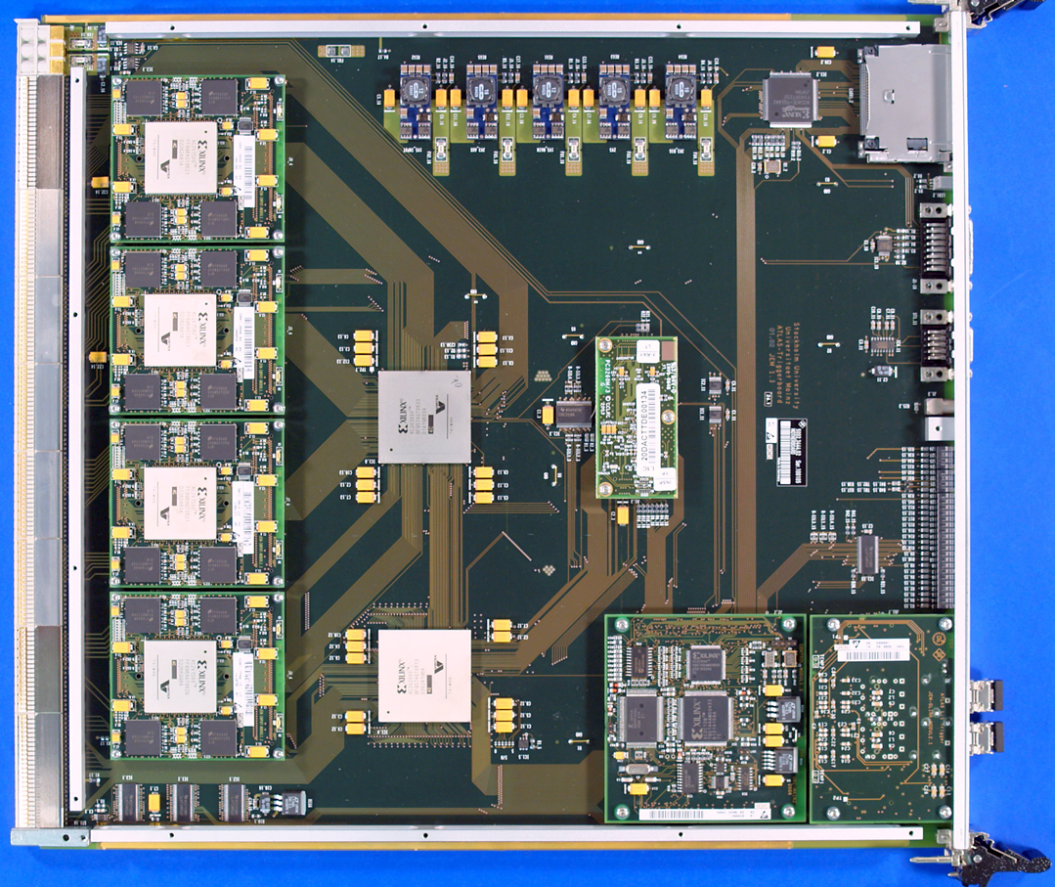
JEM components and data paths
FPGAs and mezzanines
Real-time and DAQ paths

Slide 7
New Jet/Energy processor for phase 1
Minimal approach:
Increase JEM optical output capacity by renewal of low-cost daughter modules
Add option to downgrade JEMs to fixed functionality, non software configurable fibre driver modules via an alternative FPGA configuration
Add new “nJEP” processor next to topology processor module, to receive JEM optical real-time output
Keep current JEP running while nJEP being commissioned
Eventually switch to nJEP based jet trigger
Once LArg signals are available optically at high granularity
Run LArg fibres directly from Digital PreProcessor into nJEP
Use old JEMs for e/o conversion of tile signals only
Replace JEMs with simple and cheap converter modules as further spares are required
In case we were running into a latency crisis, full JEP replacement by o/e converter modules would be effective and affordable
Consider feeding nJEP directly from PPr, at granularity of up to 0.1×0.1 in η×φ
Benefit from improved granularity physics-wise and: once tile optical signals become available, connect them up as well
→ That might be rather phase-2ish already…

Slide 8
Phase-1 upgrade with new JEP
nJEP
Jul. 28, nJEP
optional
tile

