Slide 1
JEM upgrades and optical data transmission to FEX for Phase 1
Andi E. & Uli S.

Slide 2
Phase 1 – plans : JEP
Journey to prehistory:
JEP comprising 32 JEMs
JEM is modular system
Large and empty main board
Seven mezzanine modules
JEP conceived ~ Y2K
Detailed design and production in 2003/6
Expected to run until phase 2 (202x)
Maintenance issue
FPGA design tools / device support (ISE 10.1)
Spare modules and electronic components
Number of spare mainboards seems adequate right now
Mezzanine modules of some concern
Input modules had been rather difficult to procure in sufficient quantities due to production issues
Problems with cleaning / drying procedure after assembly
A few modules had died early
Situation seems stable currently
No experience with long term operation of home built modules yet
Think about replacement JEMs, built in recent technology
Consider different partitioning of functionality into modules

Slide 3
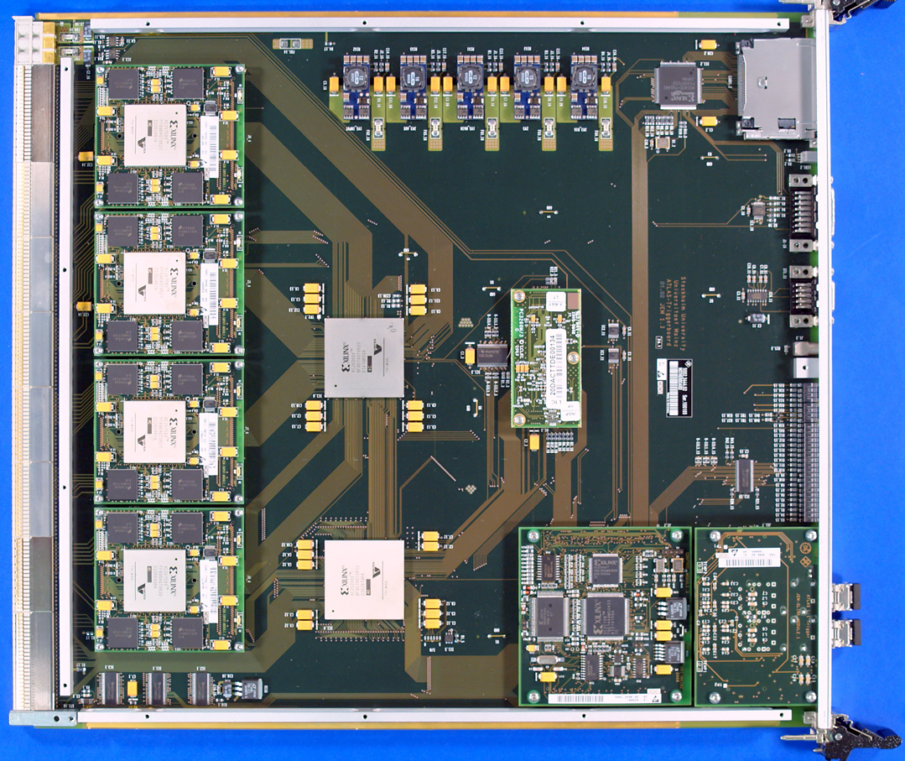
Current JEM : components and data paths
FPGAs and mezzanines
Real-time and DAQ paths

Slide 4
How to renew the Jet/Energy processor…
Initially: Increase JEM optical output capacity (real-time!) by renewal of low-cost G-link daughter modules. Add option to downgrade JEMs to fixed functionality, non software configurable fibre driver modules via an alternative FPGA configuration
Increase hadronic data path bandwidth so as to allow for finer granularity on jet/energy processing (.1×.1)
Options under discussion with Heidelberg
Renewal of JEM input daughter modules incl. electrical ~850 Mb/s input capability
Equalization circuitry
FPGA-internal de-serialization
Bunch crossing demultiplexing (as on cluster processor)
Optical data transmission from current PPr / nMCM
Add feature extractor
Supply with electromagnetic data from Digital PreProcessor
Supply with hadronic data from renewed JEM daughters / nMCM
Several fex options have been discussed: two distinct fex crates, electromagnetic/jet fexes interspersed in same crate/backplane,…
Important:
Keep current JEP running while new hardware being commissioned
Eventually switch to improved jet/energy trigger

Slide 5
Reworked JEM: components and data paths
opto
real-time and DAQ paths
opto

Slide 6
Phase-1 upgrade with new JEP

Slide 7
News from Mainz
Firmware / on-line software:
… Mainz are keeping students busy writing code Large fraction of some initial version of the framework is done. Eagerly awaiting first tests on the real thing…
The GOLD saga:
Production from mid June, 6 weeks lead time…
PCB production had been suspended at manufacturer for couple of weeks due to general problems with electroplating of PCBs with narrow structures
After that problem had been resolved we were promised the PCBs for Sep. 02
Errors found at electrical test
PCBs re-done. Should have arrived by end of last week
Yesterday: PCBs are electrically tested ok. Machined and posted…
→

Slide 8
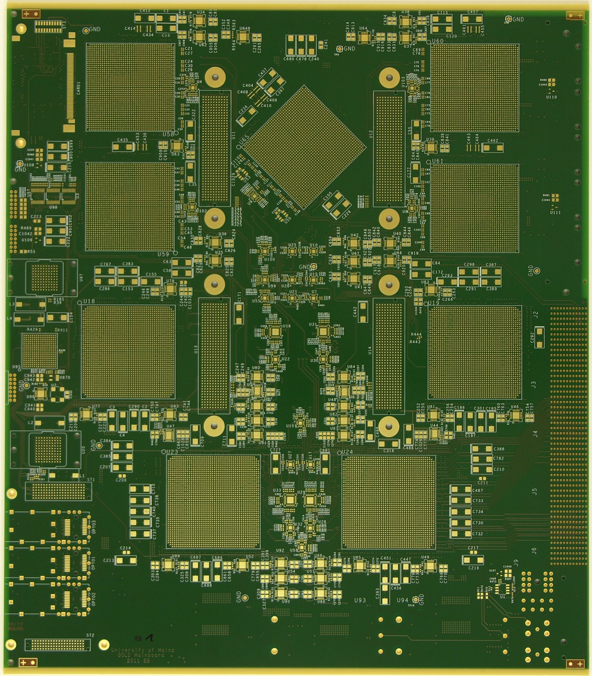
The GOLD ! (the first PCB)
Arrived at 12:00 today
2nd copy had died when being machined
+ 3 weeks for assembly…

