Slide 1
jFEX
These slides are meant to be a basis for discussions on Feb. 08/09

Slide 2
Constraints & Numerology
Assumption: one crate, several modules.
Each module covers full phi, limited eta range
Data sharing with immediate neighbour only, for practical reasons
  sensible baseline is eta coverage of 0.8 per module
  for +/- 3.2 eta coverage we need 8 modules
  maximum environment size of 0.9 in eta
  maximum environment requires 100% duplication !
Each module will carry several FPGAs
  assume 8 FPGAs, covering 0.8×0.8 (η×φ) each
    total of 64 FPGAs for jFEX processor
    compares to total of 32 jet FPGAs for current JEP
    Seems reasonable due to intended improvement on granularity
go for high density optoelectrical components
design for short electrical traces of high speed links
Latency aware

Slide 3
Components for 2018
Conservative approach: plan for devices only that are in the pipeline already now
Large(ish) Virtex-7
  SSI devices have higher latency. Avoid them unless there is considerable benefit in terms of cost
  Plan for XC7VX550T
    Mid range (smaller than the device envisaged for L1Topo)
    Foot print compatible, larger device exists
    Support up to 13 Gb/s (dependent on speed grade/price tag)
    Nothing currently known about possible gaps in line rate range
12-channel opto devices at ~10Gb/s
  can reasonably expect that microPOD will be a viable option by then
  Hope for slight increase in data rate
Expect to use ~48-fibre bundles
Basically design jFEX along the lines of L1Topo, with higher FPGA count and board-level data paths optimised for sliding windows algorithm

Slide 4
Data replication
<< If local design density permits duplication of a small fraction of signals, it will just as well allow for large scale duplication. Just a matter of money >>
No replication of any source into more than two sinks
Forward duplication only
Avoid any data retransmission
Fan-out in eta handled at source only (DPS)
  Try to persuade DPS to do duplication at the parallel end (on-FPGA), using additional MGTs
  Possible fall-back: optical fibre splitting, if optical power budget permits (probably more expensive and bulky than parallel duplication)
Fan-out in phi handled at destination only
  Consider passive electrical splitting of 10Gb/s signals
  Active signal fan-out would compromise design density
  Fall-back: retransmission on parallel links → latency penalty of more than 1 tick (SelectIO SerDes).

Slide 5
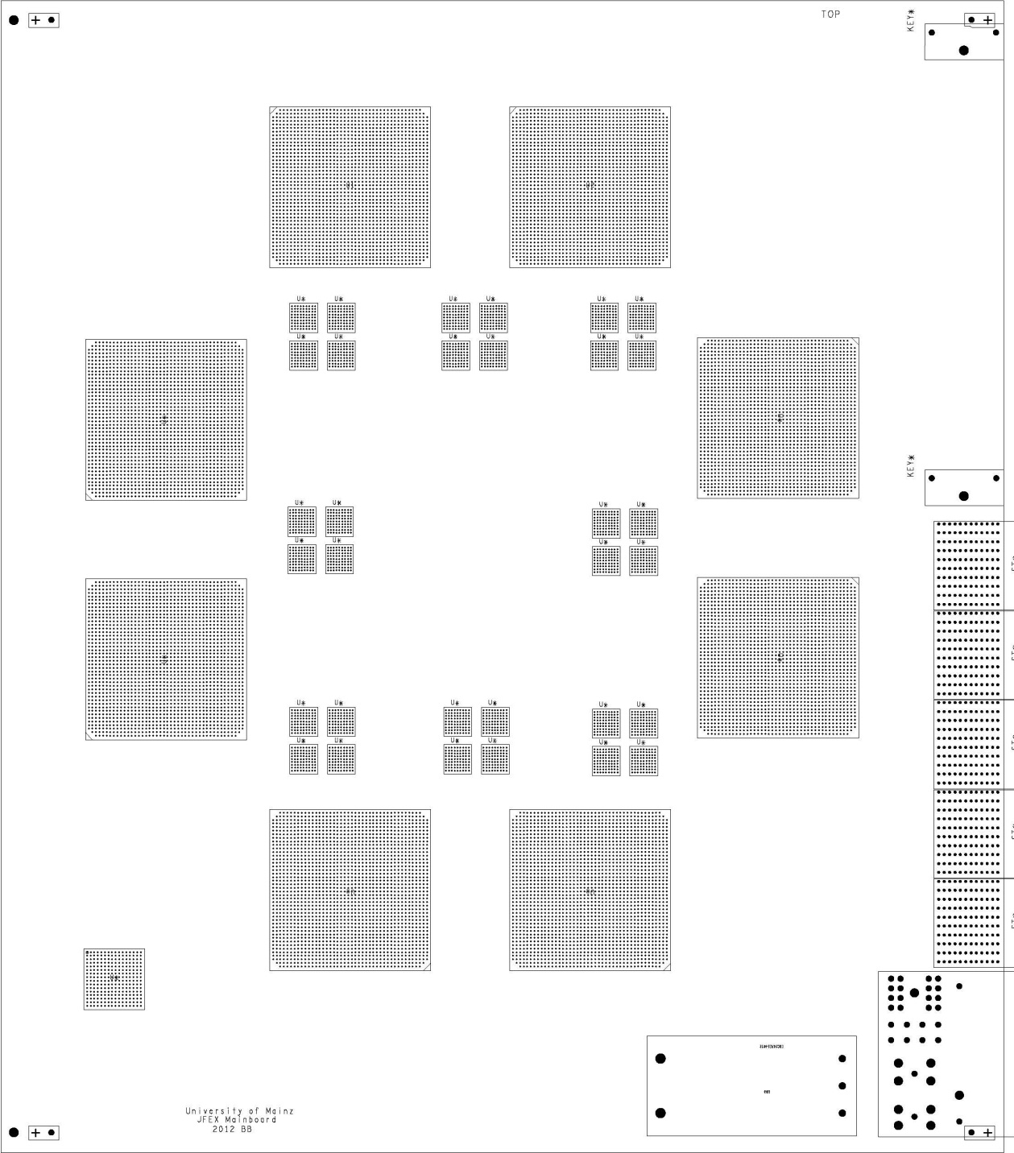
Floor plan of jFEX module
ATCA
8 processors
4 microPODs each
Passive fan-out
Small amount of control logic
Electrical backplane basically unused

Slide 6
Bandwidth vs. granularity
Let’s do the math for the suggested scheme. Go for the extreme. Do a rough estimate:
Environment 0.9×0.9
Each FPGA receives fully duplicated data in eta and phi:
1.6×1.6 worth of data required for a core of 0.8×0.8
256 bins @ 0.1 η×φ
Maximum aggregate bandwidth (payload @ 10Gb/s line rate) of chosen FPGA is 80*8Gb/s=640Gb/s
640/256 Gb/s per bin = 2.5Gb/s, ie. 62 bit
Assuming BX multiplexing, that’s basically doubled to 125bit, that’s probably more than 8 energies per bin
→ We will be able to route highly granular data into the jFEX processor chips, at large environment

Slide 7
Fibre count / conclusion
Due to full duplication in phi direction, exactly half the signals are routed into the modules on fibres
  320 fibres
  27 × 12-channel opto receivers
  7 × 48-way fibre bundles / MTP connectors
The 8-module jFEX seems possible with ~2013’s technology
Allows for both excellent granularity and large environment
Can DPS deliver the required data ?
How to arrive at sufficiently dense fibre contents for phase 2 (eta orientation of tile RODs ?) ?
Is passive electrical splitting feasible ?
→ Start to explore technologies and feasibility soon

