Slide 1
Topology module : status and planning
B.Bauß, V.Büscher, A.Ebling$, W.Ji, U.Schäfer, A.Reiß, E.Simioni, S.Tapprogge, V.Wenzel

Slide 2
The Topology Processor in its habitat
6.4Gb/s fibre bundles
Legacy electrical links
CMX
Cluster Processor
From PPr / nMCMs
Topo Processor
CTP
Core
Fibre links
CMX
Phase 0
Jet/Energy Processor
Muons

Slide 3
Topology Processor
To provide a maximum of flexibility for applying topological trigger criteria
All Level-1 trigger signals in a single module
Allow to correlate all trigger object types within full solid angle
e/m clusters, tau
Jets
Missing Energy
Recently: muon signals in phase 0
Ample logic resources to run many algorithms in parallel
Option to run separate algorithms on more than one topology module in parallel

Slide 4
Topo processor features
AdvancedTCA form factor
High input bandwidth (@ 6.4Gb/s line rate)
Electrons, tau, jets, MET : 553 Gb/s
Muons 267 Gb/s
Total aggregate bandwidth 820 Gb/s
Low processing latency on real-time path
On-FPGA multi-gigabit links
High density 12-channel opto transceivers (10Gb/s)
Fibre bundles from CMX
Fibre bundle into CTP core
Prepared for phase 1: accept line rates above 6.4Gb/s from future processors (FEXes, muons)

Slide 5
Topology Processor Schedule
2010
2011
2012
2013
2014
Technology Demonstrator (BLT)
Functional Demonstrator (GOLD)
Prototype
Production module
GOLD delivery
Production prototype
Installation
Production Completed

Slide 6
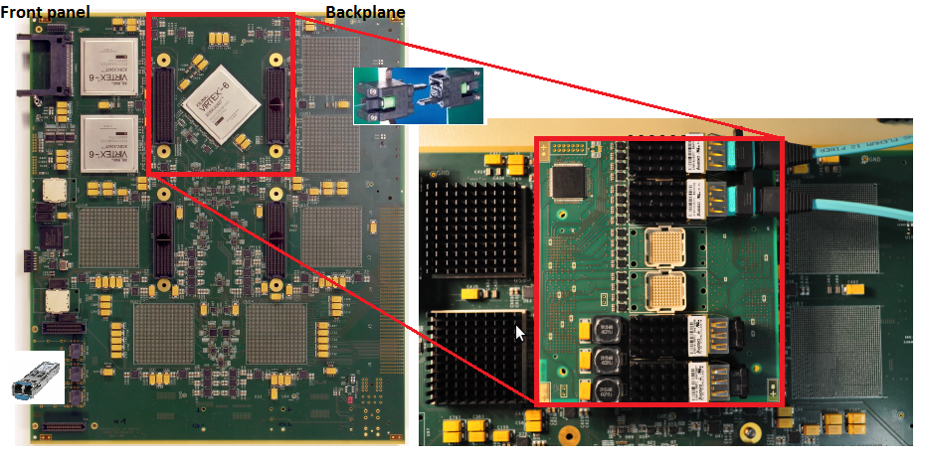
Functional Demonstrator : “GOLD”
Input from the backplane (up to 72 fibres per bundle)
10Gb/s 12-channel o/e converters on mezzanine
High performance FPGAs (XC6VLX240T) with multiple 6.4Gb/s transceivers
Output from opto links on the front panel towards CTP

Slide 7
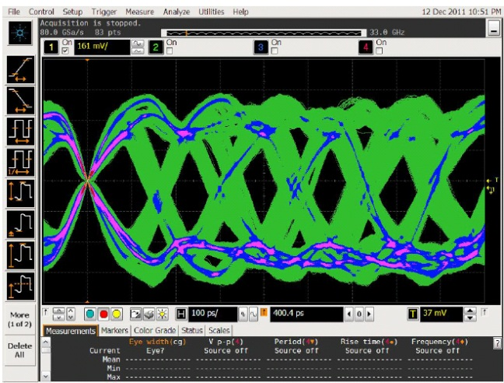
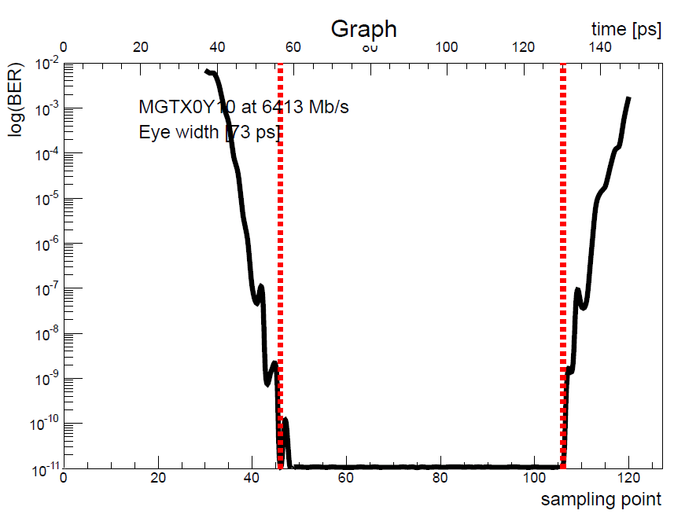
GOLD : first tests and results
PCB partially assembled
Smoke test / boundary scan
Fibre loopback tests
Signal integrity (eye diagrams, eye scan)
Transceiver parameter optimisation
→ Successful @ 6.4Gb/s, BER < 5e-16
Initial set of service- and algorithmic firmware exists
Latency optimisation:
Used to be 7-8 ticks including MGTs
Recently: n-input parallel sort tree (n*(n-1)/2) comparators → ~ 1 LHC bunch tick for full jet channel count

Slide 8
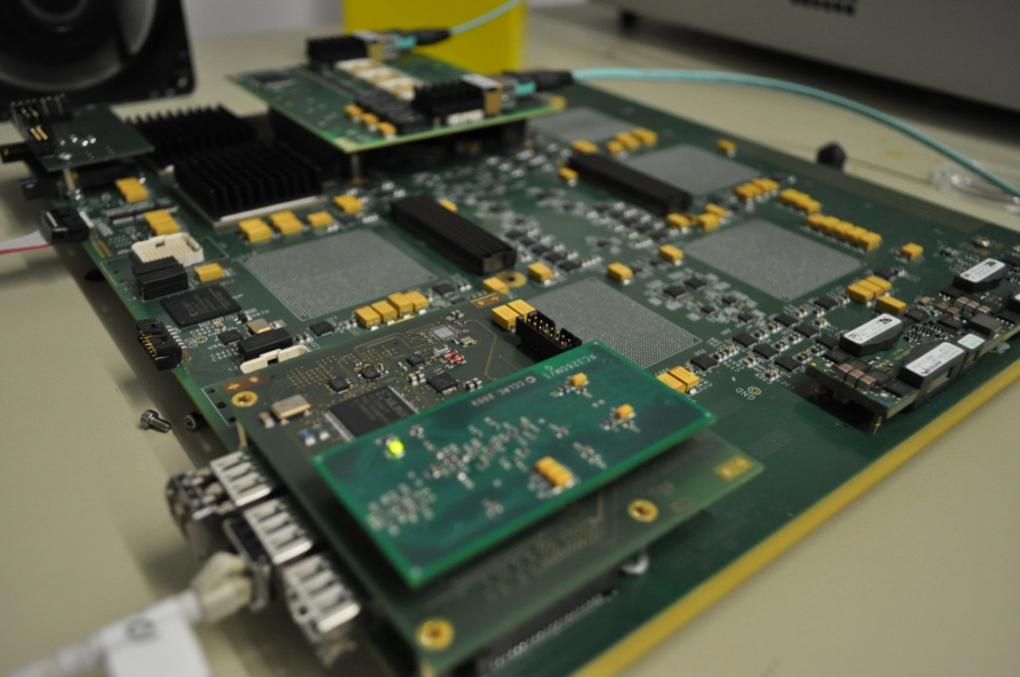
GOLD : some current activites
Convert Gigabit links to LHC synchronous operation
TTCrx daughter
Jitter cleaner
Systematic tests on all electrooptical data paths
Look into multi-fibre connectors (MTP/MPO up to 72 fibres) / attenuation
Latency, latency, la….
TTCdec/TTCrx
TTC optical in

Slide 9
Topology Processor Schedule
2010
2011
2012
2013
2014
Technology Demonstrator (BLT)
Functional Demonstrator (GOLD)
Prototype
Production module
GOLD delivery
Production prototype
Installation
Production Completed

Slide 10
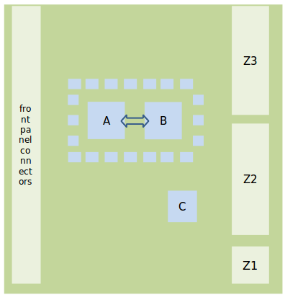
L1Topo prototype design
Fully ATCA compliant
Minimize FPGA count
2 * XC7V485T → XC7V690T
1 XC7K325T (C)
Short multi-gigabit traces
High-density mid- board o/e converters (miniPOD) on main board
No on-board electrical duplication of real-time signals
Require upstream duplication
From CMX
To CTP

Slide 11
L1Topo : Milestones
Specifications for prototype under way:
30.05.2012 design review
29.09.2012 prototype layout finished
01.12.2012 production/assembly completed
Start preparations for final module production in parallel with prototype module tests. Make prototype module available for initial tests / commissioning @ P1
04/2013 prototype system tests at P1 finished
05/2013 PRR
08/2013 production finished
11/2013 start commissioning at P1
07/2014 commissioning finished

Slide 12
Summary
TP functional demonstrator (GOLD):
Partially equipped and successfully tested
Data path between FPGA and o/e converters works
Parameters optimized at 6.4 Gb/s
Large bit-error free window
Further optimization on high speed link parameters and performance of algorithms in hardware ongoing
TP Prototype:
Design ready, schematic capture in progress
Preparing documents for the review (05/ 2012)
On schedule for installation during shutdown 13/14

