Slide 1
L1Topo : schedule and planning
Uli

Slide 2
Intro
payload up to
160 * 10Gb/s
200GB/s
(half that pre phase1)
payload up to
24 * 5Gb/s
15GB/s

Slide 3
Intro
Allow for any conceivable topological algorithm:
Route a maximum fibre count / data volume into individual module / processor
Bandwidth estimated for Stockholm (2011)
Electrons, tau, jets, MET : 553 Gb/s (pre phase 1)
Muons 267 Gb/s (phase 1)
Total aggregate bandwidth 820 Gb/s
Achievable @ 6.4Gb/s line rate
Bandwidth available for phase 1 with FEXes
twice that @ 13Gb/s line rate
supported by FPGAs
Roadmap for pluggable opto components unknown
Scalable in terms of bandwidth and processing power
FPGA type
Module count
Consider some electrical, low latency real-time path

Slide 4
Schedule
2010
2011
2012
2013
2014
Technology Demonstrator (BLT)
Functional Demonstrator (GOLD)
Prototype
Production module
GOLD delivery
Production prototype
Installation
Production Completed

Slide 5
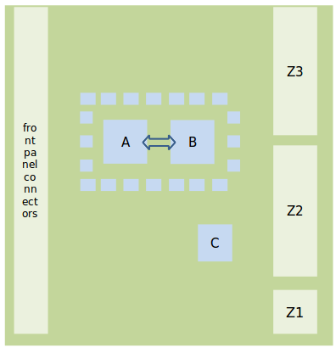
(critical) components…
Design goal: Keep compact, with short traces and no on-board signal duplication
→ require:
FPGAs A, B XC7V485T → XC7V690T
1 XC7K325T (C)
High-density mid- board o/e converters (miniPOD)
High density fibre plant
From CMX
To CTP

Slide 6
L1Topo - next steps
Bruno working on schematic capture
Have L1Topo review, session on June 12 (afternoon) @ CERN
Focus on system issues and interfaces (?)
Reviewers identified
Preparation of documents under way
Will turn up soon at http://www.staff.uni-mainz.de/uschaefe/ATLAS/Topo/
Urgently purchase critical components in JUNE !!!
FPGAs: Virtex-7 and Kintex-7: engineering samples on 1st prototype module, production silicon of XC7V485T thereafter. Final L1Topo production will be with footprint compatible XC7V690T
Opto modules: miniPOD seem to be available at acceptable lead time and cost
Fibre plant: baseline is 48-way MTP to POD octopus cable, again, seem to be available at acceptable lead time and cost
!!!!!
We do not want to separate L1Topo development from FEX R&D → have people talk about components and options NOW i.e. before volume purchase for L1topo proto modules (due mid June)
!!!!!

Slide 7
Schedule

Slide 8
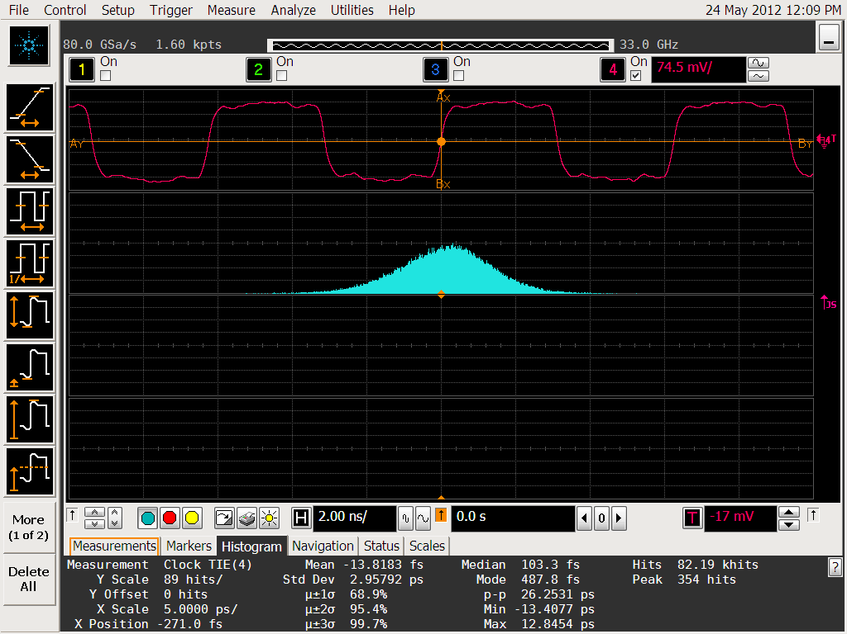
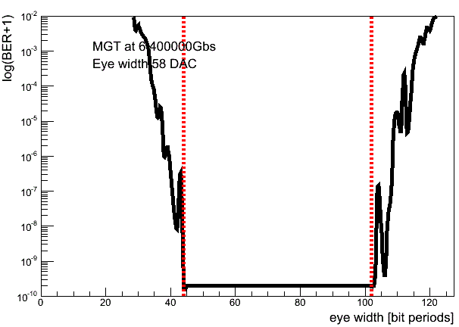
GOLD status / plans
f/w development on-going
Verification of h/w functionality
Jitter cleaner ok, drives MGT successfully @ 6.4Gb/s
Some bug fixes on opto module
Within a fortnight:
Systematic tests on large numbers of input channels
Using jitter cleaned TTC clock
Tune Mainz TTC system for 40.08 MHz operation
By mid June:
PMA far end loopback latency
Algorithm tests on GOLD
Further on: operate miniPODs on GOLD

Slide 9
Summary / outlook
GOLD measurements on-going
L1Topo prototype on schedule
Review mid June
Urgent need for purchase of critical components
Try and converge on opto/electrical equipment for imminent and future processors

Slide 10
Backup / components
Opto modules : single manufacturer, NDA on docs
Choice of device types
Round ribbon vs. bare (flat) fibre ribbon
No heat sink vs. heat sink
Fibre assemblies : probably several manufacturers, documents on the web
Choice of # fibres per POD connector 48
Choice of Round ribbon vs. bare (flat) fibre ribbon
Need to make sure fibre assemblies actually fit the modules
MPO/MTP connector - define gender : male connector on processor side
Can we try and converge very soon ? Rather pointless to go in different directions on various L1 modules.
→ review Jun 12

