Slide 1
L1Topo post review www.staff.uni-mainz.de/uschaefe/browsable/L1Calo/Topo
Observations, options, effort, plans
Uli

Slide 2
L1Topo : some observations
Review on June 12 -- for conclusions wait for the report becoming available.
However:
Real-time bandwidth and processing capacity defined by FPGAs available on the market by 2013. Have chosen largest available devices anyway. There is no alternative to the present design!
L1Topo is a modular processor that allows for optional components on mezzanines without too much impact on main board design.
Large (confusing?) number of options presented in specs
In the review session further options suggested by reviewers
Need to consolidate design while keeping options
Need to flag more clearly what’s on mainboard and what goes to mezzanines
Need to explore impact of options on the required effort : Seems rather obvious in the hardware regime. However, firmware and on-line software affected !

Slide 3
Hardware mods envisaged
Comment on… | Design mod | Impact | on
ATCA compliance | Add base interface and suitable IPMC | Low - need to copy a proven microcontroller scheme | Mezzanine
Module control via embedded processor | Replace Kintex by Zynq (FPGA w. ARM) | Low – both devices are similar. But have to understand Zynq | Mainboard peripherals on mezzanine?
DAQ / ROI | Check bandwidth – probably no h/w mods | ? | ?
MGT reference clocks / MGT rates | Probably add a few more clocks | Low | Mainboard
FPGA configuration | Add SD card | Low | Mainboard

Slide 4
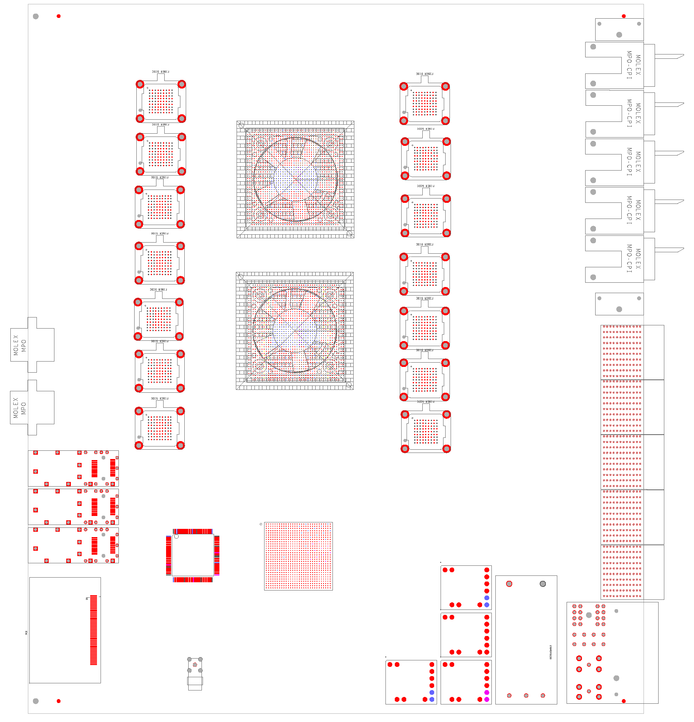
Floor plan, now and then…
RTDP:
High density fibre plant w. 48-way connectors
14 miniPODs for optical input
2 processors XC7V690T
To CTP: miniPOD and low latency LVDS
Control etc.:
XC7K325T → XC7Z045
Add SD-card for configuration and boot
Add memory
Some components not yet placed : CTP /spare PODs…

Slide 5
Firmware, on-line software
Impact of architectural decisions on f/w and s/w might be considerable:
Embedded ROD vs. use of L1Calo ROD
  JEM DAQ interface being converted to L1Topo needs
  Phase-0 DAQ bandwidth dominated by CMX link volume :
  Zero suppressed fmt w. 46 fibres @ 6.4 Gb/s @ 100kHz L1A → ~500 Mb/s per bunch tick being read out,
  1.7 Gb/s/tick for uncompressed data (96bit/processor slot)
  Effort required for embedded ROD cannot be quantified
Ethernet based control / embedded processor / IPbus
  Basic access via serialised VMEbus is available anyway, is in use on GOLD
  Both IPbus and embedded processor are supported by h/w but will require s/w and f/w effort

Slide 6
Effort & needs
MZ figures haven’t changed:
h/w Bruno & Uli
f/w
  Volker W. working on real-time f/w
  ~ 1 FTE of postdocs
s/w – so far none beyond some minimum VME-based control software required for hardware tests / PHD students
Firmware required:
Real-time path
  MGT related stuff
  Some algorithms
Diagnostics and monitoring (playback / spy)
Register map
DAQ
IPbus firmware (for FPGA-based Ethernet option)
Software required:
Some basic software access for h/w tests
HDMC register description (in case of register mapped access)
General software framework for Ethernet based control
Embedded processor software (ARM/Linux) or
IPbus specific software
Microcontroller software (IPMC)
S/W development would be eased considerably if done within L1Calo infrastructure

