Slide 1
L1Topo / post review www.staff.uni-mainz.de/uschaefe/browsable/L1Calo/Topo
Observations, options, effort, plans
Uli
Version 27.06.2012 12:14:34

Slide 2
Intro – LVL-1 2013/14
160 * 6.4Gb/s baseline
(up to 13Gb/s)
12 / 24 * 6.4Gb/s 32 * 1Gb/s LVDS

Slide 3
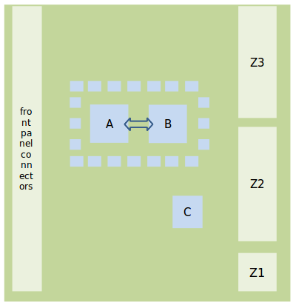
Floor plan, main components…
Design goal : Keep compact, with short traces and no on-board signal duplication
→ require:
2 processor FPGAs A, B: XC7V690T (XC7V485T initially)
High-density mid- board o/e converters (miniPOD)
High density fibre plant
Module control
Kintex (C)
Zynq
Form factor : advancedTCA
From CMX
To CTP

Slide 4
L1Topo : some observations
Review on June 12, report available in EDMS. Quite a few comments on both technical and organizational issues
Some observations:
Real-time bandwidth and processing capacity defined by FPGAs available on the market by 2013. Have chosen largest available devices anyway. There is no alternative to the present design!
L1Topo is a modular processor that allows for optional components on mezzanines without too much impact on main board design.
Large (confusing?) number of options presented in specs
In the review session further options suggested by reviewers
Need to consolidate design while keeping options
Need to flag more clearly what’s on mainboard and what goes to mezzanines
Need to explore impact of options on the required effort : Seems rather obvious in the hardware regime. However, firmware and on-line software affected !

Slide 5
Hardware mods envisaged
Comment on… | Design mod | Impact | on
ATCA compliance | Add base interface and suitable IPMC | Low - need to copy a proven microcontroller scheme | Mezzanine
Module control via embedded processor | Replace / complement Kintex by Zynq (FPGA w. ARM processor) | Low – both devices are similar. Have to understand Zynq. Kintex and/or Zynq ? | Mainboard partially on mezzanine?
Optional PCIe based module control | ? | Low | Mainboard
DAQ / ROI | Check bandwidth – probably no h/w mods | ? | ?
MGT reference clocks / MGT rates | Add a few more clocks | Low | Mainboard
FPGA configuration | Add SD card (on Zynq) | Low | Mainboard

Slide 6
Floor plan, so far…
RTDP:
High density fibre plant w. 48-way connectors
14 miniPODs for optical input
2 processors XC7V690T
To CTP: miniPOD and low latency LVDS
Control etc.:
XC7K325T and/or XC7Z0XX
Add SD-card for configuration and boot
Add memory
Some components not yet placed : CTP /spare PODs…

Slide 7
… and in 3-d

Slide 8
Firmware, on-line software
Impact of architectural decisions on f/w and s/w might be considerable:
Embedded ROD vs. use of L1Calo ROD
JEM DAQ interface being converted to L1Topo needs
Phase-0 DAQ bandwidth dominated by CMX link volume : Zero suppressed fmt w. 46 fibres @ 6.4 Gb/s @ 100kHz L1A → ~500 Mb/s per bunch tick being read out, 1.7 Gb/s/tick for uncompressed data (96bit/processor slot)
Effort required for embedded ROD cannot be quantified
Ethernet based control / embedded processor / IPbus
Basic access via serialised VMEbus is available anyway, is in use on GOLD
Both IPbus and embedded processor are supported by h/w but will require s/w and f/w effort

Slide 9
Effort & needs
MZ figures haven’t changed:
h/w Bruno & Uli
f/w
Volker W. working on real-time f/w
~ 1 FTE of postdocs
s/w – so far none beyond some minimum VME-based control software required for hardware tests / PHD students
Firmware required:
Real-time path
MGT related stuff
Some topology algorithms
Diagnostics and monitoring (playback / spy)
Register map
DAQ
IPbus firmware (for FPGA-based Ethernet option)
PCIe ??
Software required:
Some basic software access for h/w tests
HDMC register description (in case of register mapped access)
General software framework for Ethernet based control
Embedded processor software (ARM/Linux) or
IPbus specific software
Microcontroller software (IPMC)
PCIe ??
S/W development would be eased considerably if done within L1Calo infrastructure

Slide 10
PCB status and components
Detailed design under way
Incorporate some design modifications inspired by review
Initially engineering samples on prototype
1st copy using XC7V485T-2CES – ordered / available soon
2nd copy using XC7V485T-2C – ordered / available Q4, 2012
XC7V690T from 2013
Initial batch of miniPOD trans/ceivers ordered / available soon
With heat sink
For bare fibre connectors
First samples of fibre assemblies (48-way) ordered / being ordered.
POD connector style : for bare fibre
Male MPO/MTP connector
Lead times seem reasonable

