Slide 1
Topology System
B.Bauß, V.Büscher, W.Ji, U.Schäfer, A.Reiß, E.Simioni, S.Tapprogge, V.Wenzel

Slide 2
Topology 2013/14 (RTDP)
6.4Gb/s fibre bundles
Legacy electrical links
CMX
160 /
Cluster Processor
From PPr / nMCMs
12 /
Topo Processor
CTP Core
Fibre & 32 electrical LVDS links
CMX
Jet/Energy Processor
Muons

Slide 3
Topology Processor
To provide a maximum of flexibility for applying topological trigger criteria
All Level-1 topo trigger signals into a single module
Allow to correlate all trigger object types within full solid angle
e/m clusters, tau
Jets
Missing Energy
Small volume of muon signals from 2014
Ample logic resources to run many algorithms in parallel
Option to run separate algorithms on more than one topology module in parallel

Slide 4
Topo processor features
AdvancedTCA form factor
High input bandwidth (@ 6.4Gb/s baseline input rate, 2014)
Electrons, tau, jets, MET : 553 Gb/s
Muons 267 Gb/s
Total aggregate bandwidth 820 Gb/s
Low processing latency on real-time path
On-FPGA multi-gigabit links (MGTs)
High density 12-channel opto transceivers (miniPODs)
Fibre bundles from L1Calo mergers (CMXes)
Fibre bundle and low latency LVDS into CTPcore
Well prepared for phase 1:
accept line rates above 6.4Gb/s from future processors (FEXes, muons)
Employ zero suppression

Slide 5
Topology Processor Schedule
2010
2011
2012
2013
2014
Technology Demonstrator (BLT)
Functional Demonstrator (GOLD)
Prototype
Production module
GOLD delivery
Prototype production
Installation
Production Completed
Review June 12 (report : see EDMS)

Slide 6
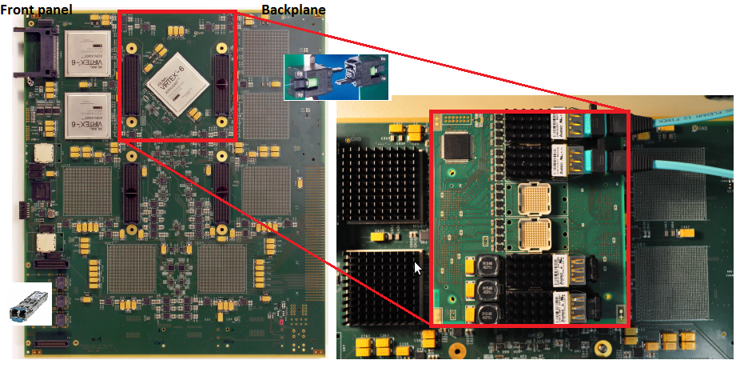
Functional Demonstrator : “GOLD”
Fibre input from the backplane (MTP-CPI connectors)
10Gb/s 12-channel industry standard o/e converters on mezzanine
High performance FPGAs (XC6VLX240T) with multiple 6.4Gb/s transceivers
Real-time output via opto links on the front panel

Slide 7
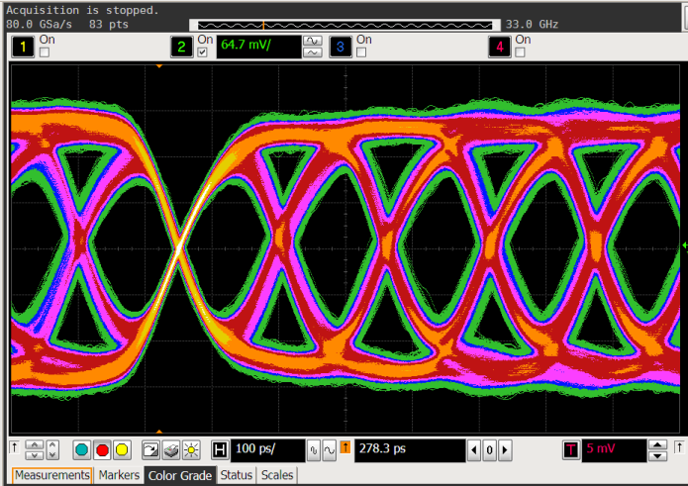
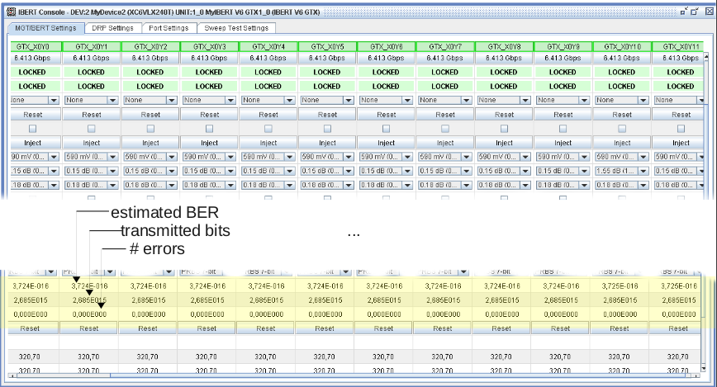
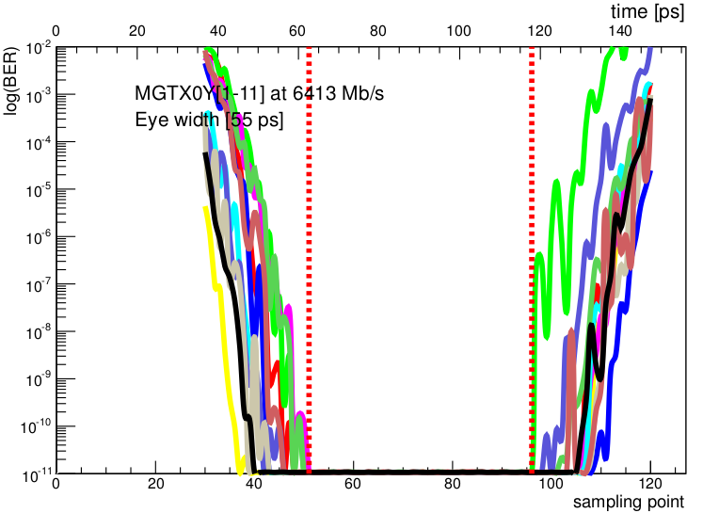
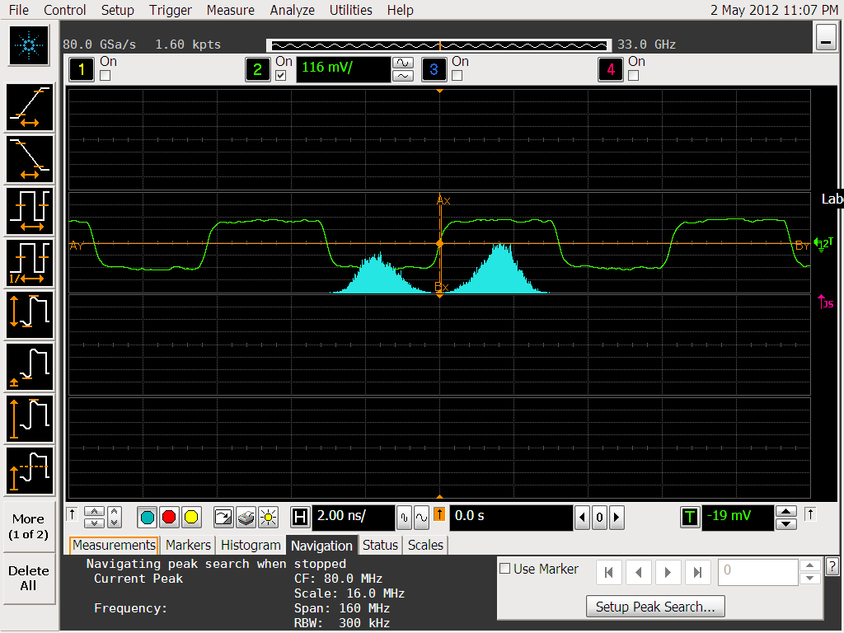
GOLD test results and plans
Characterization of Optical Links
● “MGT/AVAGO” settings
Bit Error Rate (BER) < 10⁻¹⁶ @6.4GBits/s / 12 channels
(conditions on GOLD are tougher, mezzanine connectors and long traces)

Slide 8
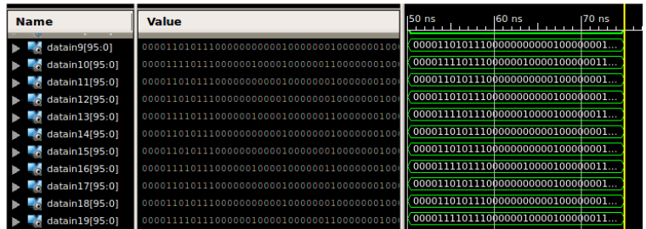
GOLD test results and plans
Current Algorithm Implementation Efforts
● Implementation of dphi Leading Jet Algorithm exists for simulation and hardware in the GOLD
● First estimate of logic usage: about 10% of (small) XC6VLX240T
● Implement toy data source for dphi alg.
Determine Latency
Logic Usage
PMA loop back test
● Prepare existing FW for Virtex-7 as far as possible (L1Topo)
● We continue to use GOLD while prototype is being built

Slide 9
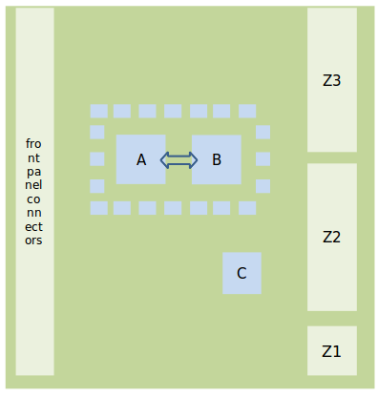
L1Topo prototype - post review
Design goal :
Keep compact for signal integrity, use largest available FPGAs (processing power, input bandwidth)
→ require:
2 processor FPGAs A, B: XC7V690T (XC7V485T initially)
High-density mid- board o/e converters (miniPOD)
High density fibre plant
Module control
Kintex FPGA (C)
Zynq on mezzanine
Form factor : advancedTCA
From CMX
To CTP

Slide 10
Post review : some system level aspects
Require ATCA crate, probably physically close to CTP
Full ATCA compliance including IPMC and base interface on mezzanine module
Real-time path:
Baseline 6.4Gb/s inputs, flexible wrt. rate selection, due to multiple reference clock trees
No on-module data duplication, incoming data might have to be duplicated at source, if required
Low latency LVDS path to CTP to complement optical path
Module control
via VMEbus bridge during initial module development phase
via embedded processor (Zynq) / Ethernet / base interface eventually
DAQ and ROI interface
up to 12 opto fibres (miniPOD)
Hardware to support both L1Calo style ROD interface, and embedded ROD / S-Link interface

Slide 11
Hardware status - floor plan, so far…
RTDP:
48-way opto connectors
14 miniPODs / optical in
add clock trees to support multiple input rates
2 processors XC7V690T
To CTP: miniPOD and low latency LVDS
Control etc.:
XC7K325T and XC7Z0XX
Add SD-card for configuration and boot
Add memory
Some components not yet placed : CTP / spare PODs…

Slide 12
… and in 3-d

Slide 13
Options and Effort
Impact of architectural decisions (as discussed at review) on f/w and s/w:
Embedded ROD vs. use of L1Calo ROD (pre phase 1)
Effort required for embedded ROD cannot be quantified yet
JEM (L1Calo) DAQ interface being converted to L1Topo needs (low effort)
DAQ bandwidth dominated by CMX data : Zero suppressed format @ 100kHz L1A → ~1/2 L1Calo ROD channel worth of data per bunch tick being read out
Ethernet based control / embedded processor / IPbus
Basic access via serialised VMEbus is available anyway, is in use on GOLD
“IPbus” or embedded processor supported by h/w, require s/w & f/w effort
Firmware :
Real-time code being developed on GOLD (MGT and some topo algorithms)
Register map
DAQ
Diagnostics and monitoring (playback / spy functionality)
IPbus firmware (for FPGA-based Ethernet option)
Software :
Some basic software access for h/w tests
HDMC register description (in case of register mapped access)
General software framework for Ethernet based control
(Embedded ARM/Linux or IPbus specific) and IPMC controller software
S/W development eased considerably if done within L1Calo infrastructure

Slide 14
Summary
L1Topo functional demonstrator (GOLD):
High-speed o/e data paths successfully tested
Parameters optimized at 6.4 Gb/s
Large bit-error free windows
Further optimization on high speed link parameters and performance (latency) of algorithms in hardware on-going
L1Topo Prototype:
Design ready, reviewed, schematic capture in progress
A few post-review modifications
Some mods go onto mezzanine module
Critical components ordered / expected on time for production
Considerable effort to go into s/w, f/w, system-level integration
On schedule for installation during shutdown 13/14

