Slide 1
L1Topo Status & Plans
B.Bauß, V.Büscher, W.Ji, S.Krause, S.Maldaner, S.Moritz, U.Schäfer, A.Reiß, E.Simioni, S.Tapprogge, V.Wenzel

Slide 2
Topology 2013/14 (RTDP)
6.4Gb/s fibre bundles
Legacy electrical links
CMX
160 /
Cluster Processor
From PPr / nMCMs
12 /
Topo Processor
CTP Core
Fibre & 32 electrical LVDS links
CMX
Jet/Energy Processor
Muons

Slide 3
Topology Processor
To provide a maximum of flexibility for applying topological trigger criteria:
Maximise aggregate input bandwidth without compromising on on-board RTDP bandwidth
Two high-end processors
820 Gb/s @ 6.4Gb/s (2014 baseline rate)
Jets, clusters, Muons into single module
Allow to correlate all trigger object types within full solid angle
Option to run separate algorithms on more than one topology module in parallel
High density 12-channel opto transceivers (miniPODs)
Fibre bundles from L1Calo CMXes and Muons
Both fibre bundle and low latency LVDS into CTPcore
Some critical circuitry on mezzanine, to allow for later mods
Make use of data duplication at source, if required
Well prepared for phase 1:
accept line rates above 6.4Gb/s from future processors (FEXes, muons)
Employ zero suppression

Slide 4
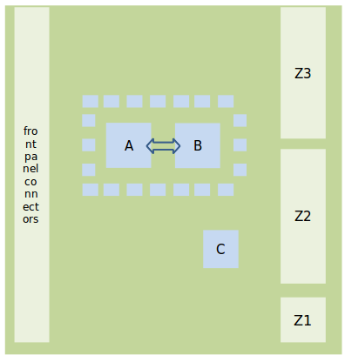
Topo processor details – post PDR
Real-time path:
14 fibre-optical 12-way inputs (miniPOD)
Via four 48-way backplane connectors
4-fold segmented reference clock tree, 3 Xtal clocks each, plus jitter-cleaned LHC bunch clock multiple
Two processors XC7V690T (prototype XC7V485T)
Interlinked by 238-way LVDS path
12-way (+) optical output to CTP
32-way electrical (LVDS) output to CTP via mezzanine
Full ATCA compliance / respective circuitry on mezzanine
Module control via Kintex and Zynq processors
Initially via VMEbus extension
Eventually via Kintex or Zynq processor (Ethernet / base interface)

Slide 5
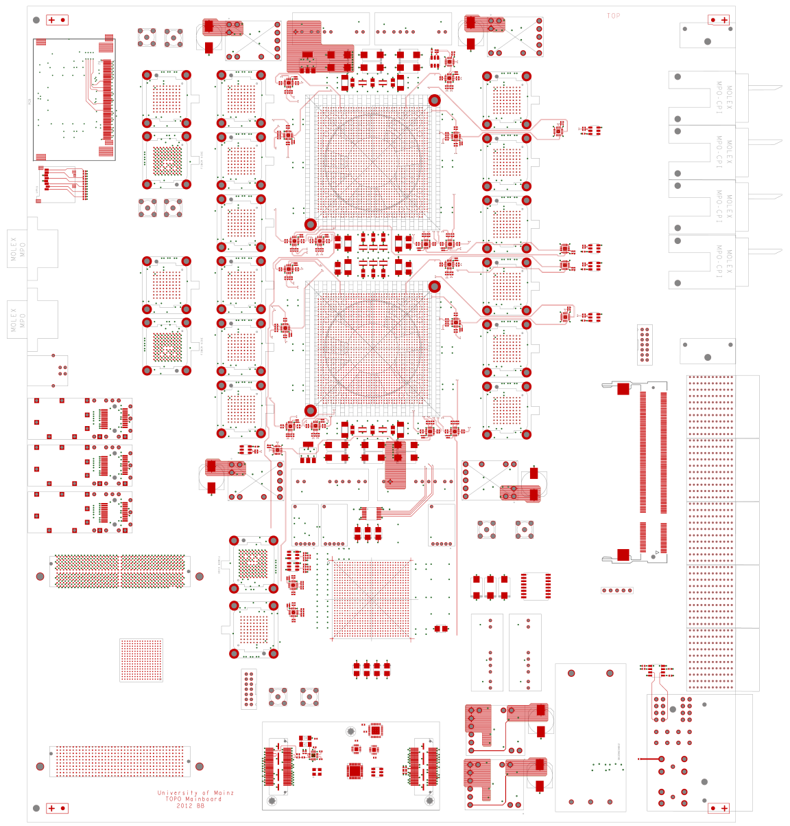
floor plan, so far…
Processor FPGA configuration via SystemACE and through module controller
Module controller configuration via SPI and SD-card
DAQ and ROI interface
Two SFPs, L1Calo style
up to 12 opto fibres (miniPOD)
Hardware to support both L1Calo style ROD interface, and embedded ROD / S-Link interface on these fibres

Slide 6
… and in 3-d

Slide 7
Hardware status
Implemented recommendations from PDR
Schematics near final
Layout done to ~60%
Bruno busy completing design
Some ATCA and module control specific circuitry moved to mezzanine, to be finalized later
Initial version of mezzanine design to be made as soon as L1Topo mainboard out for manufacture
→ Have follow-up to PDR end November

Slide 8
Topology Processor Schedule
2010
2011
2012
2013
2014
Technology Demonstrator (BLT)
Functional Demonstrator (GOLD)
Prototype
Production module
GOLD delivery
Prototype production
Installation
Production Completed

Slide 9
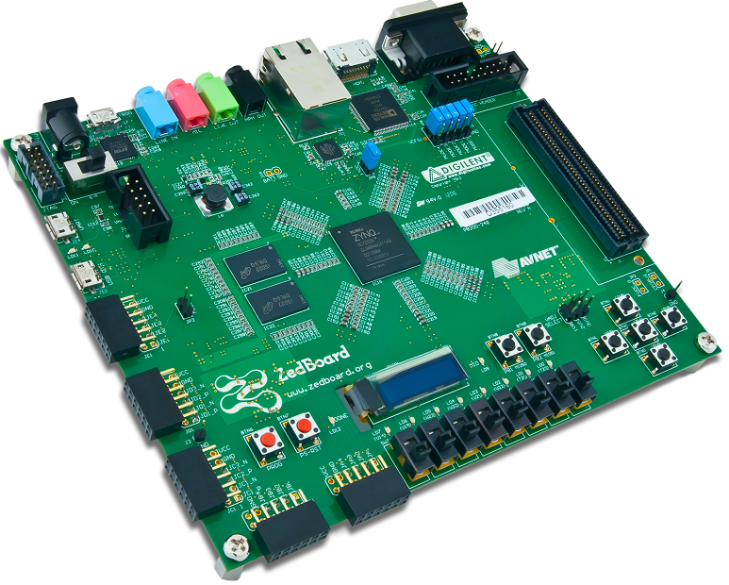
Current activities: module control
Sebastian working on register model (s/w)
Andreas R. making the fibre-optical VME extension more robust (f/w)
Sascha K. started work on Zynq processor (FPGA fabric plus ARM processor)
Device chosen for L1Topo (Mars ZX3) not yet available
Currently using Zedboard to get acquainted to the processor and design environment
Got system up with supplied software (Linux) and firmware images
Got networking into usable state, wildly patching initrd image
Major software development effort using cross compiler tool chain on Ubuntu (see next slide…)

Slide 10
Module control
Almost done !
Now digging at hardware access
Out of the box there is a GPIO interface implemented in the fabric, allowing for some lights to be flashed from Linux command line
Build L1Topo specific hardware interface (VME-like register model ?) in firmware
Attach the interface to the ARM core and write support software
→ need to get used to Xilinx EDK

Slide 11
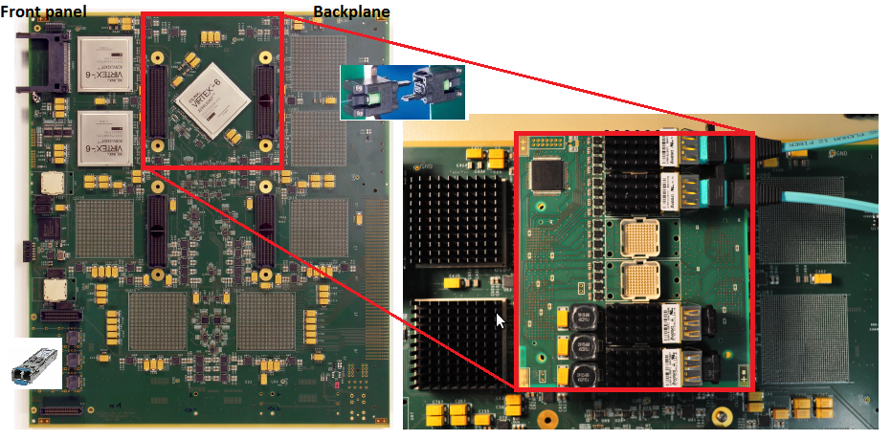
Functional Demonstrator : “GOLD”
Try out technologies and schemes for L1Topo
Fibre input from the backplane (MTP-CPI connectors)
Up to 10Gb/s o/e data paths via industry standard converters on mezzanine
Using mid range FPGAs (XC6VLX240T) up to 6.4Gb/s, 24 channels per device
Typical sort/dφ algorithm (successfully implemented) takes ~ 13% logic resources
Real-time output via opto links on the front panel (currently used as data source for latency measurements etc.)
Will continue to be used as source/sink for L1Topo tests

Slide 12
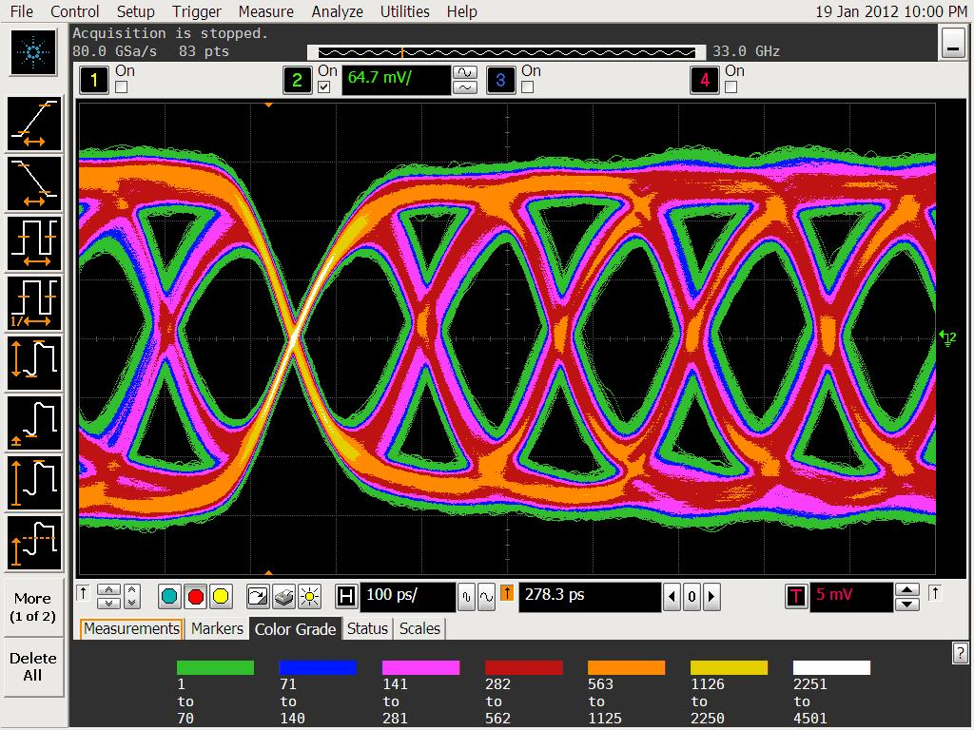
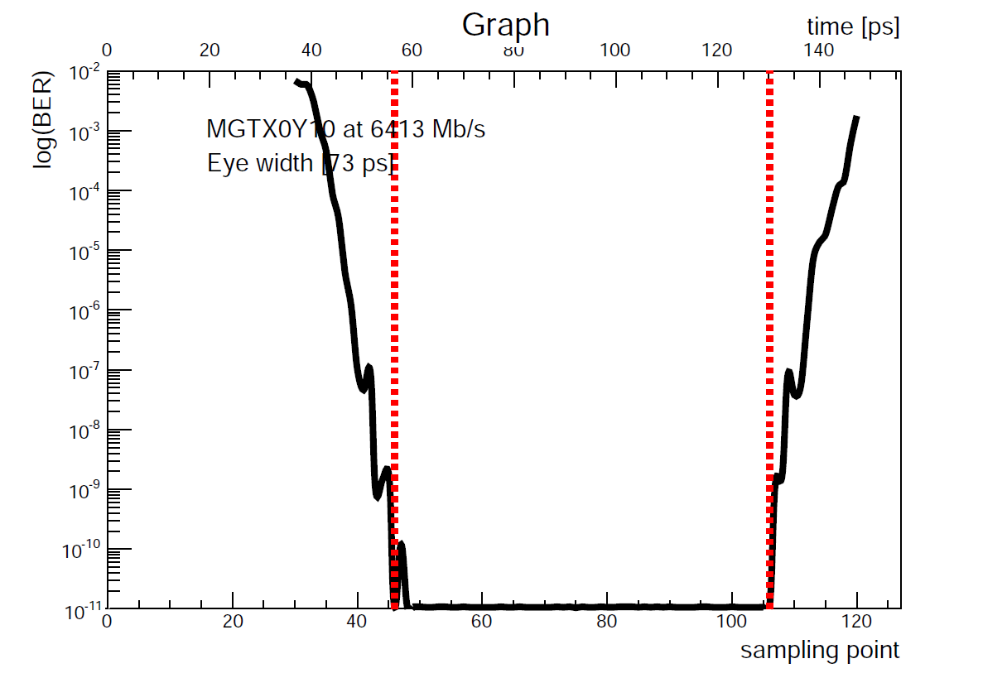
Recent GOLD results (Virtex-6)
Jitter analysis on cleaned TTC clock (σ = 2.9 ps)
Signal integrity: sampled in several positions along the chain
MGT and o/e converters settings optimization
Bit Error Rate (BER) < 10⁻¹⁶ at 6.4 Gbps / 12 channels
Eye widths above 60 ps (out of 156 ps)
Crosstalk among channels measured in some cases but with negligible effect
Sampled after fan-out chip

Slide 13
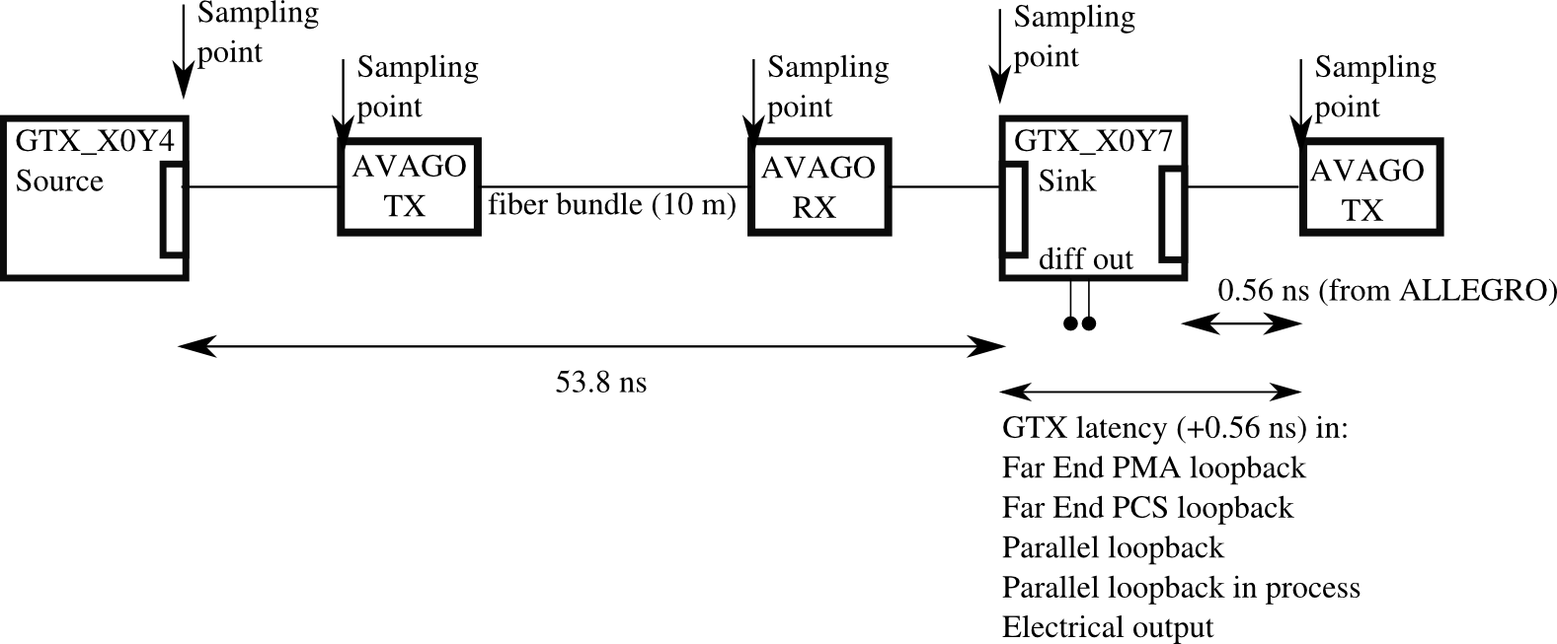
GOLD latency (Virtex-6)
Latency measured along the real-time path in various points at 6.4 Gbs, 16 bit data width, and 8b/10b encoding
Far End PMA loopback: 34 ns latency
Electrical (LVDS) output: 63 ns latency
Far End PCS loopback: 78 ns latency
Parallel loopback in fabric: 86 ns latency
Firmware mod for latency measurement including algorithm, and electrical out towards CTP under way (Volker almost got there…)

Slide 14
Further firmware / tests…
Some CPLD f/w for o/e converters, jitter cleaners, TTCRx control exists for GOLD, being adapted for L1Topo
For initial Virtex-7 tests, VC707 eval board will be used (via SFP) and some firmware needs to be developed to that end
Initial loopback test (single channel) already successful (half day, 0 errors)
BER cores worked out of the box but there are bugs on the ChipScope analyser which prevent to run automatic parameters scans
Since GOLD will continue to be used as source/sink module, some further f/w will be required for V6
Algorithms
Weina updating dφ algorithm to most recent data format
Stephan M. joined group and will work on algorithms
Initially on highly parallel sort with largish number of output objects ?
Expand dφ algorithm to clusters …
Obviously need to move further code onto Virtex-7 asap (in particular for latency tests)
Try to move on to Vivado as soon as it gets stable, and as more effort goes into V7 firmware

Slide 15
L1Topo : Milestones
Specifications for prototype under way:
30.05.2012 PDR
End November prototype layout finished
End November follow-up to PDR
20.02.2013 production/assembly completed
Start preparations for final module production in parallel with prototype module tests. Make prototype module available for initial tests / commissioning @ P1
06/2013 prototype tests finished
06/2013 PRR
09/2013 production finished
12/2013 start commissioning at P1
08/2014 commissioning finished

Slide 16
Summary
L1Topo functional demonstrator (GOLD):
High-speed o/e data paths successfully tested
MGT Parameters tuned at 6.4 Gb/s for large bit-error free windows
Latency measurements taken, activity on-going
L1Topo Prototype:
Design ready, reviewed, schematic capture almost finished
Modifications due to review incorporated
Layout well advanced
Some not yet finalised circuitry to go onto mezzanine module
PDR follow-up in November
Considerable effort going into s/w, f/w, system-level integration
On schedule for installation during shutdown 13/14

