Slide 1
L1Topo Status & Plans
B.Bauß, V.Büscher, W.Ji, S.Krause, S.Moritz, U.Schäfer, A.Reiß, E.Simioni, S.Tapprogge, V.Wenzel

Slide 2
Topo system
Topo processor, post-PDR
Current activities
Some results from Gold
Targeting V7
Zynq
Service firmware
Algorithmic firmware
Hardware status
Timeline
Summary

Slide 3
Topology 2013/14 (RTDP)
6.4Gb/s fibre bundles
Legacy electrical links
CMX
160 /
Cluster Processor
From PPr / nMCMs
12 /
Topo Processor
CTP Core
Fibre & 32 electrical LVDS links
CMX
Jet/Energy Processor
Muons

Slide 4
Topology Processor
To provide a maximum of flexibility for applying topological trigger criteria:
Maximise aggregate input bandwidth without compromising on on-board RTDP bandwidth
Two high-end processors
820 Gb/s @ 6.4Gb/s (2014 baseline rate)
Jets, clusters, Muons into single module
Allow to correlate all trigger object types within full solid angle
Option to run separate algorithms on more than one topology module in parallel
High density 12-channel opto transceivers (miniPODs)
Fibre bundles from L1Calo CMXes and Muons
Both fibre bundle and low latency LVDS into CTPcore
Some critical circuitry on mezzanine, to allow for later mods
Make use of data duplication at source, if required
Well prepared for phase 1:
accept line rates above 6.4Gb/s from future processors (FEXes, muons)
Employ zero suppression

Slide 5
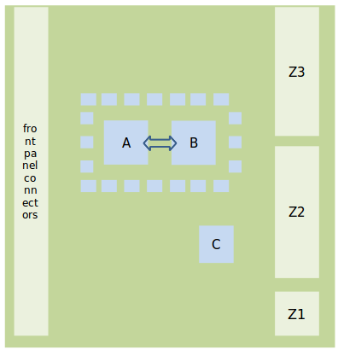
Topo processor details – post PDR
Real-time path:
14 fibre-optical 12-way inputs (miniPOD)
Via four 48-way backplane connectors
4-fold segmented reference clock tree, 3 Xtal clocks each, plus jitter-cleaned LHC bunch clock multiple
Two processors XC7V690T (prototype XC7V485T)
Interlinked by 238-way LVDS path
12-way (+) optical output to CTP
32-way electrical (LVDS) output to CTP via mezzanine
Full ATCA compliance / respective circuitry on mezzanine
Module control via Kintex and Zynq processors
Initially via VMEbus extension
Eventually via Kintex or Zynq processor (Ethernet / base interface)

Slide 6
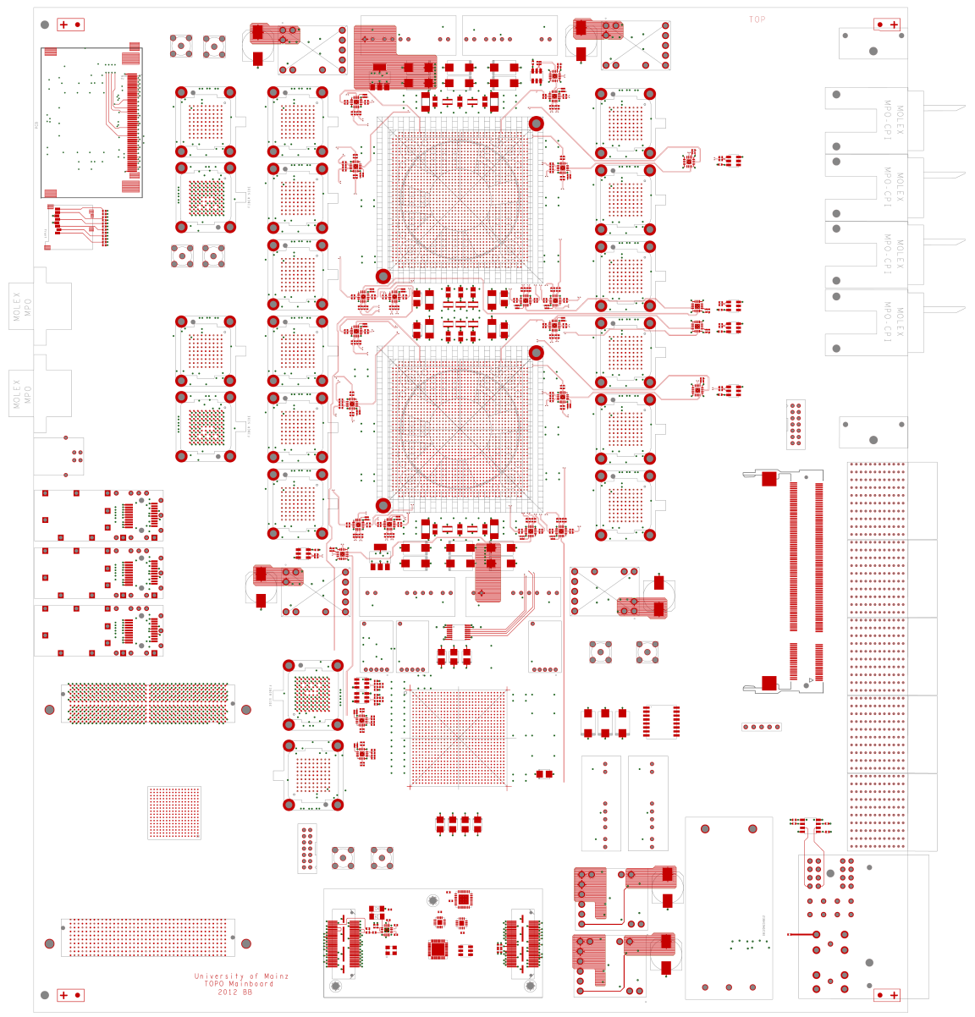
floor plan, so far…
Processor FPGA configuration via SystemACE and through module controller
Module controller configuration via SPI and SD-card
DAQ and ROI interface
Two SFPs, L1Calo style
up to 12 opto fibres (miniPOD)
Hardware to support both L1Calo style ROD interface, and embedded ROD / S-Link interface on these fibres

Slide 7
… and in 3-d

Slide 8
Topology Processor Schedule
2010
2011
2012
2013
2014
Technology Demonstrator (BLT)
Functional Demonstrator (GOLD)
Prototype
Production module
GOLD delivery
Prototype production
Installation
Production Completed

Slide 9
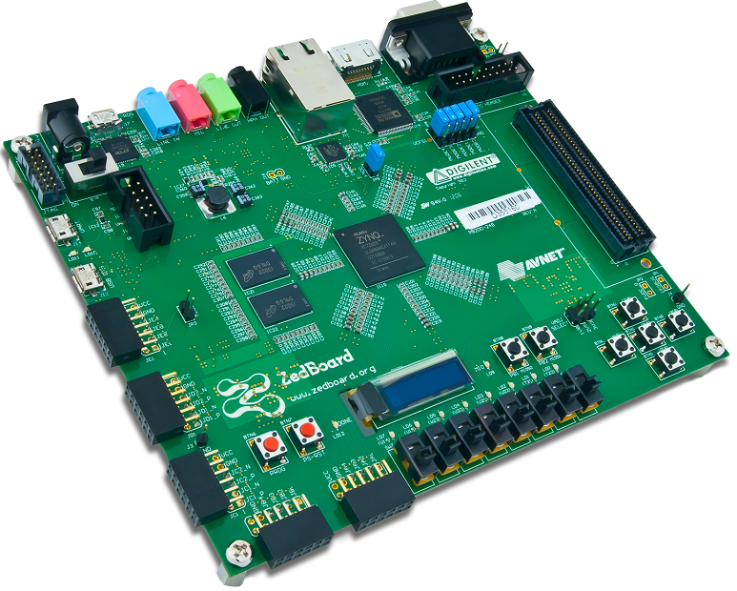
Current activities: module control
Sebastian working on register model (s/w)
Andreas making the fibre-optical VME extension more robust (f/w)
Sascha started work on Zynq processor (FPGA fabric plus ARM processor)
Device chosen for L1Topo (Mars ZX3) not yet available
Currently using Zedboard to get acquainted to the processor and design environment
Got system up with supplied software (Linux) and firmware images
Got networking into usable state, wildly patching initrd image
Major software development effort using cross compiler tool chain on Ubuntu (see next slide…)

Slide 10
Module control
Almost done !
Now digging at hardware access
Out of the box there is a GPIO interface implemented in the fabric, allowing for some lights to be flashed from Linux command line
Build L1Topo specific hardware interface (VME-like register model ?) in firmware
Attach the interface to the ARM core and write support software
→ need to get used to Xilinx EDK

Slide 11
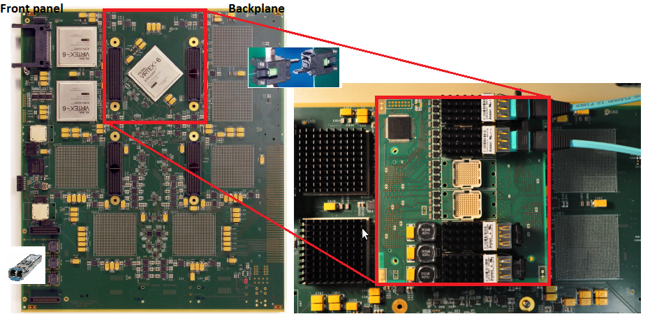
Functional Demonstrator : “GOLD”
Try out technologies and schemes for L1Topo
Fibre input from the backplane (MTP-CPI connectors)
Up to 10Gb/s o/e data paths via industry standard converters on mezzanine
Using mid range FPGAs (XC6VLX240T) up to 6.4Gb/s, 24 channels per device
Typical sort/dφ algo takes ~ 13% logic resources
Real-time output via opto links on the front panel

Slide 12
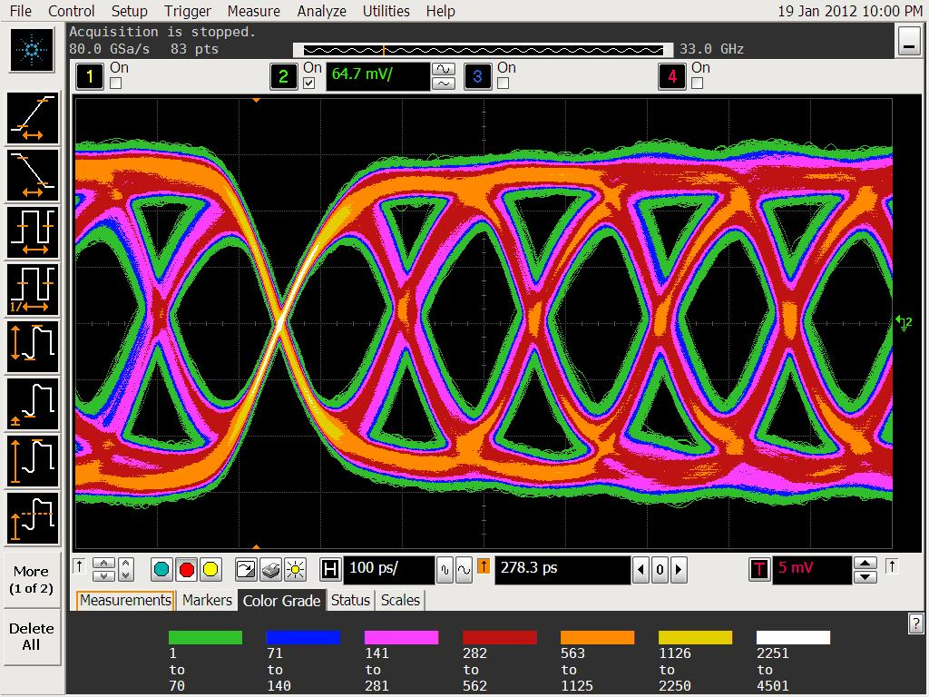
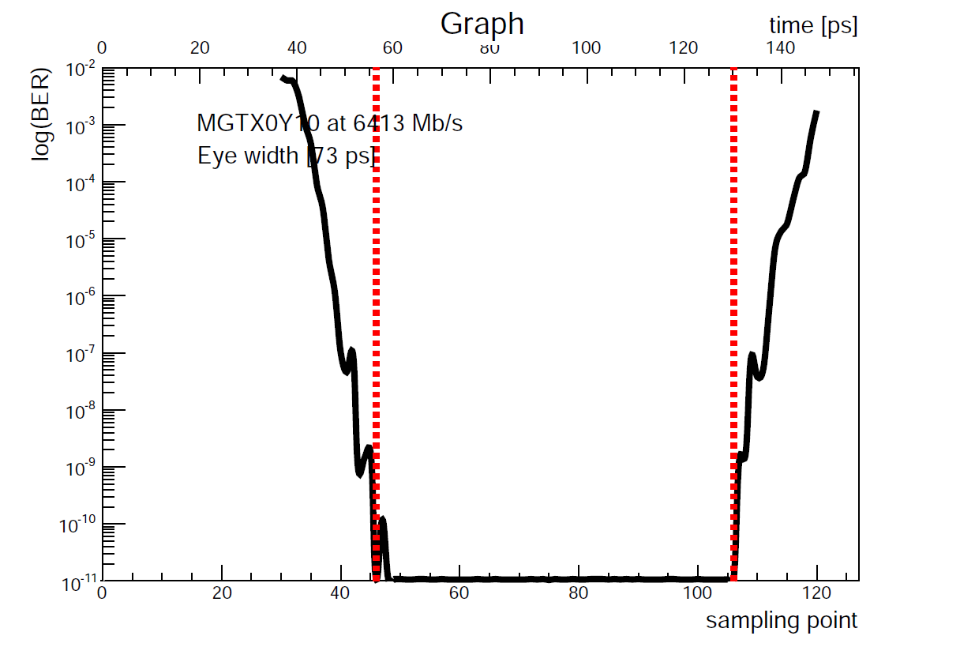
Recent GOLD results (Virtex-6)
Jitter analysis on cleaned TTC clock (σ = 2.9 ps)
Signal integrity: sampled in several positions along the chain
MGT and o/e converters settings optimization
Bit Error Rate (BER) < 10⁻¹⁶ at 6.4 Gbps / 12 channels
Eye widths above 60 ps (out of 156 ps)
Crosstalk among channels measured in some cases but with negligible effect
Sampled after fan-out chip

Slide 13
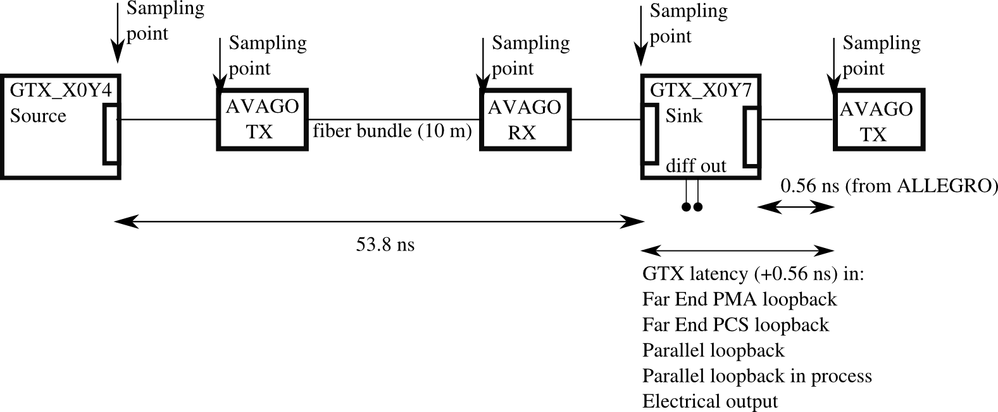
GOLD latency (Virtex-6)
Latency measured along the real-time path in various points at 6.4 Gbs, 16 bit data width, and 8/10 bit encoding
Far End PMA loopback: 34 ns latency
Electrical (LVDS) output: 63 ns latency
Far End PCS loopback: 78 ns latency
Parallel loopback in fabric: 86 ns latency

Slide 14
GOLD TESTS (Virtex-7)
We are experiencing with Virtex7-VC707 evaluation board using the GOLD as a source
BER cores worked out of the box but there are bugs on the ChipScope Analizer which prevent to run automatic parameters scans
4 channels pulled to 10 Gbs with a not optimized setting and no errors measured in a short data acquisition of half day
Repeating the Latency measurement on Virtex-7

Slide 15
Service FW
CPLD FW for o/e converters, jitter cleaners, TTCRx
GOLD will used as a source/sink for testing purposes
Feed the VC-707 via SFP with defined data vectors (for V7 latency measurements)
Feed the sorting algorithm programmed in one input GOLD FPGA. Only 12 channels are feed due to HW limitations
In the future the GOLD will feed the TP prototype in a similar way
Improving the communication firmware among the VME extension (BLT module) to the GOLD via SFP fiber

Slide 16
Summary
L1Topo functional demonstrator (GOLD):
High-speed o/e data paths successfully tested
MGT Parameters tuned at 6.4 Gb/s for large bit-error free windows
Latency measurements taken, activity on-going
L1Topo Prototype:
Design ready, reviewed, schematic capture almost finished
Modifications due to review incorporated
Layout well advanced
Some not yet finalised circuitry to go onto mezzanine module
PDR follow-up in November
Considerable effort going into s/w, f/w, system-level integration
On schedule for installation during shutdown 13/14

Slide 17
Latency measurements done in several configurations at 6.4 Gbs
(16 bit data width and 8/10 bit encoding)
Far End PMA loopback: 34 ns latency
Electrical output: 63 ns latency
Far End PCS loopback: 78 ns latency
Parallel loopback in fabric: 86 ns latency

Slide 19
L1Topo : Milestones
Changes in red
Specifications for prototype under way:
30.05.2012 PDR
29.09.2012 end november prototype layout finished
End november follow-up to PDR
20.02.2012 production/assembly completed
Start preparations for final module production in parallel with prototype module tests. Make prototype module available for initial tests / commissioning @ P1
05/2013 prototype tests finished
05/2013 PRR
08/2013 production finished
11/2013 start commissioning at P1
07/2014 commissioning finished

