Slide 1
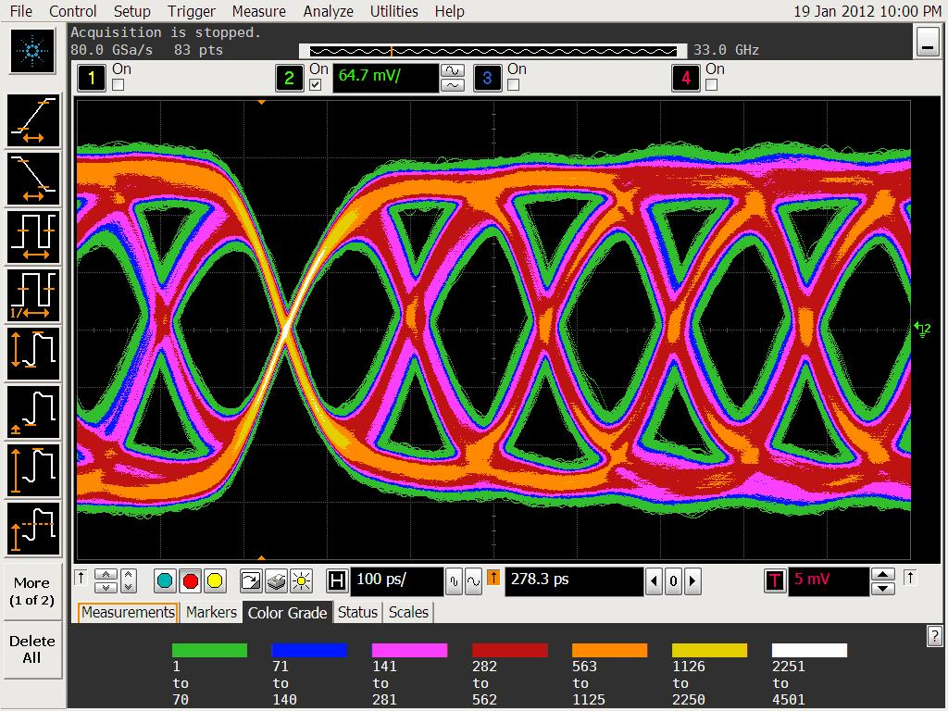
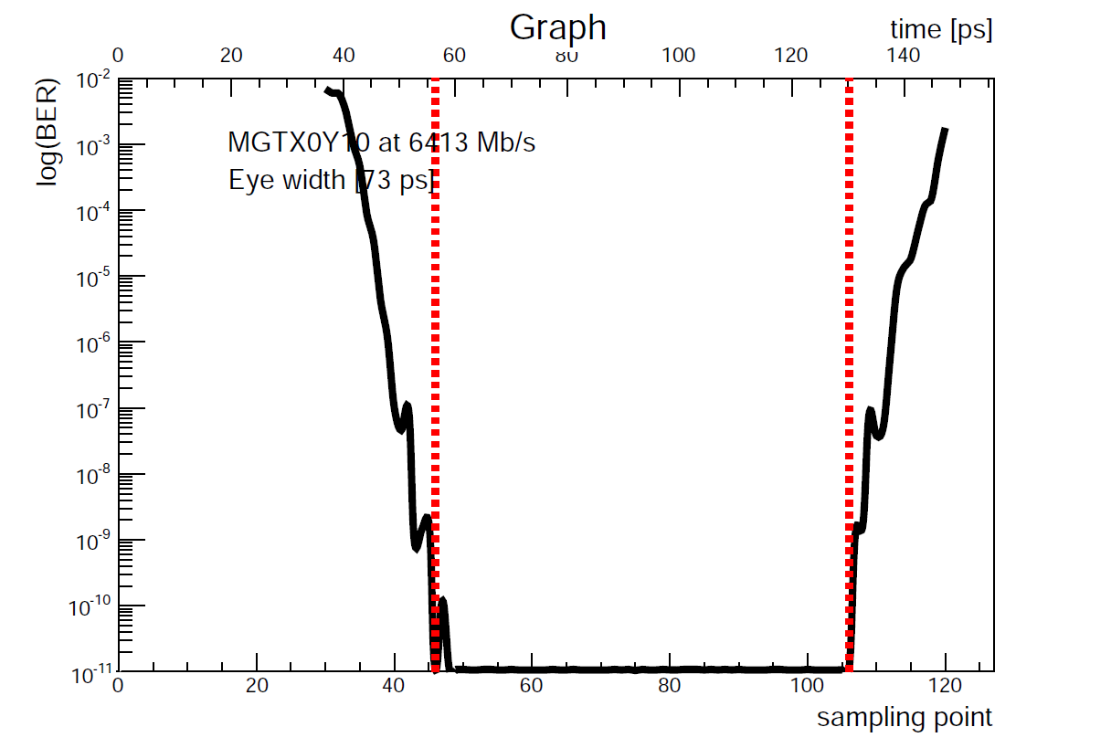
GOLD TESTS (Virtex-6)
Jitter analysis on cleaned TTC clock (σ = 2.9 ps)
Signal integrity: sampled in several positions along the chain
MGT and o/e converters settings optimization
Bit Error Rate (BER) < 10⁻¹⁶ at 6.4 Gbps / 12 channels
Eye widths above 60 ps (out of 156 ps)
Crosstalk among channels measured in some cases but with negligible effect
Sampled after fan-out chip

Slide 2
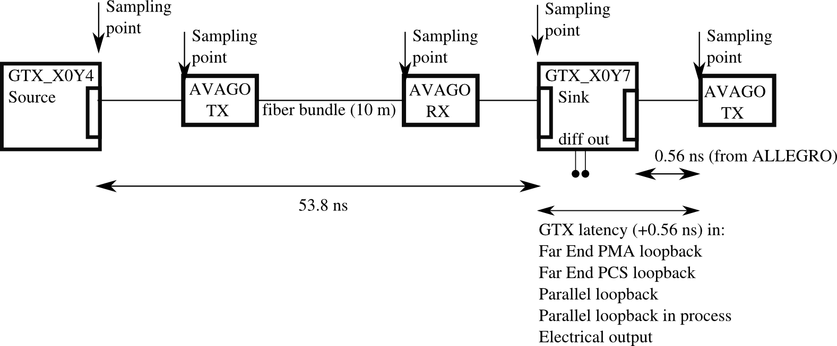
GOLD TESTS (Virtex-6)
Latency measurements done in several configurations at 6.4 Gbs
(16 bit data width and 8/10 bit encoding)
Far End PMA loopback: 34 ns latency
Electrical output: 63 ns latency
Far End PCS loopback: 78 ns latency
Parallel loopback in fabric: 86 ns latency

Slide 3
GOLD TESTS (Virtex-6)
GOLD is our test-bench for topological algorithms
Logic consumption: a medium size algorithm (sorting algorithm) absorb about 10% of the logic

Slide 4
GOLD TESTS (Virtex-7)
We are experiencing with Virtex7-VC707 evaluation board using the GOLD as a source
BER cores worked out of the box but there are bugs on the ChipScope Analizer which prevent to run automatic parameters scans
4 channels pulled to 10 Gbs with a not optimized setting and no errors measured in a short data acquisition of half day
Repeating the Latency measurement on Virtex-7

Slide 5
Service FW
CPLD FW for o/e converters, jitter cleaners, TTCRx
GOLD will used as a source/sink for testing purposes
Feed the VC-707 via SFP with defined data vectors (for V7 latency measurements)
Feed the sorting algorithm programmed in one input GOLD FPGA. Only 12 channels are feed due to HW limitations
In the future the GOLD will feed the TP prototype in a similar way
Improving the communication firmware among the VME extension (BLT module) to the GOLD via SFP fiber

