Slide 1
jFEX
Mainz

Slide 2
L1Calo Phase-1 System
RTM
eFEX
Hub
Hub
Opt.
Plant
ROD
Hub
ROD
ROD
From Digital Processing System
RTM
jFEX
Hub
Hub
ROD
Hub
ROD
ROD
L1Topo
L1Topo
L1Topo
JEM
JEM
JEM
CMX
CMX
CMX
PPR
PPR
JMM
JMM
JMM
CPM
CPM
CPM
CMX
CMX
CMX
New at Phase 1

Slide 3
jFEX system
ATCA shelf / blades
Sharing infrastructure with e-FEX
Handling / splitting of fibre bundles
ROD design
Hub design
Need to handle both high granularity and large jet environment
Require high density / high bandwidth per module
Single crate
~ 8 modules (+FCAL ?)

Slide 4
Initial baseline
Input signals
Granularity .1×.1 (η×φ)
One electromagnetic, one hadronic tower
6.4 Gb/s line rate, i.e. 128 bit per BC
assume 16bit per tower, 8 towers per fibre
Cannot pre-sum e/h towers before duplication for reason of latency
Modules
Each module covers full phi, limited eta range
Data sharing with immediate neighbour only, for practical reasons
sensible baseline is eta coverage of 0.8 per module
for full eta coverage we need 8+ modules
maximum environment size of 0.9 in eta
maximum environment requires 100% duplication
Each module carries eight FPGAs
Each covering 0.8×0.8 (η×φ)
32 core
go for high density optoelectrical components
design for short electrical traces of high speed links
Latency aware

Slide 5
Components for 2018
Conservative approach: plan for devices only that are in the pipeline already now
Virtex-7 : baseline XC7VX415T
Mid range
Several foot print compatible, larger devices exist
48 GTH links (line rate dependent on speed grade/price tag)
Nothing currently known about possible gaps in line rate range
12-channel opto devices at ~10Gb/s
can reasonably expect that microPOD will be a viable option by then (fall-back to miniPOD)
Expect to use ~48-fibre bundles
Basically design jFEX along the lines of L1Topo, with higher FPGA count and board-level data paths optimised for sliding window algorithm

Slide 6
Data replication
<< If local design density permits duplication of a small fraction of signals, it will just as well allow for large scale duplication. Just a matter of money >>
No replication of any source into more than two sinks
Forward duplication only
Avoid any data retransmission
Fan-out in eta handled at source only (DPS)
Try to persuade DPS to do duplication at the parallel end (on-FPGA), using additional MGTs
Possible fall-back: optical fibre splitting, if optical power budget permits (probably more expensive and bulky than parallel duplication)
Fan-out in phi handled at destination only
Consider passive electrical splitting of 10Gb/s signals
Active signal fan-out would compromise design density
Fall-back: retransmission on parallel links → latency penalty of more than 1 tick (SelectIO SerDes).

Slide 7
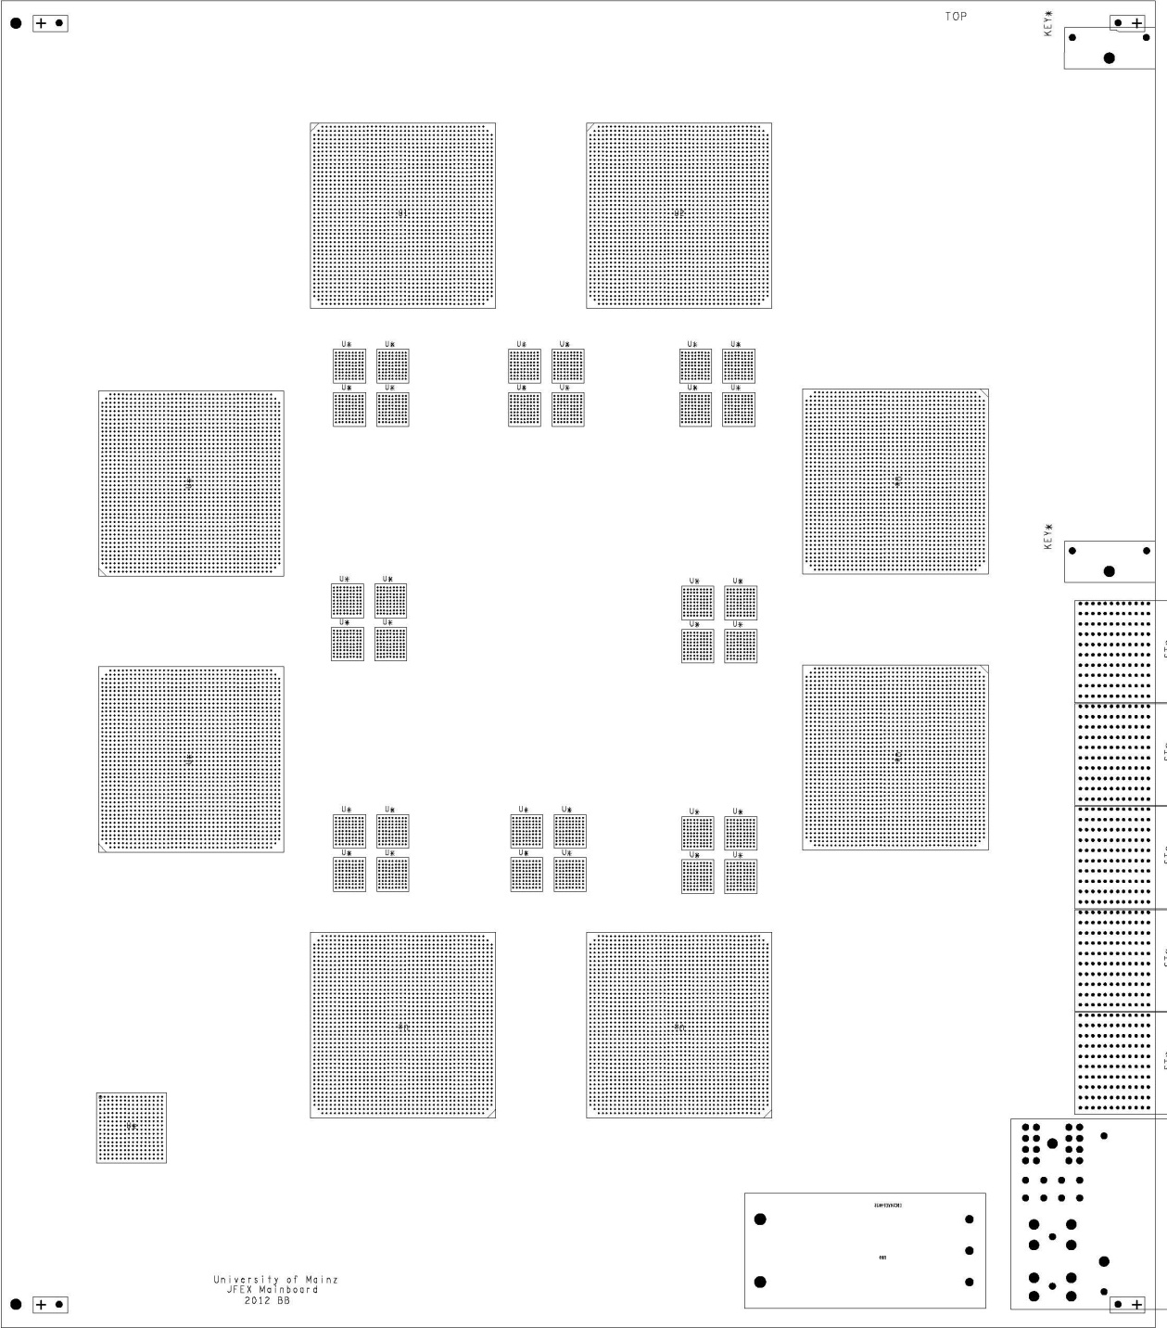
How to fit on a module ?
ATCA
8 processors
2-4 microPODs each
Passive fan-out
Small amount of control logic
Electrical backplane basically unused

Slide 8
Bandwidth vs. granularity
Let’s do the math for the suggested scheme. Go for the extreme. Do a rough estimate:
Environment 0.9×0.9
Each FPGA receives fully duplicated data in eta and phi: 1.6×1.6 worth of data required for a core of 0.8×0.8
256 bins @ 0.1×0.1 in η×φ, e/m + had
Baseline 6.4Gb/s, 128 bit per BC per fibre
8 16-bit words per fibre
Maximum aggregate bandwidth (payload @ 10Gb/s line rate) of chosen FPGA is 48*8Gb/s=384Gb/s
per bin : 384/256 Gb/s = 1.5Gb/s, i.e. 37 bit
That’s probably ~ 3 energies
Scalable to some extent by choice of FPGA and line rate
→ We will be able to route large data volume into the jFEX processor chips, at large environment and at required granularity

Slide 9
fibre count / conclusion
Due to full duplication in phi direction, exactly half the signals are routed into the modules on fibres
192 fibres
16 × 12-channel opto receivers
4 × 48-way fibre bundles / MTP connectors
The 8-module jFEX seems possible with ~2013’s technology
Allows for both sufficient granularity and large environment
Can DPS handle the required duplication?
How to arrive at sufficiently dense fibre contents for phase 2 (eta orientation of tile RODs ?) ?
Is passive electrical splitting feasible ?
Start to explore technologies and feasibility soon
Some further (last minute) remarks on next slide

Slide 10
And further…
Some last minute remarks (triggered by Sam’s comments)
Readout density into L1Topo would probably be low, leading to high fibre count into L1Topo (1 fibre per FPGA = 64 fibres total)
Probably depends on determination to avoid upgrade of L1Topo for phase-1
Consider merger FPGA (comes at the expense of more than 1 tick of additional latency)
Not sure about maximum fibre density on a MTP/MPO connector. People talking about 72 fibres per connector, though at higher optical losses compared to 48-fibre variant !
Readout into LVL-2 and DAQ will be included. Aiming at use of mini/microPOD at whatever data rate required by future RODs (or ROBins, in case on-board RODs are used)
Towers .1×.1 with aggregate bandwidth of 37bits per tower available for total of e and h sections (no attempt made to sort out contents per fibre)
Each module covering core of nominally .8 in η (different at FCAL)
8 FPGAs per module, each covering core of .8×.8, including environment: additional 4 bins each at +/-eta, +/- phi total data processed on one FPGA: 1.6×1.6 worth of data

