Slide 1


jFEX
Mainz

Slide 2
Jet processing
Phase-0 jet system consisting of
Pre-Processor
  Analogue signal conditioning
  Digitization
  Digital signal processing
  Jet element pre-summation
  to 0.2 x 0.2 (η×φ)
Jet processor
  Sliding window processor for jet finding
  Jet multiplicity determination
  Jet feature extraction into L1Topo (pre-phase1)
At phase-1: complement with jet feature extractor jFEX
Improve on jet finding (and MET measurement)
LAr signals optically from digital processor system
TileCal signals three options
L1Topo
L1Topo
L1Topo
JEM
JEM
JEM
CMX
CMX
CMX
PPR
PPR
JMM
JMM
CPM
CPM
CPM
CMX
CMX
CMX

Slide 3
L1Calo Phase-1 System
RTM
eFEX
Hub
Hub
Opt.
Plant
ROD
Hub
ROD
ROD
From Digital Processing System
RTM
jFEX
Hub
Hub
ROD
Hub
ROD
ROD
L1Topo
L1Topo
L1Topo
JEM
JEM
JEM
CMX
CMX
CMX
PPR
PPR
JMM
JMM
JMM
CPM
CPM
CPM
CMX
CMX
CMX
New at Phase 1

Slide 4
jFEX input data
  Fibre optical inputs only
  Fibre bundles via patch panel / fibre re-bundling stage
  Granularity .1×.1 (η×φ)
  One electromagnetic, one hadronic tower per η×φ bin
Unlike eFEX, no “BCMUX” scheme possible due to consecutive non-zero data
6.4 Gb/s line rate, 8b/10b encoding, → 128 bit per BC
16bit energy per tower, 8 towers per fibre
LAr data from DPS
Tile …

Slide 5
FEX input data – TileCal
Three options for TileCal opto fibres
Option 1 – replicate analogue TileCal trigger signals into additional TileCal digitizer stations
Replicate existent L1Calo digital electrical output into fibres
  Option 2 : At source (Pre-Processor)
  Option 3 : At sink (Jet/Energy Processor)

Slide 6
TileCal input options
Barrel sector logic
Muon Trigger
MuCTPi
Can extract Tile tower sums from:
Tile receiver stations
PreProcessor modules
JEM modules in JEP
Muon detector
Endcap sector logic
eFEX
Central Trigger
DPS
L1Topo
CTP
EM calorimeter
digital readout
C
O
R
E
EM data to FEX
jFEX
Hadronic data to FEX
Tile tower
“DPS”
2
3
1
JEP
Analog sums from Tile/LAr
PreProcessor
C
M
X
Receiver
stations
JEM
nMCM
CP
C
M
X
CTP output
New/upgraded
Hardware
L1Calo Trigger
Topological info

Slide 7
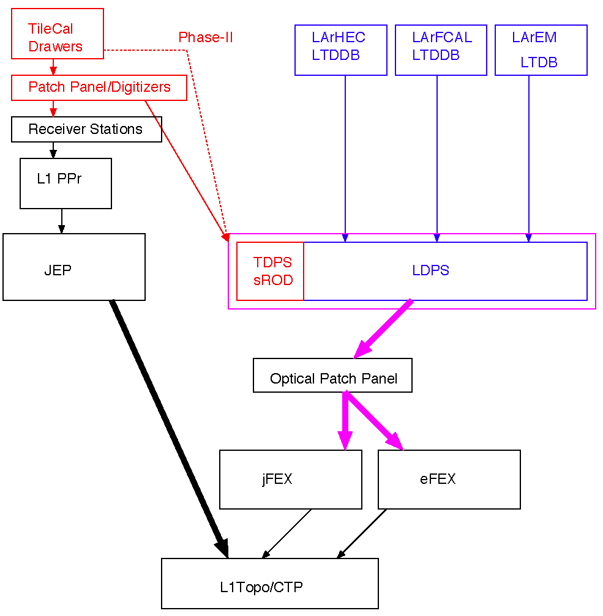
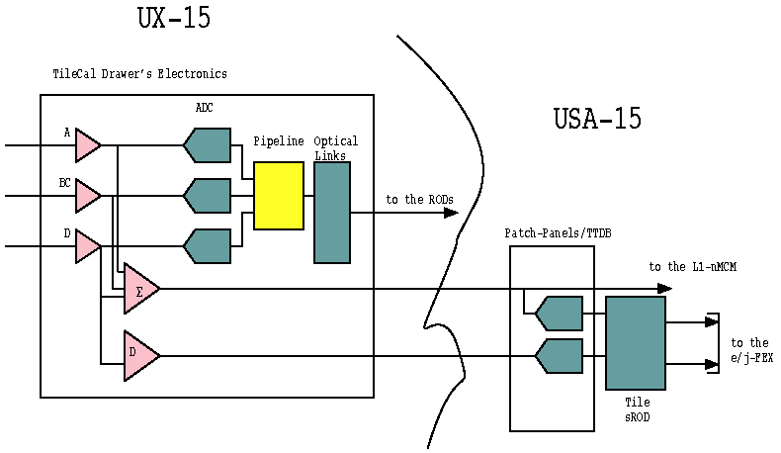
Option 1: Tile stations
Signals extracted at arrival point in USA15
Build a new system to digitize and process analog signals
  Patch panel / split off analog signal to be digitized
  Digitizer
  Serializer / fibre driver
  Tile sROD (incl. L1 PP)

Slide 8
Pre-phase1 Pre-Processor System
nMCM with firmware option to serialize to 960Mb/s
Phase0 LCD card
Data electrically to CP and JEP via backplane through-connectors
r/o data
RGTM
to DAQ
J
2
power
LCD
(f/o & routing)
ch1
BCMUX
LVDS-Tx
CP1
ch2
ch3
10
32x
FPGA
C
P
BCMUX
LVDS-Tx
CP2
to CP
(LVDS cables)
ch4
480Mb/s
FPGA
SUM
10
LVDS-Tx
FPGA (Spartan-6)
MCM #1
FPGA
J
E
P
to JEP
(LVDS cables)
JEP
16x
MCM #16
480/960Mb/s
FPGA
PPM
Virtex-II

Slide 9
Option 2, PPM h/w upgrade
Add rear transition module
Equip with FPGA (V7) and 12-channel e/o transmitters
4-fold fan-out to FEXes in FPGA
Rear Extension
r/o data
J
2
RGTM
to DAQ
power
to jFEX
(optic fibers)
LCD
(f/o & routing)
ch1
BCMUX
LVDS-Tx
CP1
SNAP12
ch2
ch3
10
CP2
32x
FPGA
C
P
C
P
BCMUX
LVDS-Tx
to CP
(LVDS cables)
ch4
480Mb/s
FPGA
FPGA
SUM
10
LVDS-Tx
FPGA (Spartan-6)
MCM #1
FPGA
J
E
P
J
E
P
to JEP
(LVDS cables)
JEP
16x
MCM #16
480/960Mb/s
FPGA
PPM
Virtex-II
Xilinx 7 Series

Slide 10
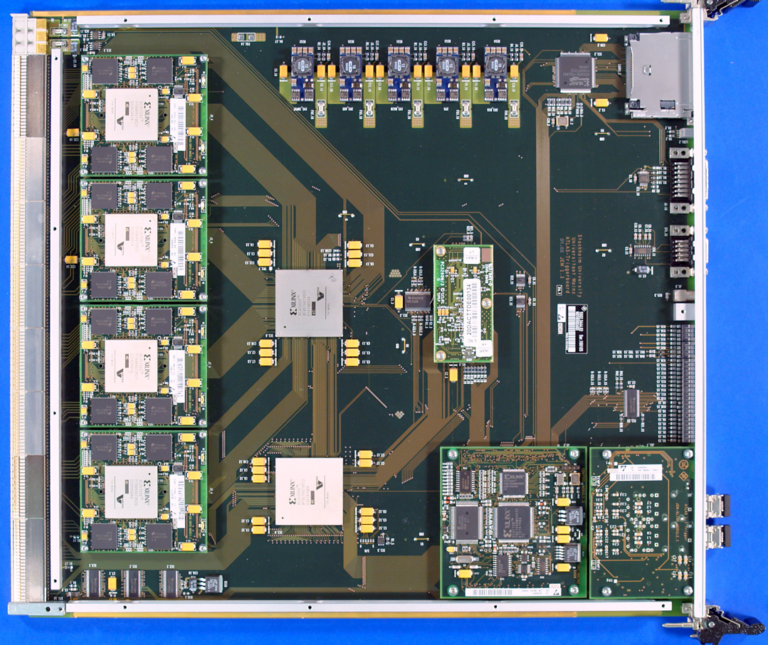
Option 3: JEM h/w Upgrade
New input daughter card (JEM Mezzanine Module) at phase-1
Virtex-7 based
Receive 960Mb/s (i.e. double rate) high granularity tile data electrically
Loop through to MGTs
w/o processing
Run through MicroPOD
transmitters
4 copies of incoming data
to FEXes via front panel

Slide 11
Considerations
Need to assess:
Latency
  Latency figures for O1 not known
  Minor differences O2 / O3 (signal path)
Dynamic range / resolution (would like to improve…)
  Current L1Calo towers have 8 bit dynamic range with 1GeV/LSB
  O2/O3 limited by ENOB of ADCs “equivalent number of bits”
  O1 limited by analogue noise (any better?)
Cost to implement
  O2 and O3 using existent digitization and pre-processing
  O3 basically just adding optoelectronics to a module that we are prepared to replace anyway
  O2 similar in terms of FPGA needs and optoelectronics
  O1 difficult (for me) to judge. A lot of all-new circuitry
Risk of disruption to / interference with existing system
N.b. input geometry of FEXes (eta vs. phi strip) hasn’t yet been finalized. Might affect cost/complexity for given option.
… and review, to narrow down options … to 1 …

Slide 12
Algorithms, now…
Sliding window algorithm (sliding in φ, η)
Operate on jet elements (towers) 0.2 x 0.2
Find and disambiguate ROIs sized 0.4 x 0.4
Calculate jet energy in three differently sized windows (programmable), up to 0.8 x 0.8
Jet size (window size) limited by environment (data duplication)
Granularity defined by arithmetic on Pre-Processor ASIC (pre-sum)

Slide 13
… and then
Improve granularity by factor of four, to 0.1×0.1 (η×φ)
Slightly increase environment (0.9 × 0.9 baseline)
Allow for flexibility in jet definition (non-square jet shape, Gaussian filter, …)
Fat jets to be calculated from high granularity small jets
Optionally increase jet environment
Phase 0 Phase 1

Slide 14
Data replication
Sliding window algorithm requiring large scale replication of data
Forward duplication only (fan-out), no re-transmission
Baseline: no replication of any source into more than two sinks
Fan-out in eta handled at source only (DPS)
  Transmit “core” and “environment” data
  Duplication at the parallel end (on-FPGA), using additional Multi-Gigabit Transceivers
  Allowing for differently composed
  streams
  Minimizing latency
Fan-out in phi handled at
destination only
  Baseline “far end PMA loopback”
  Looking into details and alternatives
N.B. phi strip vs. eta strip organisation tbd.
ϕ
η

Slide 15
jFEX partitioning
Algorithm requiring environment of 0.9×0.9 around
each tower to be processed → +/- 4 neighbours in eta and phi
Processor FPGAs
core of 0.8×0.8
Fully duplicated data in both eta and phi
Total of 1.6×1.6 worth of data required
256 bins @ 0.1×0.1 granularity
separate e/m + had channels → 512 numbers (16-bit energies)
That equals 64 on-chip receivers @6.4Gb/s (128 bit/lane/BC)
Due to 100% on-board duplication, 32 of them are driven from a fibre
Processor modules
  Processing strip along phi
  Receiving fully duplicated data in eta from DPS
  Module covering full phi (8×0.8), limited eta range of .8
  Carrying 8 FPGAs
  → total of 8×32=256 fibres coming in
  22 × 12-way opto modules “MicroPOD” high density receivers
  Four 72-way fibre connectors (“MPO/MTP”)
ϕ
η

Slide 16
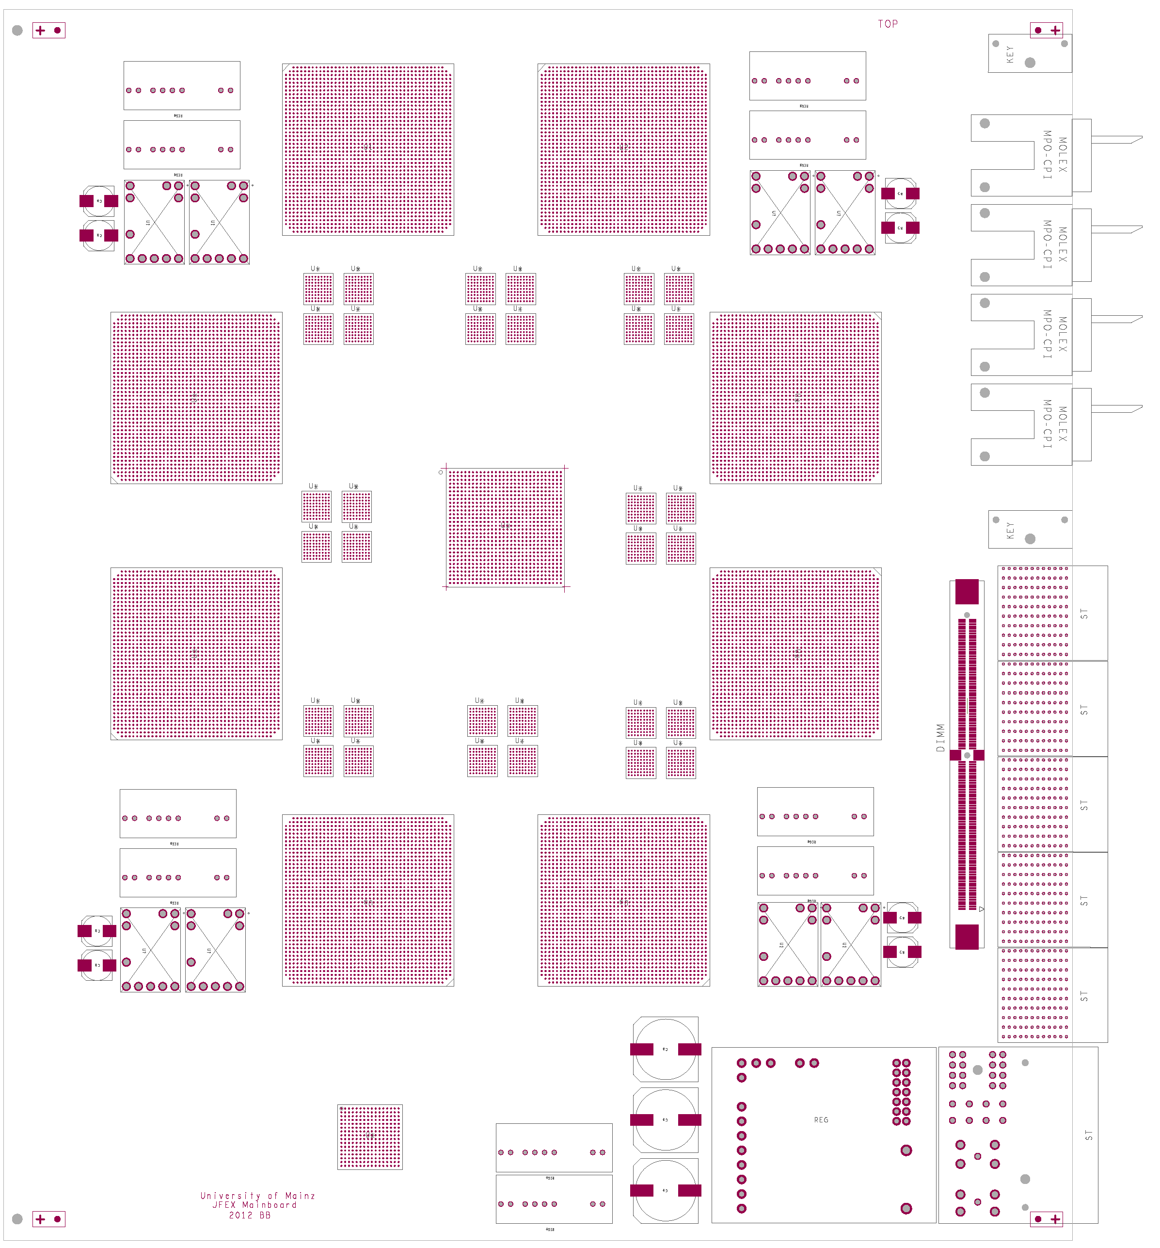
How to fit on a module ?
AdvancedTCA format
8 processors (~XC7VX690T)
4 microPOD sockets each μ
(including spare output)
Opto connectors in
Zone 3
Fibre bundles from rear F
fan-out via “far end PMA loopback” P
consolidation of results on one of the processors Q
(alternatively direct output)
Output to front panel
Small amount of module control logic / non-realtime (ROD)
Maximise module payload with help of small-footprint ATCA power brick and tiny IPMC mini-DIMM
7V
Z3
μ
F
front
in
rear
Q
out
P

Slide 17
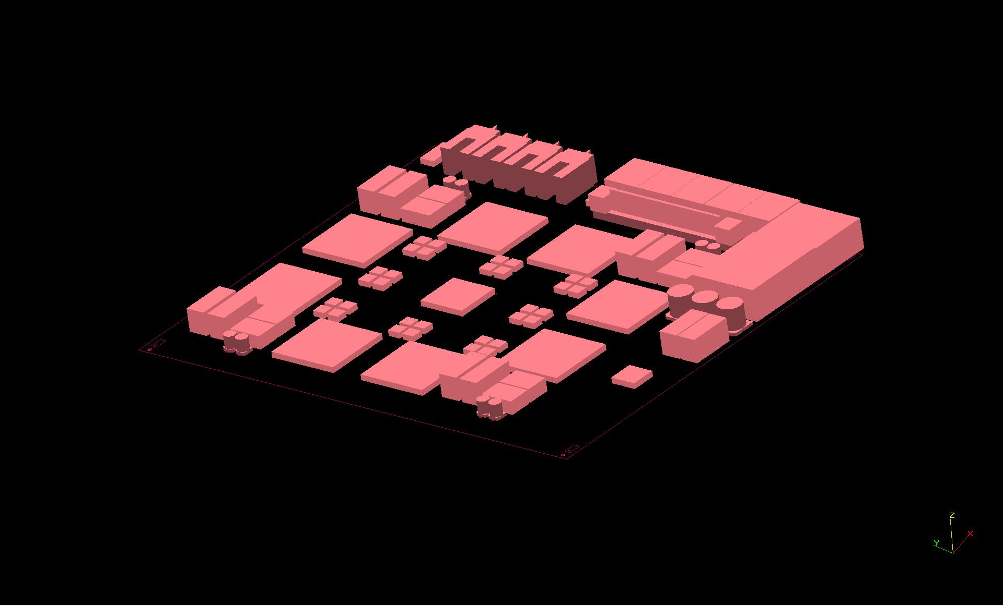
…and 3-d

Slide 18
jFEX system
  Need to handle both fine granularity and large jet environment (minimum 0.9×0.9)
  Require high density / high bandwidth to keep input replication factor at acceptable level (3/4 of all FPGA inputs are duplicates)
  Fit in ~ 8 modules (+FCAL ?)
Single crate
→ go for ATCA shelf / blades:
Sharing infrastructure with eFEX
  Handling / splitting of fibre bundles
  ROD design
  Hub design
  RTM
ϕ
η
RTM
eFEX
Hub
Hub
Opt.
Plant
ROD
Hub
ROD
ROD
Optical inputs
RTM
jFEX
Hub
Hub
ROD
Hub
ROD
ROD
L1Topo
L1Topo
L1Topo

Slide 19
Some considerations…
jFEX relies on “MicroPOD” high-density optical devices
  Electro-optical engine identical to popular “MiniPOD”s
  Currently looking into mechanical and thermal issues
  In contact to manufacturer to benefit from recent developments there
  MicroPODs small enough to provide additional direct output from each processor FPGA if required (for fat jet determination on L1Topo module)
6.4 Gb/s baseline seems rock solid
Fibre and module density are high but feasible
Aim at higher line rates (currently FPGAs support 13 Gb/s, MicroPOD 10 Gb/s)
  Allow for even finer granularity / larger jets / smaller FPGA devices :
  If digital processor baseline allows for full duplication of 6.4Gb/s signals, the spare capacity, when run at higher rate, can be used to achieve a replication of more than 2-fold, so as to support a larger jet environment.
The jFEX shall be compatible to phase 2
  might affect organisation of input links (eta strips vs. phi strips)
  Organisation of input links to be sorted out anyway

Slide 20
Firmware / Software
jFEX firmware
Sliding window algorithm / feature extraction
Board-level merging
Monitoring and diagnostics
Infrastructure for high speed links
Module control
DAQ (buffers and embedded ROD functionality)
ATCA control
TTC interface
Most items are common effort with eFEX
TileCal input – Example : JEM based TileCal inputs
Serialization nMCM 960Mb/s
Serialization JMM 6.4Gb/s
Re-target existing JEM input firmware to new FPGA
Software:
jFEX specific software is mainly register model and simulation of real-time path

Slide 21
jFEX development line at Mainz
The jFEX is a further, advanced module within an ongoing development programme for high-speed opto-electrical, high performance processors
Backplane & Link tester 2010
Technology demonstrator “GOLD” 2011
Level-1 Topology processor: Prototype to go into production early February 2013
Test modules for specific aspects of data transmission
MicroPOD test modules to be built and evaluated soon

Slide 22
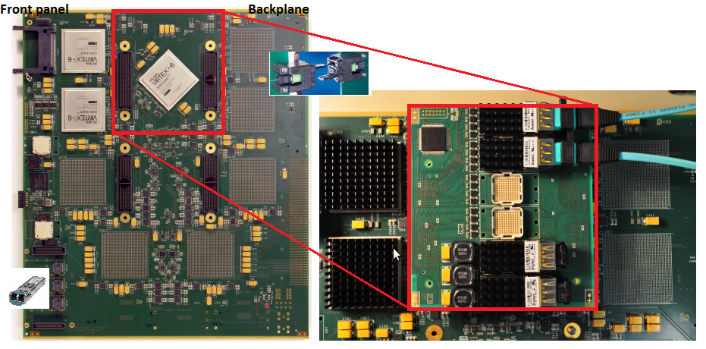
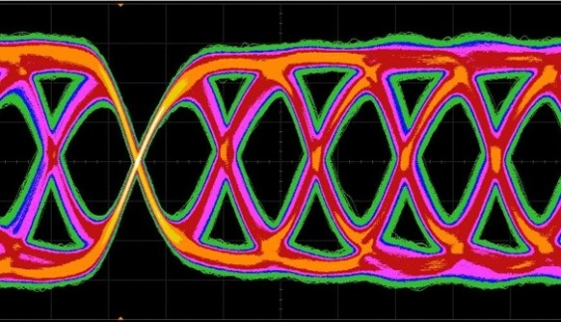
Generic Opto Link Demonstrator – GOLD
6.4 G
Industry standard o/e converters (similar SNAP12) on mezzanine
Designed for data paths up to 10Gb/s
Including CML level fan-out devices
Fibre input from the backplane (MTP-CPI connectors)
Populated with mid range FPGAs (XC6VLX240T) up to 6.4Gb/s
Successfully tested with TTC clock / jitter cleaner
BER < 10⁻¹⁶
Continues to be used as source/sink for test bench

Slide 23
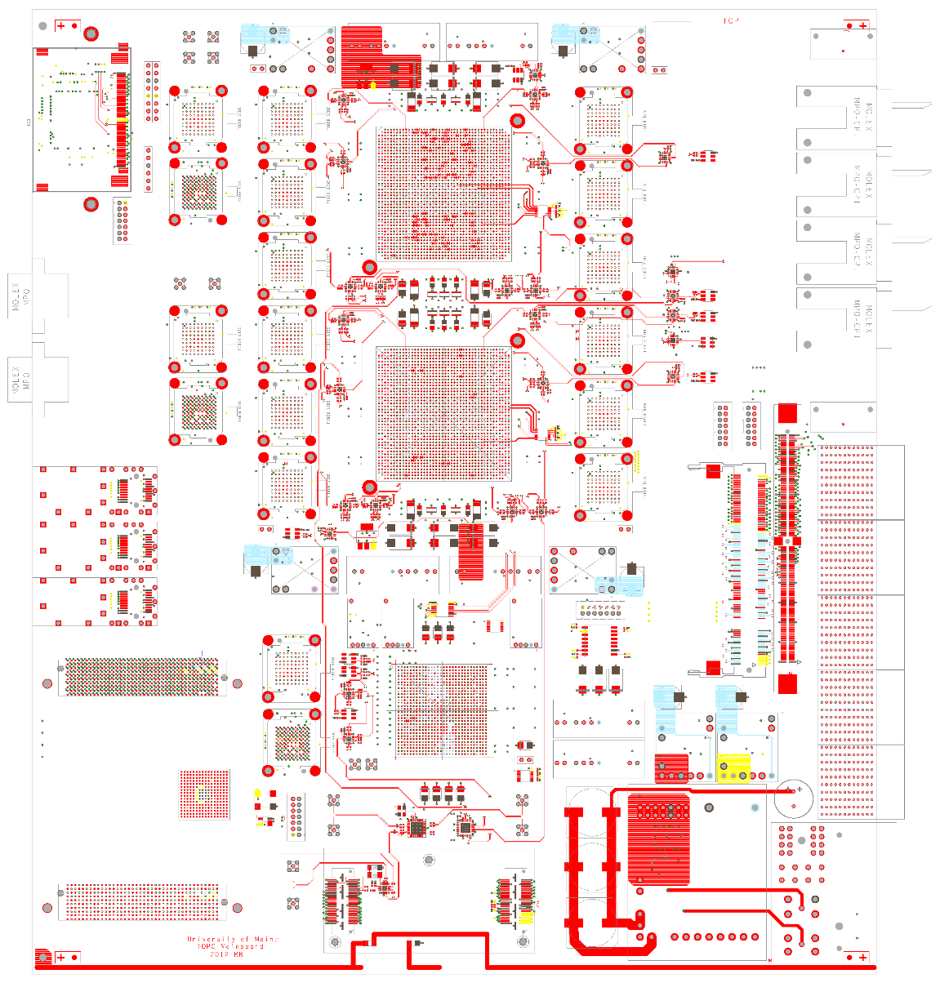
Topology processor L1Topo
Same technologies as proposed for jFEX
AdvancedTCA
Real-time path:
  Four 48-way fibre connectors zone 3
  14 fibre-optical 12-way inputs (MiniPOD)
  Two processors XC7VX690T,
  80 × 13Gb/s each
  LVDS and optical output (front panel)
Complex multi-rate clocking scheme
LHC clock + crystals
Several module control options (incl. Ethernet / IPbus etc.)
Multiple processor FPGA configuration schemes
Multiple options for DAQ and ROI interface
  L1Calo style (SFP
  Embedded ROD / S-Link interface via MiniPOD

Slide 24
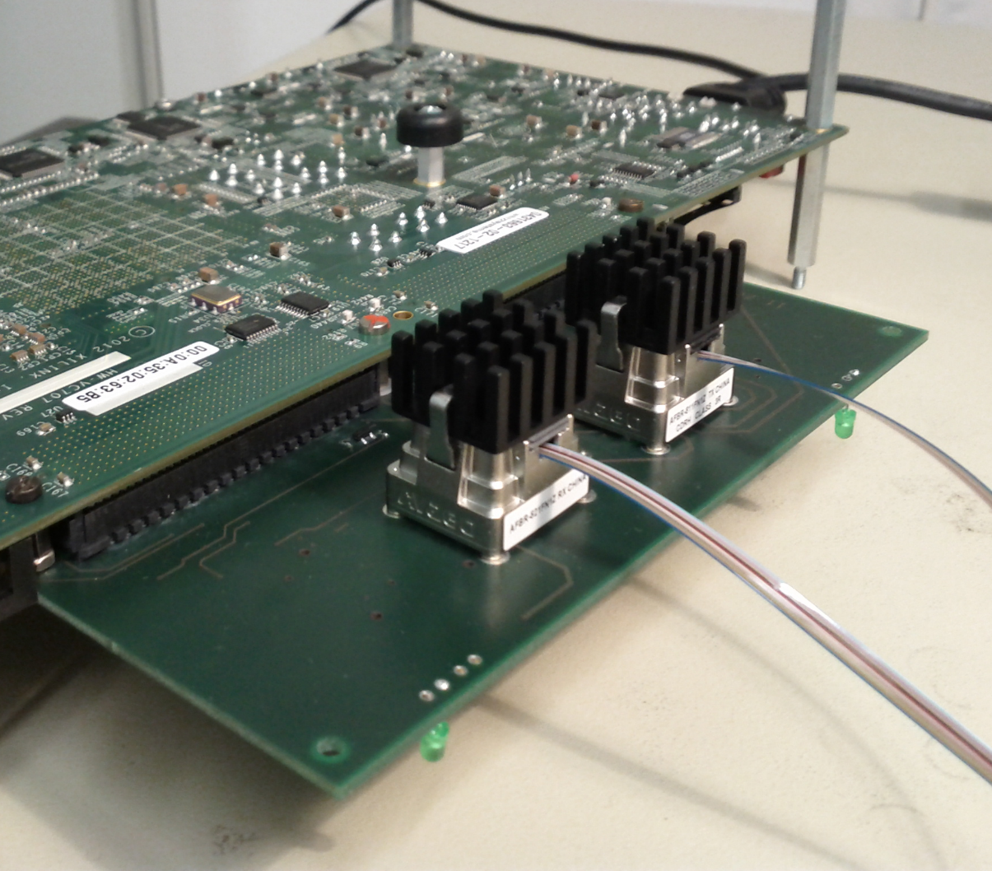
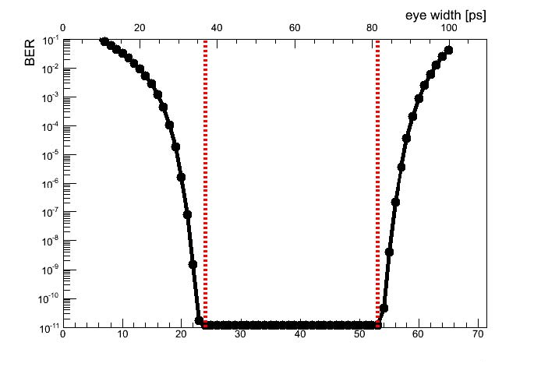
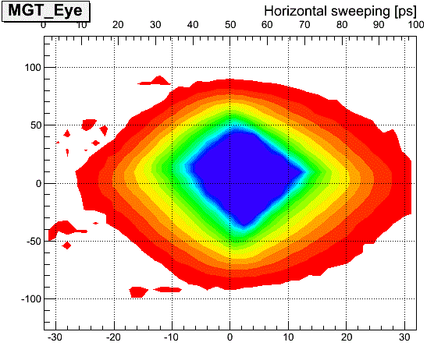
Minipod BER tests
MiniPOD pair RX/TX on
Xilinx XC7VX485T
Loopback via 10m fibre bundle
3 stages of MTP/MPO connectors
6 channels exercised
@ 10Gb/s
No errors observed
Bit error rate < 6.4·10⁻¹⁷
45ps@10Gb/s

Slide 25
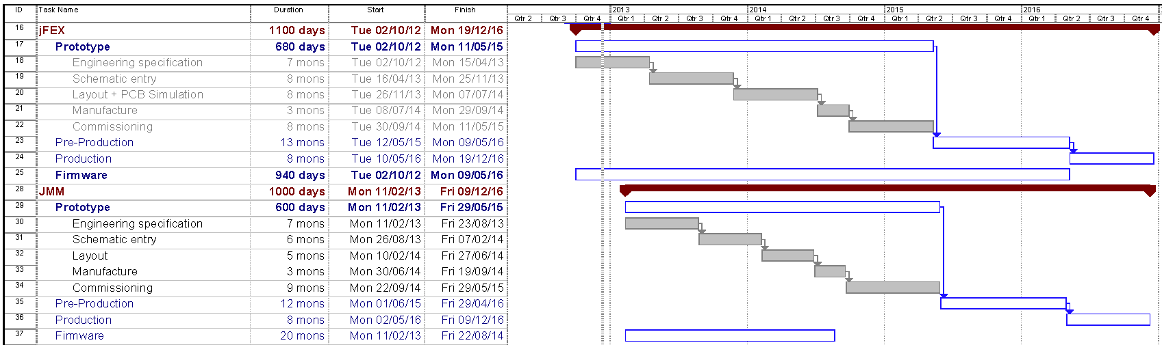
Schedule / Effort
Plus installation/commissioning/system tests thereafter.
Milestones: jFEX PDR Q2/2013 - IDR Q2/2015 - PRR Q2/2016
JMM PDR Q3/2013 - PRR Q2/2016
Effort requirements
jFEX hardware, firmware: total of 17 FTE over 6 years, rather evenly spread until production…
JMM mezzanine renewal (h/w+f/w) including TileCal fibre interface: total of 5 FTE over 6 years
Integration, installation, commissioning (jFEX share): 6 FTE / 6 years

Slide 26
Conclusion
The 8-module jFEX seems possible with ~2013’s technology
Key technologies explored already (GOLD, L1Topo,…)
Use of MicroPODs challenging for thermal and mechanical reasons, but o/e engine is the same as in popular MiniPODs
Scheme allows for both fine granularity and large environment at 6.4Gb/s line rate and a limit of 100% duplication of input channels
Rather dense circuitry, but comparable to recent projects
Even finer granularity and / or larger jets possible at higher transmission rates
DPS needs to handle the required duplication (in eta)
Details of fibre organization and content cannot be presented now
Started work on detailed specifications, in parallel exploring higher data rates…
TileCal signals required in FEXes in fibre-optical format
Three options for generating them
All seem viable, but probably at different cost. Need to converge.

