Slide 1

jFEX
Mainz

Slide 2
L1Calo Phase-1 System
RTM
eFEX
Hub
Hub
Opt.
Plant
ROD
Hub
ROD
ROD
From Digital Processing System
RTM
jFEX
Hub
Hub
ROD
Hub
ROD
ROD
L1Topo
L1Topo
L1Topo
JEM
JEM
JEM
CMX
CMX
CMX
PPR
PPR
JMM
JMM
JMM
CPM
CPM
CPM
CMX
CMX
CMX
New at Phase 1

Slide 3
Data replication
Sliding window algorithm requiring large scale replication of data
Avoid data re-transmission (latency !)
→ Forward duplication only (fan-out)
Baseline: no replication of any source into more than two sinks
Fan-out in eta handled at source only (DPS)
  Duplication at the parallel end (on-FPGA), using additional Multi-Gigabit Transceivers
  Allowing for differently composed streams
  Minimizing latency
Fan-out in phi handled at destination only
  “far end PMA loopback” (well, not quite a re-transmission, but…)
  Alternatively consider passive electrical splitting of multi-Gbps signals
  Active signal fan-out would compromise design density

Slide 4
jFEX system
ATCA shelf / blades:
Sharing infrastructure with eFEX
  Handling / splitting of fibre bundles
  ROD design
  Hub design
Need to handle both high granularity and large jet environment
Require high density / high bandwidth per module
Single crate
~ 8 modules (+FCAL ?)
  Input signals:
  Granularity .1×.1 (η×φ)
  One electromagnetic, one hadronic tower
Cannot pre-sum e/h towers before duplication for reason of latency
Unlike eFEX, no “BCMUX” scheme due to consecutive non-zero data
6.4 Gb/s line rate, 8b/10b encoding, → 128 bit per BC
For now, assume 16bit per tower, 8 towers per fibre

Slide 5
Initial baseline
8+ Modules, each covering full phi, limited eta range
  Environment of 0.9 in eta (core bin +/- 4 neighbours)
Each module receives fully duplicated data in eta :
1.6 eta worth of data required for a core of 0.8
16 eta bins including environment
8 FPGAs per module
Environment 0.9×0.9
Each FPGA receives fully duplicated data in eta and phi:
1.6×1.6 worth of data required for a core of 0.8×0.8
256 bins @ 0.1×0.1 in η×φ, e/m + had → 512 numbers, 64 Multi-Gb/s receivers
→ 512 Multi-Gb/s receivers per module

Slide 6
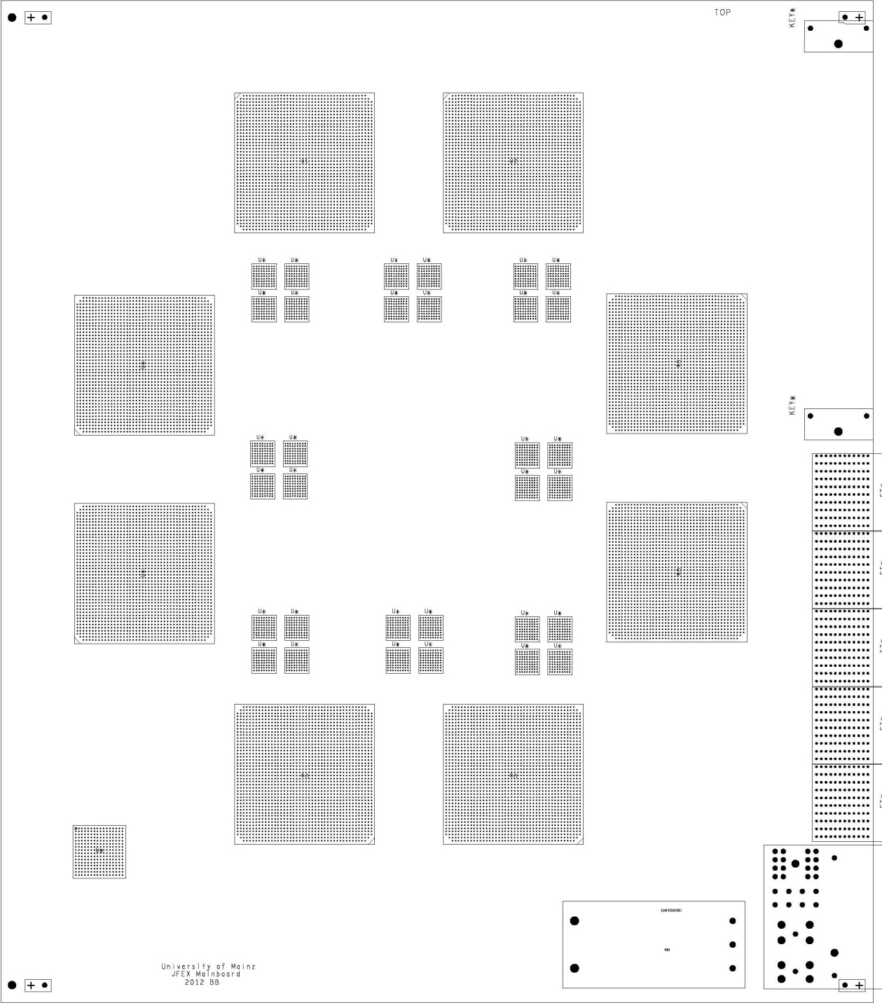
How to fit on a module ?
ATCA
8 processors (~XC7VX690T)
≤ 4 microPODs each
fan-out passive or “far end PMA loopback”
Small amount of control logic / non-realtime (ROD)
Might add 9th processor for consolidation of results
Electrical backplane basically unused
Opto connectors in
Zone 3
Z3

Slide 7
fibre count / density
Due to full duplication in phi direction, exactly half of all 512 signals are routed into the modules optically on fibres
  256 fibres
  22 × 12-channel opto receivers
  4 × 72-way fibre bundles / MTP connectors
For larger jets window we would require larger FPGAs, some more fibres and replication factor > ×2
Horrible ?
  Reduce number of bits per tower: at 11 bit/tower (11 towers per fibre) it is 186 fibres / 16 microPODs / 4*48-way MTP
  Aim at higher line rates (currently FPGAs support 13 Gb/s, microPOD 10 Gb/s)
    Allow for even finer granularity / larger jets / smaller FPGA devices :
    If digital processor baseline allows for full duplication of 6.4Gb/s signals, the spare capacity, when run at higher rate, can be used to achieve a replication of more than 2-fold, so as to support a larger jet environment.

Slide 8
conclusion
The 8-module jFEX seems possible with ~2013’s technology
Key technologies used on L1Topo already
Allows for both rather good granularity and large environment at 6.4Gb/s line rate
Rather dense circuitry
For finer granularity and / or larger jets things get even more complicated and we need to explore higher data rates
DPS needs to handle the required duplication (in eta)
Start to work on detailed specifications soon,
in parallel explore higher data rates…

