Slide 1
FEX
L1Calo
For more eFEX details see
indico.cern.ch/getFile.py/access?contribId=73&sessionId=51&resId=0&materialId=slides&confId=170595

Slide 2
L1Calo Phase-1 System
RTM
eFEX
Hub
Hub
Opt.
Plant
ROD
Hub
ROD
ROD
From Digital Processing System
RTM
jFEX
Hub
Hub
ROD
Hub
ROD
ROD
L1Topo
L1Topo
L1Topo
JEM
JEM
JEM
CMX
CMX
CMX
PPR
PPR
JMM
JMM
JMM
CPM
CPM
CPM
CMX
CMX
CMX
New at Phase 1

Slide 3
Data replication
Sliding window algorithm requiring large scale replication of data
Forward duplication only (fan-out), no re-transmission
Baseline: no replication of any source into more than two sinks
Fan-out in eta (or phi) handled at source only (DPS)
Duplication at the parallel end (on-FPGA), using additional Multi-Gigabit Transceivers
Allowing for differently composed streams
Minimizing latency
Fan-out in phi (or eta) handled at destination only
Baseline “far end PMA loopback”
Looking into details and alternatives

Slide 4
FEX systems
ATCA shelf / blades:
eFEX and jFEX sharing some infrastructure
Handling / splitting of fibre bundles
ROD design
Hub design
Need to handle both very fine granularity and large environment
eFEX up to 0.5×0.5 (η×φ)
jFEX minimum 0.9×0.9
Require high density / high bandwidth per module
eFEX probably two crates (baseline)
jFEX single crate, ~ 8 modules (+FCAL ?)
Need that density to keep input replication factor at acceptable level

Slide 5
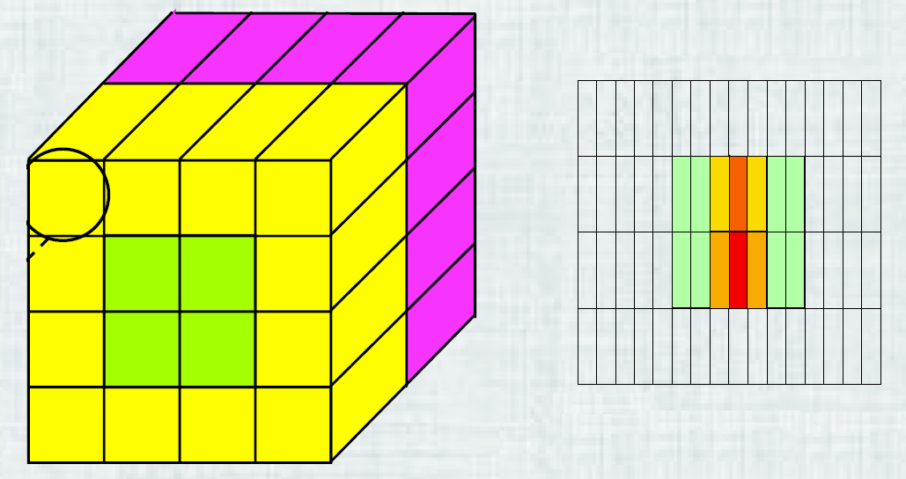
FEX input (baseline)
6.4 Gb/s line rate, 8b/10b encoding, → 128 bit per BC per fibre
Assume fully duplicated data (in phi) from DPS
Base granularity .1×.1 (η×φ)
eFEX (1-4-4-1)e + h
0.025×.1 in strip layer and middle layer
Reduce the required bandwidth by factor of two with help of “BCMUX”
Rely on each channel carrying zero data every other bunch tick, due to FIR filter characteristics/peak finder
jFEX e+h
No “BCMUX” due to consecutive non-zero (pre-summed) data

Slide 6
Example : jFEX
8+ Modules, each covering full phi, limited eta range
8 FPGAs per module
Processing core of 0.8×0.8
Environment 0.9×0.9
Each FPGA receives fully duplicated data in eta and phi: 1.6×1.6 worth of data required for a core of 0.8×0.8
256 bins @ 0.1×0.1 in η×φ, e/m + had → 512 energies, 64 Multi-Gb/s receivers (@6.4Gb/s)
→ 512 Multi-Gb/s receivers per module

Slide 7
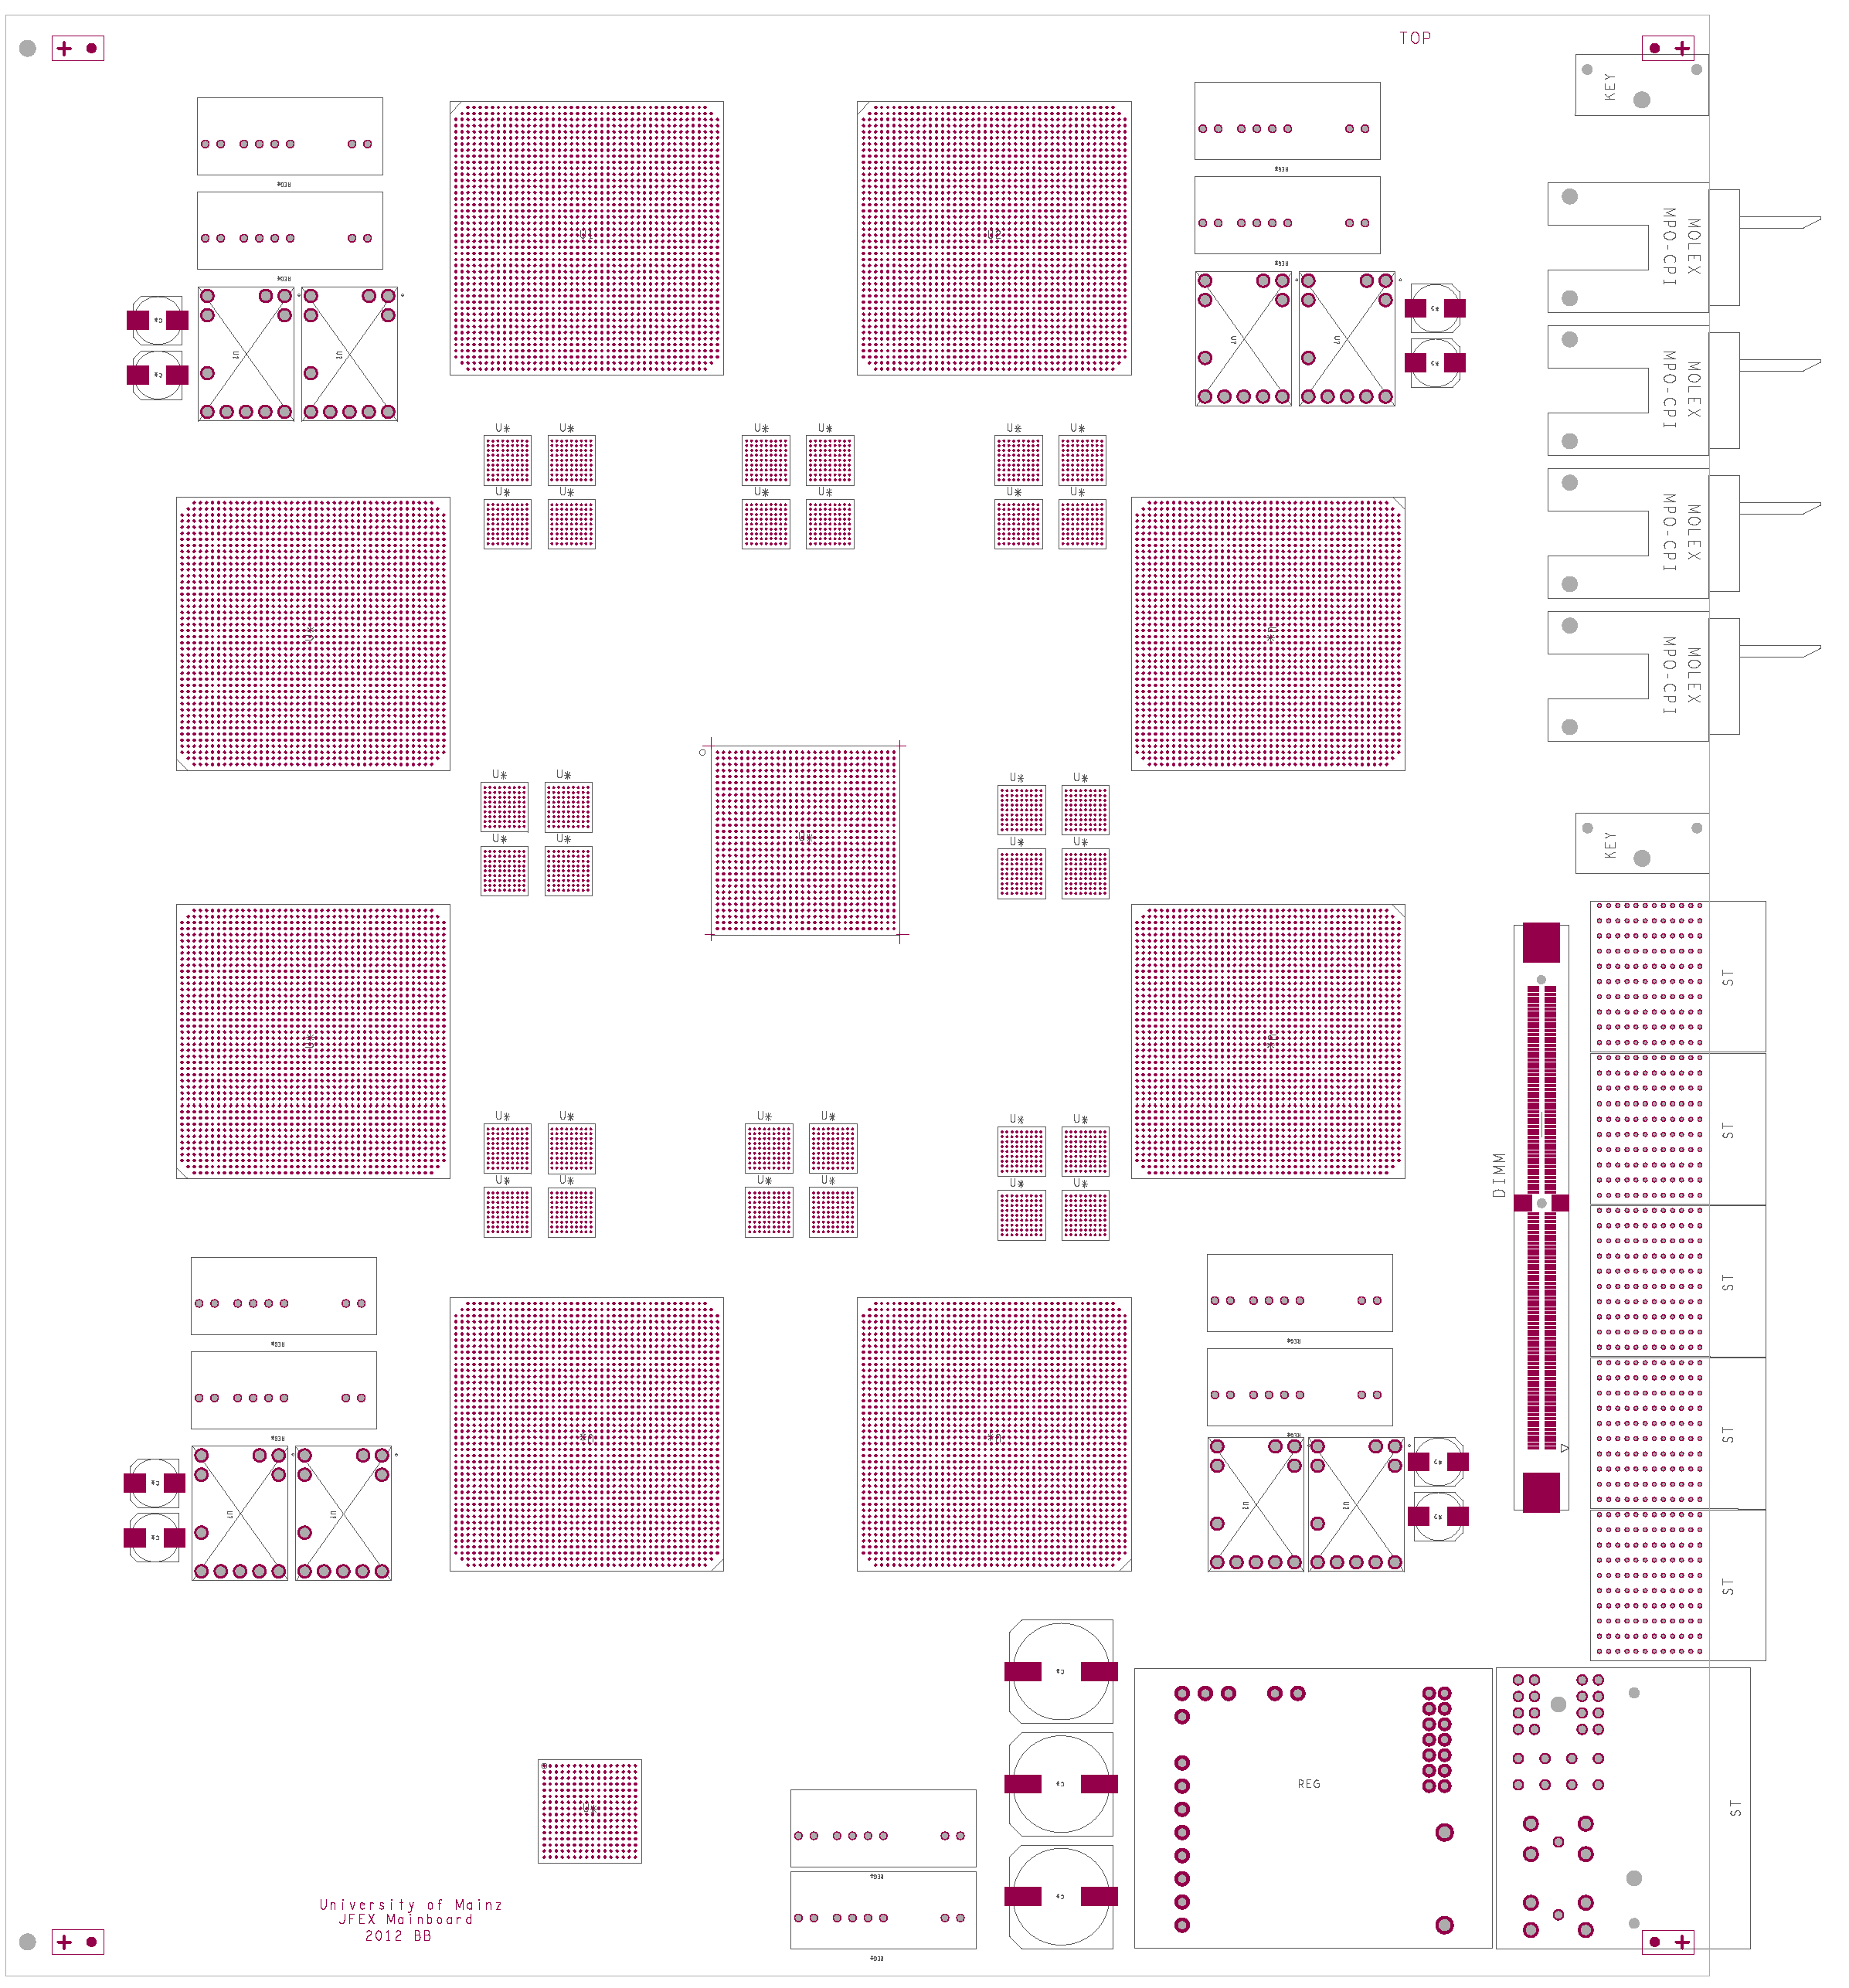
How to fit on a module ? -- jFEX
ATCA
8 processors (~XC7VX690T)
≤ 4 microPODs each
fan-out passive or “far end PMA loopback”
Small amount of control logic / non-realtime (ROD)
Might add 9th processor for consolidation of results
Electrical backplane basically unused
Opto connectors in Zone 3
Maximise module payload with help of small-footprint ATCA power brick and tiny IPMC mini-DIMM
Z3

Slide 8
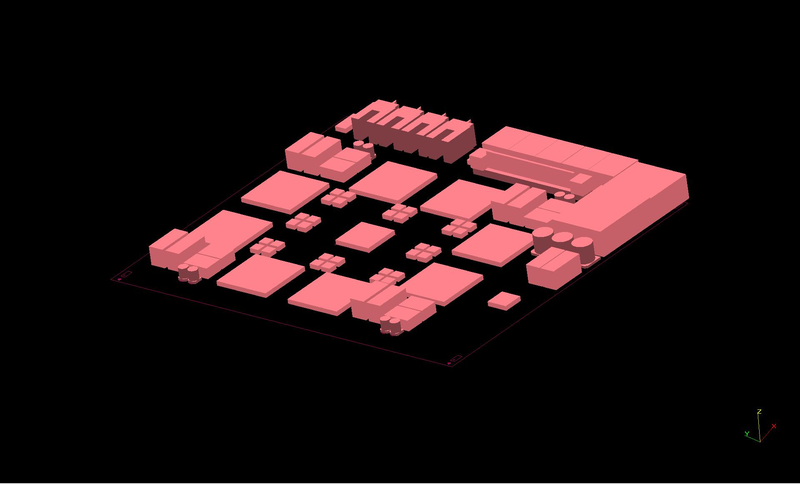
…and 3-d

Slide 9
fibre count / density
jFEX
full duplication in phi direction, exactly half of all 512 signals are routed into the modules optically on fibres
256 fibres
22 × 12-channel opto receivers
4 × 72-way fibre bundles / MTP connectors
For larger jet window we would require larger FPGAs, some more fibres and replication factor > ×2
eFEX
150~200 optical links for data input from LAr DPS
>50% shared between modules
>25% shared between FPGAs on the same module
All numerology depends on exact partitioning of the FEXes:

Slide 10
eFEX numerology

Slide 11
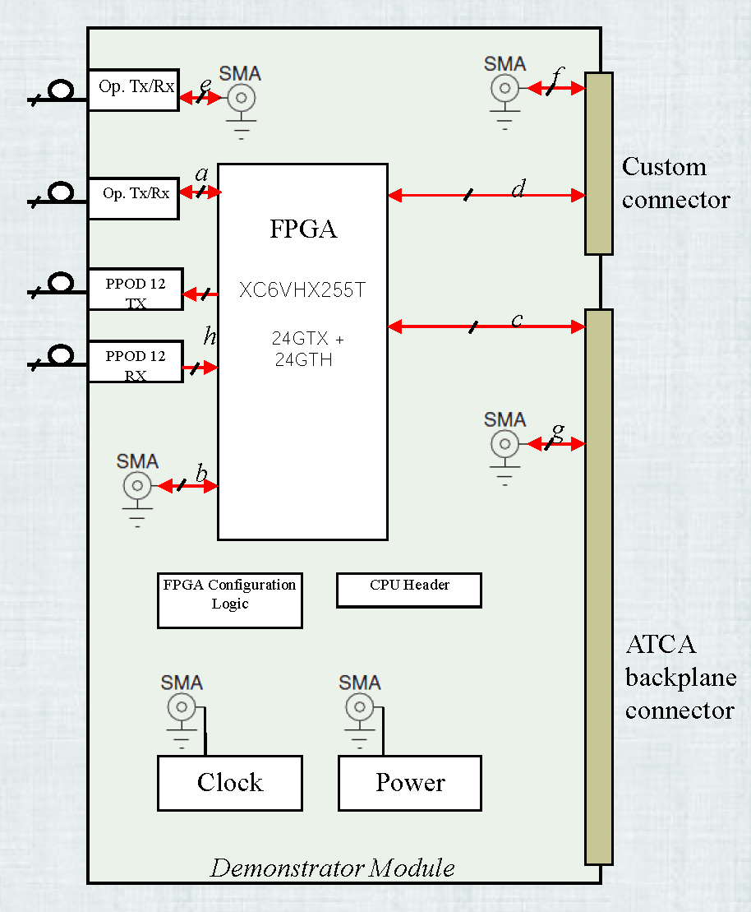
Some considerations…
6.4 Gb/s baseline seems rock solid
PCB simulations and measurements (on HSD) done for the eFEX agree well
Fibre and module density are high at 6.4
Continue to dig into higher data rates
Not ready to commit to 10Gb/s yet
Even basic FEXes still have options
Final choices once link speeds/bandwidth settled
eFEX link contents awaiting final decision on BCMux scheme (simulations?)
eFEX input data replication depends on environment for Tau agorithm
jFEX depends on jet size
Organisation of input links to be sorted out

Slide 12
conclusion
1-crate jFEX and 2-crate eFEX seem possible with ~2013’s technology
Key technologies being used on L1Topo and UK HSD
Allows for both good granularity and large environment at 6.4Gb/s line rate
Rather dense circuitry
Looking into higher transmission rates
DPS needs to handle the required duplication (in eta)
Details of fibre organization and content cannot be presented now

