Slide 1
JEM firmware
Uli

Slide 2
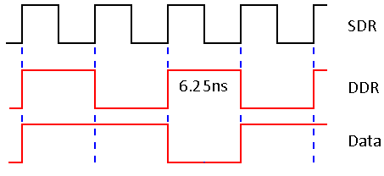
Backplane data transmission
… following discussions at CMX review…
Multiplex jet and energy sum data four-fold, to 160 Mb/s
24 source terminated data lines per JEM slot
Data contents have been specified elsewhere
Run a DDR clock signal (i.e. 80MHz) along the data lines
Source and sink terminated (on-chip)
Discussion on edge alignment between clock and data
CMXers will explore use of clocks edges lined up with data transitions at source
Possibly sub-optimal data window
… post CMX review…
started to look into JEM FPGA resources again
Might be able to shift DDR clock edge to centre of data eye
Check Virtex-2 resources – phase shifted clock vs. 160MHz … … just started (ISE 10.1 installed on Windows 8 …)

Slide 3
JEP firmware modification
Real-time path on both jet and energy sum processor
ROI data serialization to Level-2 on jet processor
DAQ data collected and formatted on energy sum processor
Data stream from input modules unchanged
Parallel data path from jet processor cut down from 24bit to 8bit wide (presence map)
Energy sum fields to be extended
Playback and spy memories on the merger data ports should probably be adapted, though they’ve never been used after initial test bench operation at Mainz (requires online software modifications as well!)
Only urgent activity is verification of phase shifted DDR clock option !
…two slides from Stockholm to follow…

Slide 4
Jet processor

Slide 5
Jet processor

