Slide 1
jFEX
Uli

Slide 2
Intro: L1Calo Phase-1 System / Jets
Jets
Phase-0
Jet elements 0.2 x 0.2 (η×φ) (pre-processor)
Sliding window processor for jet finding JEP / JEM
Jet multiplicity determination
Jet feature extraction into L1Topo (pre-phase1)
Phase-1: jet feature extractor jFEX
Improve on jet finding (and MET measurement)
Finer granularity
RTM
eFEX
Hub
Hub
Opt.
Plant
ROD
Hub
ROD
ROD
From Digital Processing System
RTM
jFEX
Hub
Hub
ROD
Hub
ROD
ROD
L1Topo
L1Topo
L1Topo
JEM
JEM
JEM
CMX
CMX
CMX
PPR
PPR
JMM
JMM
JMM
CPM
CPM
CPM
CMX
CMX
CMX
New at Phase 1

Slide 3
jFEX input data
Fibre optical inputs only
Fibre bundles via patch panel / fibre re-bundling stage
Granularity .1×.1 (η×φ)
One electromagnetic, one hadronic tower per η×φ bin
Unlike eFEX, no “BCMUX” scheme possible due to consecutive non-zero data
Baseline 6.4 Gb/s line rate, 8b/10b encoding, → 128 bit per BC
16bit energy per tower, 8 towers per fibre
LAr data from DPS
Tile … there are options…

Slide 4
Sliding Window Algorithms
Jet elements (towers)
ROIs environment
Increase dynamic range
Improve granularity by factor of four, to 0.1×0.1 (η×φ)
Slightly increase environment (0.9 × 0.9 baseline)
Allow for flexibility in jet definition (non-square jet shape, Gaussian filter, …)
Fat jets to be calculated from high granularity small jets
Optionally increase jet environment
Phase 0 Phase 1

Slide 5
Data replication
Sliding window algorithm requiring large scale replication of data
Forward duplication only (fan-out), no re-transmission
Baseline: no replication of any source into more than two sinks
Fan-out in eta handled at source only (DPS)
Transmit “core” and “environment” data
Duplication at the parallel end (on-FPGA), using additional Multi-Gigabit Transceivers
Allowing for differently composed streams
Minimizing latency
Fan-out in phi handled at destination only
Baseline “far end PMA loopback”
Looking into details and alternatives
N.B. phi strip vs. eta strip organisation tbd.
ϕ
η

Slide 6
jFEX module partitioning
Algorithm requiring environment of 0.9×0.9 around
each tower to be processed → +/- 4 neighbours in eta and phi
Processor FPGAs
core of 0.8×0.8
Fully duplicated data in both eta and phi
Total of 1.6×1.6 worth of data required
256 bins @ 0.1×0.1 granularity
separate e/m + had channels → 512 numbers (16-bit energies)
That equals 64 on-chip receivers @6.4Gb/s (128 bit/lane/BC)
Due to 100% on-board duplication, 32 of them are driven from a fibre
Processor modules
Processing phi ring
Receiving fully duplicated data in eta from DPS
Module covering full phi (8×0.8), limited eta range of .8
Carrying 8 FPGAs
→ total of 8×32=256 fibres coming in
22 × 12-way opto modules “MicroPOD” high density receivers
Four 72-way fibre connectors (“MPO/MTP”)
ϕ
η

Slide 7
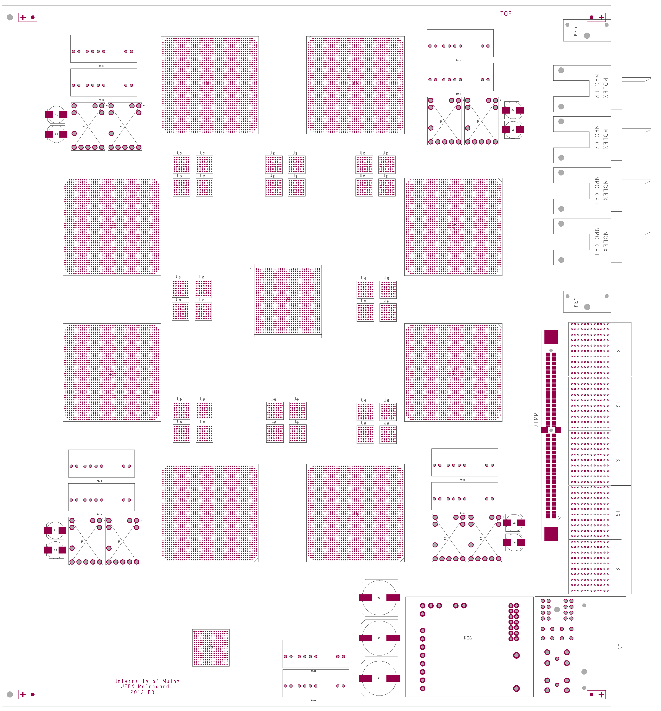
How to fit on a module ?
AdvancedTCA format
8 processors (~XC7VX690T)
4 microPOD sockets each μ (including spare output)
Opto connectors in Zone 3
Fibre bundles from rear F
fan-out via “far end PMA loopback” P
consolidation of results on one of the processors Q (alternatively direct output)
Output to front panel
Small amount of module control logic / non-realtime (ROD)
Maximise module payload with help of small-footprint ATCA power brick and tiny IPMC mini-DIMM
7V
Z3
μ
F
front
in
rear
Q
out
P

Slide 8
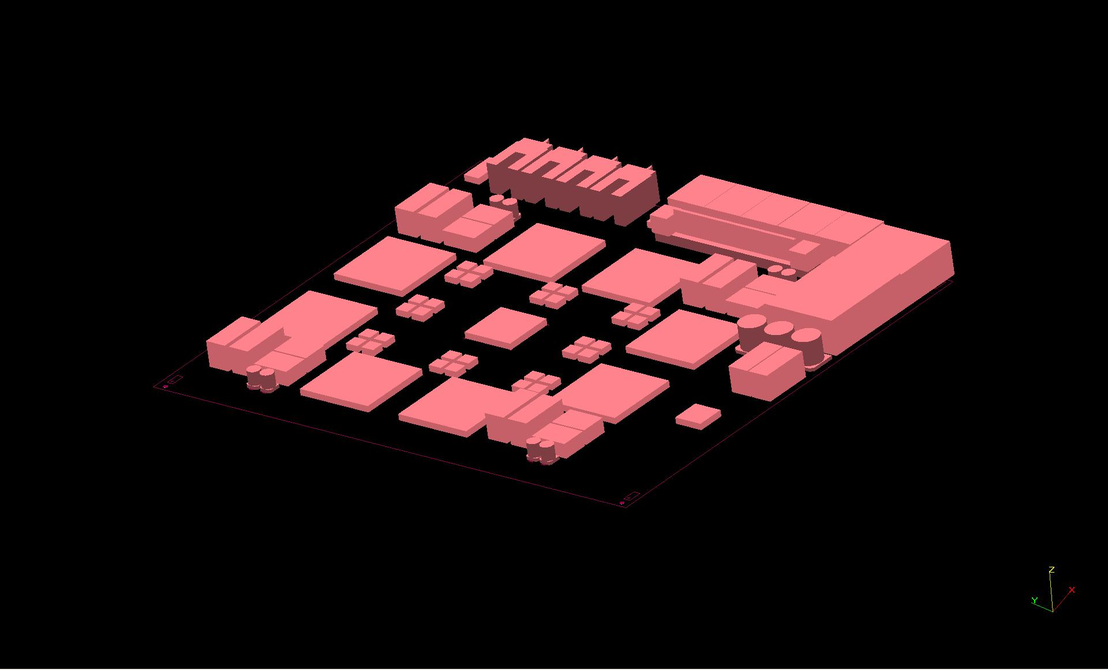
…and 3-d

Slide 9
Alternative partitioning : eta strips
At phase-2 strips along eta might better match tile modularity
Larger environment is favoured physics-wise
Explore different mapping of (η×φ)-space to modules
–→
Cut detector in two halves along η=0
Process 10-11 phi bins and half of all eta bins (~32) on one jFEX
Allows for environment up to 1.1×1.1
Density of 352 bins per module (vs. 512 for phi ring scheme)
Requires additional duplication at η=0
Optical re-transmission might be possible due to (currently) lower latency for central barrel channels (cable paths)
Short fibre links between neighbouring modules, if modules of +/- η, same φ are interleaved in crate.
Discussions required
- η +

Slide 10
jFEX system
Need to handle both fine granularity and large jet environment (minimum 0.9×0.9)
Require high density / high bandwidth to keep input replication factor at acceptable level (3/4 of all FPGA inputs are duplicates)
Fit in 8 modules / 12 modules
Single ATCA shelf
Sharing infrastructure with eFEX
Handling / splitting of fibre bundles
ROD design
Hub design
RTM
ϕ
η
RTM
eFEX
Hub
Hub
Opt.
Plant
ROD
Hub
ROD
ROD
Optical inputs
RTM
jFEX
Hub
Hub
ROD
Hub
ROD
ROD
L1Topo
L1Topo
L1Topo

Slide 11
Firmware and (control / test) software
high speed infrastructure (MGT)
data conditioning (alignment/40Mbps/masks/pre-sums)
thresholding scheme
default jet algorithm (sliding window)
advanced algorithms: jets, fat taus, ...
energy sums
board level merger / topology object formation and selection
DAQ/ROI interface / embedded ROD (f/w, s/w)
low level control (ATCA / IPMC to FPGA paths) f/w, s/w
module (high level) control: register maps / IPBus and interfaces (f/w, s/w)
Alignment control / monitoring / diagnostics / playback / spy incl. s/w
TTC interface / embedded TTC
in situ configuration update scheme (f/w, s/w)
*Firmware requiring large amount of corresponding software, PC based / embedded processor. Partitioning in firmware vs. software not currently defined. Significant effort required on module and system tests at CERN.

Slide 12
Schedule / Effort
Plus installation/commissioning/system tests thereafter.
Milestones PDR Q3/2013 FDR Q3/2015 PRR Q3/2016
Requirements
jFEX hardware, firmware: total of 17 FTE over 6 years, rather evenly spread until production…
JMM mezzanine renewal (h/w+f/w) including TileCal fibre interface: total of 5 FTE over 6 years
Integration, installation, commissioning (jFEX share): 6 FTE / 6 years
Known available effort:
Mainz is able to cover all required work on hardware, firmware and installation/commissioning
Total effort available: Physicist 5FTE, Engineer 1FTE per year

Slide 13
Conclusion
The 8-module, single crate jFEX seems possible with today’s technology
Use of MicroPODs challenging (thermal and mechanical) – o/e engine is the same as in popular MiniPODs
Phi ring scheme (→IDR) allows for fine granularity and large environment @ 6.4Gb/s and 100% duplication of input data
Larger environment achieved at baseline data rate by eta strip partitioning (2*6 modules, 1 crate)
Which scheme is more suitable for phase-2 ?
Even finer granularity and / or larger jets possible at higher transmission rates
DPS needs to handle the required duplication
in eta (phi ring scheme)
in phi (eta strip scheme)
Details of fibre organization and content to be defined.
Started work on detailed specifications, in parallel exploring higher data rates…

