Slide 1
jFEX
Mainz

Slide 2
Jet processing
Phase-0 jet system consisting of
Pre-Processor
Analogue signal conditioning
Digitization
Digital signal processing
Jet element pre-summation to 0.2 x 0.2 (η×φ)
Jet processor
Sliding window processor for jet finding
Jet multiplicity determination
Jet feature extraction into L1Topo (pre-phase1)
At phase-1: complement with jet feature extractor jFEX
Improve on jet finding (and MET measurement)
LAr signals optically from digital processor system
TileCal signals three options
L1Topo
L1Topo
L1Topo
JEM
JEM
JEM
CMX
CMX
CMX
PPR
PPR
JMM
JMM
CPM
CPM
CPM
CMX
CMX
CMX

Slide 3
L1Calo Phase-1 System
RTM
eFEX
Hub
Hub
Opt.
Plant
ROD
Hub
ROD
ROD
From Digital Processing System
RTM
jFEX
Hub
Hub
ROD
Hub
ROD
ROD
L1Topo
L1Topo
L1Topo
JEM
JEM
JEM
CMX
CMX
CMX
PPR
PPR
JMM
JMM
JMM
CPM
CPM
CPM
CMX
CMX
CMX
New at Phase 1

Slide 4
jFEX input data
Fibre optical inputs only
Fibre bundles via patch panel / fibre re-bundling stage
Granularity .1×.1 (η×φ)
One electromagnetic, one hadronic tower per η×φ bin
Unlike eFEX, no “BCMUX” scheme possible due to consecutive non-zero data
6.4 Gb/s line rate, 8b/10b encoding, → 128 bit per BC
16bit energy per tower, 8 towers per fibre
LAr data from DPS
Tile … see later presentations

Slide 5
Algorithms, now…
Sliding window algorithm (sliding in φ, η)
Operate on jet elements (towers) 0.2 x 0.2
Find and disambiguate ROIs sized 0.4 x 0.4
Calculate jet energy in three differently sized windows (programmable), up to 0.8 x 0.8
Jet size (window size) limited by environment (data duplication)
Granularity defined by arithmetic on Pre-Processor ASIC (pre-sum)

Slide 6
… and then
Increase dynamic range
Improve granularity by factor of four, to 0.1×0.1 (η×φ)
Slightly increase environment (0.9 × 0.9 baseline)
Allow for flexibility in jet definition (non-square jet shape, Gaussian filter, …)
Fat jets to be calculated from high granularity small jets
Optionally increase jet environment
Phase 0 Phase 1

Slide 7
Data replication
Sliding window algorithm requiring large scale replication of data
Forward duplication only (fan-out), no re-transmission
Baseline: no replication of any source into more than two sinks
Fan-out in eta handled at source only (DPS)
Transmit “core” and “environment” data
Duplication at the parallel end (on-FPGA), using additional Multi-Gigabit Transceivers
Allowing for differently composed streams
Minimizing latency
Fan-out in phi handled at destination only
Baseline “far end PMA loopback”
Looking into details and alternatives
N.B. phi strip vs. eta strip organisation tbd.
ϕ
η

Slide 8
jFEX partitioning
Algorithm requiring environment of 0.9×0.9 around
each tower to be processed → +/- 4 neighbours in eta and phi
Processor FPGAs
core of 0.8×0.8
Fully duplicated data in both eta and phi
Total of 1.6×1.6 worth of data required
256 bins @ 0.1×0.1 granularity
separate e/m + had channels → 512 numbers (16-bit energies)
That equals 64 on-chip receivers @6.4Gb/s (128 bit/lane/BC)
Due to 100% on-board duplication, 32 of them are driven from a fibre
Processor modules
Processing strip along phi
Receiving fully duplicated data in eta from DPS
Module covering full phi (8×0.8), limited eta range of .8
Carrying 8 FPGAs
→ total of 8×32=256 fibres coming in
22 × 12-way opto modules “MicroPOD” high density receivers
Four 72-way fibre connectors (“MPO/MTP”)
ϕ
η

Slide 9
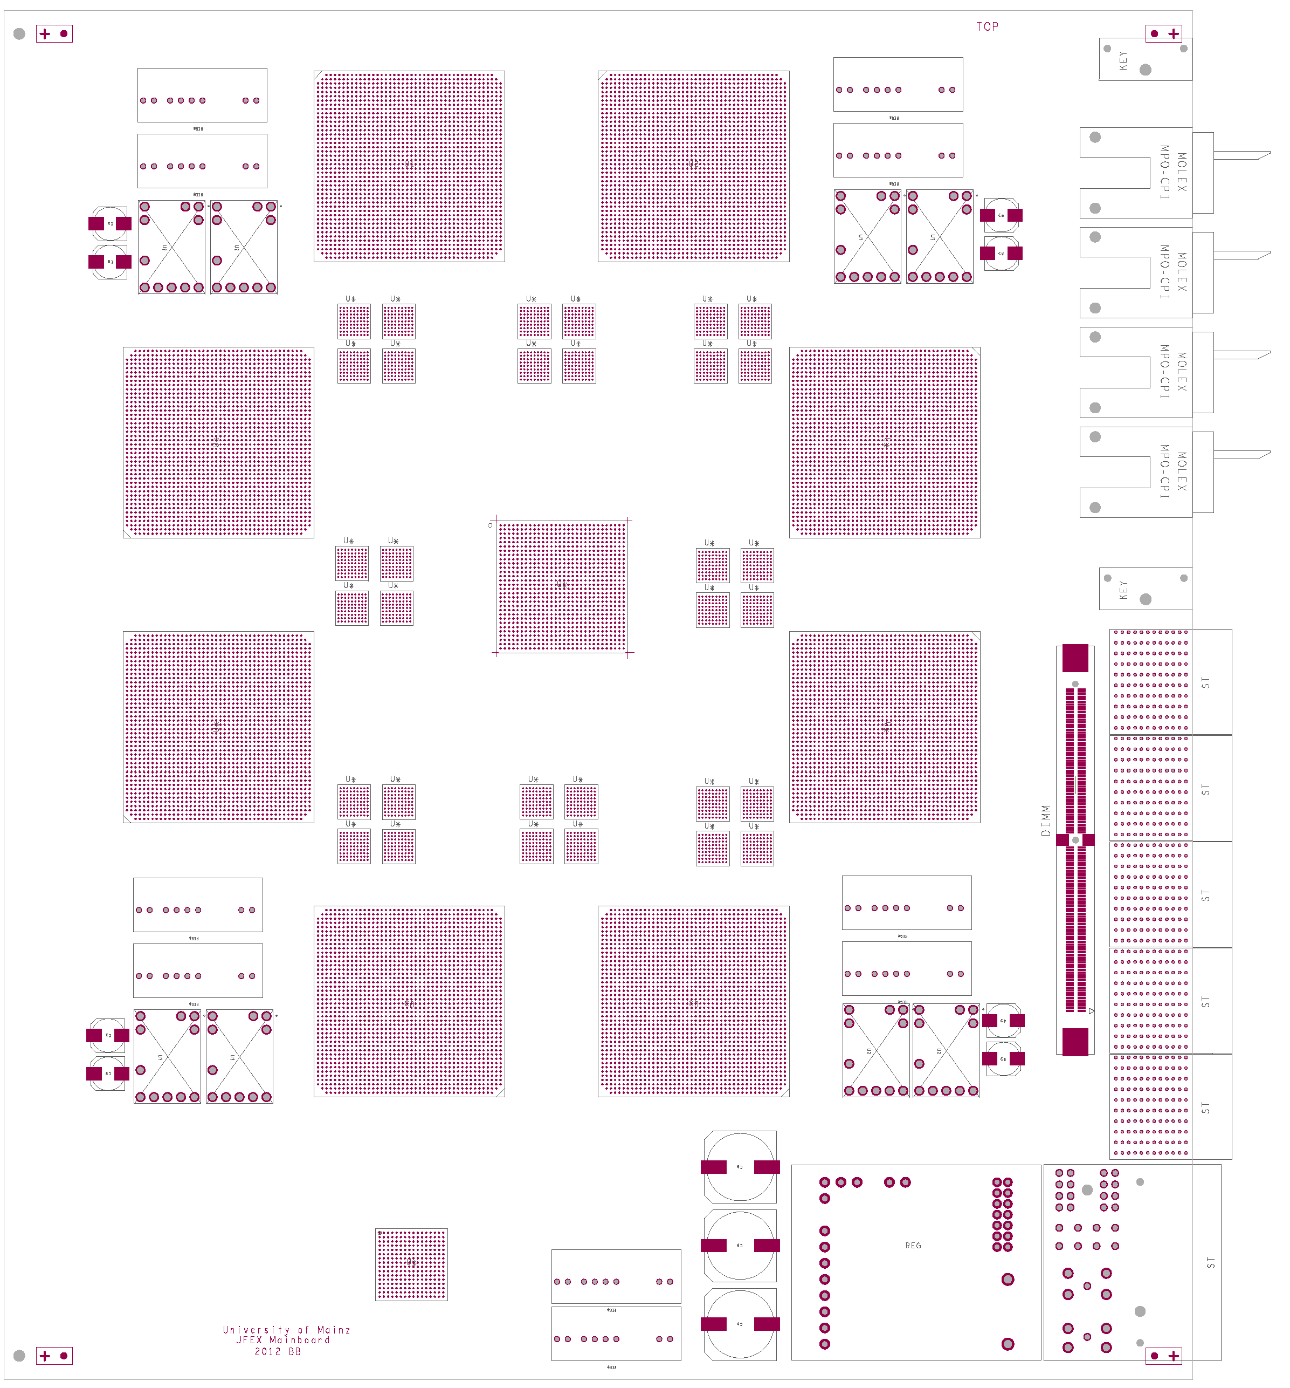
How to fit on a module ?
AdvancedTCA format
8 processors (~XC7VX690T)
4 microPOD sockets each μ (including spare output)
Opto connectors in Zone 3
Fibre bundles from rear F
fan-out via “far end PMA loopback” P
consolidation of results on one of the processors Q (alternatively direct output)
Output to front panel
Small amount of module control logic / non-realtime (ROD)
Maximise module payload with help of small-footprint ATCA power brick and tiny IPMC mini-DIMM
7V
Z3
μ
F
front
in
rear
Q
out
P

Slide 10
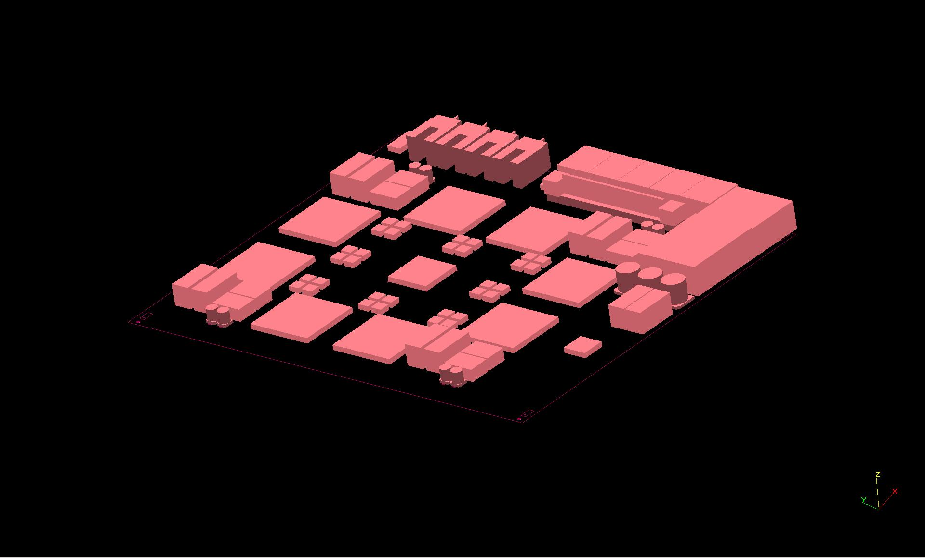
…and 3-d

Slide 11
jFEX system
Need to handle both fine granularity and large jet environment (minimum 0.9×0.9)
Require high density / high bandwidth to keep input replication factor at acceptable level (3/4 of all FPGA inputs are duplicates)
Fit in ~ 8 modules (+FCAL ?)
Single crate
→ go for ATCA shelf / blades:
Sharing infrastructure with eFEX
Handling / splitting of fibre bundles
ROD design
Hub design
RTM
ϕ
η
RTM
eFEX
Hub
Hub
Opt.
Plant
ROD
Hub
ROD
ROD
Optical inputs
RTM
jFEX
Hub
Hub
ROD
Hub
ROD
ROD
L1Topo
L1Topo
L1Topo

Slide 12
Some considerations…
jFEX relies on “MicroPOD” high-density optical devices
Electro-optical engine identical to popular “MiniPOD”s
Currently looking into mechanical and thermal issues
In contact to manufacturer to benefit from recent developments there
MicroPODs small enough to provide additional direct output from each processor FPGA if required (for fat jet determination on L1Topo module)
6.4 Gb/s baseline seems rock solid
Fibre and module density are high but feasible
Aim at higher line rates (currently FPGAs support 13 Gb/s, MicroPOD 10 Gb/s)
Allow for even finer granularity / larger jets / smaller FPGA devices :
If digital processor baseline allows for full duplication of 6.4Gb/s signals, the spare capacity, when run at higher rate, can be used to achieve a replication of more than 2-fold, so as to support a larger jet environment.
The jFEX shall be compatible to phase 2
might affect organisation of input links (eta strips vs. phi strips)
Organisation of input links to be sorted out anyway

Slide 13
Firmware / Software
jFEX firmware
Sliding window algorithm / feature extraction
Board-level merging
Monitoring and diagnostics
Infrastructure for high speed links
Module control
DAQ (buffers and embedded ROD functionality)
ATCA control
TTC interface
Most items are common effort with eFEX
TileCal input – Example : JEM based TileCal inputs
Serialization nMCM 960Mb/s
Serialization JMM 6.4Gb/s
Re-target existing JEM input firmware to new FPGA
Software:
jFEX specific software is mainly register model and simulation of real-time path

Slide 14
Schedule / Effort
Plus installation/commissioning/system tests thereafter.
Milestones PDR Q3/2013 FDR Q3/2015 PRR Q3/2016

Slide 15
Effort
Requirements
jFEX hardware, firmware: total of 17 FTE over 6 years, rather evenly spread until production…
JMM mezzanine renewal (h/w+f/w) including TileCal fibre interface: total of 5 FTE over 6 years
Integration, installation, commissioning (jFEX share): 6 FTE / 6 years
Known available effort:
Mainz is able to cover all required work on hardware, firmware and installation/commissioning of jFEX and JMM.
Total effort available: Physicist 5FTE, Engineer 1FTE per year
Heidelberg
is able to cover estimated need of 2 FTE/year on LCD and RTM
Total effort available > 2FTE/year

Slide 16
Conclusion
The 8-module jFEX seems possible with ~2013’s technology
Key technologies explored already (GOLD, L1Topo,…)
Use of MicroPODs challenging for thermal and mechanical reasons, but o/e engine is the same as in popular MiniPODs
Scheme allows for both fine granularity and large environment at 6.4Gb/s line rate and a limit of 100% duplication of input channels
Rather dense circuitry, but comparable to recent projects
Even finer granularity and / or larger jets possible at higher transmission rates
DPS needs to handle the required duplication (in eta)
Details of fibre organization and content cannot be presented now
Started work on detailed specifications, in parallel exploring higher data rates…
TileCal signals required in FEXes in fibre-optical format
Three options for generating them
All seem viable, but probably at different cost. Need to converge.

