Slide 1
jFEX
not yet final…
Uli
Intro / overview / issues
Some questions flagged

Slide 2
Intro: L1Calo Phase-1 System / Jets
Jets
Phase-1: jet feature extractor jFEX
Finer granularity:
Improve on jet finding (and MET measurement)
Jet size…
RTM
eFEX
Hub
Hub
Opt.
Plant
ROD
Hub
ROD
From Digital Processing System
RTM
jFEX
Hub
Hub
ROD
Hub
ROD
L1Topo
L1Topo
L1Topo
JEM
JEM
JEM
CMX
CMX
CMX
PPR
PPR
JMM
JMM
JMM
CPM
CPM
CPM
CMX
CMX
CMX
New at Phase 1

Slide 3
Baseline jFEX input data
  Fibre bundles via patch panel / fibre re-bundling stage
  Granularity .1×.1 (η×φ)
  One electromagnetic, one hadronic tower per η×φ bin
Baseline 6.4 Gb/s line rate, 8b/10b encoding,
→ 128 bit per BC
Up to 16bit energy per tower ➔ 8 towers per fibre
LAr : pre-summed data from DPS (no BCmux)
Tile … options…
Stick to 6.4 ?

Slide 4
Sliding Window Algorithms
Jet elements (towers)
ROIs environment
Increase dynamic range
Improve granularity by factor of four, to 0.1×0.1 (η×φ)
Slightly increase environment (0.9 × 0.9 baseline)
Allow for flexibility in jet definition
Fat jets to be calculated from high granularity small jets ?
Optionally increase jet environment
Assume fat tau algorithm resides in same FPGAs
Baseline ?
Phase 0 Phase 1

Slide 5
Data replication
Sliding window algorithm requiring large scale replication of data
Forward duplication only (fan-out), no re-transmission
Baseline: no replication of any source into more than two sinks
Eta-strip / phi quadrant organisation:
Fan-out in phi handled at source only (DPS)
  Transmit “core” and “environment” data
  Duplication at the parallel end (on-FPGA), using additional Multi-Gigabit Transceivers
  Allowing for differently composed
  streams
  Minimizing latency
Fan-out in eta handled at
destination only
  Baseline “far end PMA loopback”
  Looking into details and alternatives
  (passive electrical splitting)
?
ϕ
η

Slide 6
jFEX module partitioning baseline
Algorithm requiring environment of 0.9×0.9 around
each tower to be processed → +/- 4 neighbours in eta and phi
Processor modules
  Process strips along eta
  Receive fully duplicated data in phi from DPS
  8 modules covering half of eta, phi quadrant each
  Most cells duplicated in a regular way at both
  source and sink
  “Irregular” duplication at η=0
  (Current) detector cabling has lower latency around η=0 due to cable path
  Benefit from this latency reserve
  and use for additional optical fan-out
  (re-transmission)
Enough?
ϕ
η
Rely on that ?
η=0

Slide 7
jFEX baseline partitioning
Processor modules
Half eta × phi quadrant per module ~3.2 × 1.6
Total of ~32 × 16 bins × 2 × 2 (upstream duplication, e/h)
~256 incoming fibres @ 6.4Gb/s baseline
~22 × 12-way “MicroPOD” high density receivers
Four 72-way fibre connectors (“MPO/MTP”)
Note: further connectivity required for duplication at η=0: either front (re-transmission) or back (separate active optical fanout station)
Processor FPGAs
Core of up to 1.2×0.8 (η×ϕ), plus environment 0.8×0.8
20 × 16 bins → 80 high speed links
6 large FPGAs per module (3 × 2)
Eta coverage nominally (3 × 1.2)+0.4 = 4
288 fibres enough ?
FCAL granularity
overlap region

Slide 8
Baseline and options
Phi quadrant baseline driven by need for a rock solid design:
Line rate limited to 6.4 Gb/s only
Avoid extremely dense module
Sufficient η ×ϕ coverage at module level to allow for increase of environment » baseline of 0.9 × 0.9
Orientation along eta might better match Tilecal in phase 2 ?
Backup
In case of problems with η=0 - duplication go for full eta,
phi octant scheme
Options
Continue work on higher link speed
Continue work on duplication schemes
Consider slightly larger/more FPGAs
→ Increase environment beyond 0.9 × 0.9
Do we need the details for higher rate option now ?

Slide 9
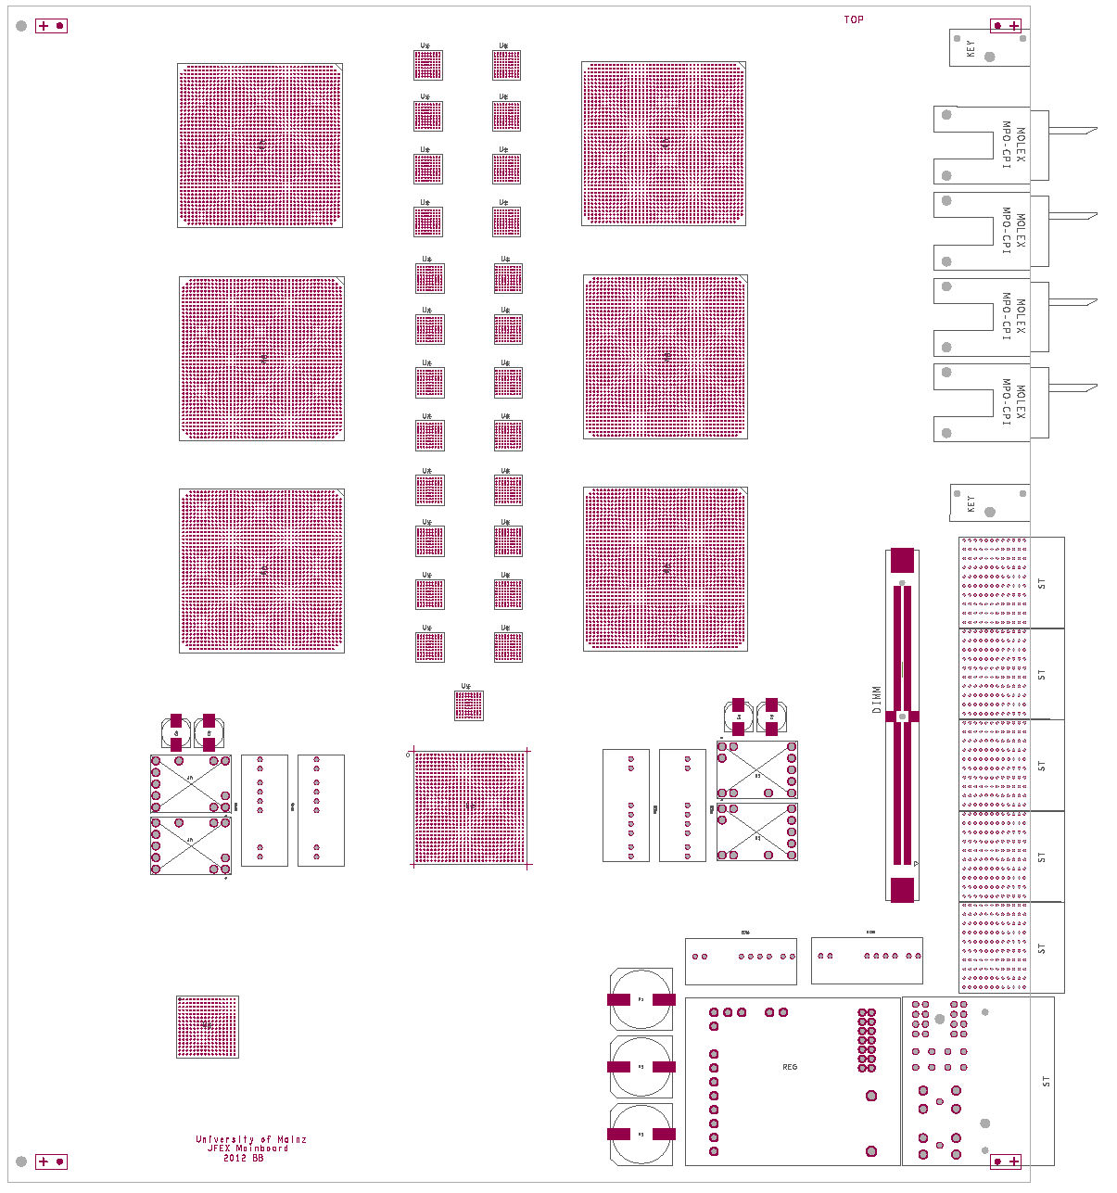
How to fit on a module ?
AdvancedTCA format
6 processors XC7VX690T
4 microPOD sockets each μ
Opto connectors in Zone 3
Fibre bundles from rear F
fan-out via “far end PMA loopback” P
Output to front panel
Readout via backplane
Maximise module payload: small-footprint ATCA power brick, tiny IPMC mini-DIMM
7V
Z3
μ
P
in
F
front
rear
out
ATC250 enough ?

Slide 10
jFEX system (baseline)
  Need to handle both fine granularity and large jet environment (minimum 0.9×0.9)
  Require high density / high bandwidth to keep input replication factor at acceptable level (~3/4 of all FPGA inputs are duplicates)
  Fit in 8 modules (difficult to spread out)
Single ATCA shelf
Sharing infrastructure with eFEX
  Handling / splitting of fibre bundles
  Some communalities in ROD design
  Hub design
  RTM
ϕ
η
RTM
eFEX
Hub
Hub
Opt.
Plant
ROD
Hub
ROD
ROD
Optical inputs
RTM
jFEX
Hub
Hub
ROD
Hub
ROD
ROD
L1Topo
L1Topo
L1Topo

Slide 11
Some remarks on baseline
FPGA density reduced wrt previously presented phi ring scheme
Still very dense design, high power dissipation
FPGA count might grow again for larger jet option
Real-time circuitry has absolute precedence over non-real-time components
  Happy to see RODs move off module
  Any TTC solution must be minimum footprint
  Power and ATCA control minimized in floor-plan shown
Baseline design would probably allow for low-latency direct output into L1Topo (48 fibres total)
Output consolidation possible at some latency penalty
jFEX relies on “MicroPOD” high-density optical devices
Aim at higher line rates (currently FPGAs support 13 Gb/s, Mini/MicroPOD 14 Gb/s)
Would allow for even finer granularity or larger jets or smaller FPGA devices

Slide 12
Issues / questions
Many issues that came up recently are common to both FEXes. Concentrate on jFEX specific issues here.
What is our default jet algorithm ?
The 6.4 Gb/s baseline is not quite what we want to build
  At module level there is enough environment for large jets
  With FPGAs available on the market that cannot be exploited (excessive on-board duplication)
Is 6.4 Gb/s / 0.9 x 0.9 ok, assuming we will not actually build the baseline but rather increase input rates 2-fold ?
jFEX preferring 12.8G 8b/10b over eFEX preferred 64/66!
What real-time output bandwidth is required ?
  Board level merging (phase 1) ?
  Phase 2 output to L1Calo ?

Slide 13
Power…
Large FPGAs easily dissipate 30W each.
Standard ATCA power modules rated 250W (ATC250)
Might have to find non-standard solution
High power crates today provide 450W/slot (power, cooling)
Larger jet environment will inevitably increase power consumption
microPODs are tiny and have a considerable local dissipation, likely to require custom mechanics/heat sinks

Slide 14
questions
Can we agree on common components
  IPbus
  LAPP DIMM
  Configuration (SysACE?)
  Some TTC
    Small footprint
    Ideally firmware only
    Just one clean clock plus an MGT link for data ?
The ROD is understood to be conceptually similar between FEXes.
Can we agree on something that doesn’t require large local buffers on the processors ?

