Slide 1
jFEX baseline
Uli

Slide 2
Intro: L1Calo Phase-1 System / Jets
Jets
Phase-0
Jet elements 0.2 x 0.2 (η×φ) (pre-processor)
Sliding window processor for jet finding JEP / JEM
Jet multiplicity determination
Jet feature extraction into L1Topo (pre-phase1)
Phase-1: jet feature extractor jFEX
Improve on jet finding (and MET measurement)
Finer granularity
RTM
eFEX
Hub
Hub
Opt.
Plant
ROD
Hub
ROD
ROD
From Digital Processing System
RTM
jFEX
Hub
Hub
ROD
Hub
ROD
ROD
L1Topo
L1Topo
L1Topo
JEM
JEM
JEM
CMX
CMX
CMX
PPR
PPR
JMM
JMM
JMM
CPM
CPM
CPM
CMX
CMX
CMX
New at Phase 1

Slide 3
jFEX input data
Fibre optical inputs only
Fibre bundles via patch panel / fibre re-bundling stage
Granularity .1×.1 (η×φ)
One electromagnetic, one hadronic tower per η×φ bin
Baseline 6.4 Gb/s line rate, 8b/10b encoding, → 128 bit per BC
16bit energy per tower, 8 towers per fibre
LAr data from DPS
Tile … options…

Slide 4
Sliding Window Algorithms
Jet elements (towers)
ROIs environment
Increase dynamic range
Improve granularity by factor of four, to 0.1×0.1 (η×φ)
Slightly increase environment (0.9 × 0.9 baseline)
Allow for flexibility in jet definition (non-square jet shape, Gaussian filter, …)
Fat jets to be calculated from high granularity small jets
Optionally increase jet environment
Phase 0 Phase 1

Slide 5
Data replication
Sliding window algorithm requiring large scale replication of data
Forward duplication only (fan-out), no re-transmission
Baseline: no replication of any source into more than two sinks
Eta-strip organisation
Fan-out in phi handled at source only (DPS)
Transmit “core” and “environment” data
Duplication at the parallel end (on-FPGA), using additional Multi-Gigabit Transceivers
Allowing for differently composed streams
Minimizing latency
Fan-out in eta handled at destination only
Baseline “far end PMA loopback”
Looking into details and alternatives
N.B. module orientation in phi vs. eta strip tbd. Above scheme is baseline !
ϕ
η

Slide 6
Module partitioning
Give up on phi ring scheme
Baseline : Go for strips along eta !

Slide 7
jFEX module partitioning baseline
Algorithm requiring environment of 0.9×0.9 around
each tower to be processed → +/- 4 neighbours in eta and phi
Processor modules
Process strips along eta
Receive fully duplicated data in phi from DPS
8 modules covering half of eta, phi quadrant each
Most cells duplicated in a regular way at both source and sink
“Irregular” duplication at η=0
(Current) detector cabling has lower latency around η=0 due to cable path
Benefit from this latency reserve and use for additional optical fan-out (re-transmission)
ϕ
η
η=0

Slide 8
jFEX baseline partitioning
Processor modules
Half eta × phi quadrant per module
Total of ~32 × 16 bins × 2 × 2 (upstream duplication, e/h)
~256 incoming fibres @ 6.4Gb/s baseline
22 × 12-way opto modules “MicroPOD” high density receivers
Four 72-way fibre connectors (“MPO/MTP”)
Note: further connectivity required for duplication at η=0: either front (re-transmission) or back (separate active optical fanout station)
Processor FPGAs
Core of up to 1.2×0.8 (η×ϕ), plus environment 0.8×0.8
20 × 16 bins → 80 high speed links
6 large FPGAs per module

Slide 9
Baseline and options
Phi quadrant baseline driven by need for a rock solid design:
Line rate limited to 6.4 Gb/s only
Avoid extremely dense module
Sufficient η ×ϕ coverage at module level to allow for increase of environment » baseline of 0.9 × 0.9
Orientation along eta might better match Tilecal in phase 2
Backup
In case of problems with η=0 - duplication go for full eta, phi octant scheme
Options
Continue work on higher link speed
Continue work on duplication schemes
Consider slightly larger/more FPGAs
→ Increase environment beyond 0.9 × 0.9

Slide 10
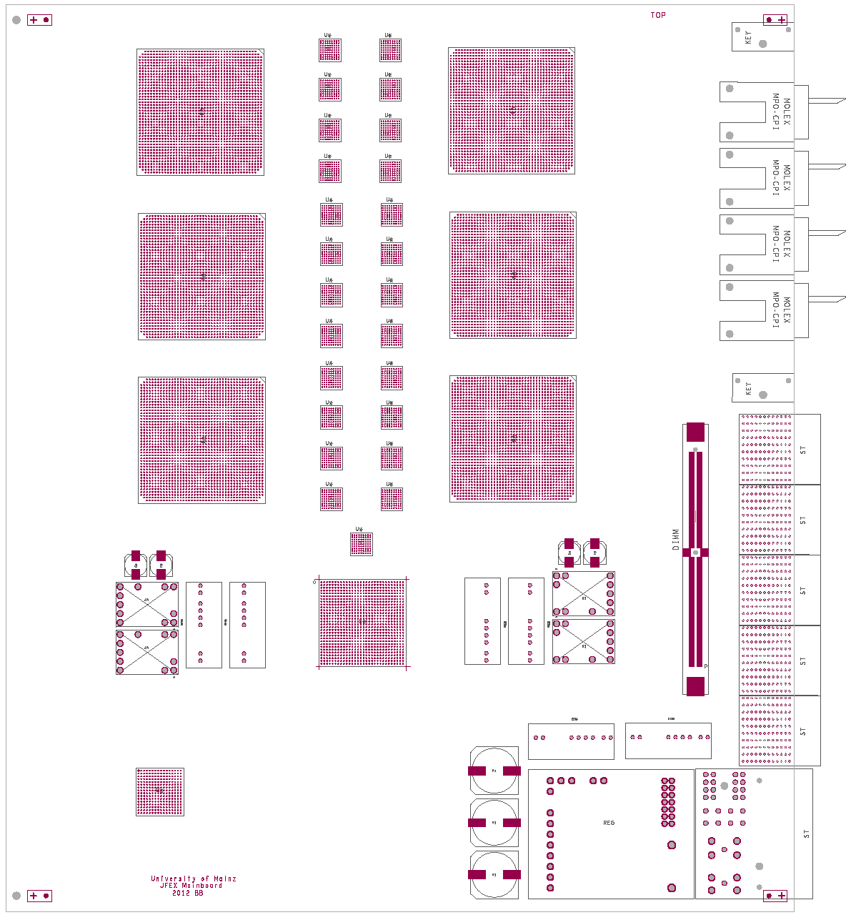
How to fit on a module ?
AdvancedTC A format
6 processors XC7VX690T
4 microPOD sockets each μ
Opto connectors in Zone 3
Fibre bundles from rear F
fan-out via “far end PMA loopback” P
Output to front panel
Small amount of module control logic / non-realtime
Maximise module payload: small-footprint ATCA power brick, tiny IPMC mini-DIMM
7V
Z3
μ
P
in
F
front
rear
out

Slide 11
jFEX system (baseline)
Need to handle both fine granularity and large jet environment (minimum 0.9×0.9)
Require high density / high bandwidth to keep input replication factor at acceptable level (~3/4 of all FPGA inputs are duplicates)
Fit in 8 modules
Single ATCA shelf
Sharing infrastructure with eFEX
Handling / splitting of fibre bundles
Some communalities in ROD design
Hub design
RTM
ϕ
η
RTM
eFEX
Hub
Hub
Opt.
Plant
ROD
Hub
ROD
ROD
Optical inputs
RTM
jFEX
Hub
Hub
ROD
Hub
ROD
ROD
L1Topo
L1Topo
L1Topo

Slide 12
Some remarks on baseline
FPGA density reduced wrt previously presented phi ring scheme
Still very dense design
FPGA count might grow again for larger jet option
Real-time circuitry has absolute precedence over non-real-time components
RODs tiny mezzanines or even external modules
Any TTC solution must be minimum footprint
Power and ATCA control minimized in floor-plan shown
Baseline design would probably allow for low-latency direct output into L1Topo (48 fibres total)
Output consolidation possible at some latency penalty

Slide 13
Conclusion
8-module, single crate jFEX possible with today’s technology
Use of MicroPODs challenging (thermal and mechanical) – o/e engine is the same as in popular MiniPODs
Eta strip (phi quad) scheme allows for fine granularity and large environment 0.9×0.9 @ 6.4Gb/s
Relies on lower latency of incoming data near η=0
With 100% duplication of input data at source there is enough environment data available on-module for larger environment
Higher transmission rates
DPS needs to handle the required 100% duplication in phi
Details of fibre organization and content to be defined.
Started work on detailed specifications, in parallel exploring higher data rates…

