Slide 1
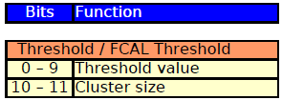
Software
Upgrade of JetProcessor pre-phase 1
Using updated firmware register map from Stockholm
Upgrade of EnergySumProcessor pre-phase 1
Firmware not yet updated
Updates to playback and spy memory
changes in the module services, simulation and test vectors
Integration of IPBus sw/register model for L1Topo
In cooperation with Christian and Murrough
Trying to setup IPBus software and L1Calo package on a virtual machine in Mainz
Write module services from scratch
Register model, test vectors, … to be done

