Slide 1
L1Topo Hardware Status & Plans
B.Bauß, V.Büscher, U.Schäfer, E.Simioni, S.Tapprogge, A. Vogel

Slide 2
Topology 2013/14 (RTDP)
6.4Gb/s fibre bundles
Legacy
electrical links
CMX
160 /
Cluster Processor
From PPr / nMCMs
Topo Processor
CTP
Core
12
/
Fibres & 3*32 electrical LVDS links
CMX
Jet/Energy Processor
Muons

Slide 3
Topology Processor – Pre-phase1
Correlating trigger objects (TOBs: jets, clusters, muons)
Single AdvancedTCA crate
Up to three modules running separate algorithms concurrently
    Fibre-optical input via Rear Transition Module on 48-way connectors
    MiniPOD optical receivers
    Input bandwidth 820 Gb/s @ 6.4Gb/s (2014 baseline rate)
    Two high-end FPGA processors (7-series) working concurrently on separate copies of the TOBs
    Additional parallel inter-FPGA real-time links (> 200Gb/s)
Both fibre bundle and low latency LVDS into CTPcore
Some critical circuitry on mezzanine, to allow for later mods
Well prepared for phase 1 / 2:
  Module control and readout compatible to L1Calo/FEX scheme
  accept line rates above 6.4Gb/s from future processors (FEXes, muons)

Slide 4
Topo Processor – Prototype
Fully ATCA compliant
  Form factor, power scheme, IPMC, base interface (Ethernet)
Real-time input path capable of multiple data rates
  One LHC bunch clock derived reference clock for receivers and transmitters
  Segmented clock trees with multiple crystal-based frequencies (receiver references only)
Total of 18 MiniPOD sockets (real-time input and output, readout)
Via four 48-way backplane connectors (realtime inputs) and front panel
XC7V690T FPGAs (first prototype: XC7V485T)
Interlinked by 238-way LVDS path
12-way optical output to CTP
32-way electrical (LVDS) output to CTP via mezzanine
Module control via “Kintex” control FPGA
Embedded ROD on control FPGA
Low-level control via IPMC dimm
Spare socket for “MARS” module

Slide 5
L1Topo
FPGA configuration via SystemACE or SD card
Optional use of SFP links into L1Calo RODs for initial debug (ROD neutral firmware)
Minor modifications expected for production modules
Remove “MARS” module option
Possibly remove SFP link option
Possibly increase bandwidth to allow for AXI4-stream interconnect to processor FPGAs (see presentation later today)
Simplify extension module scheme
Add optional readout and TTC connectivity for compatibility with L1Calo Phase-1 scheme (FEXes)
Final modifications will be discussed with reviewers at PRR

Slide 6
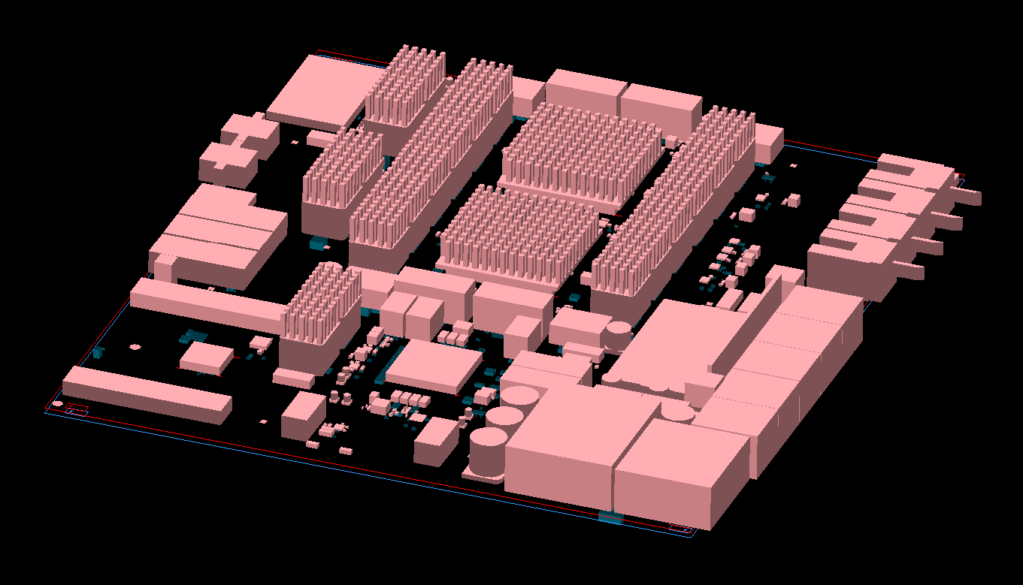
3–d

Slide 7
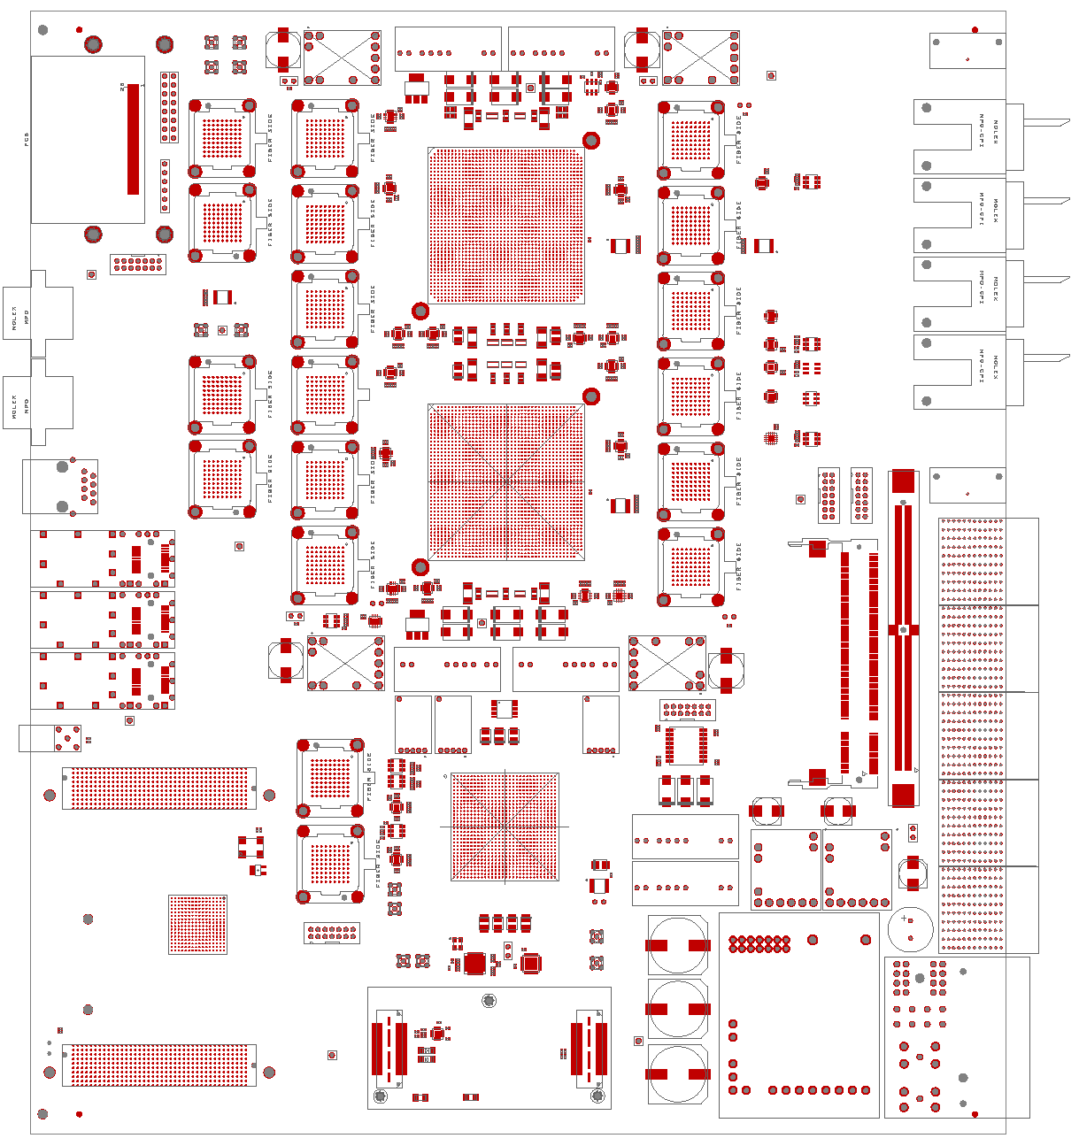
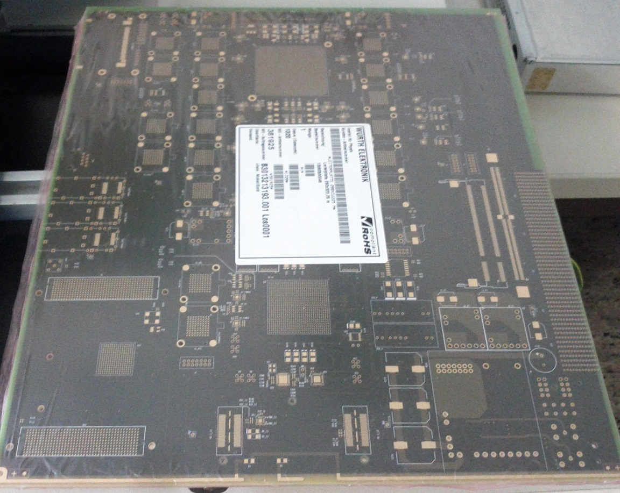
L1Topo Prototype
Floorplan and PCB

Slide 8
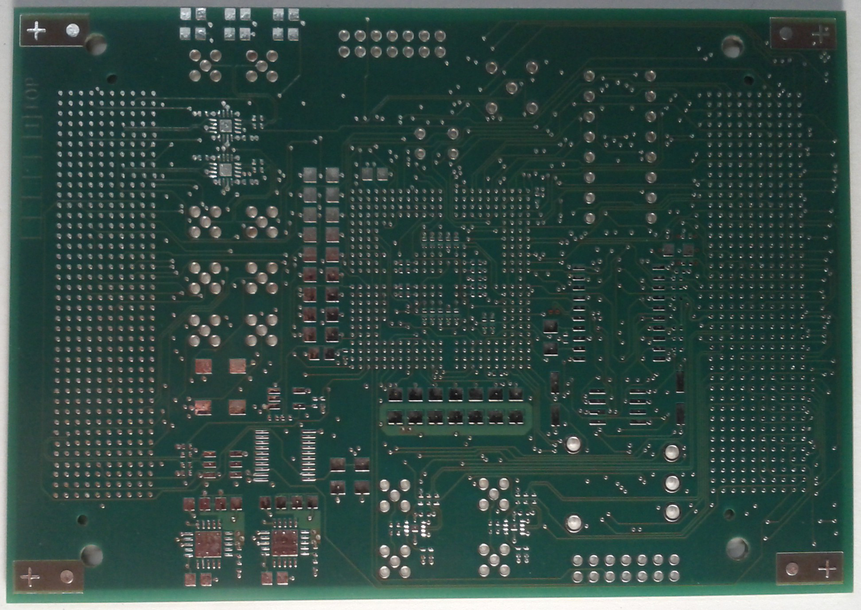
Hardware status
April 10 L1Topo PCB submission (3 weeks)
Production issues
Eventually three prototype PCBs received from manufacturer
One PCB out for assembly (4 weeks) since end of May
Delayed to probably mid July
Bruno will start initial tests (smoke test, boundary/scan) after vacation early August
Initial version of extension mezzanine:
  Bridging b/scan and control paths
  Connecting TTC/clocks and I2C buses
  PCB available
  Assembly in-house early August
No IPMC dimm available yet. Bring up
L1Topo on the bench initially

Slide 9
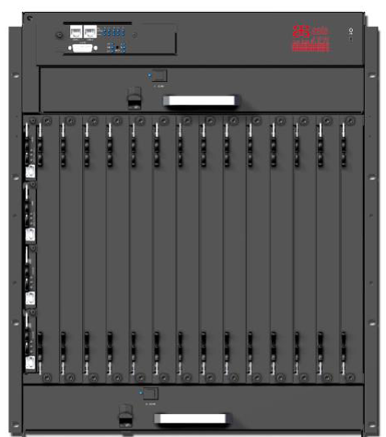
Hardware status
Eduard trying to find suitable ATCA crate
(vertical air flow) for operation in USA15
14 slots
14U(Height) × 10U (Width) × 9-10U (Depth)
Shelf management (IPMI two front access)
AC modular PSU
Base interface: Dual Star supporting
10/100/1000 Base-T Ethernet
Fabric interface: Full mesh available,
40 Gbps/chan
Dual redundant IPMC support
Up to 10 self cooled, AC hot swappable
PSU IPMI
-48 VDC, five feeds per PEM (up to 250 Amp)
~ 14K€ euro including NRE cost
+ power supply
Can be purchased once funds released

Slide 10
L1Topo – some Milestones
Jun 2012 PDR
Jan 2013 Internal review
May 2013 FDR
Oct 2013 start prototype tests @ CERN
Oct 2013 PRR
Jan 2014 assembly of production module finished
Apr 2014 start production module tests @ CERN
End 2014 commissioning done

Slide 11
Further news
Firmware and online S/W status will be presented separately
While we are waiting for L1Topo prototype to become available for tests:
Systematic link tests (Alex)
Work on I2C based component control (Eduard)

Slide 12
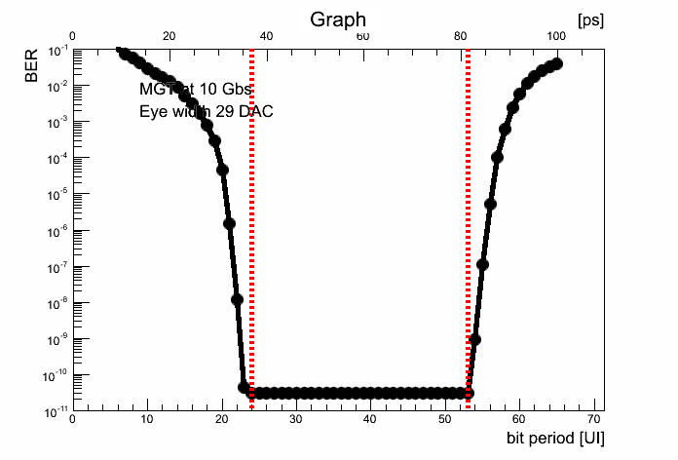
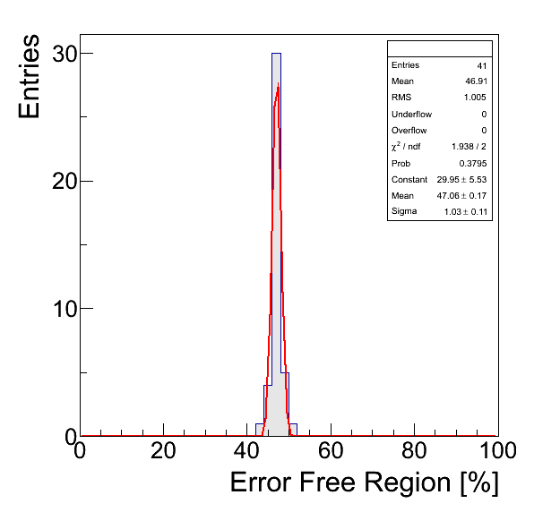
MGT systematic tests
For 10Gb/s, 8/10 bit encoding and 7bit PBRS path, and 1 second dwell time.
Repeated measurements of the error free region are well reproducible with
a standard deviation of 1%.
Measurements follows a gaussian distribution.
Next: verify if it holds for:
  different signal paths
  larger dwell time
  Link speed

Slide 13
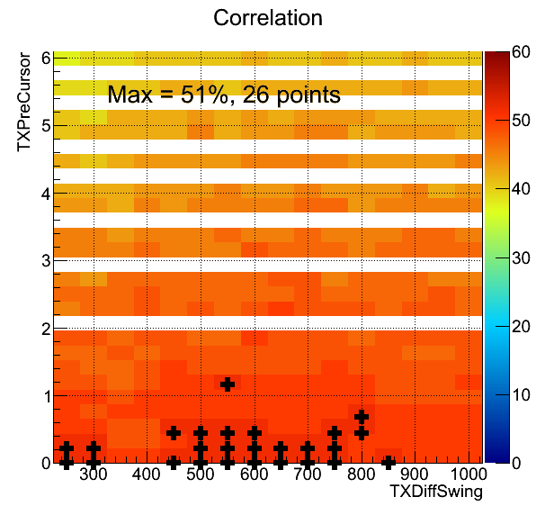
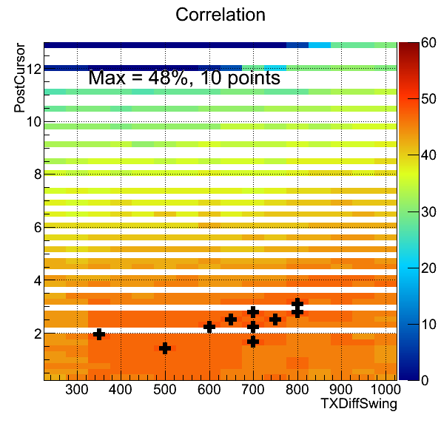
MGT systematic tests
MGT parameters characterization to maximize error free region
TX pre-cursor
TX diff-swing

Slide 14
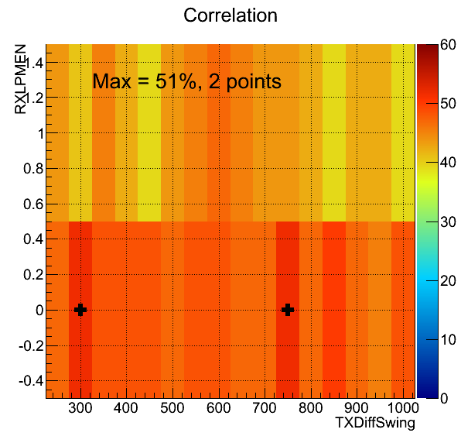
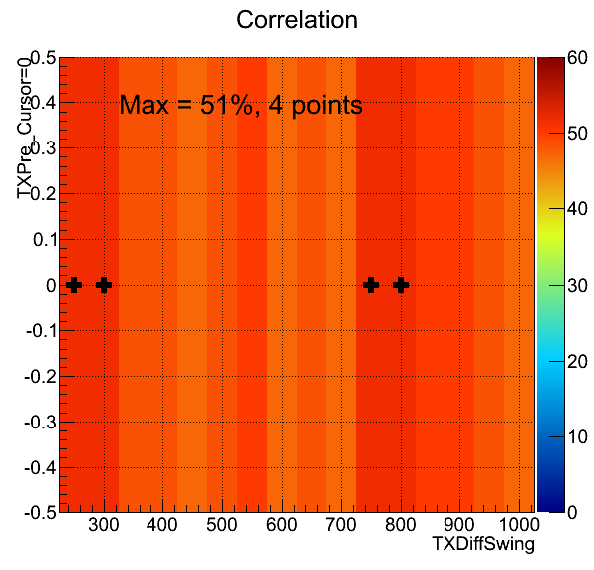
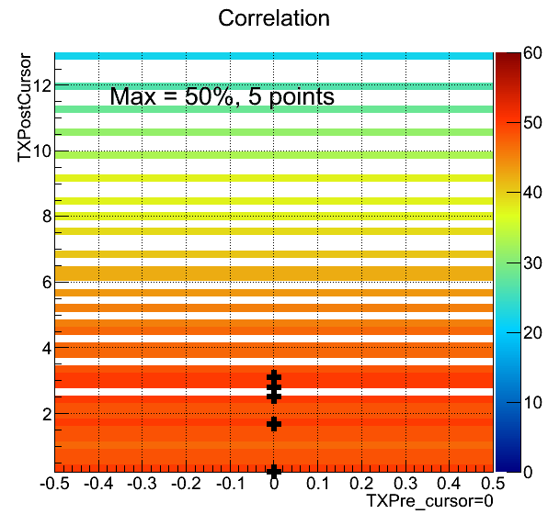
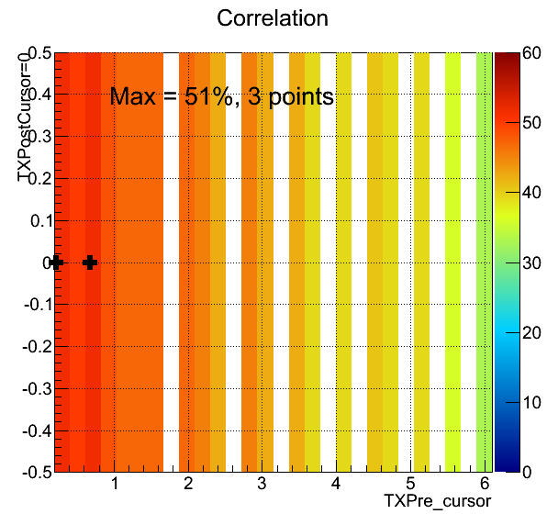
MGT systematic tests

Slide 15
Summary
L1Topo Prototype
PCBs successfully done
Assembly under way
Tests starting in August
At CERN in October
L1Topo Production modules
minor modifications wrt prototype
FDR done
Commissioning at CERN from spring 2014
On schedule for installation during shutdown 13/14

Slide 16
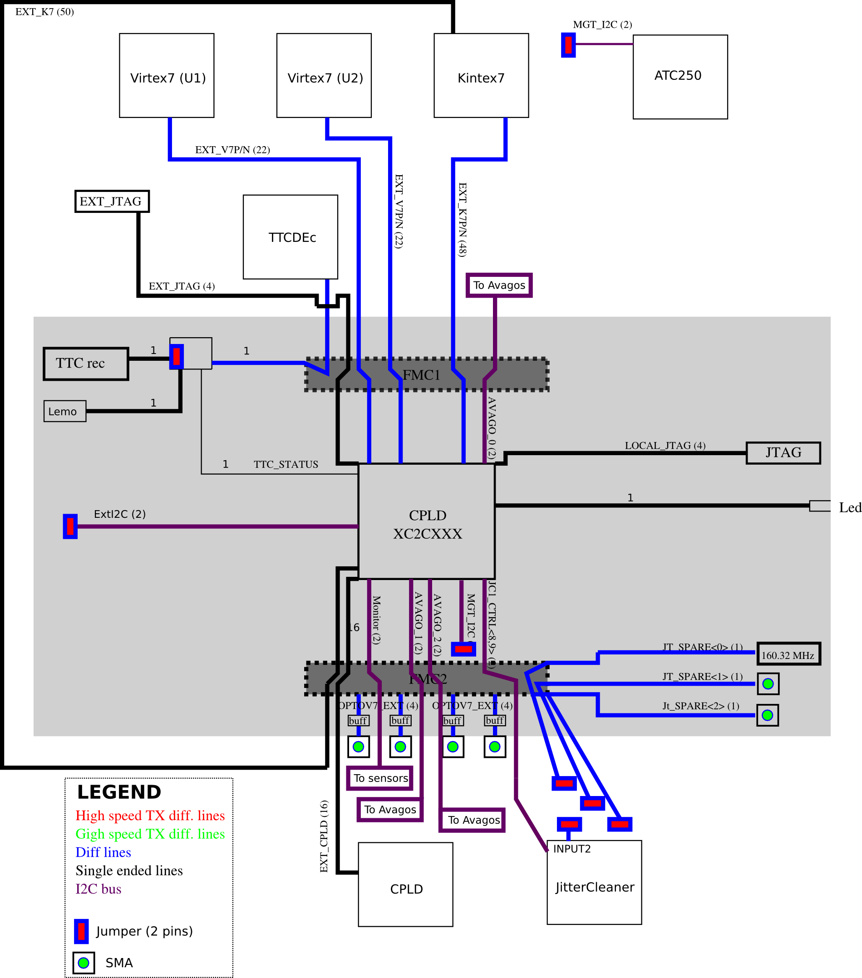
Extension Mezzanine (first version)
Connect diff. buses from L1Topo V7,K7,CPLD (for
boundary scan)
Optical and electrical TTC input
160.32 MHz local crystal clock plus external SMA input
External input for I2C master
SMA sockets connected to spares miniPOD Rx

Slide 17
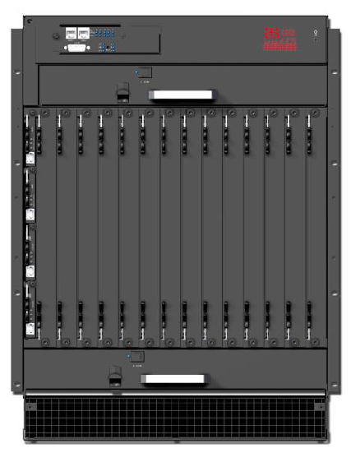
ATCA crates with modified airflow direction
14 slots chassis
8U×280mm front blades and 8U×70mm RTMs
14U(Height) × 10U (Width) × 9-10U (Dept)
Shelf management (IPMI two front access)
10/100/1000 Base-T Ethernet
AC modular PSU
Base interface: Dual Star supporting ethernet
Fabric interface: Full mesh, DS and DDS, 40 Gbps/ch
12 node slots: (DS) or 10 node slots: (DDS)
2 Hub slots: (DS) or 4 Hub slots: (DDS)
Dual redundant IPMC support
Up to 10 self cooled, AC hot swappable PSU IPMI
support
-48 VDC, five feeds per PEM (up to 250 Amp)
Modification for vertical airflow for operation in USA15
14250 euro (offer from ASIS, including NRE cost + power supply)
Power supply (from TDK lambda):
1.6kW PSU, 545 euro per unit
2.5kW PSU, 850 euro per unit

