Slide 1
JEP F/W status and plans
Uli, Pawel

Slide 2
JEM upgrade for run 2
Upgrade real-time path to 160 Mb/s backplane operation
Route TOBs out of the backplane ports
Affected components:
jet processor
energy sum processor
In both processors update:
clock scheme
real-time &
non real-time data paths
Slides from
Pawel: jet FPGA
Uli: energy sum FPGA

Slide 3
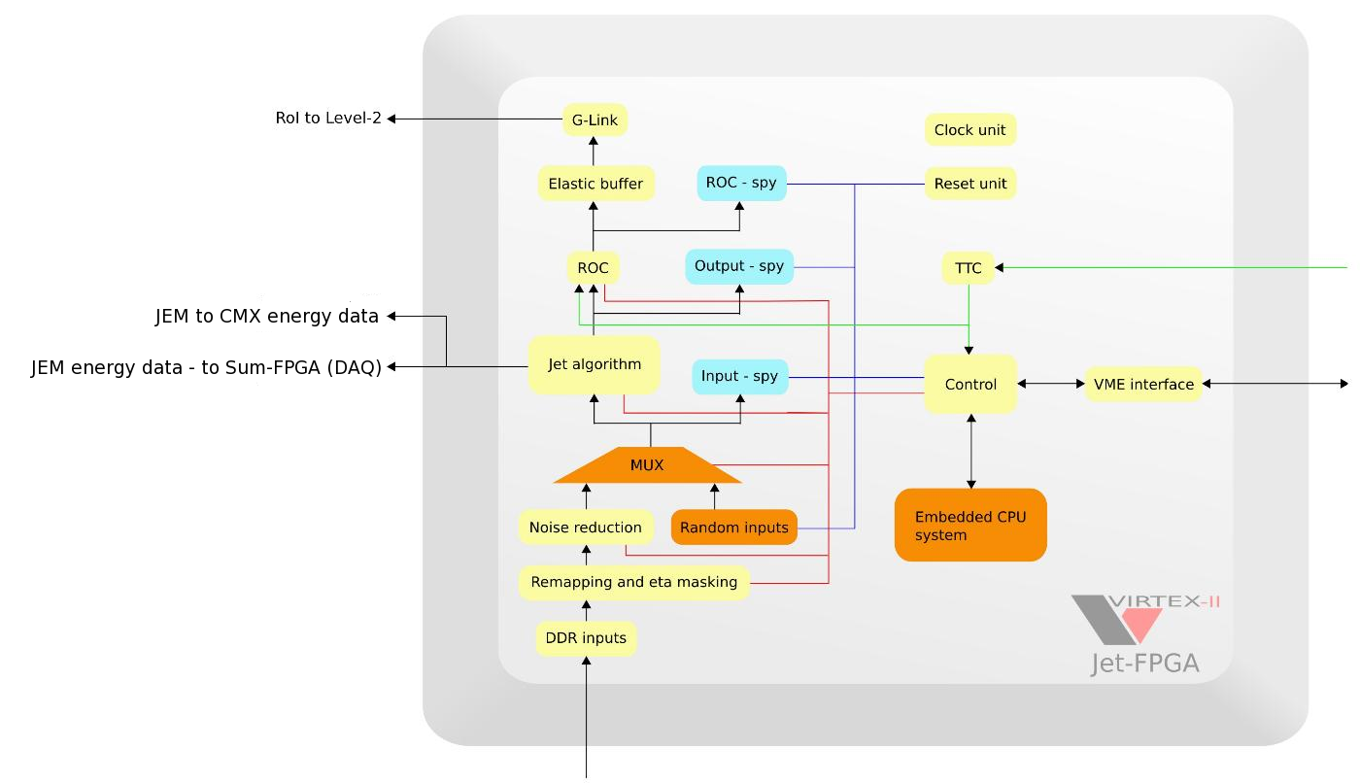
Architecture of the jet-FPGA
Component 3
Component 1
Component 4
Component 2
Component 5
Architecture is modular, its easier to add, replace or modify...

Slide 4
General remarks
JEM-Jet firmware upgrade to add RoIs to the real time output.
Algorithm will report up to four RoIs.
16 registers (thresholds), eta dependent thresholds easy to add.
Updated components:
- Algorithm (including backplane@160MHz and DAQ data).
- VME interface.
- Glink stream (RoI-to-L2).
- SPY Memory.
- Clock manager (DCM, 160MHz).
No design overhauls and no FPGA resource limitations
to implement new functionality.
Online software is updated (Jan, Duc, Murrough, Bruce).
JEM-Jet firmware tests in progress at CERN (Pawel, Duc).

Slide 5
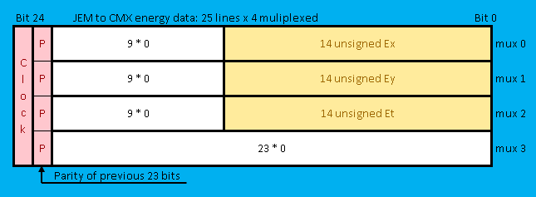
Energy sum FPGA
Extract sum data before quad linear encoding
Multiplex to 160Mb/s (160MHz clock)
Calculate odd parity bit per sub-slice
Generate phase shifted DDR clock on bit 24
Playback/Spy memory on outputs probably not been used/supported for ages. Upgrade at all ?
Single-bit readout stream into DAQ G-link to be updated..
no more jet data

Slide 6
Status/Plans
Jet FPGA firmware in good shape and tested
Sum FPGA firmware urgently to be modified and tested
Required design software (ISE10.1) seems to be working again
Hope to do code modifications in November
Will do our best to provide at least a preliminary version for next test campaign
when ?

