Slide 1
JEP F/W status and plans
Uli, Pawel

Slide 2
Upgrade for run 2
Upgrade real-time path to 160 Mb/s backplane operation
Affected components: jet and energy sum processor
Clock circuitry, real-time and non real-time components
Slides from
Pawel: jet FPGA
Uli: energy sum FPGA

Slide 3

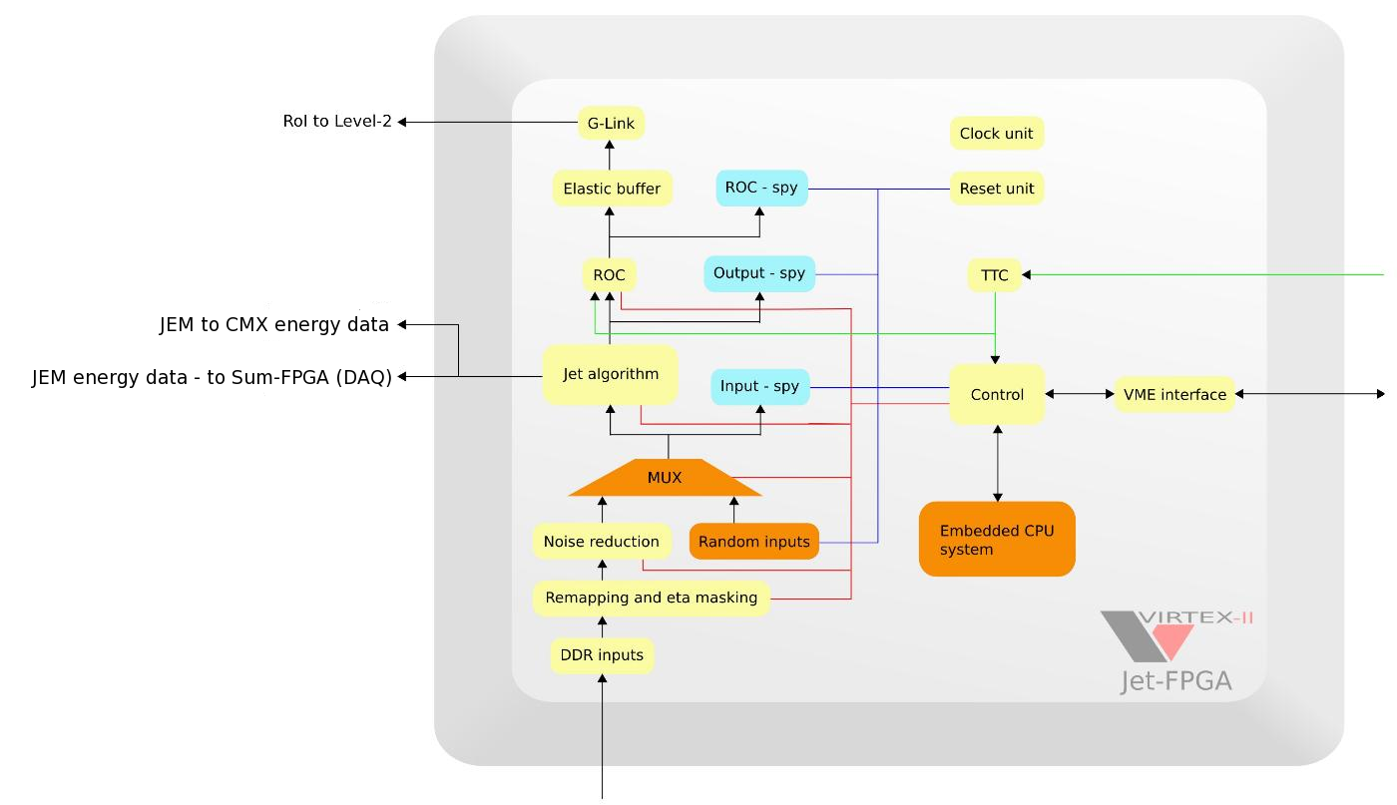

Architecture of the jet-FPGA
Component 3
Component 1
Component 4
Component 2
Component 5
Architecture is modular, its easier to add, replace or modify...

Slide 4
General remarks
JEM-Jet firmware upgrade to add RoIs to the real time output.
Algorithm will report up to four RoIs.
16 registers (thresholds), eta dependent thresholds easy to add.
Updated components:
- Algorithm (including backplane@160MHz and DAQ data).
- VME interface.
- Glink stream (RoI-to-L2).
- SPY Memory.
- Clock manager (DCM, 160MHz).
No design overhauls and no FPGA resource limitations
to implement new functionality.
Online software is updated (Jan, Duc, Murrough, Bruce).
JEM-Jet firmware tests in progress at CERN (Pawel, Duc).

Slide 5
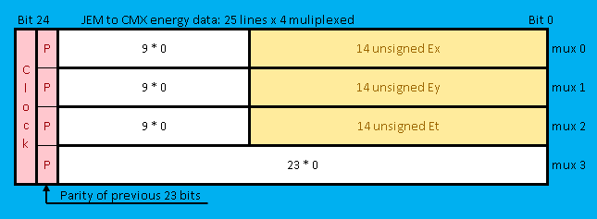
Sum processor

