Slide 1
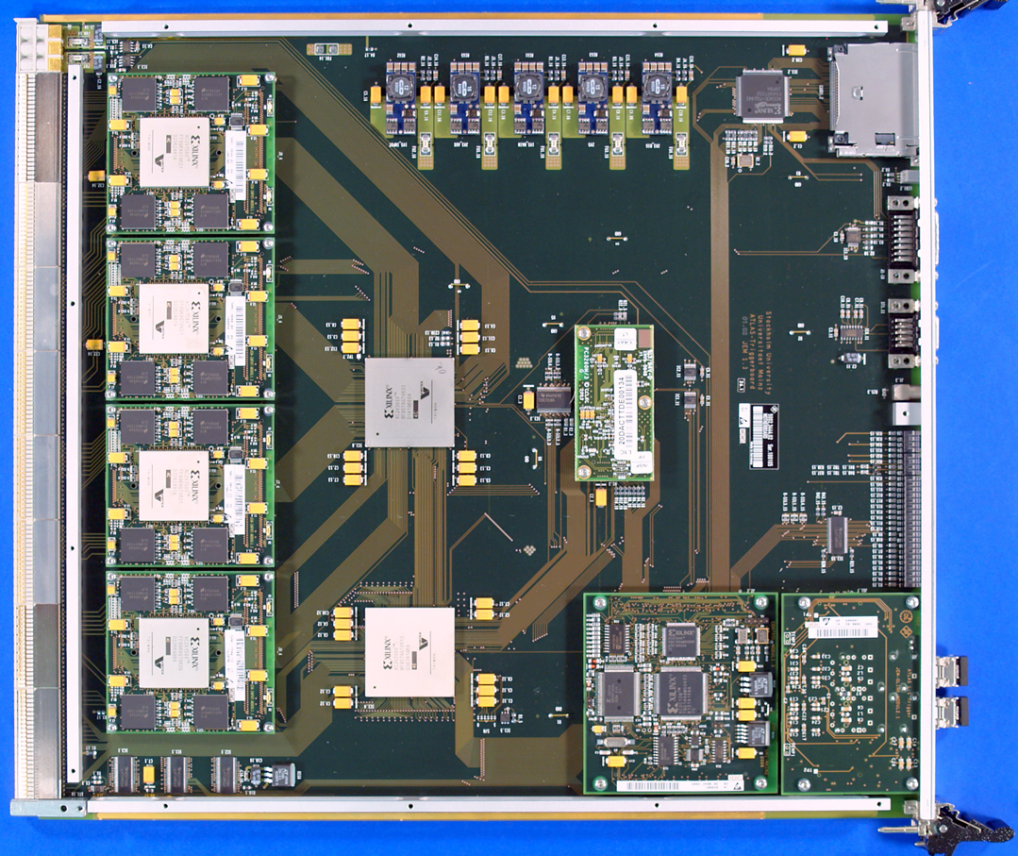
JEM Mezzanines
16 (out of 32) JEMs receiving signals from TileCal PPMs
Four input mezzanines per JEM
12 hadronic (and 12 electromagnetic) inputs each
Replace three mezzanines handling core signals
Large Artix FPGA
Receive 960 Mb/s
On to MGTs w/o processing
3 fibres worth of incoming tile data at 6.4 Gb/s
4 copies to FEXes
Through MicroPOD 12-channel transmitter
To front panel (MPO/MTP)
Replacement on half the JEMs (3*16 plus spares)

